Slide 1
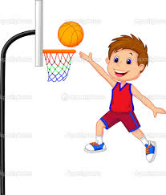

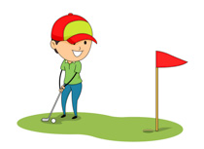


Basketball
Swimming
Golf
Sunny
Rainy

Slide 2
Neural
Network
Neural
Network
Sunny
Rainy

Slide 3






Basketball
Swimming
Golf

Slide 4

Neural
Network
Neural
Network
Sunny
Rainy

Slide 5


Slide 6
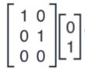

Slide 7
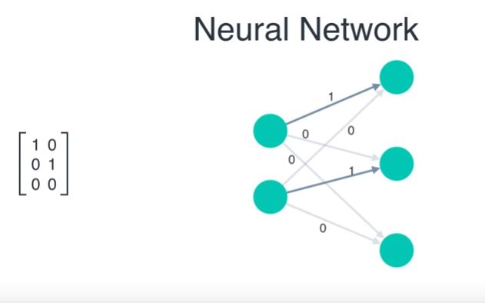

Slide 8
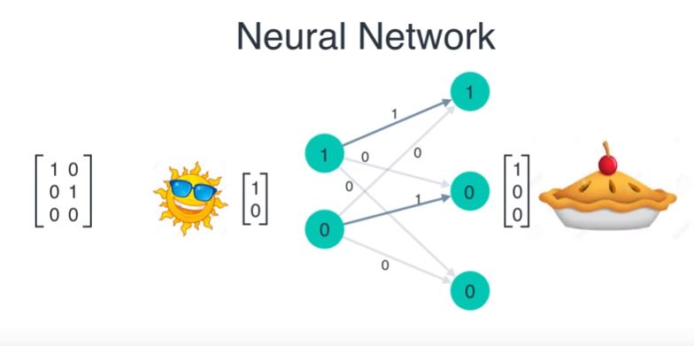

Slide 9
Sports Schedule
Monday
Tuesday
Wednesday
Thursday
Friday
Saturday
Basketball
Swimming
Golf
Basketball
Golf

Slide 10

Recurrent
Neural
Network

Slide 11
Recurrent
Neural
Network

Slide 12
Recurrent
Neural
Network

Slide 13
Recurrent
Neural
Network

Slide 14

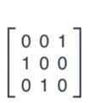

Slide 17
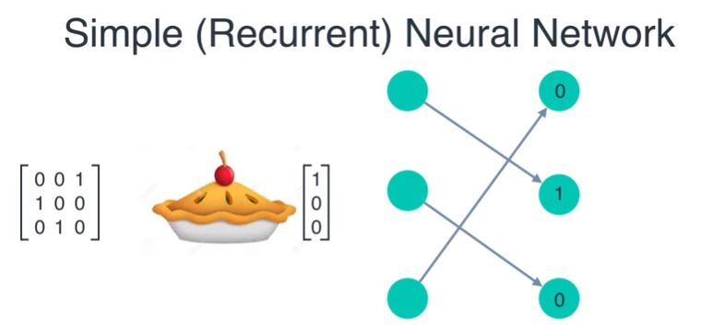
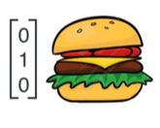

Slide 18
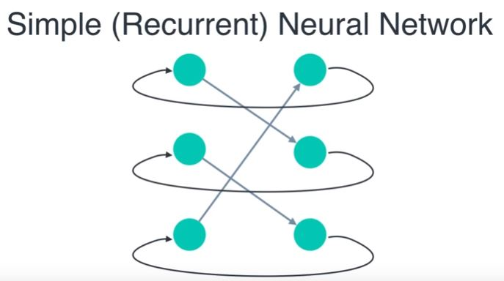

Slide 19
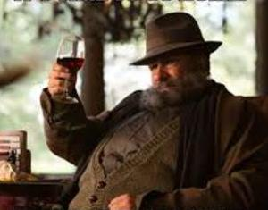

Time for Wine?

Slide 20
‘ Variet ’
‘ Wine ‘
‘ Age ’
‘ three ’
‘ year ’
This tremendous 100% varietal wine hails from Oakville and was aged over three years in oak.

Slide 21
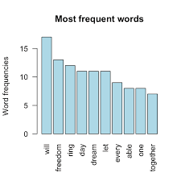
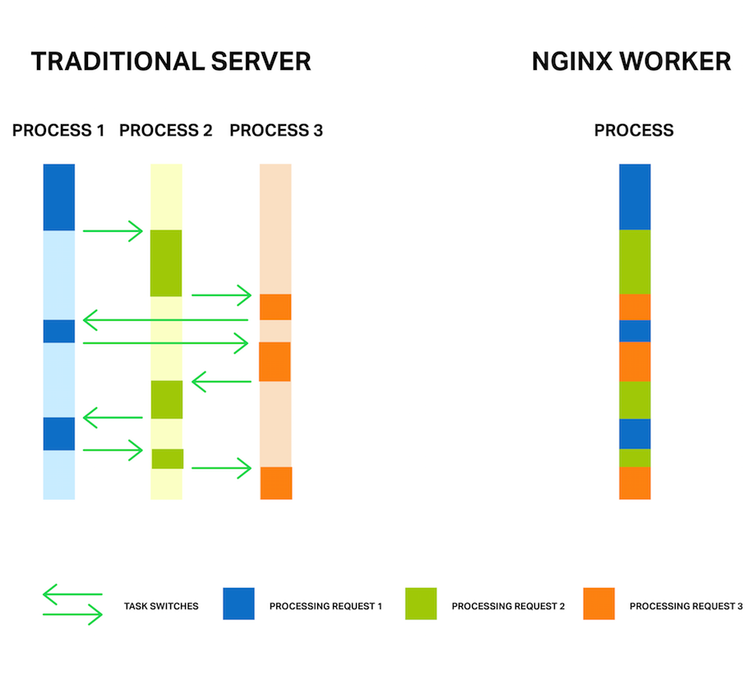

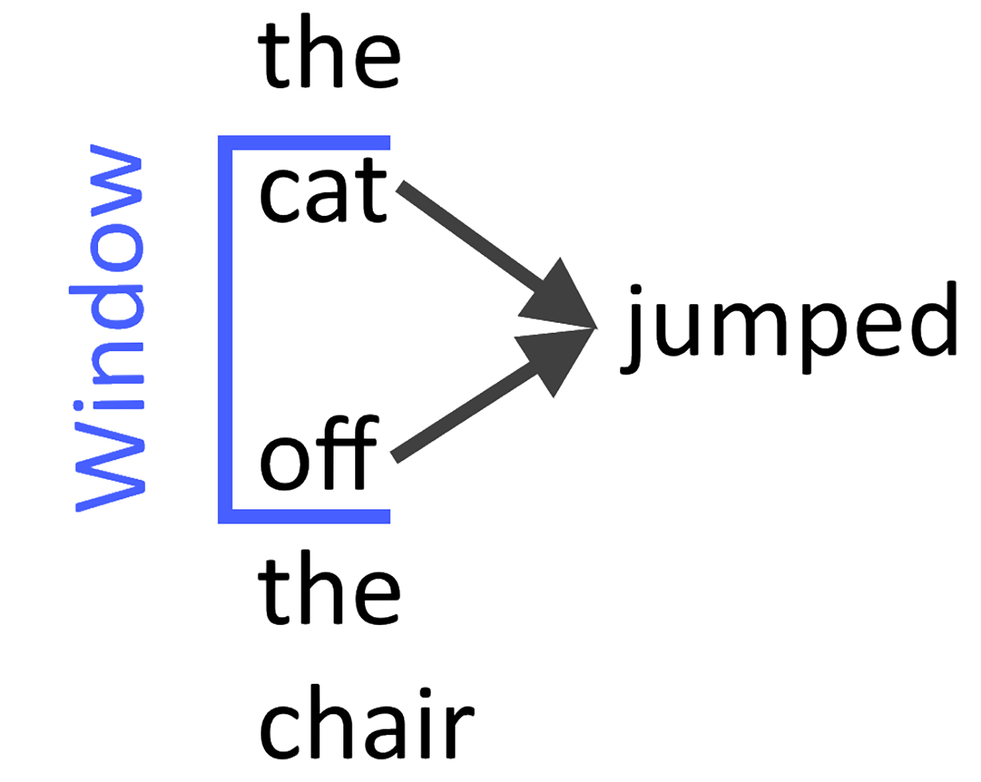
Size
Window
min_count
workers

Slide 22
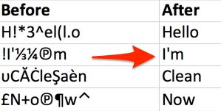
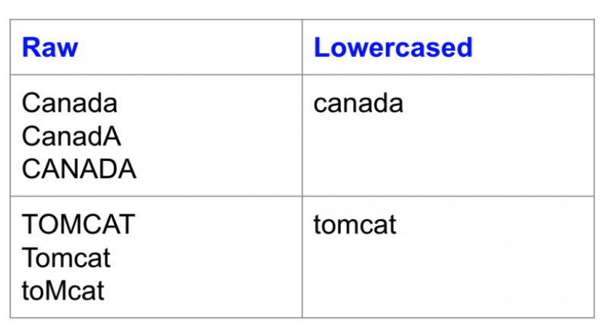
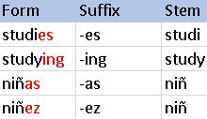
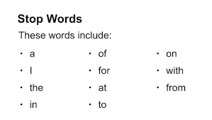

1. Remove non-letters
2. Change to Lowercase
3. Remove
4. Stemming

Slide 23

Stem ming

