Slide 1
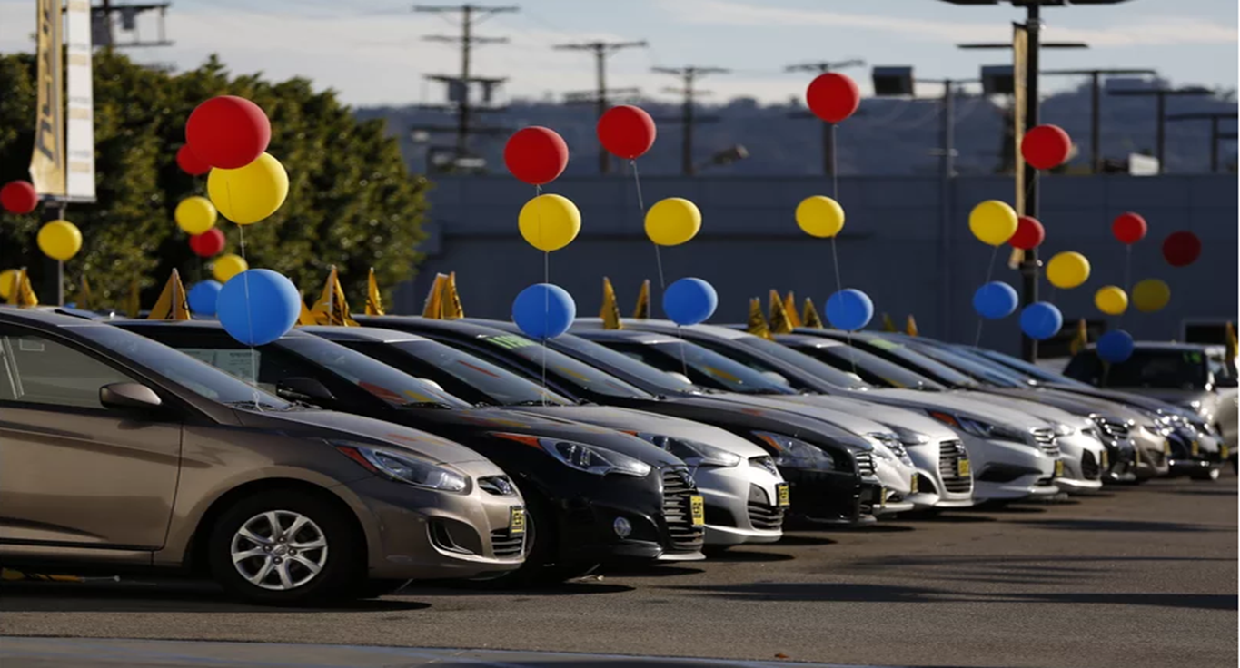
Car Sales - Exploratory Data Analysis
By Uday Pratap Yati

Slide 2
Introduction
Data set : Car sales data set
Goal : Find the car purchase trend of people, the likeliness toward the features of the cars, purchase based on budgetary constraints, etc.
Records : 9576 records with 10 columns/features
Car
Price
Body Type
Engine Volume
Engine Type
Drive Type
Registration
Production year
Mileage
Model

Slide 3
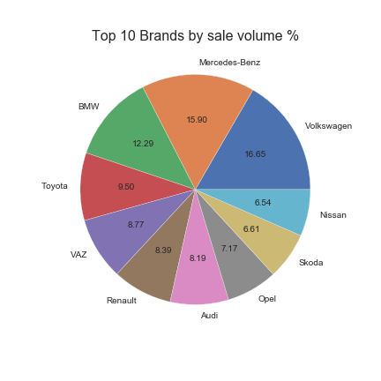
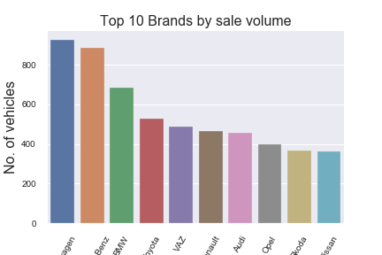
Top 10 Car Brands by sale volume
Volkswagen and Mercedes-Benz are top brands on sale

Slide 4
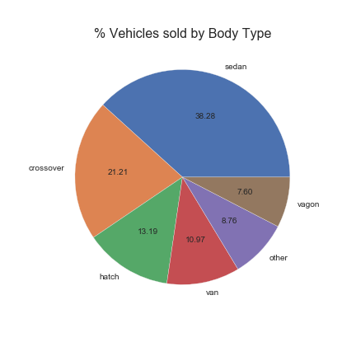
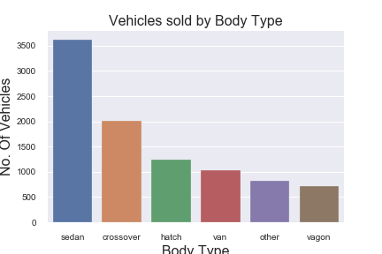
Sale Distribution by Body Type
"Sedan" body type cars are the most sold cars.
perfect and comfortable car for small size family within lower budget.

Slide 5
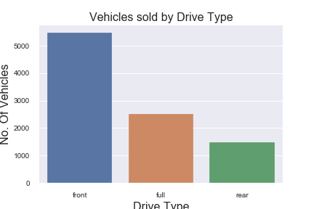
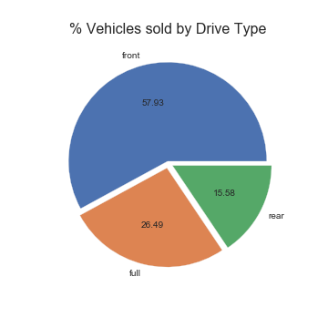
Sale Distribution by Drive Type
Front drive cars are the most sold cars.
Approx. 58% of total cars sold are front drive type, 26% are full drive type and 16% in rear drive type.

Slide 6
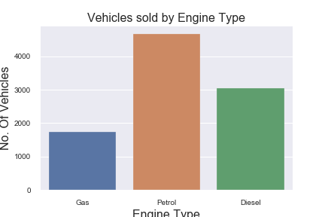
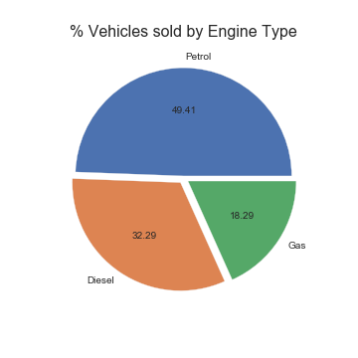
Sale Distribution by Engine Type
Petrol engine are most preferred.
Approx. 50% of total vehicles sold are petrol engine type.

Slide 7
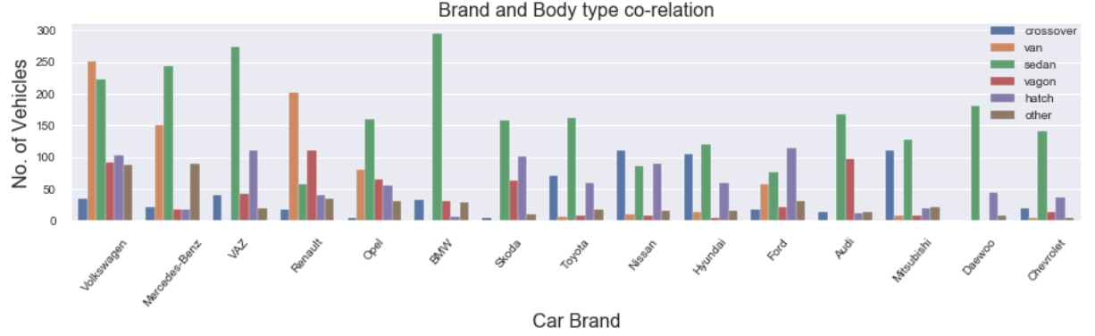
Co-relation between Brand and Body Type
Sedan cars are highest selling in lower price segment for all the brands except for Volkswagen and Renault, which have Van type of cars selling more.
Leading brands for each body type
Sedan : BMW, closely followed by VAZ and Mercedes-Benz
Van : Volkswagen, followed by Renault and Mercedes-Benz
Wagon : Renault, followed by Audi and Volkswagen
Crossover : Mitsubishi and Nissan followed by Hyundai
Hatch : Ford followed by VAZ and Volkswagen

Slide 8
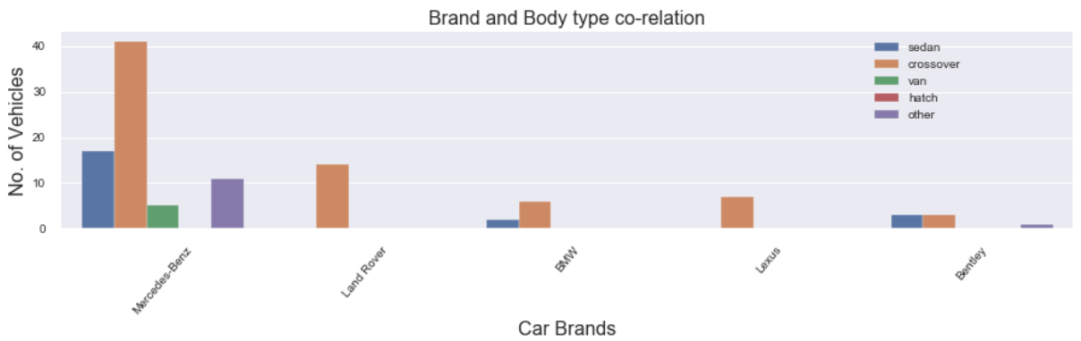
Co-relation between Brand and Body Type
Crossover type of cars are highest selling in higher price segment for all the brands.
In higher price segment leading brands by body type are as below :
Sedan : Mercedes-Benz, closely followed by Bentley and BMW
Crossover : Mercedes-Benz followed by Land Rover and Lexus

Slide 9
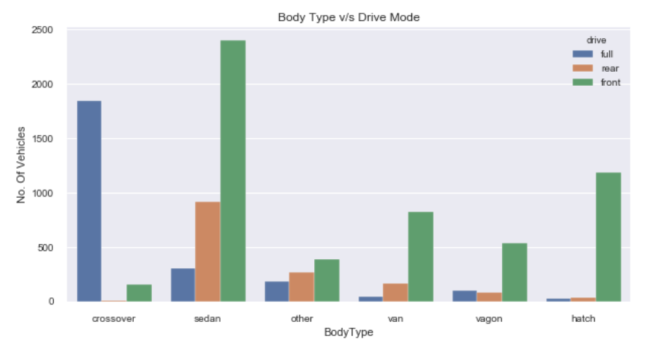
Co-relation between Drive mode and Body Type
Front Drive cars are the top sellers in all body type except for Crossover body type cars.
In Crossover body type, full wheel drive is the leading seller/most preferred car.

Slide 10
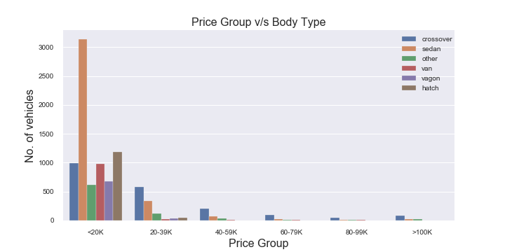
Co-relation between Price Group & Body Type
Most of the cars are sold in price range 250 to 19999. Majority of these cars are sedan body type.
Crossover body type cars are highest selling units, in price range of 20000 or above.

Slide 11
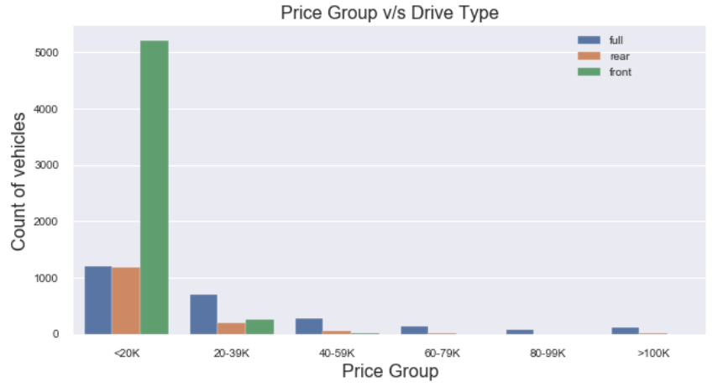
Co-relation between Price Group & Drive Type
Most of the cars are sold in price range 250 to 19999. Majority of these cars are front drive type.
Full drive cars are highest selling units, in price range of 20000 or above.

Slide 12
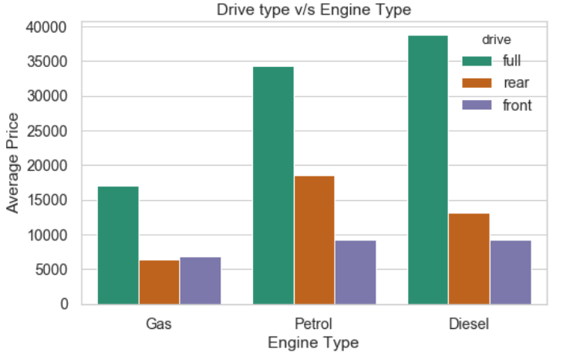
Co-relation between Drive mode and Engine Type
Full drive cars have higher average price
Front drive cars are cheaper in all engine types (Gas type is an exception)

Slide 13
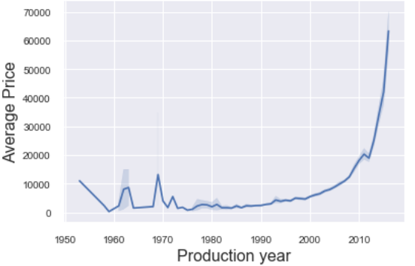
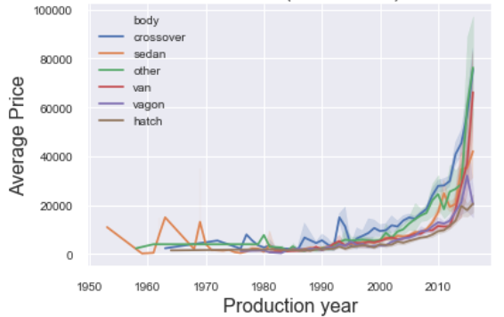
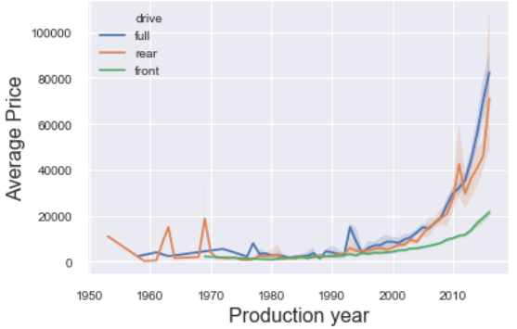
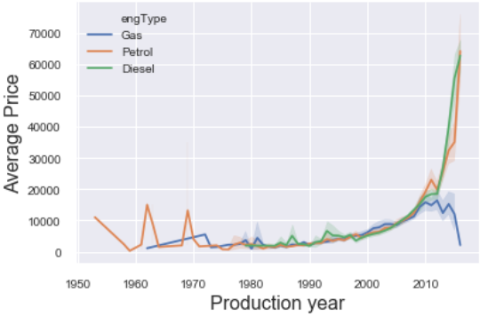
Price Trend
Price increased in most recent years.
Engine Type
Price increased for petrol & diesel
Price decreased for gas after 2010
Drive Type
Price increase is low for front drive
Body Type
Price increased for all body types

Slide 14
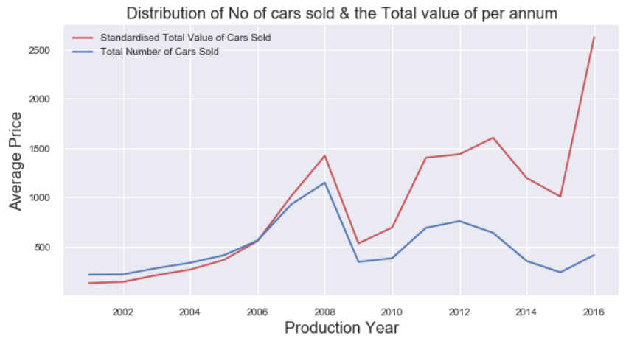
Relation between number of cars sold and the total value of cars
People are preferring high cost luxury cars from 2015 as seen from the quite drastic jump in the total value of cars sold between 2015 and 2016.

Slide 15
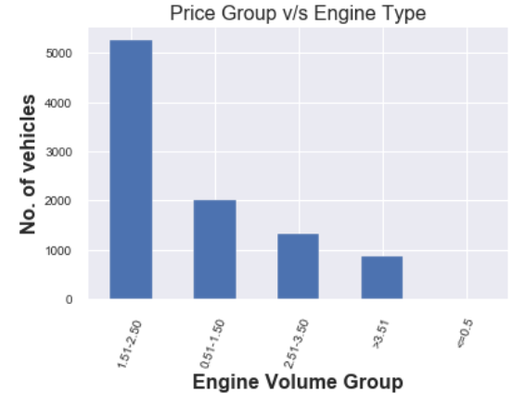
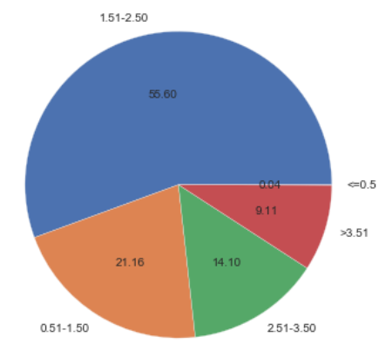
Car sale distribution based on engine volume
1st Category : > 1.5 & <= 2.5 (In this category approx. 56% of cars are available)
2nd Category : > 0.5 & <= 1.5 (In this category approx. 21% of cars are available)
3rd Category : > 2.5 & <= 3.5 (In this category approx. 14% of cars are available)
Out of total cars sold, approx. 90% cars fall in range of engine volume more than 1.5 CC to 3.5 CC

Slide 16
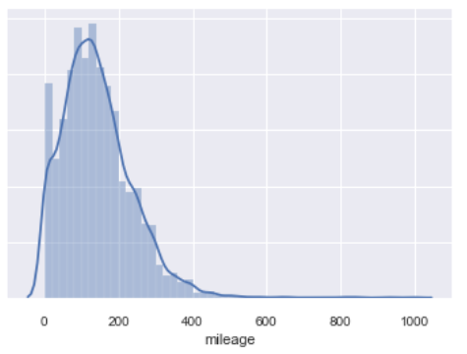
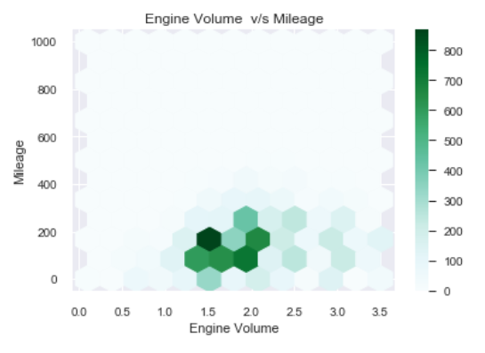
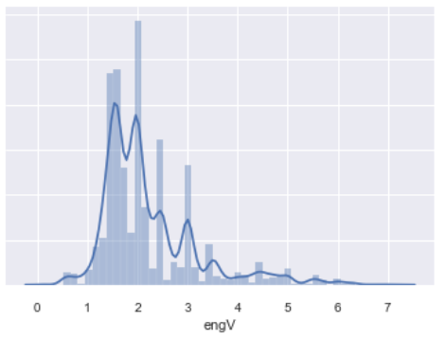
Engine volume v/s mileage.
Highest selling engine volumes are between 1.5 to 3.5 CC
Highest selling cars have an avg mileage of 200.
1.5 CC engine cars are highest selling cars with a
mileage of approx 200.

Slide 17
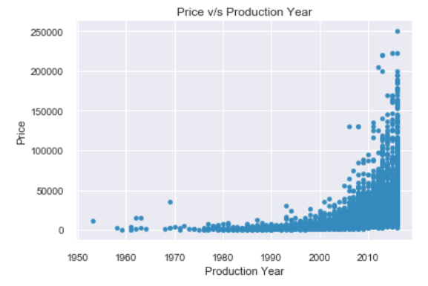
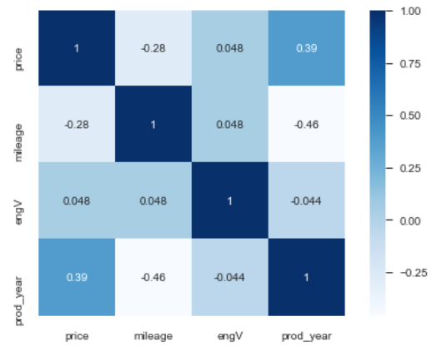
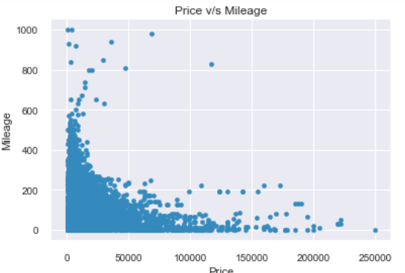
Correlation
Price and mileage have negative correlation
Price and production year have strong positive correlation.
Price and engine volume have mild positive correlation
Production year and engine volume have some negative correlation.
Mileage and production year have strong negative correlation.

Slide 18
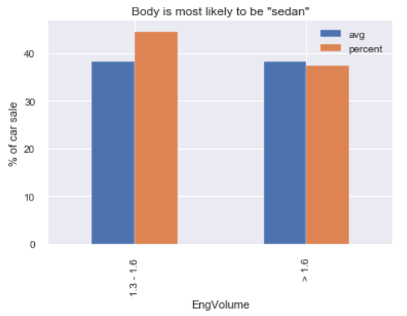
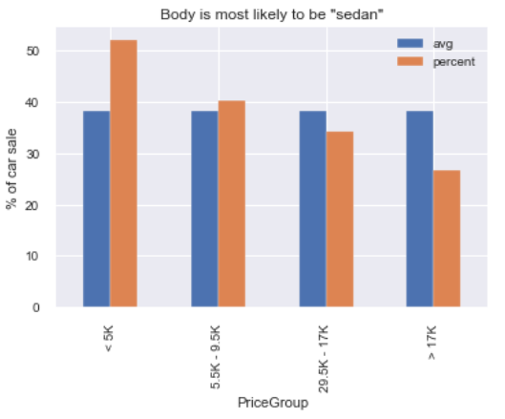
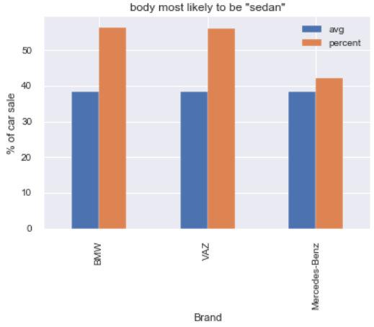
Body Type is “Sedan”
Price Group [avg : 38%]
<5K, increase by 14%
Brand [avg : 38%]
BMW, increase by 18%
VAZ , increase by 18%
Mercedes-Benz, increase by 4%
Engine Volume [avg : 38%]
1.3-1.6 CC, increase by 6%

Slide 19
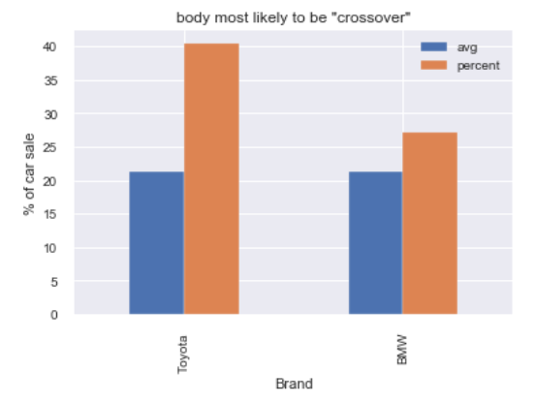
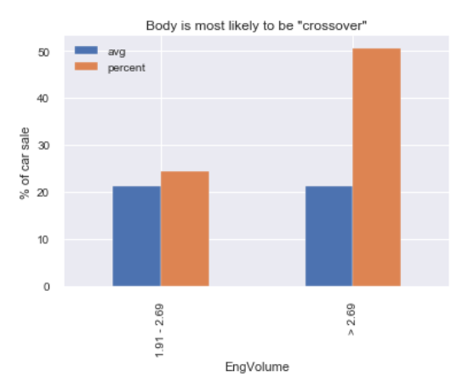
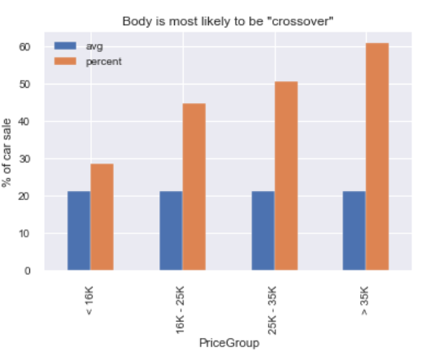
Body Type is “Crossover”
Brand [avg : 21%]
Toyota, increase by 19%
BMW, increase by 6%
Engine Volume [avg : 21%]
1.9-2.6, increase by 3%
>2.69, increase by 29%
Price Group [avg : 21%]
>35K, increase by 40%
25K-35K, increase by 30%
16K-25K, increase by 23%

Slide 20
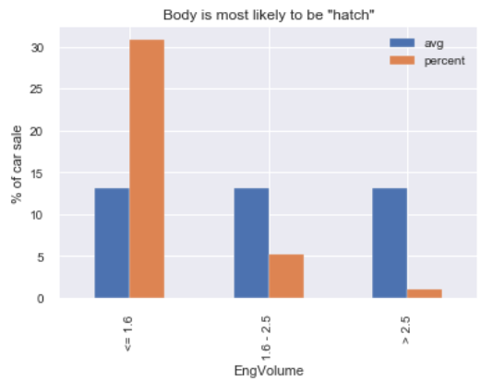
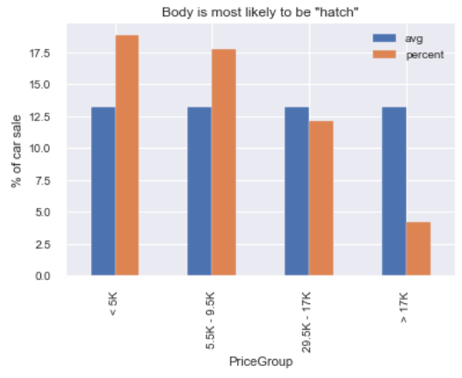
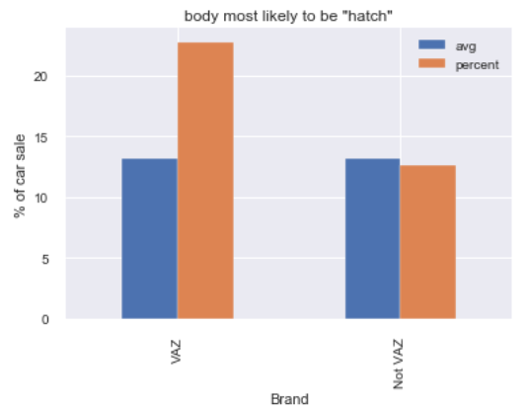
Body type is “Hatch”
Brand [avg : 13%]
VAZ, increase by 9%
Engine Volume [avg : 13%]
<= 1.6, increase by 17%
Price Group [avg : 13%]
<5K, increase by 5%
5.5K-9.5K, increase by 4%

Slide 21
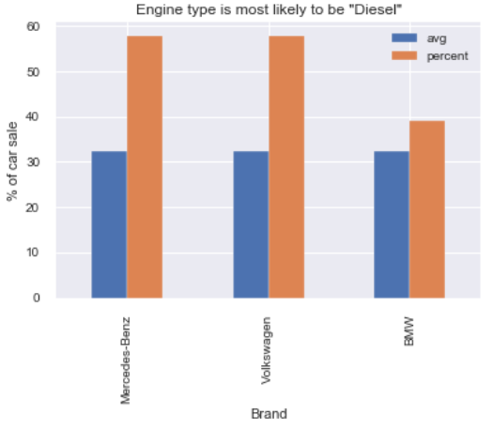
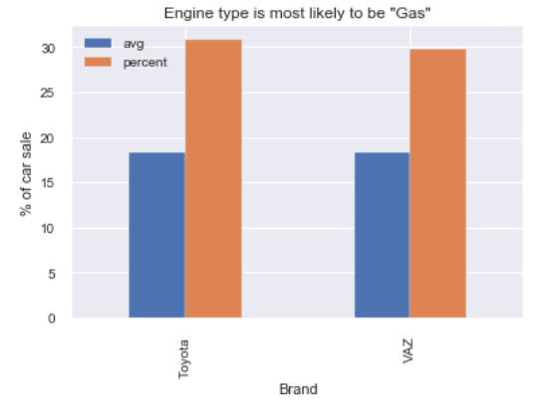
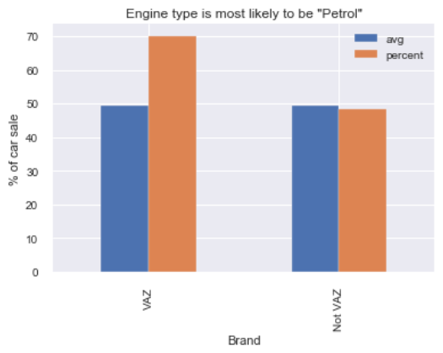
Sale of car based on engine type
DIESEL [avg : 32%]
Mercedes-Benz, up by 26%
Volkswagen, up by 26%
BMW, up by 7%
GAS [avg : 18%]
Toyota, up by 12%
VAZ, up by 11%
PETROL [avg : 49%]
VAZ, up by 21%

Slide 22
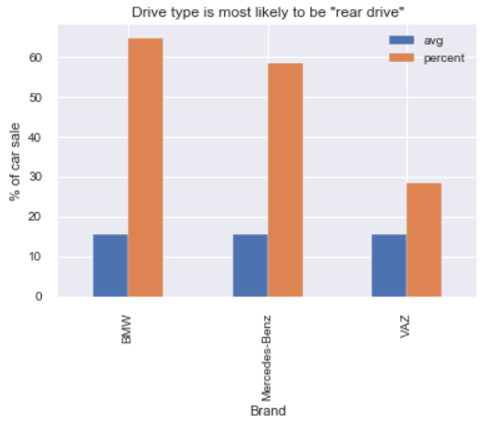
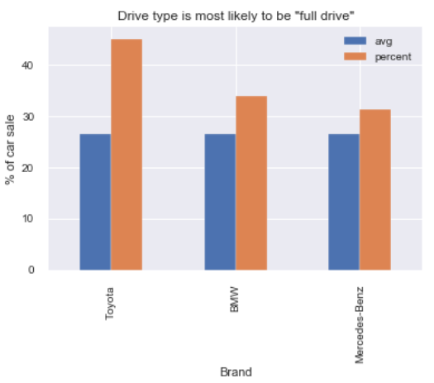
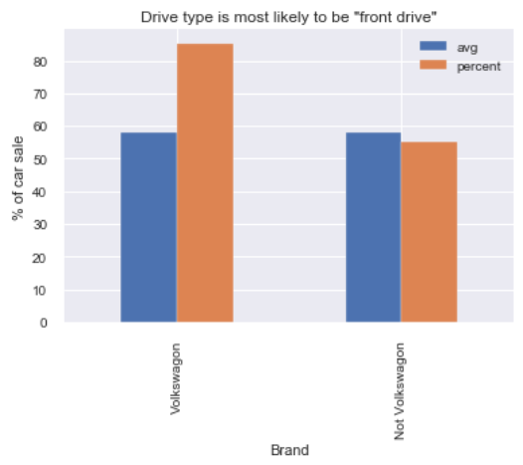
Sale of car based on drive type
REAR DRIVE [avg : 15%]
Mercedes-Benz, up by 43%
VAZ, up by 13%
BMW, up by 50%
FULL DRIVE [avg : 26%]
Toyota, up by 19%
BMW, up by 8%
Mercedes-Benz, up by 5%
FRONT DRIVE [avg : 58%]
Volkswagen, up by 27%

Slide 23
Conclusion
Brand : Volkswagen, Mercedes-Benz and BMW are top car sellers.
Engine : Petrol powered cars are highest selling cars.
Body type : Sedan body type are sold highest.
Drive type : Front wheel drive cars are the highest sold cars
Per unit cost of the vehicles has gone up over the years, this implies, either purchase power of the people has increased or new regulations are introduced by the local government, which resulted in price increase.
Mercedes-Benz is the first choice for customers in luxury car segment.
Majority of the luxury cars are sold with body type as Crossover, drive type as Full and engine type as Diesel.
Full drive cars have high average price in all segments.
Cars with 1.5CC – 2.0CC engine, are sold highest.
lower price segment car has higher mileage and vice-versa.
Highest no. of cars were sold in, Production year 2008 and 2012

Slide 24
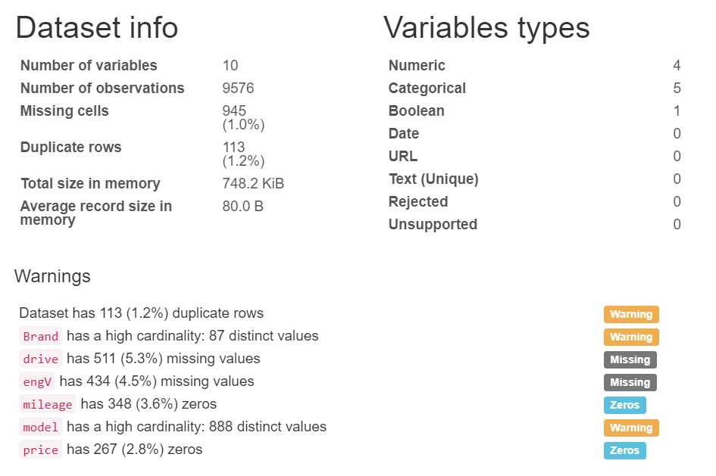
DATA SET – Before Processing
This is the sales data of the cars, from 1953 to 2016.

Slide 25
DATA Processing
Renamed some columns names, to get meaningful information. [Car->Brand, year ->Production Year]
Removed Duplicates [113 records]
Deal with zero and missing values
Replacing zero values of price column with median value.
Replacing zero values of mileage column with median value.
Replacing null/missing values of engine volume with median value.
Replacing null /missing values of drive column with mode value.
Replace “others” values in engine type column with the mode value.
Drop “model” column due to its high cardinality [888 distinct values].

Slide 26
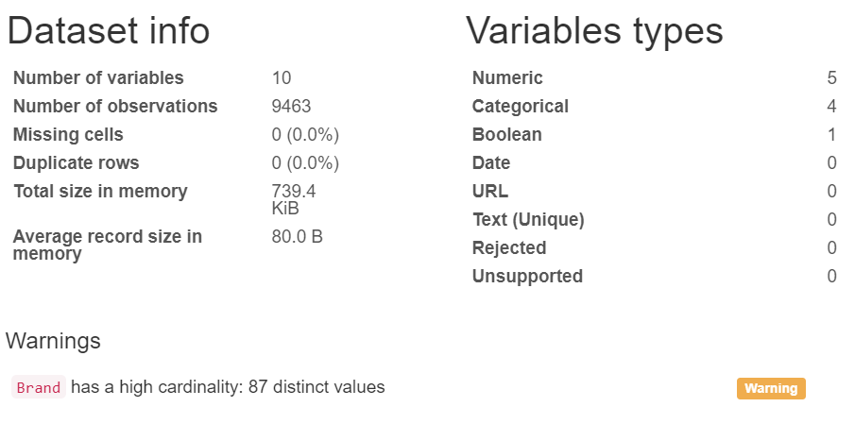
DATA SET – After Processing
No missing/zero values.
No duplicate records.

Slide 27
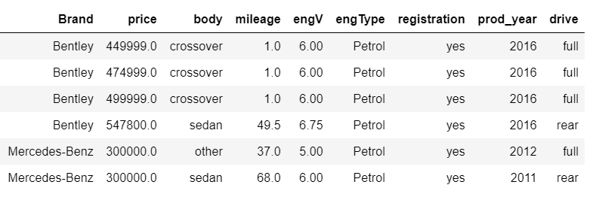
Top 5 highest price selling vehicles
E-mail marketing for high profile income group
Sales Target

Slide 28
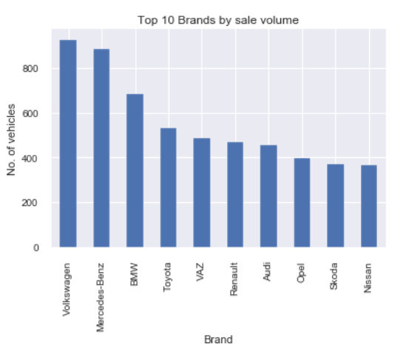
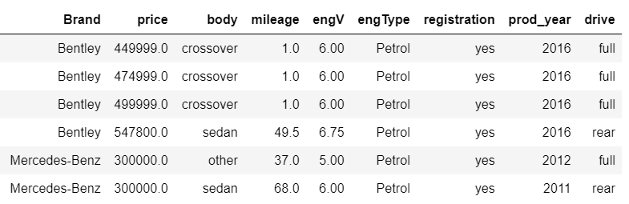
Top 10 Car Brands by sale volume
Volkswagen and Mercedes-Benz are top brands on sale
E-mail marketing for high profile income group peoples
Top 5 highest price selling car and their models details

Slide 29
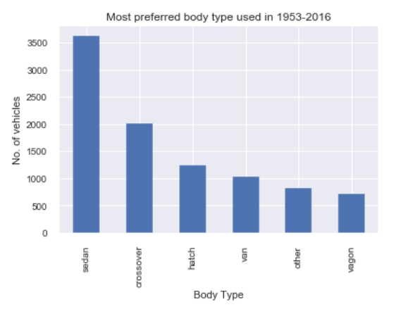
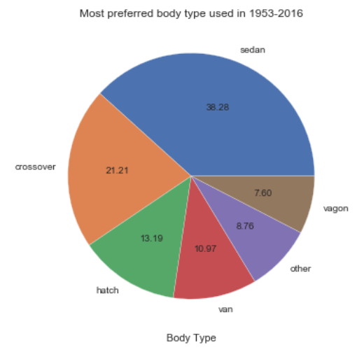
Sale Distribution by Body Type
"Sedan" body type cars are the most sold cars.
perfect and comfortable car for small size family within lower budget.

Slide 30



Co-relation between Car Brand and Body Type
Luxury price segment

Slide 31


Co-relation between Brand and Body Type
Lower price segment v/s Luxury price segment.

