Slide 1


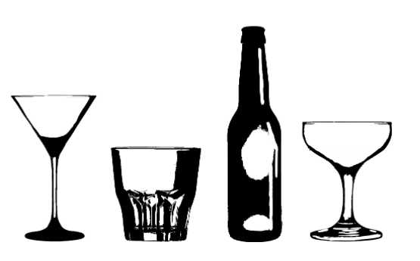
by Upgraded Potato:
Elliott McFarland, Celeste Muniz-Lithgow, Sai Prasanna,
Tim Samson, Saroja Shreenivasan, Sara Simoes

Slide 2

It is an interactive website where you can find recipes for
hundreds of unique cocktails.
Bartenders
Event Planners
Restaurant Owners
Everyone stuck at home
Your next zoom happy hour
You!

Slide 3

YES!
NO!

Slide 4

Cocktail Data: https://github.com/rfordatascience/tidytuesday/blob/master/data/2020/2020-05-26/readme.md’
Top Cocktails by State : Most Popular Cocktail Recipe In Every State In 2020 | Kitchn
State Latitude and Longitude from Kaggle.com
Cocktail Images : https://www.thecocktaildb.com/api.php

Slide 5

Cleaning the data in jupyter notebook
Used formulas to change measurements to be consistent
Changed ‘null’ values non-liquid ingredients
Combined data to create the locations for points on map

Slide 6

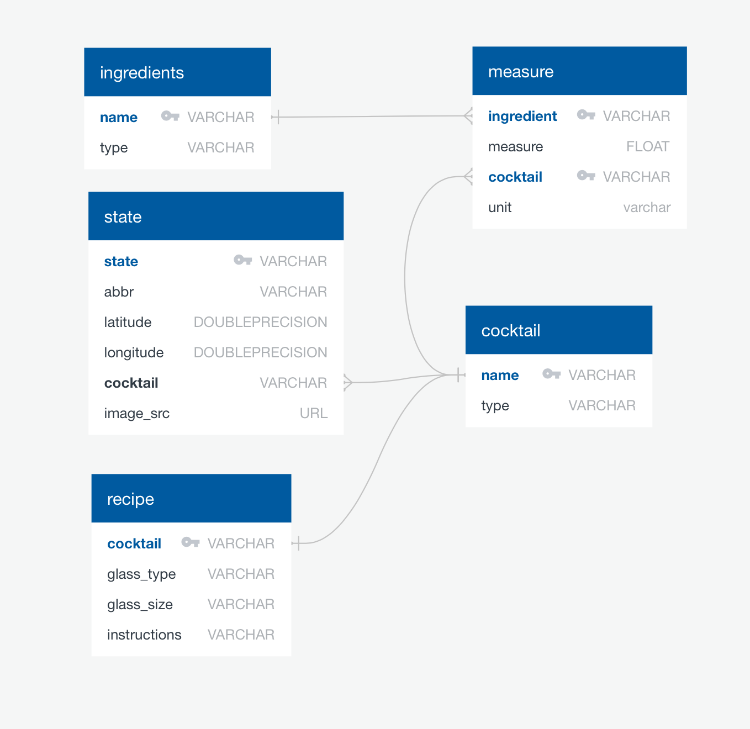
Created schema to develop database
Assigned foreign keys to link tables
Loaded tables into cocktail_db using Postgres

Slide 7

Cocktail Dropdown that displays recipe using d3
Stacked Bar chart of ingredient proportions using Plotly
Bubble chart Shows most used ingredients in popular cocktails
“Top Cocktail by State” map of using Leaflet.js and Mapbox

Slide 9


Slide 10




