Slide 1


Secure Messenger Application using AES Algorithm
A comprehensive overview of the development and implementation of a secure messenger application using the AES algorithm, ensuring data privacy and protection.

Slide 2

Project Introduction
1
Objective
Create a secure messaging platform that guarantees privacy and confidentiality for users.
2
Use Case
→ End-to-end encryption
→ Key Management
→ Message Retrieval
→ Authentication and Access Control
→ Offline Security
3
Importance
In an increasingly connected world, the need for secure communication solutions is essential in protecting sensitive information from unauthorized access.

Slide 3

Secure Messenger Application Overview
1
User Interface
An intuitive and user-friendly interface that allows seamless communication between users.
2
End-to-End Encryption and Decryption
Utilizing the AES algorithm to encrypt and decrypt messages, ensuring that only authorized parties can access the information.
3
Multi-Platform Compatibility
The application is designed to work across various devices and operating systems to enhance accessibility and usability.

Slide 4
AES Algorithm Implementation
Advanced Encryption Standard (AES)
Key Expansion
Substitution-Permutation Network
The process of generating a set of round keys from the original key for each round of encryption and decryption.
An industry-standard symmetric encryption algorithm providing robust security and efficiency in data encryption.
The core transformation in which bytes are substituted and shuffled to ensure maximum confusion and diffusion of the data.

Slide 5
Challenges and Solutions
Key Management
Performance Optimization
Developing an efficient and secure method for generating, storing, and exchanging encryption keys without compromising security.
Addressing any performance issues while maintaining a high level of security, focusing on reducing encryption and decryption overhead.
User Experience
Backward Compatibility
Creating an intuitive and seamless user experience without compromising security features.
Consideration of compatibility with older versions of the application to ensure smooth transition and user adoption.

Slide 6
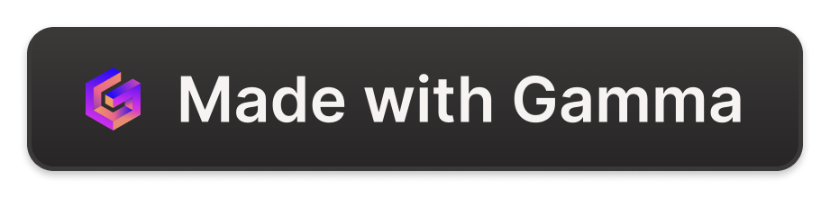
Timeline and Milestones
1
Project Initiation
Performing research, defining project requirements, and assembling the development team.
Design and Development
2
Creating the user interface, implementing the AES algorithm, and conducting extensive testing to ensure functionality and security.
3
Quality Assurance and Testing
Thoroughly reviewing the application, identifying potential vulnerabilities, and conducting rigorous testing to ensure an error-free and secure experience.
Deployment and Launch
4
Making the application available to the public, promoting its features, and ensuring a successful adoption by users.

Slide 7
Working Of AES
1
Byte Sub
2
Shift Row
In this each byte in the state array is replaced with a Sub Bytes.
Shift Row step operates on the rows of the state. It cyclically shifts the bytes in each row by a certain ​offset​
3
Mix Column
4
Add Round Key
In the MixColumns step, the four bytes of each column of the state are combined using an invertible ​linear transformation.​
In the AddRoundKey step, the subkey is combined with the state.

Slide 8

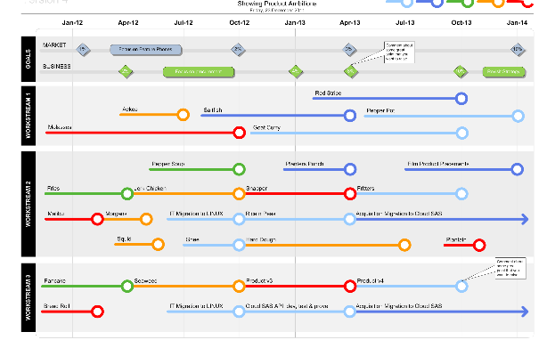
Conclusion and Future work
Future Enhancements
Roadmap
Discussing potential future enhancements such as integration with emerging technologies, adoption of quantum-resistant encryption algorithms, and expanding platform compatibility.
Outlining the strategic plan for continuous improvement, periodic updates, and proactive defense against evolving threats in the realm of secure messaging applications.

