Slide 1
Fluid Simulation with Surfacing
Chuqian Li
Tongzhou Wang
Huirong Zhu

Slide 2
Final GIFs

Slide 3
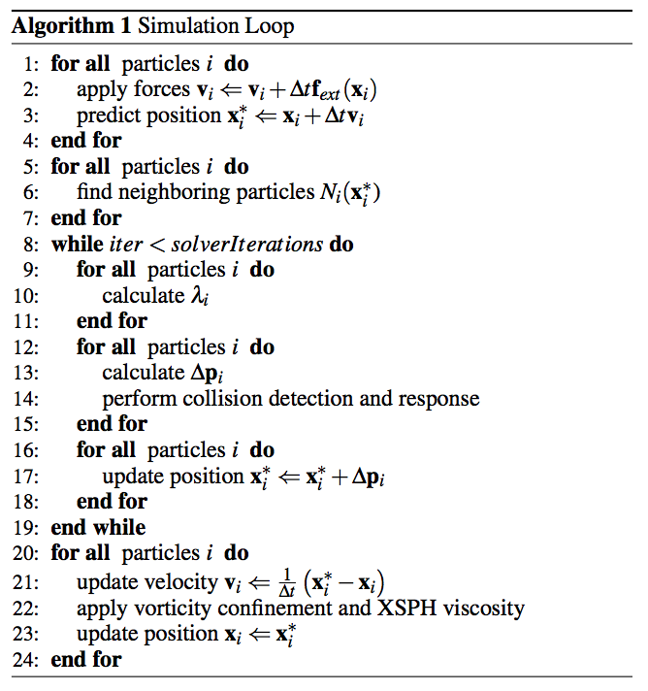
Problem: Fluid simulation
Simulate fluid by updating velocity and positions of particles
Challenges:
Collision detection & response when particles hit solid meshes.
Parameter tuning.
Speed up simulation (avoid redundant computation, grid-based neighbor finding, etc.).
Features:
Command line option to specify initial particles as an xml file.
Key controlled simulation in visualization mode.
Exporting simulation process as pngs with particles colored proportional to densities.

Slide 4
Buggy GIFs

Slide 5
Surfacing
Option 1:
Visualize all particles as small spheres
Naïve, a temporary option to test fluid simulation
Option 2:
Visualize all particles as their convex hull
Could not work in practice (say, the convex hull may cross the surface of a solid sphere)
Option 3:
Visualize all particles by marching tiles
Final choice

Slide 6
Lessons learned
1.
2.

