Slide 1
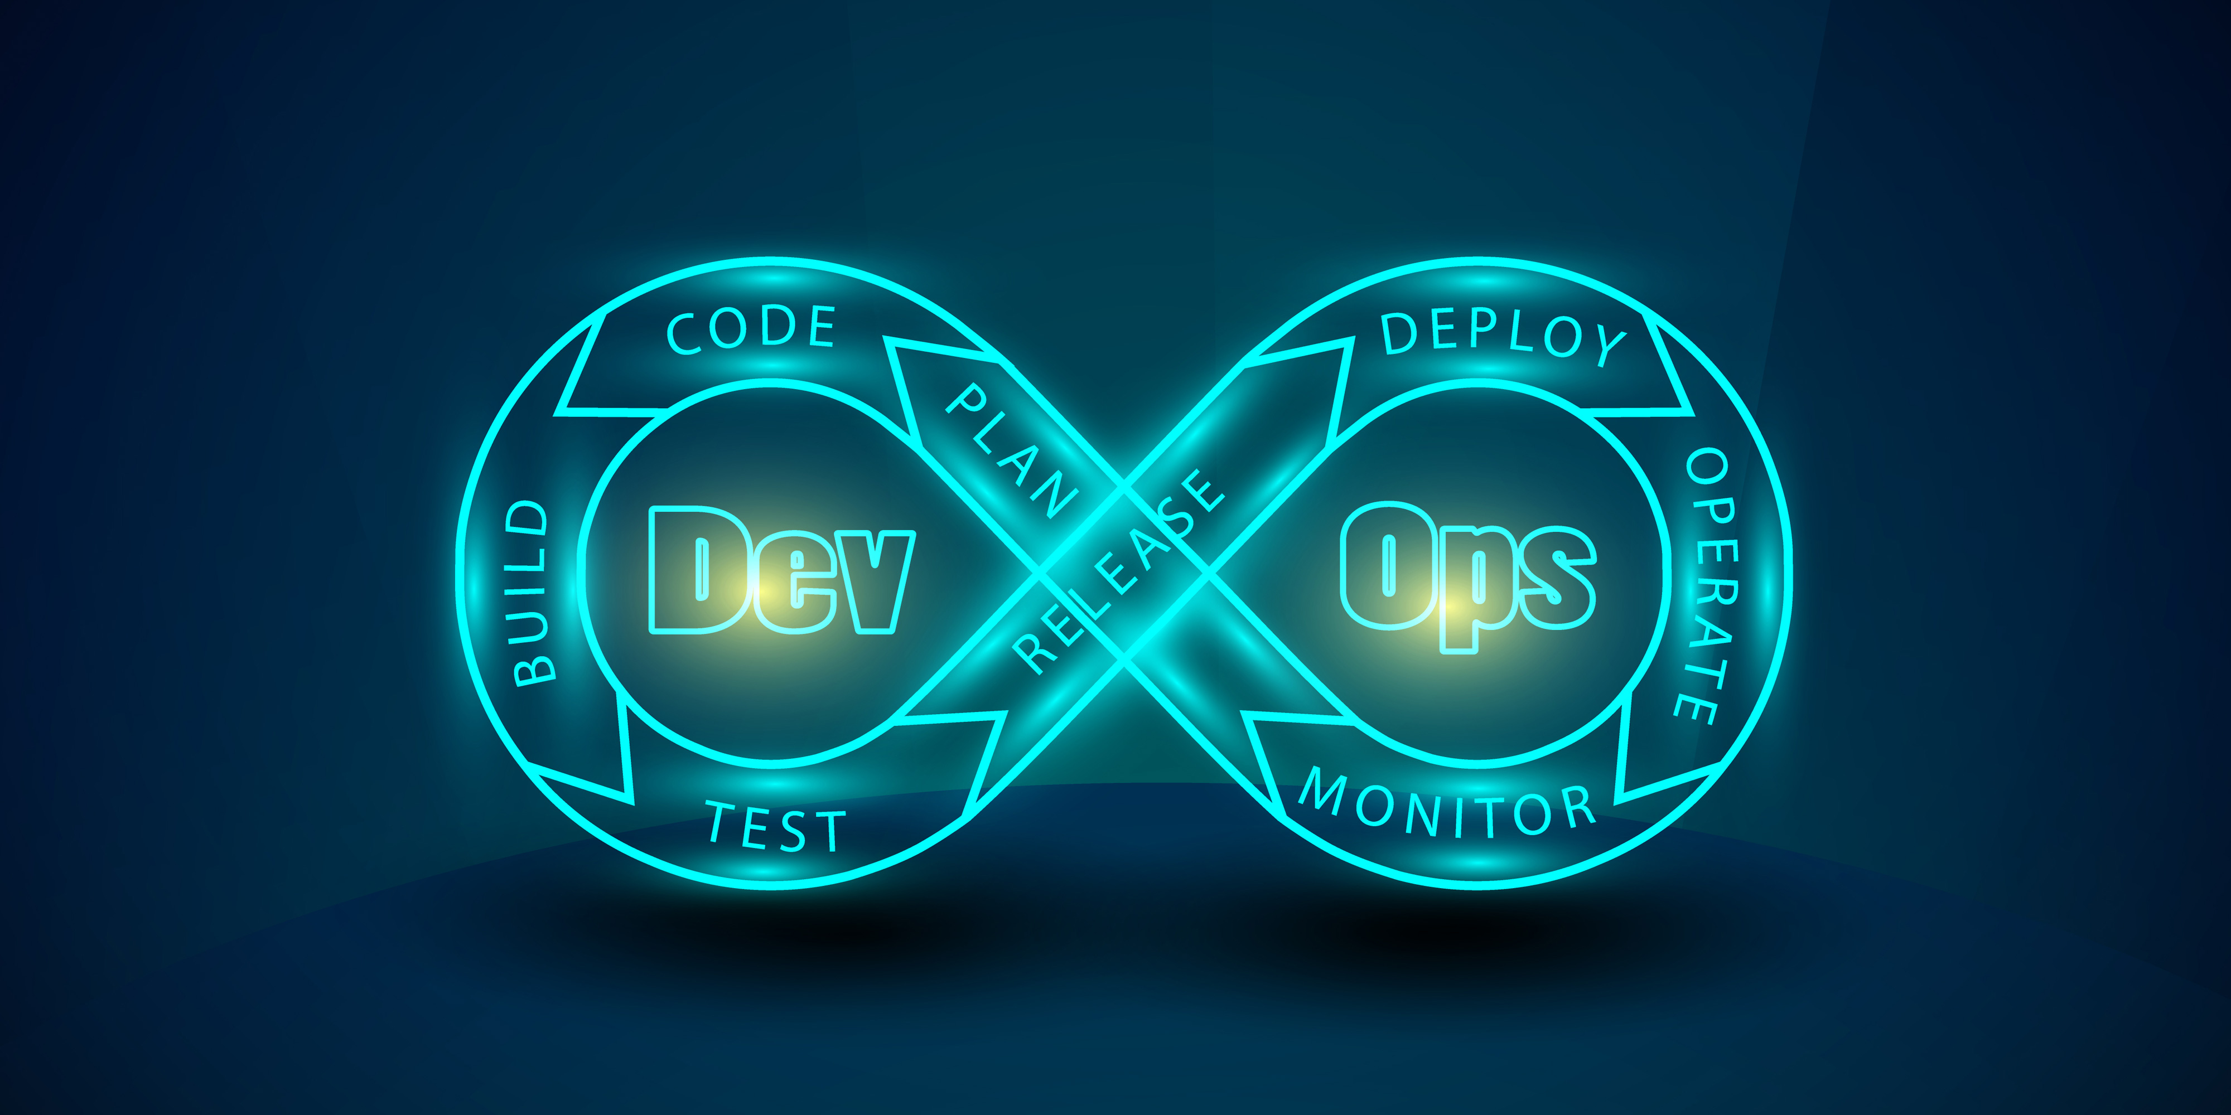

The Technology Value Stream Optimizing Lead and Processing Times By: Shayna Solomon 01/12/2025

Slide 2
Introduction
A value stream represents all the steps required to deliver value to customers, from the time a request is made to the time it is fulfilled.
This presentation explores:
Lead Time vs. Processing Time
Challenges with long deployment lead times.
The DevOps Ideal: Reducing deployment times to minutes.
Understanding value streams is critical to improving efficiency and customer satisfaction.

Slide 3
Defining Lead Time vs. Processing Time
Lead Time:
The total time from when a customer request is made to when it is delivered, including waiting time.
Processing Time:
The actual time spent working on the request, excluding any time in queues.
Key Insight:
Lead time is the most critical metric because it reflects the customer experience.
Shorter lead times improve customer satisfaction and operational efficiency.

Slide 4
The Challenge: Long Deployment Lead Times
Many organizations face deployment lead times that can stretch to months.
Causes:
Tightly coupled, monolithic systems.
Scarcity of test environments.
Reliance on manual testing and lengthy approval processes.
Impact:
Feedback and errors are discovered too late.
Fixing issues can take weeks or longer.
Poor customer satisfaction and wasted resources.

Slide 5
The DevOps Ideal: Minutes, Not Months
Goal: Deployment lead times measured in minutes or hours, not months.
How It Works:
Automated testing, approvals, and deployments.
Frequent, small updates with quick feedback loops.
Results:
Faster delivery of value.
Fewer errors and reduced risks.
Improved customer satisfaction.

Slide 6
Traditional vs. DevOps Deployment
Traditional Deployment | DevOps Deployment
Lead times in months | Lead times in minutes
Manual testing | Automated testing
Late error discovery | Early error detection

Slide 7
Benefits of the DevOps Ideal
Faster Delivery:
Quicker response to customer needs.
Higher Quality:
Automated testing reduces errors.
Better Collaboration:
Teams work together seamlessly.
Flexibility:
Easily adapt to changing requirements.
DevOps helps organizations innovate faster and more reliably.

Slide 8
Value streams are crucial for understanding and improving how value flows through an organization.
Long deployment lead times create inefficiencies and harm customer satisfaction.
The DevOps Ideal transforms these processes, enabling rapid deployments with fewer errors.
By automating workflows and fostering collaboration, DevOps helps organizations achieve faster and more reliable results.
Conclusion

