Slide 1

Sentiment analysis

Slide 2
Introduction
In today's digital age, Businesses, organizations, individuals and political parties use social media extensively to Analyzes sentiment of social media content (tweets, posts, comments).
It helps them shape public perception, refine their messaging, and achieve their political objectives.
supports political parties with understanding the public's perception of their messages.

Slide 3

Goal: Analyzes sentiment in a labeled dataset using TextBlob and shows the sentiment distribution for understanding the overall sentiment of the text data.
Aim: The aim is to categorize the sentiments of texts in the dataset as positive, neutral, or negative, based on the polarity of the text sentiments analyzed by TextBlob.
Purpose: Automates sentiment analysis to understand general sentiment trends in text data, useful for applications like social media monitoring, customer feedback analysis, and brand reputation management.

Slide 4
Problem statement
Need for efficient sentiment analysis of text collections.
Manual analysis of large datasets is time-consuming and error-prone.
Automation with tools like TextBlob allows faster and more consistent sentiment analysis.

Slide 5
Data analysis
Sentiment counts
Sentiment Distribution Visualization
Insights - Positive Sentiment Dominance, Neutral Sentiment Significance, Negative Sentiment Consideration
Further Analysis - Keyword Analysis, Temporal Analysis, User Engagement

Slide 6

Model implementation using python
Step 1: Import Libraries
Step 2: Load Dataset
Step 3: Data Exploration
Step 4: TextBlob Sentiment Analysis
Step 5: Data Analysis
Step 6: Visualize Sentiment Distribution

Slide 7
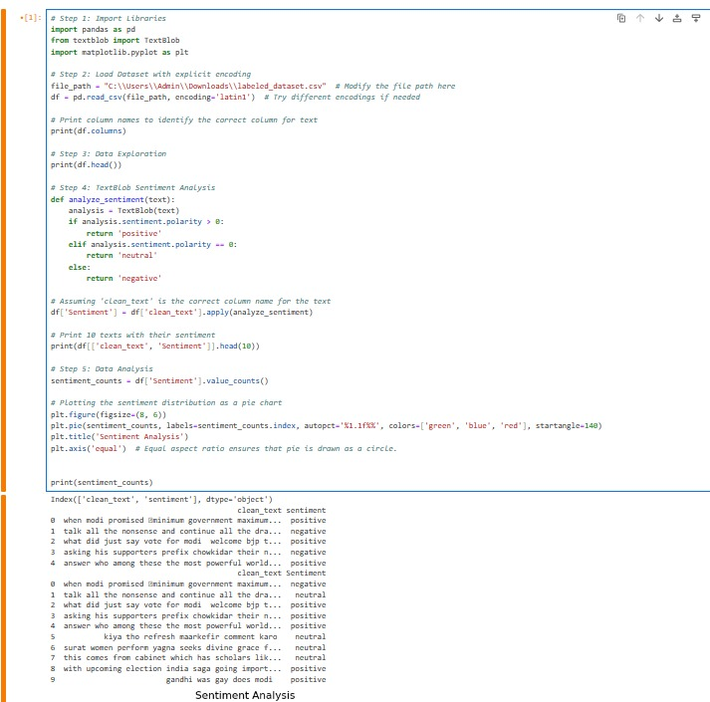
Code

Slide 8
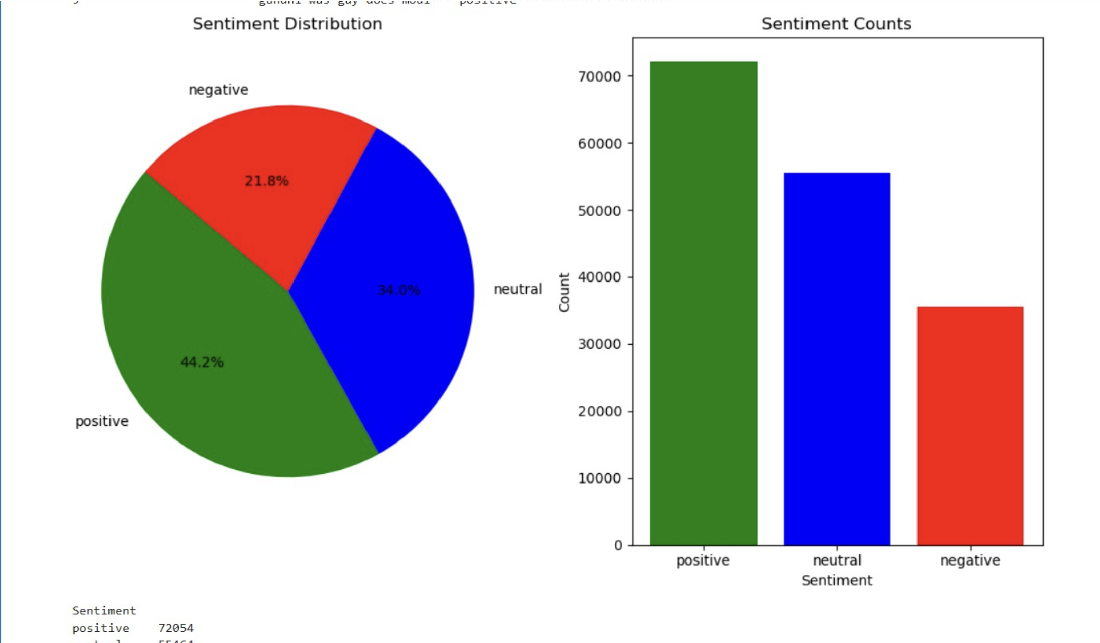
Result implementation

