Slide 1
Analysis on Cereal Dataset
Project by: Gabe-Kass Johnson, Harsh Patel, John Sun, Manasa Bathina, Sonam Sharma

Slide 2

Data Science
It is the study of where information comes from, what it represented, and how it can be turned into a valuable resource in the creation of business and IT strategies

Slide 3
Machine Learning
Supervised Learning
Unsupervised Learning
Regression
Classification
Clustering
Dimensionality Reduction

Slide 4
Running clustering algorithms on “Cereal Dataset” to understand the evolving level of health consciousness of consumers

Slide 5
Fields in Data set
Name
Mfr: Amerian home food Products, General mills, Kellogs,Nabisco,Post,Quaker Oats,Ralston Purina
Type: Hot ,Cold
Calories/Per serving
Protein/gm
Fat/gm
Sodium/mg
Fiber/gm
Carbo/gm
Sugars/gm
Potass/mg
Vitamins/% of FDA approved
Shelf/display
Weight/oz
Cups/Number of cups
Rating/Consumer reports

Slide 6
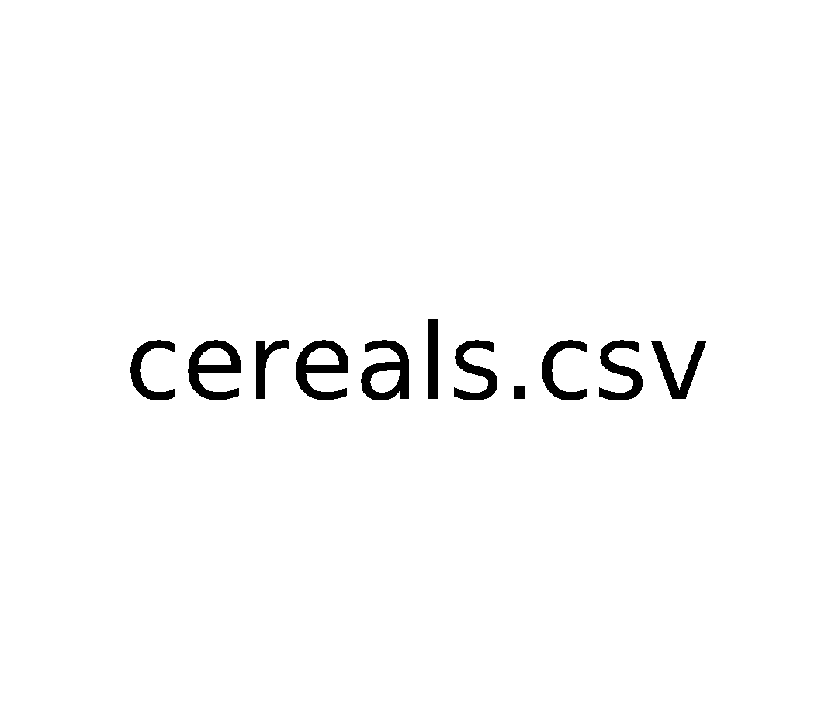
Description of Data Set
This data set contains 80 different cereals, their manufacturer, type(Hot/Cold), ingredients and rating
Cereals Dataset
Linear and Multiple Regression
Random forest
Naïve Bayes
K-means
K-nearest neighbor
SVM
Logistic Regression Classifier
MLPRegressor
PCA

Slide 7
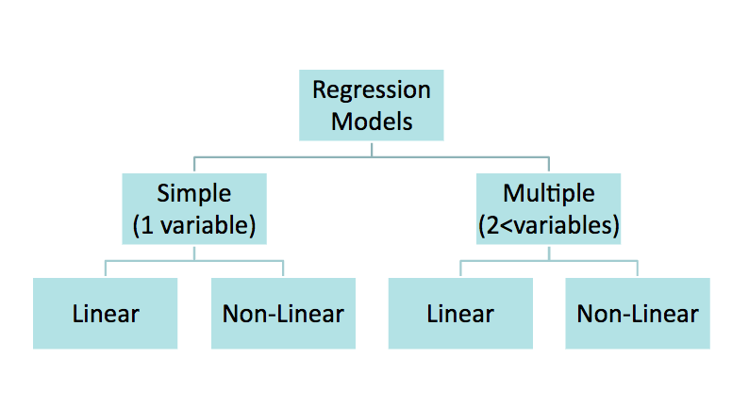
Types of Regression Models

Slide 8
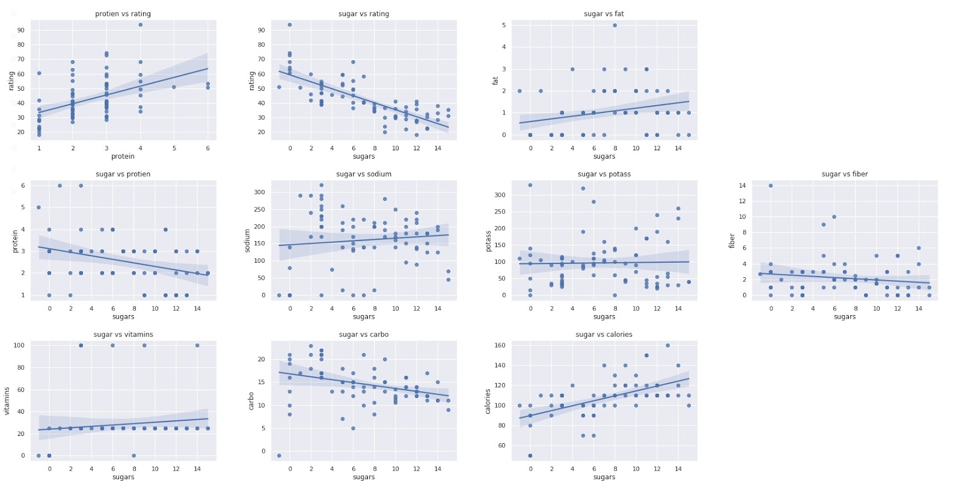
Linear Regression plots

Slide 9
KNN & SVM
Predicted the binary k-means grade of rating using four different methods..
The highest accuracy was 98% from KNN, SVM that tied.
Multiple linear regression to explain why some cereals were rated higher.
99.2% of the variance was explainable by MLR

Slide 10
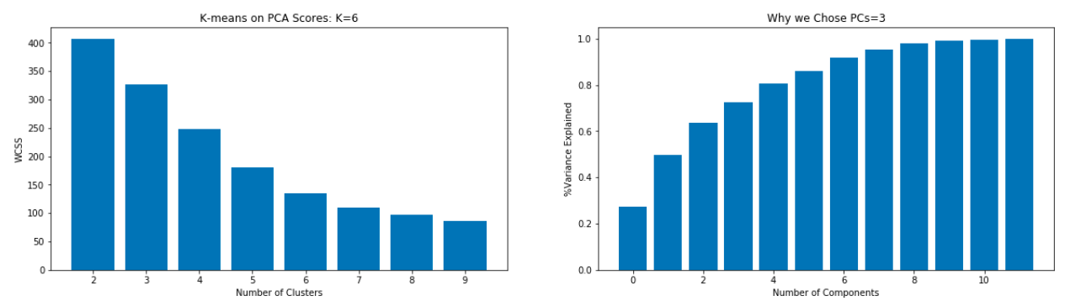
K-means on PCA scores

Slide 11
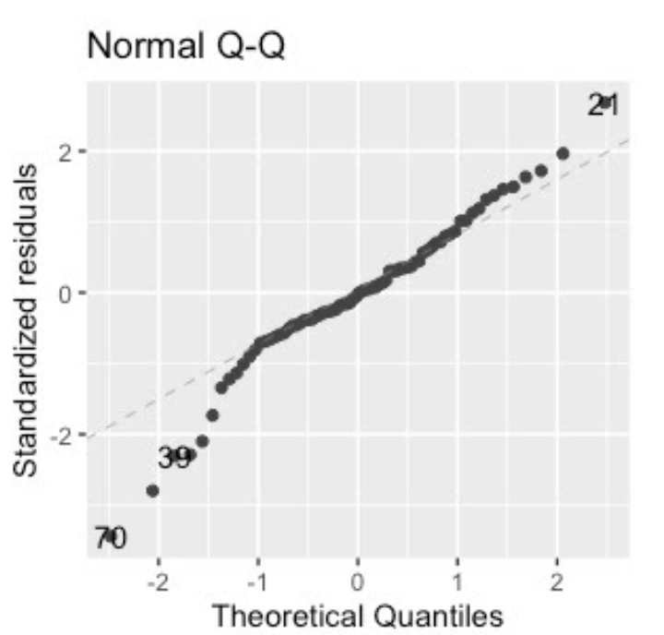
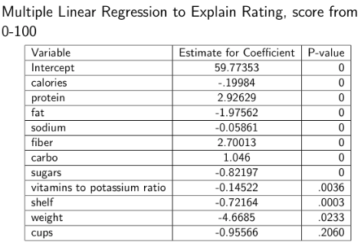
Multiple linear regression

Slide 12
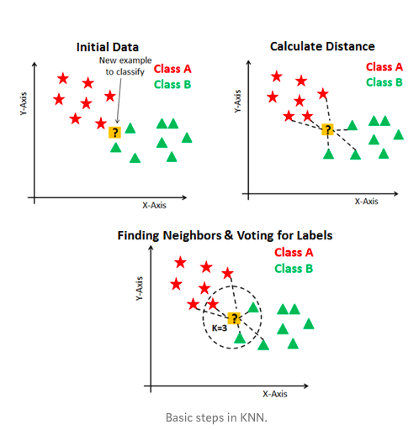
How does K-Nearest Neighbors Work?
https://towardsdatascience.com/knn-visualization-in-just-13-lines-of-code-32820d72c6b6

Slide 13
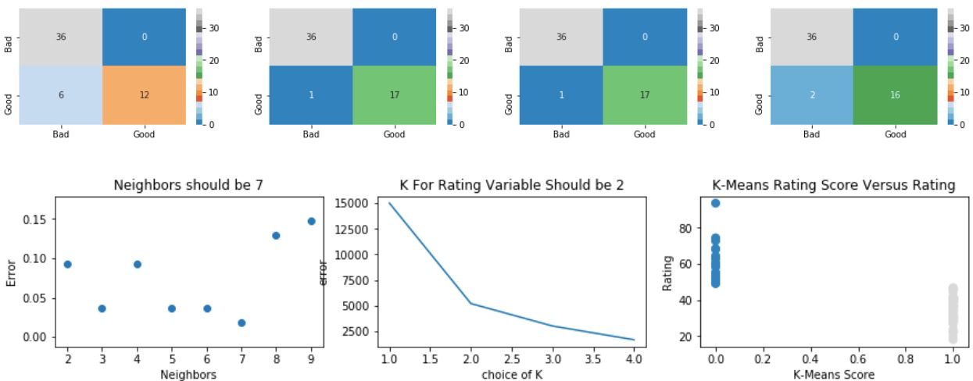
NAIVEBAYES VS KNN VS SVM VS Logistic Regression

Slide 14
Random forest Classifier
It is a supervised learning method consisting of a large number of individual decision trees that work as a ensemble.
Each individual tree in the forest splits out a class prediction and the one with most votes becomes the model's prediction.
In general, randomness gives great diversity to get more accurate and stable predictions.

Slide 15
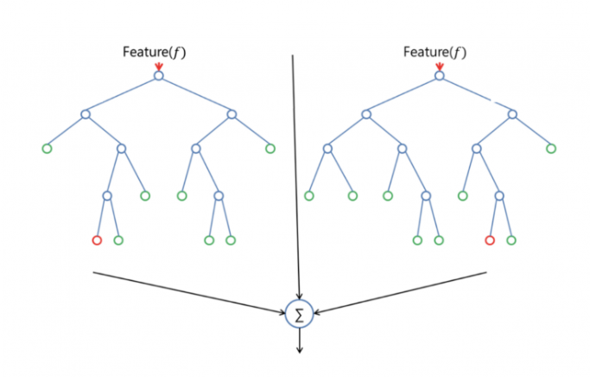
Working of Random Forest
A large number of relatively uncorrelated models (trees) operating as a committee will outperform any of the individual constituent models

Slide 16

Multinomial Naïve Bayes and TF-IDF
It is a supervised learning method that uses Bayes theorem. Multinomial NB is the most popular method for the analysis of categorical data, specifically text data rather than numerical data.
As described by Manning et al (2008), estimates the conditional probability of a particular word/term/token given a class as the relative frequency of term t in documents belonging to class C
Thus this variation takes into account the number of occurrences of term t in training documents from class c, including multiple occurrences.
In our project, we used a pipeline to connect the Multinomial NB and TF-IDF vectorizer. acronym that stands for “Term Frequency – Inverse Document” Frequency which are the components of the resulting scores assigned to each word.
Without going into the math, TF-IDF is word frequency scores that try to highlight words that are more interesting, e.g. frequent in a document but not across documents.

Slide 17
Summary
After comparing both models , whichever does better to predict the three categorical variables Mfr, Type of cereal and Healthiness Rating, we get the following results:
To predict the Mfr and type of cereal both methods showed similar results and the accuracy came to 27% and 96% respectively.
While predicting the healthiness rating NB showed 67% accuracy while Random forest showed 70% accuracy

Slide 18
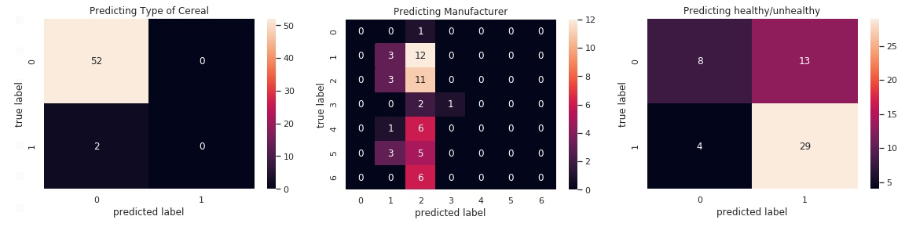
Confusion Matrix is shown as Heatmap

Slide 19
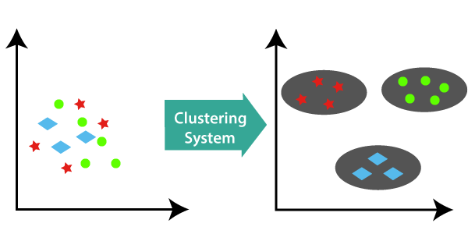
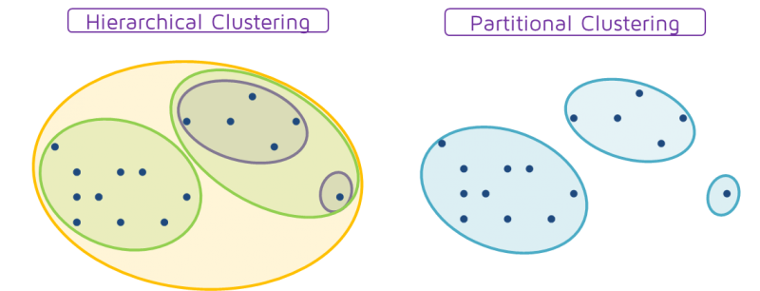
Clustering
Clustering is the classification of objects into different groups, or more precisely, the partitioning of Data set into subsets (clusters), so that the data in each subset(ideally) share some common trait – often according to some defined distance measure.
Types of clustering-
Hierarchical Clustering
Partitional Clustering
Image credit: QuantDare.com

Slide 20
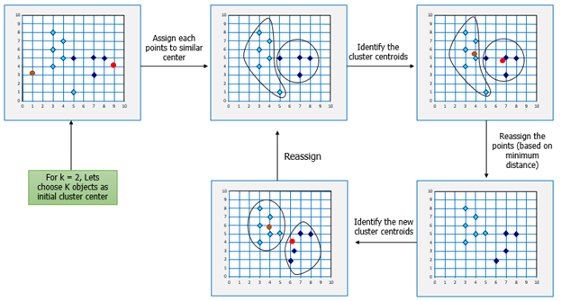
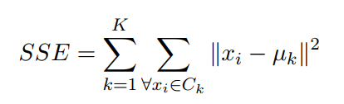
K-means clustering
The k-means algorithm is an algorithm to cluster n objects based on attributes into k partitions ,where k < n
Each cluster is represented by the center of the cluster and the algorithm converges to stable centroids of clusters.
Objective of Algorithm for clustering
Minimize the sum of squares criterion.
x_{i} is vector representing the i^{th} data point and μ_{k} is the centroid of the data points in C_{k}
Image credit: Edureka.com

Slide 21
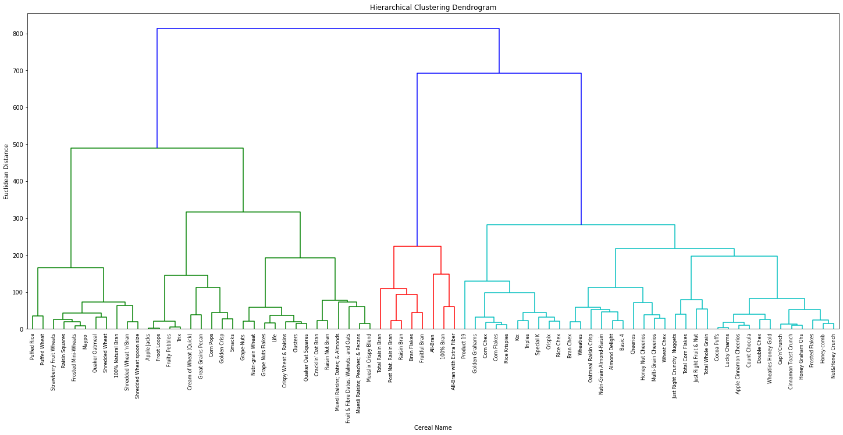
Hierarchical Clustering
Sweet
Energy
Fibrous
High Vitamins

Slide 22
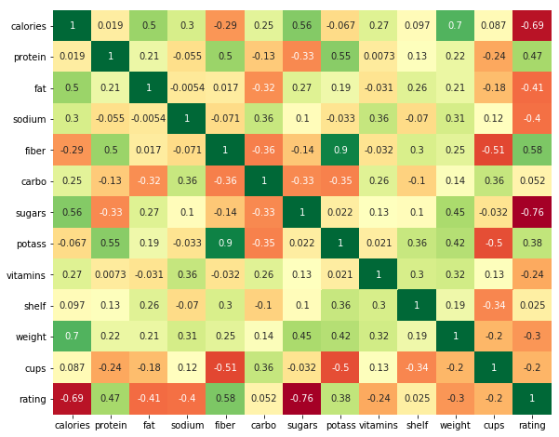
Heatmap
There is a strong co-relation between dietary fiber and Potassium.
Rating is pretty much negatively correlated to Sugars and Calories.

Slide 23
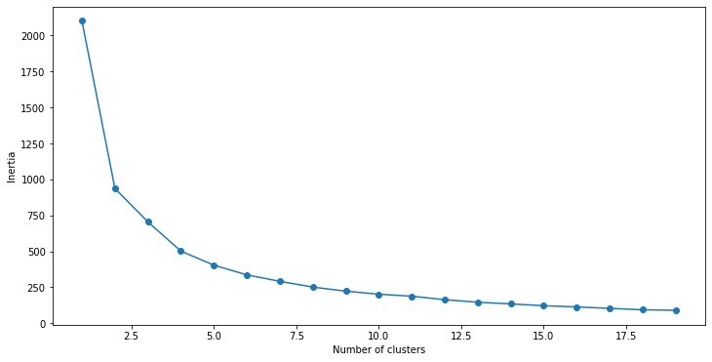
Elbow Method
There was no clear elbow while considering all the features in the dataset.
Better Elbow point with four features: 'fiber’ ,'sugars’ ,'fat' ,'protein’.
Better insight with 5 clusters.

Slide 24
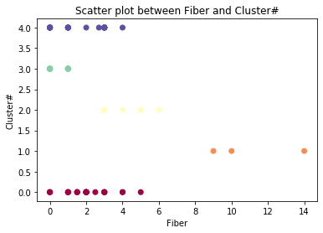
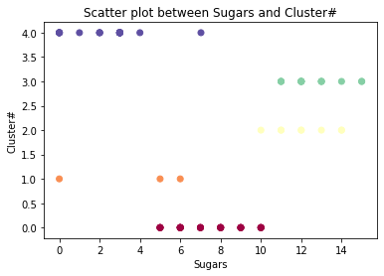
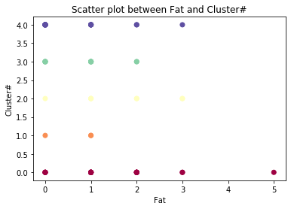
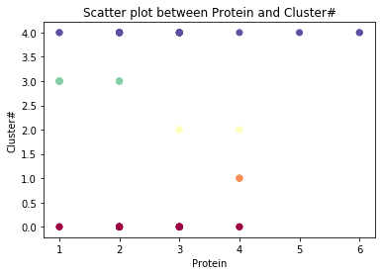
Scatter Plots
Cluster# | Counts
0 | 27
1 | 3
2 | 8
3 | 14
4 | 25

Slide 25
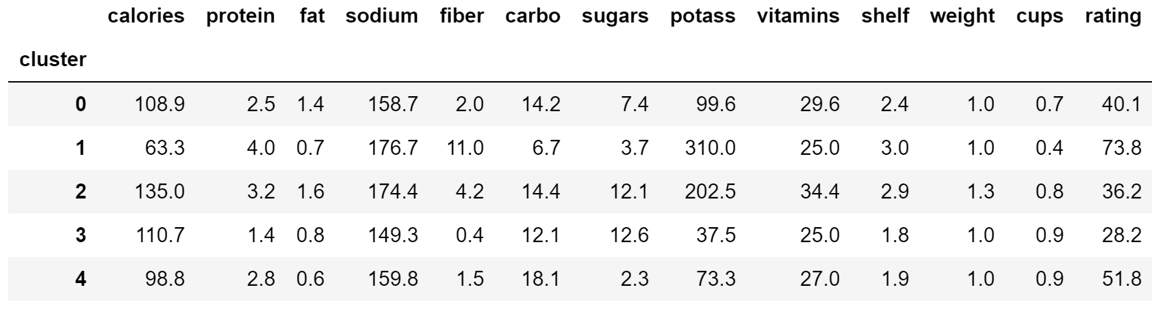
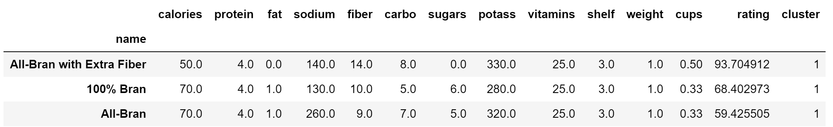
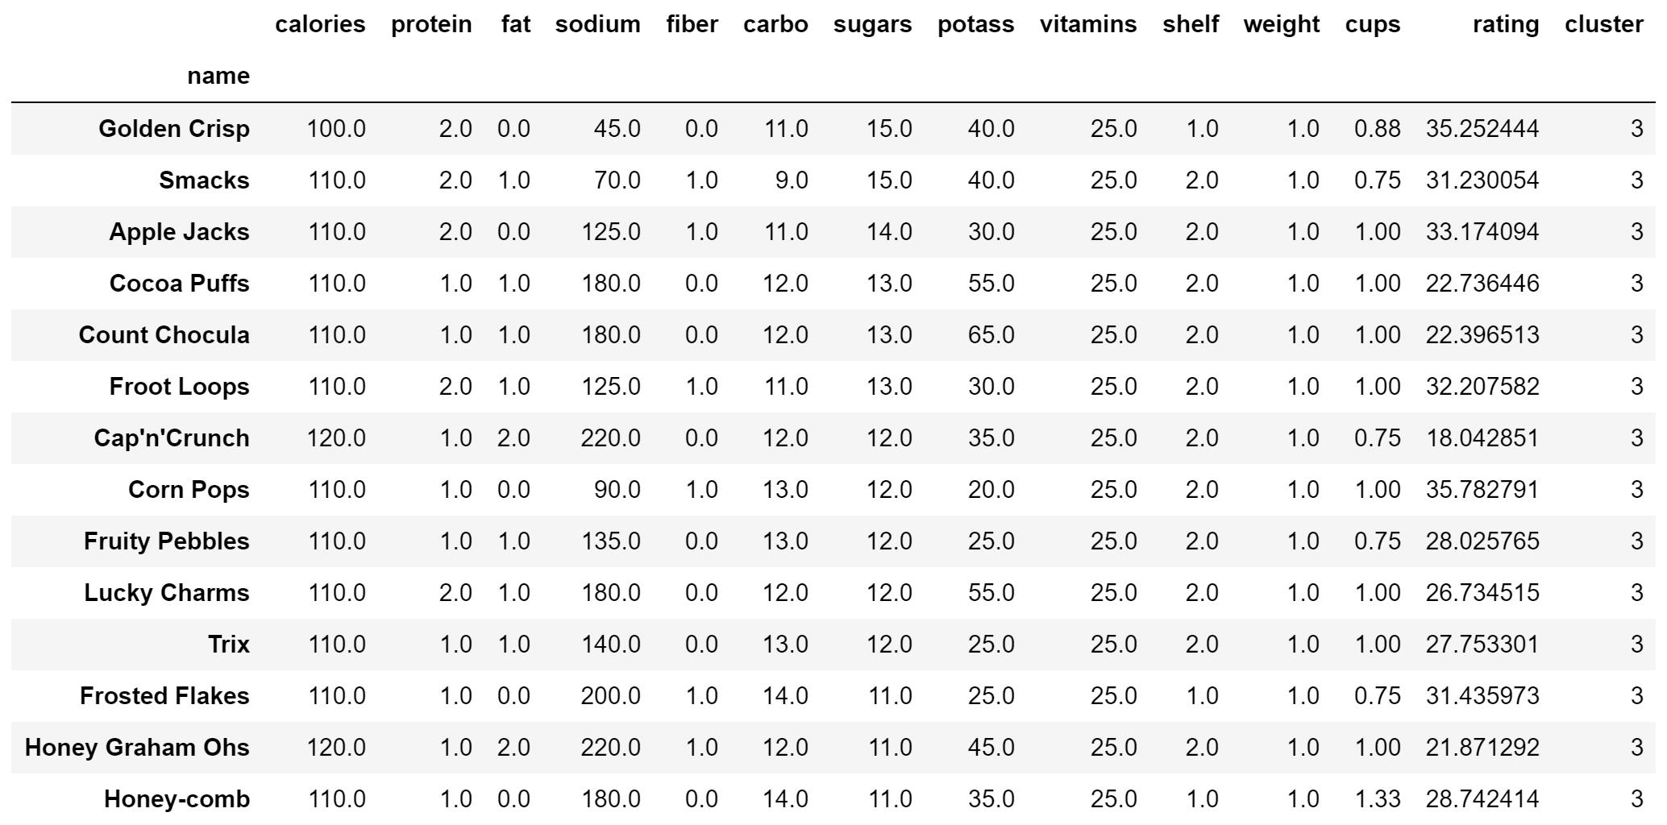
Mean values of all features in Cluster
Healthy Cluster
Unhealthy Cluster

Slide 26
K-means on PCA scores

Slide 27
Multiple linear regression

Slide 28
How does K-Nearest Neighbors Work?
https://towardsdatascience.com/knn-visualization-in-just-13-lines-of-code-32820d72c6b6

Slide 29
NAIVEBAYES VS KNN VS SVM VS Logistic Regression

Slide 30
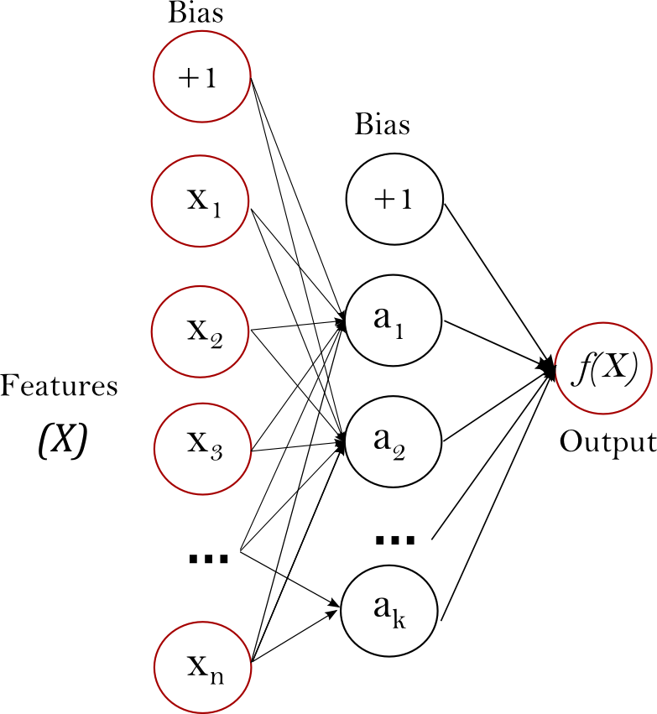
Multi-Layer Perceptron and Neural Networks
Diagram from scikit-learn.org

Slide 31
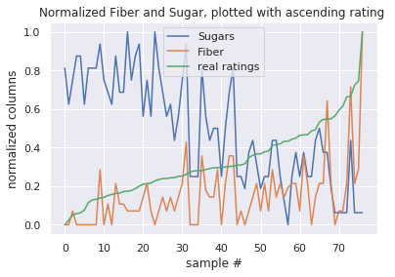
Plotting Normalized Features
When sugar and fiber are plotted against an ascending rating, the trends are clear, if noisy.

Slide 32
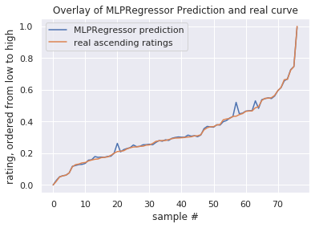
Plotting the Model’s Predictions
This plot shows the curve of the prediction given by the MLPRegressor model, overlayed with the real curve of the ratings.

Slide 33
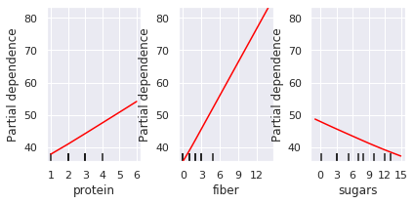
Dependence Diagrams
These figures show the strength of effect of each feature upon the target feature, the rating. Fiber is a strong predictor of a high rating, and sugar is a strong predictor of a low rating.

Slide 34
Conclusion
Lingering Questions:
How do we make sense of the models?
The neural net is approximating a simpler function that looks a lot like a polynomial curve.
How do we make sense of this data?
Is this data set authentic or fabricated in some way?
Interpreting the results of the models.
Making hypotheses about the data.

