Slide 1






SRM INSTITUTE OF SCIENCE AND TECHNOLOGY
DEPARTMENT OF COMPUTER SCIENCE AND ENGINEERING
DESIGN AND INNOVATION CLUB
SOLX
Sarcasm & Online harm Locator with eXplainability
NLP HACKATHON 2026
PROBLEM STATEMENT 1 | AI-Powered Tanglish Cyberbullying & Sarcasm Detection
Team Inferno
Y Roshni RA2311003040018
Sai Shivaram LN RA2311003040023
Live Demo
Archana Ramesh RA2311003040050
ssr446.github.io/SOLX_Sample
NLP Hackathon 2026 | SRM Institute of Science and Technology | Dept. of CSE

Slide 2

CHOOSEN PROBLEM
Develop an AI-powered model to understand Tanglish (Tamil written in English alphabets) and detect toxic comments, hate speech, online harassment, and cultural sarcasm embedded in pop-culture references across digital platforms.
Currently Existing Issues
No Standard Spelling
Invisible Cultural Sarcasm
"Enna" / "yenna" / "ena" / "yena" — dozens of spelling variants per Tamil word. Standard tokenizers cannot handle this non-standard orthography.
Tamil meme culture wraps insults in film dialogues & meme templates. Generic NLP models have zero awareness of these references.
Code-Switching Confusion
Scarce Labelled Data
Tanglish mixes Tamil grammar with English mid-sentence, defeating NLP pipelines built for single-language input.
Publicly available Tanglish cyberbullying datasets are extremely scarce, making supervised model training highly challenging.

Slide 3
PROBLEM ABSTRACT
Objectives & Theme Alignment
OBJECTIVES
THEME ALIGNMENT
‣ Detect toxic, harassing and hate-speech content in Tanglish text
‣ Identify culturally embedded sarcasm via Tamil pop-culture references
‣ Standardize Tanglish spelling variants with a phonetic normalizer
‣ Provide explainable, plain-English justification for every prediction
‣ Improve digital safety for Tamil-speaking online communities
‣ Next-Gen Tamil Language & Cultural AI (Hackathon Theme)
‣ Preserve classical Tamil digital culture
‣ Improve digital accessibility for Tamil communities
‣ Secure online communication using intelligent AI
‣ Bridge rural language use and modern digital platforms

Slide 4
OBJECTIVES AND SOLUTION
Objectives with the solution approach for each
OBJECTIVE
SOLUTION APPROACH
Detect toxic, harassing and hate-speech content in Tanglish text
High-performance LinearSVC Pipeline with TF-IDF Vectorization trained on nearly 30,000 real-world examples (Twitter Hate Speech, TweetEval Irony, and curated Tanglish) detects toxicity with high precision.
Identify culturally embedded sarcasm via Tamil pop-culture references
Cultural Context Engine queries a knowledge-base of Tamil film dialogues and internet meme templates to unmask sarcasm that keyword filters and generic NLP models are completely blind to.
Standardize Tanglish spelling variants with a phonetic normalizer
A Regex & Substring Dictionary mapping resolves common spelling variants before classification.
Provide explainable, plain-English justification for every prediction
An XAI layer generates moderator-ready explanations — not just a label, but WHY a comment is harmful, which phrase triggered it, and its cultural origin — enabling transparent, auditable moderation.
Improve digital safety for Tamil-speaking online communities
Structured JSON API output integrates directly into platform moderation pipelines (Twitter, YouTube, Instagram) — making SOLX a plug-in safety layer for any Tamil-content platform.

Slide 5
FUNCTIONALITIES AND SOLUTION
Functionalities with the solution explaining the approach
FUNCTIONALITY
HOW IT WORKS — THE APPROACH
Multi-Label Detection
A single comment passes through the optimized LinearSVC classifier, producing independent scores for Toxic, Sarcastic, and Cyberbullying — one comment can trigger all three labels at once.
Severity Scoring (0–100%)
Model confidence / decision scores are converted into a 0–100% severity score. Scores above configurable thresholds trigger moderation actions, enabling tiered responses (warn / restrict / remove).
Tanglish Normalizer
A phonetic mapping table maps character-level variants of Tamil words to a canonical root form before tokenization. This ensures the classifier sees consistent input regardless of how a user spells a word.
Cultural Context Engine
When the classifier flags sarcasm, a knowledge-base lookup identifies whether a phrase is a known film dialogue, meme template, or internet slang — and retrieves the cultural origin and typical intent.
Explainable AI Output
The XAI layer stitches classifier output with the cultural context result to generate a plain-English explanation: which phrase triggered the flag, why it is harmful, and its origin — ready for a human moderator.
API-Ready JSON Output
All outputs are serialized into a structured JSON response (label, score, normalized_text, explanation, severity) making SOLX a drop-in moderation microservice for any content platform's backend.

Slide 6
PROPOSED SOLUTION
3-Stage AI Pipeline — Normalizer > Classifier > Explainer
01
Typo & Slang Normalizer
02
Multi-Label Classifier
03
Cultural Context Explainer
Preprocessing Layer
Core NLP Model
Explainable AI Layer
‣ Phonetic mapping of spelling variants
‣ 'enna' / 'yenna' / 'ena' -> unified root
‣ Internet slang & abbreviation lookup
‣ Output: clean, normalized Tanglish text
‣ Optimized LinearSVC / TF-IDF Model
‣ Categories: Toxic / Sarcastic / Cyberbullying
‣ Confidence score 0-100% per category
‣ Single comment can trigger multiple labels
‣ Handles Tamil-English code-switching
‣ Knowledge-base of Tamil film dialogues
‣ Maps phrase to meme template or dialogue
‣ Identifies sarcasm vehicle and intent
‣ Plain-English moderator explanation
‣ Severity score + structured JSON output
>
>

Slide 7
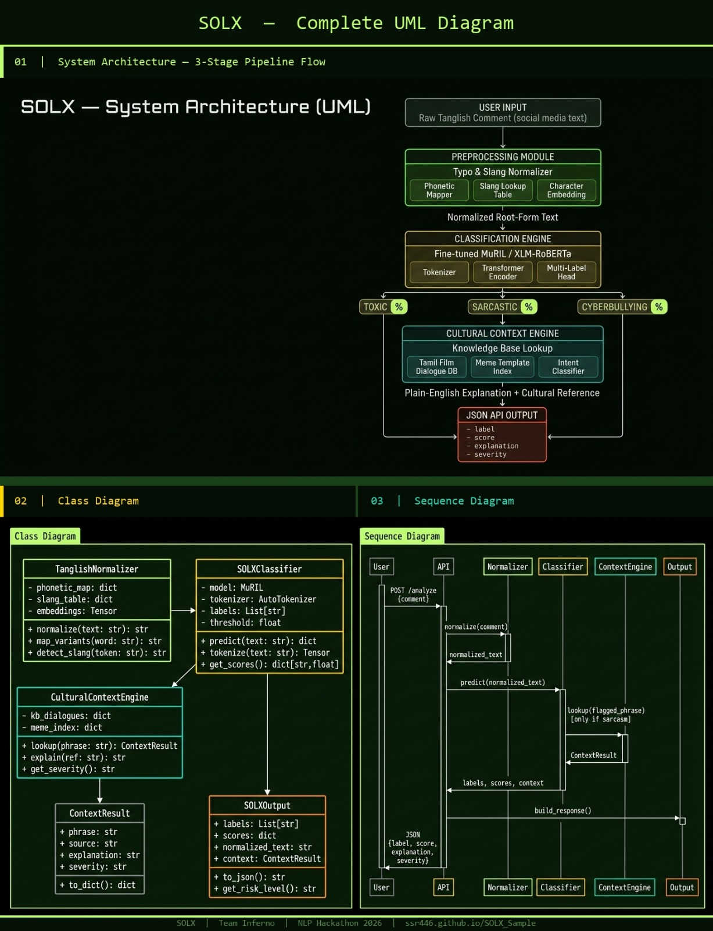
UML DIAGRAM
UML DIAGRAM
Technologies & System Architecture

Slide 8
TECH STACK
UML DIAGRAM
Raw Tanglish Input » Regex Normalizer » LinearSVC Classifier » Cultural Context Engine » JSON Output
NLP & AI Models
Data & Processing
Backend & API
Frontend & Demo
▸ Python 3.11
▸ TF-IDF Vectorization (Word & Char n-grams)
▸ LinearSVC (Support Vector Classifier)
▸ XLM-RoBERTa (fallback)
▸ scikit-learn
▸ NLTK / spaCy
▸ Custom Tanglish Corpus
▸ Phonetic Mapping Tables
▸ Regex Normalizer Engine
▸ Pandas / NumPy
▸ Label Studio (annotation)
▸ Davidson Hate Speech Dataset
▸ TweetEval (Irony) Dataset
▸ FastAPI + Uvicorn
▸ REST API / JSON Output
▸ Pydantic Validation
▸ Docker (deployment-ready)
▸ OAuth2 (future scope)
▸ Swagger Auto-Docs
▸ HTML5 / CSS3 / JS
▸ Cyber-green dark UI theme
▸ GitHub Pages hosting
▸ Responsive design
▸ 8 live demo examples
▸ ssr446.github.io/SOLX_Sample
WHY SOLX IS UNIQUE
First system to combine Tanglish normalization + hate detection + cultural explainability in one pipeline — no existing tool does all three
Cultural Context Engine acts like a "Tamil Internet Anthropologist" — identifies sarcasm that no keyword filter or generic NLP model can detect
Explainability-first design: generates moderator-ready plain-English explanations, not just toxic/non-toxic binary labels
Modular 3-stage architecture — each stage (Normalizer, Classifier, Explainer) can be independently upgraded without breaking the pipeline

Slide 9
WORKING PROTOTYPE
Simulated end-to-end demo — click any example phrase at: ssr446.github.io/SOLX_Sample
INPUT (Raw Tanglish)
KEY FUNCTIONALITIES
"Avaru periya Appatakar da, yenna pannuvanunga"
v Normalizer v
Multi-Label Detection
Flags Toxic, Sarcastic, Cyberbullying simultaneously
NORMALIZED TEXT
Severity Scoring
"Avar periya Aptakar da, enna pannuvanga"
0-100% confidence score per detected label
v Classifier + Explainer v
OUTPUT
Tanglish Normalizer
Maps common Tanglish spelling variants using regex / substring rules
Sarcasm: 82% | Cyberbullying: 74%
Cultural Context Engine
Cultural Ref: "Appatakar" — sarcastic title for someone pretending to be superior. Origin: Tanglish meme template (2019 onwards).
Identifies film dialogues & meme templates
Explainable AI Output
Plain-English justification for every decision
API-Ready JSON
Structured output plugs into any platform backend

Slide 10
REFERENCES & CITATIONS
[1]
Chakravarthi, B. R. et al. (2021). Dravidian-CodeMix: Sentiment Analysis for Code-Mixed Social Media Text. Proceedings of EACL. ACL Anthology.
[2]
Kula, M. et al. (2020). Offensive Language Identification in Dravidian Languages. Proceedings of FIRE 2020 Workshop.
[3]
Davidson, T., et al. (2017). "Automated Hate Speech Detection and the Problem of Offensive Language." Proceedings of ICWSM.
[4]
Barbieri, F., et al. (2020). "TweetEval: Unified Benchmark and Comparative Evaluation for Tweet Classification." Findings of EMNLP.

Slide 11
SOLX
Sarcasm & Online harm Locator with eXplainability
Team Inferno
Y Roshni | Sai Shivaram LN | Archana Ramesh
THANK YOU
ssr446.github.io/SOLX_Sample
NLP Hackathon 2026 | SRM Institute of Science and Technology | Dept. of CSE

