Slide 1
MOVIE RECOMMENDATION SYSTEM PROJECT
DONE BY
SSRK KASYAP
DATA SCIENCE AND MACHINE LEARNING INTERN
INTERN ID:228418 GITAM UNIVERSITY

Slide 2
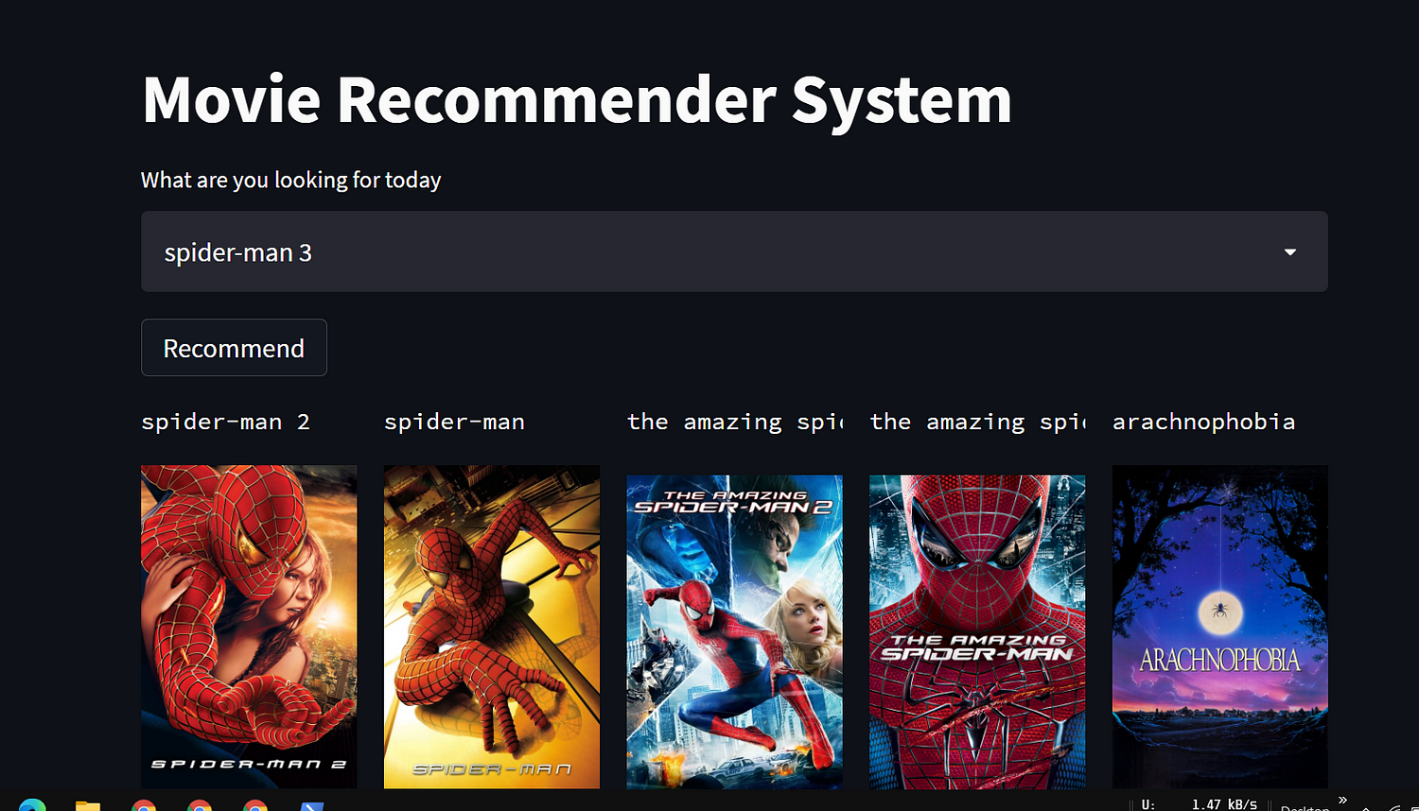
INTRODUCTION
In today's world, where we are constantly bombarded with an overwhelming amount of content, it can be difficult to decide what to watch next. This is where movie recommendation systems come in.
These systems use data analysis and algorithms to suggest movies that you are likely to enjoy based on your viewing history and preferences.
Movie recommendation systems are not only beneficial for viewers but also for the entertainment industry. By providing personalized recommendations, these systems can increase customer satisfaction and engagement, leading to higher revenue for streaming platforms and production companies.
Moreover, recommendation systems can help promote lesser-known movies and TV shows, giving them a chance to shine in a crowded market.

Slide 3
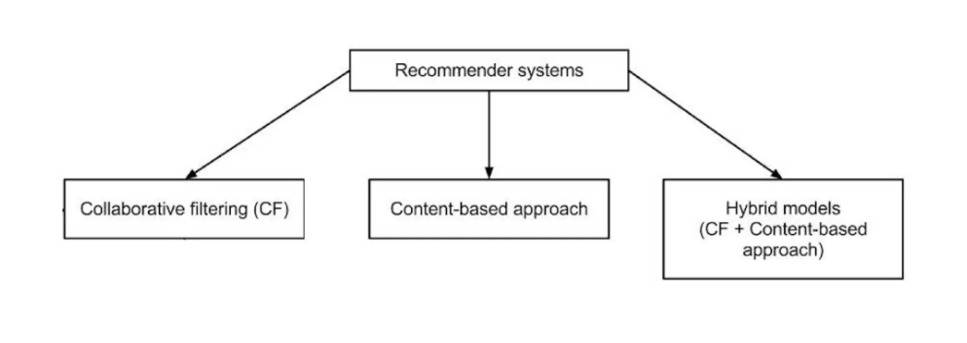
TYPES OF RECOMMENDATION SYSTEMS
In this project, I am using a content-based approach.

Slide 4
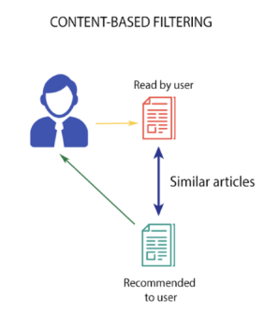
Content-based approach
A content-based recommendation system is a type of recommendation system that suggests items based on their attributes or features.
This means that the system recommends items that are similar in terms of their content, rather than looking at other users' behavior or preferences. For example, if you watched a movie with a lot of action scenes, the system would recommend other movies with similar action scenes.
The content-based recommendation system works by analyzing the attributes of each item in the system's database and then comparing them to the user's preferences.
he system then generates recommendations based on the similarity between the attributes of the user's preferred items and the other items in the database. This process is often called 'item profiling' or 'content analysis'.

Slide 5
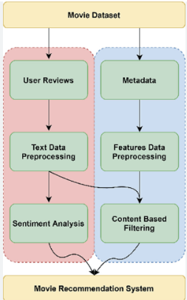
How does it work?
The content-based recommendation system works by analyzing the characteristics of items that users have previously shown interest in and recommending similar items.
This is done by collecting user data such as search history, ratings, and reviews. The system then analyzes this data to identify patterns and similarities between items.
Once the system has identified these patterns, it generates recommendations based on the characteristics of items that the user has previously shown interest in.
For example, if a user has previously watched and rated several action movies, the system will recommend other action movies with similar characteristics.

Slide 6

The patterns used by the recommender system are generated using Cosine similarity.
Cosine similarity is a measure of similarity between two non-zero vectors of an inner product space that measures the cosine of the angle between them.
Formula:
To remove all the stops words affecting the accuracy of the recommender system, here I have used natural language processing library nltk’s count vectorize function, using this I have removed all the stops and stored more frequent weight vectors for better recommendation.

Slide 7
Deployment
STREAMLIT
Streamlit is an open-source Python library that allows developers to easily create web applications for machine learning and data science projects. It has gained popularity among developers due to its simplicity and ease of use, allowing them to focus on their models instead of the complexities of web development.
One of the main advantages of Streamlit is its ability to quickly deploy machine learning models as web applications, recommenders, etc. This makes it an ideal tool for deploying movie recommendation systems, which rely heavily on machine learning algorithms. In addition, Streamlit provides a simple interface for users to interact with the model and receive recommendations based on their preferences.
Project’s Code Link: https://github.com/tjayanth2001/Movie_recommendation_system-.git

Slide 8
Conclusion
In conclusion, using a content-based recommendation system can greatly enhance the user experience by providing personalized recommendations based on their interests and preferences. This leads to increased engagement and customer satisfaction, which is crucial in the competitive entertainment industry.
Furthermore, deploying such a system with Streamlit offers numerous benefits such as ease of use, flexibility, and scalability. Streamlit has been used successfully in various projects, including data visualization and machine learning applications. By leveraging its capabilities, developers can create powerful and efficient recommendation systems that meet the needs of their users.
We encourage you to try out our movie recommendation system deployed with Streamlit and experience the benefits firsthand. Whether you are a movie enthusiast or simply looking for something new to watch, our system can help you discover movies that match your taste and preferences. Give it a try and let us know what you think!

