Slide 1
An introduction to path dependent types
Aristov Ivan, Raiffeisen Bank 4 march 2020, Rostov-on-Don Special for Lambda61

Slide 2
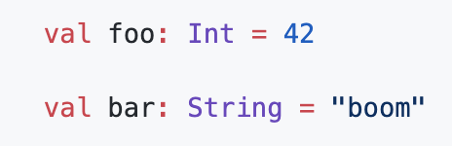
Normal types
Usually type hardwired to a value at compile-type and sometimes at runtime.

Slide 3
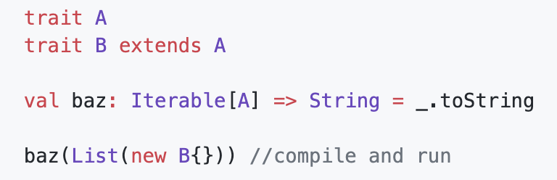
Normal types
Usually type hardwired to a value at compile-type and sometimes at runtime.
Also in the modern PL type systems had a type variance.
So, to typecheck functions compiler check type variance.

Slide 4
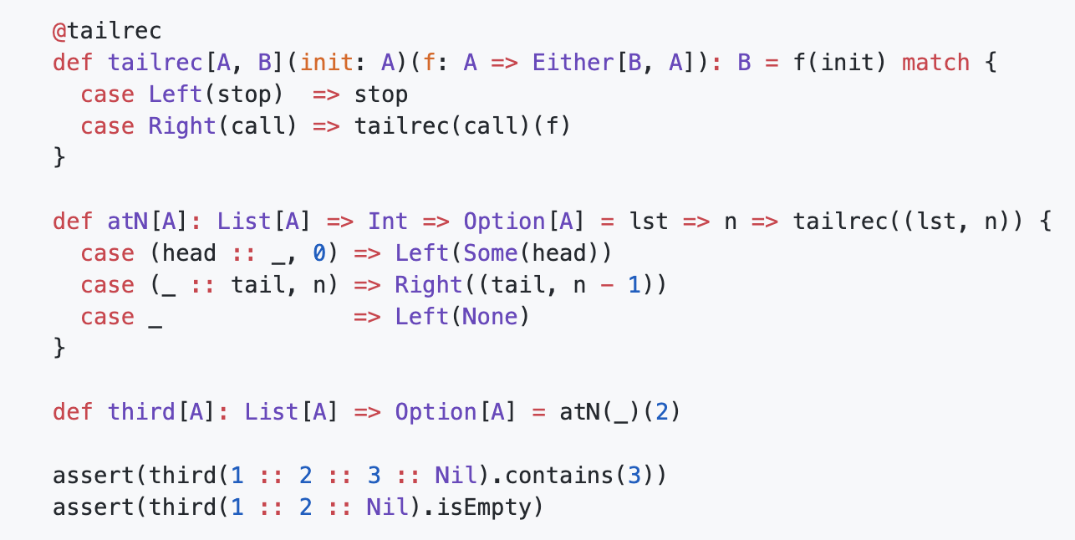
Normal types
For example, you want to retrieve the third element from list…

Slide 5
Normal types
Problems:
Need to use hand-made functional tail recursive state function

Slide 6
Normal types
Problems:
Need to use hand-made functional tail recursive state function
…Because of foldLeft every time pass over all the elements

Slide 7
Normal types
Problems:
Need to use hand-made functional tail recursive state function
…Because of foldLeft every time pass over all the elements
...But it also had an overhead

Slide 8
Normal types
Problems:
Need to use hand-made functional tail recursive state function
…Because of foldLeft every time pass over all the elements
...But it also had an overhead
Don’t refine int value during the compile-time

Slide 9
Normal types
Problems:
Need to use hand-made functional tail recursive state function
…Because of foldLeft every time pass over all the elements
...But it also had an overhead
Don’t refine int value during the compile-time
A lot of unsafe code

Slide 10
Normal types
Problems:
Need to use hand-made functional tail recursive state function
…Because of foldLeft every time pass over all the elements
...But it also had an overhead
Don’t refine int value during the compile-time
A lot of unsafe code
Possible infinite recursion…

Slide 11
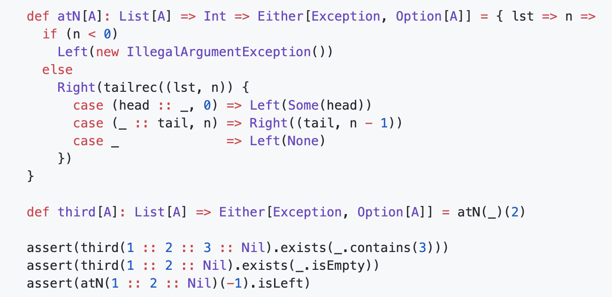
Normal types
“Safe solution”

Slide 12
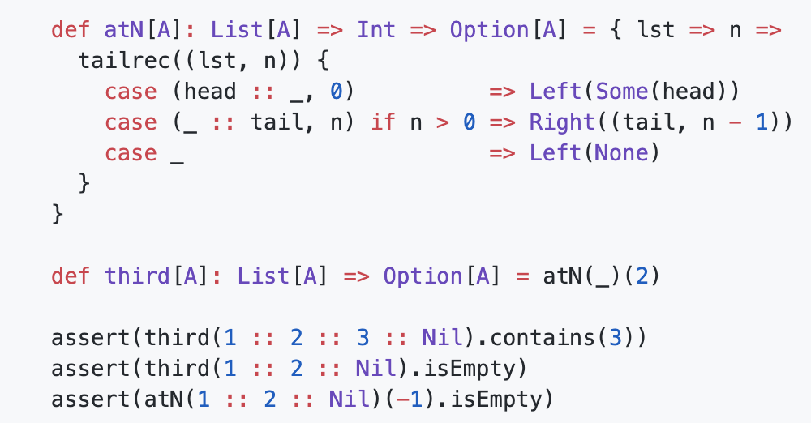
Normal types
Avoid recursion, but leaks check…

Slide 13
Heterogenous List
Heterogenous List is a list, where all elements with their type maybe (the most efficient for programmer) are fully-known at compile-time.

Slide 14
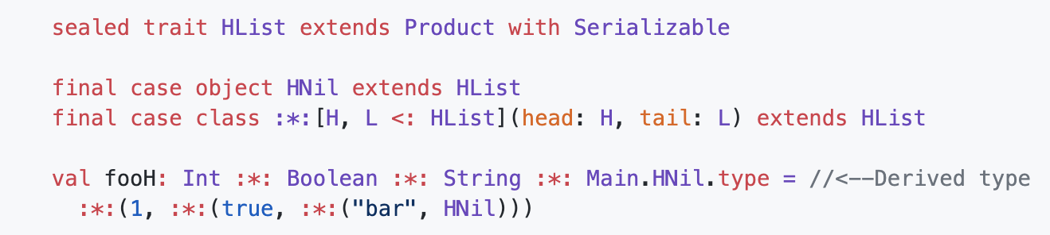
Heterogenous List
Heterogenous List is a list, where all elements with their type maybe (the most efficient for programmer) are fully-known at compile-time.

Slide 15
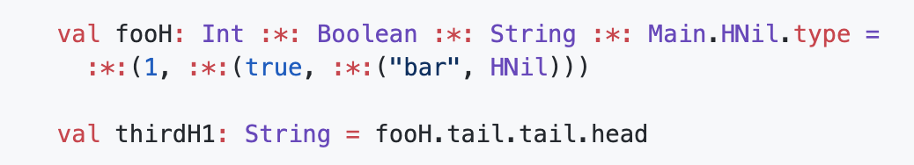
Heterogenous List
Let’s retrieve the third element…

Slide 16
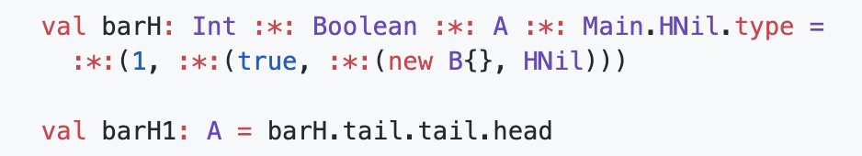
Heterogenous List
Let’s retrieve the third element…But, wait!

Slide 17

Heterogenous List
Let’s retrieve the third element…But, wait!

Slide 18
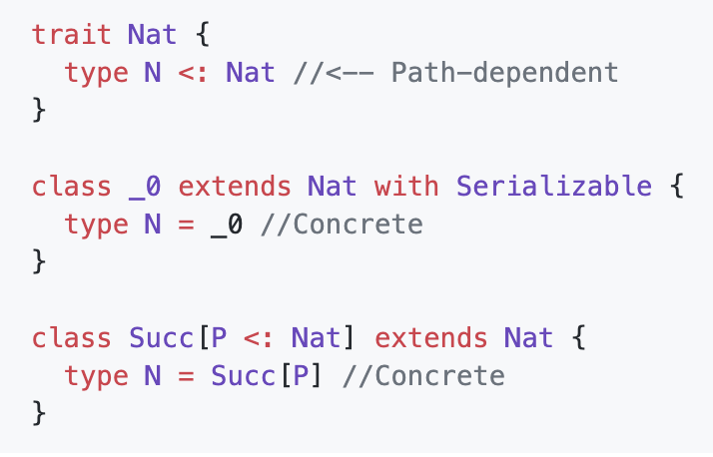
Typelevel Nat

Slide 19
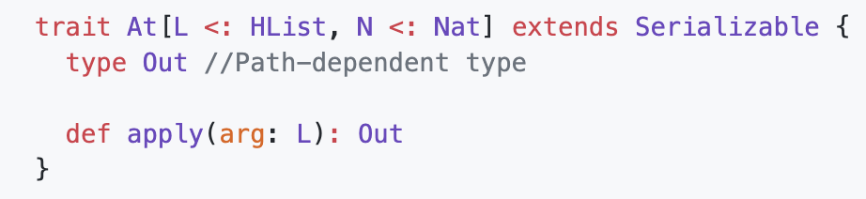
At typeclass

Slide 20
At typeclass
Then we need to define recursion in term of types!

Slide 21
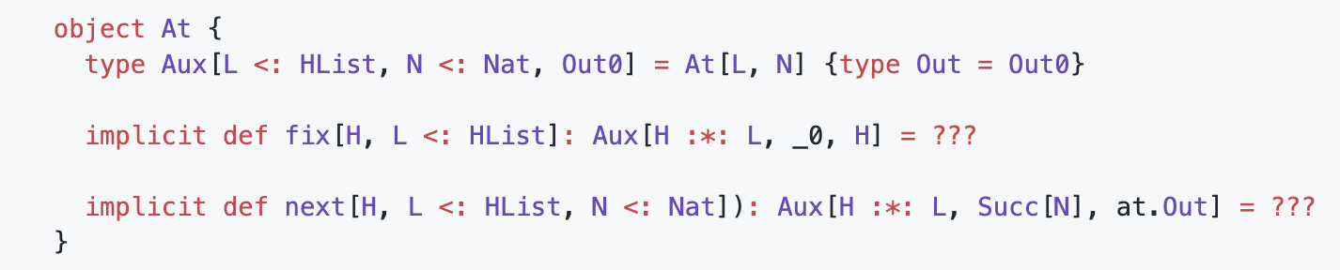
At typeclass

Slide 22
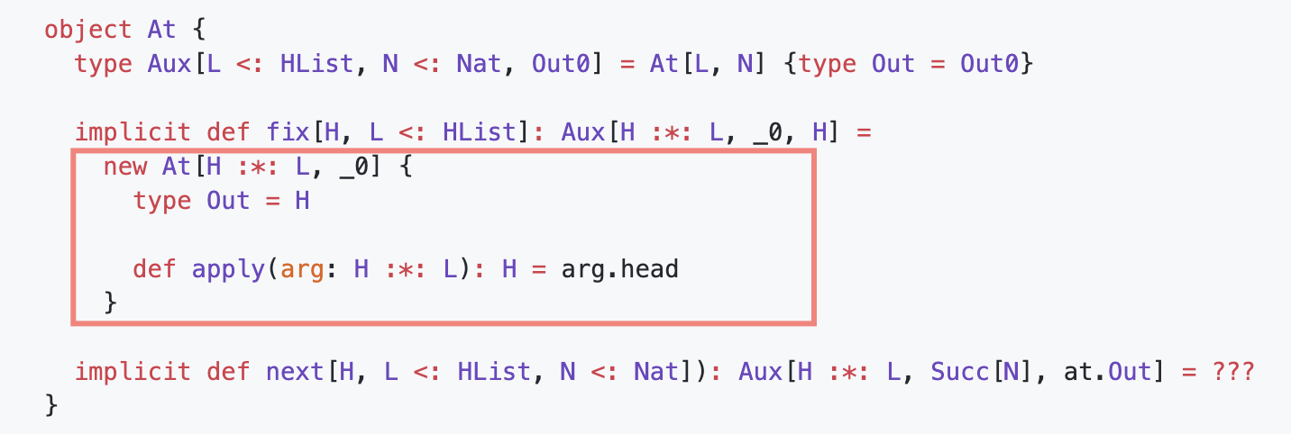
At typeclass

Slide 23
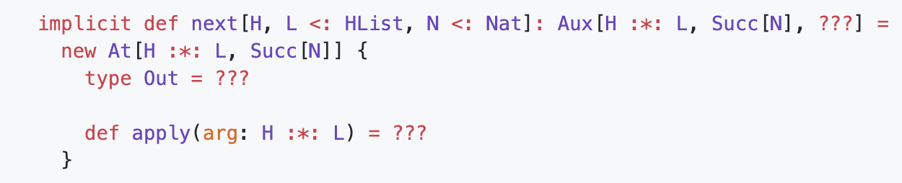
At typeclass

Slide 24
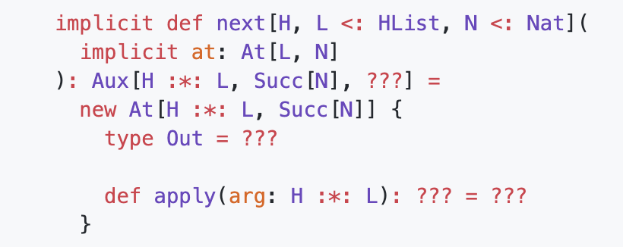
At typeclass

Slide 25
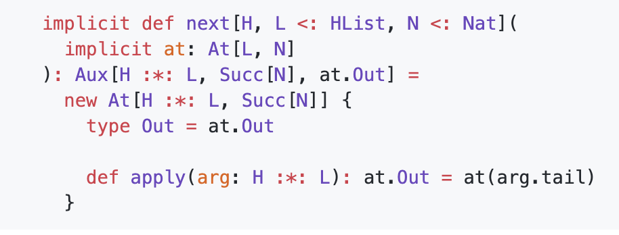
At typeclass

Slide 26
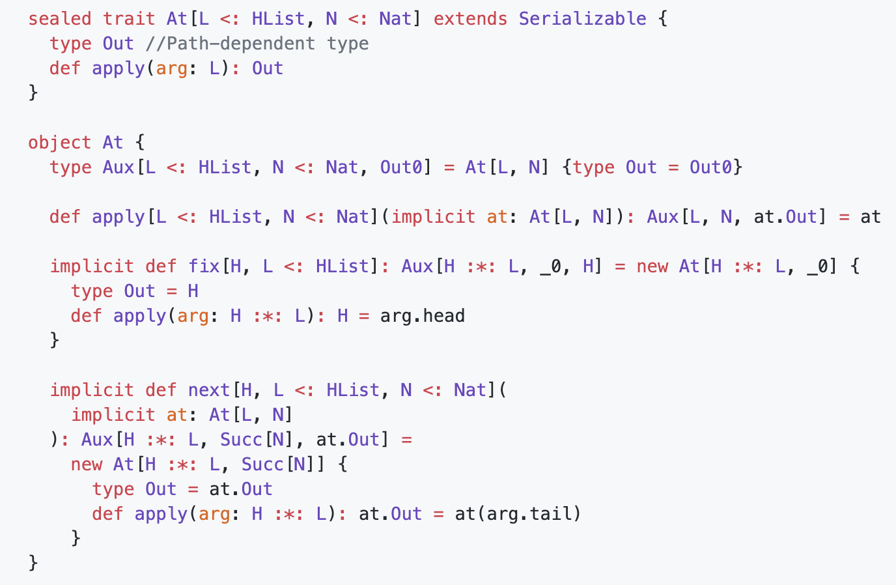
At typeclass

Slide 27
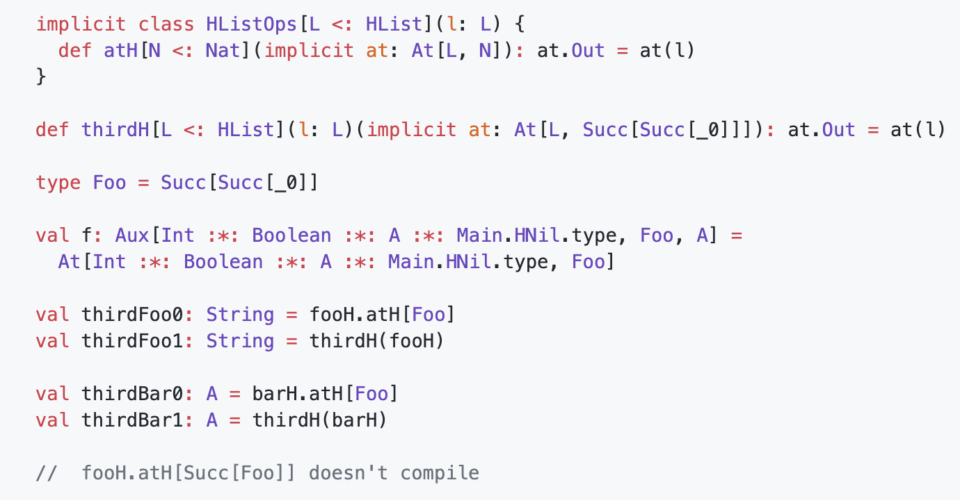
Usage

Slide 28

Thanks!

