Slide 1
An introduction to path dependent types
Aristov Ivan, Raiffeisen Bank 4 march 2020, Rostov-on-Don Special for Lambda61

Slide 2
Agenda
Normal type system
List’s recursion problem
Heterogenous list
Typelevel natural numbers
Solve list’s recursion problem with Hlist and Nat
How compiler works
Showcase, usage cases

Slide 3
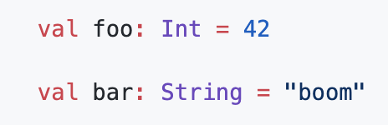
Normal types
Usually type hardwired to a value at compile-type and sometimes at runtime.

Slide 4
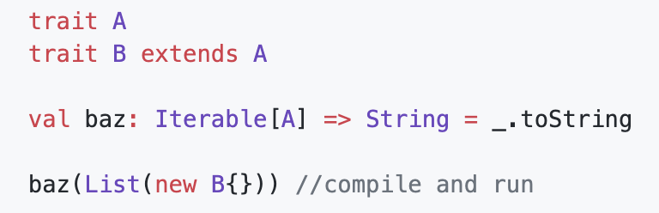
Normal types
Usually type hardwired to a value at compile-type and sometimes at runtime.
Also in the modern PL type systems had a type variance.
So, to typecheck functions compiler check type variance.

Slide 5
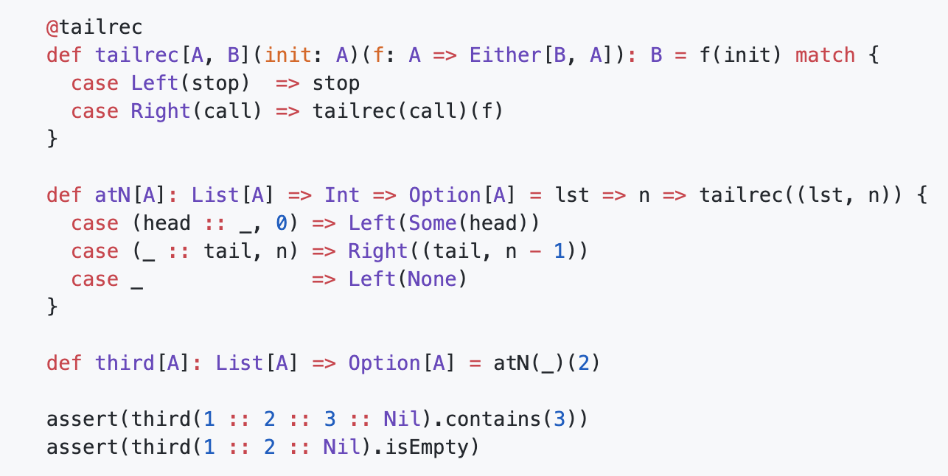
Normal types
For example, you want to retrieve the third element from list…

Slide 6
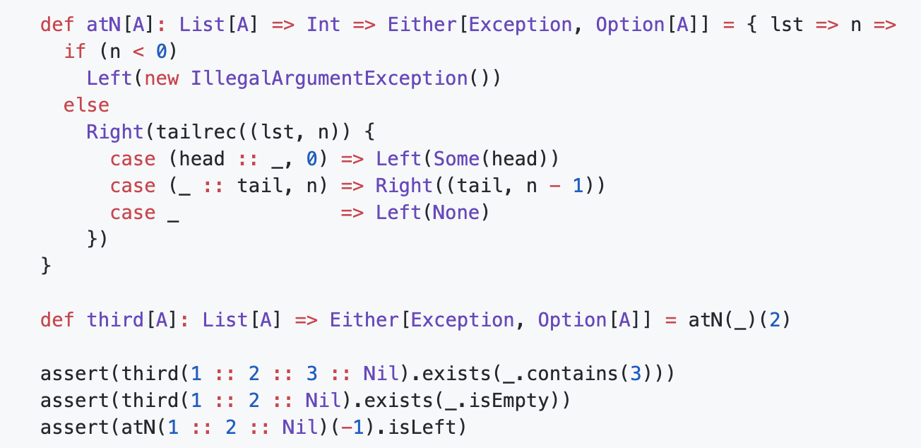
Normal types
“Safe solution”

Slide 7
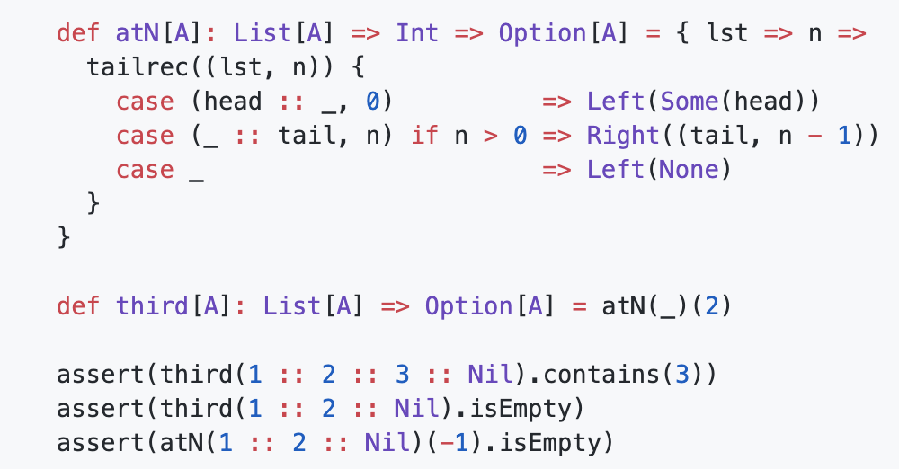
Normal types
Avoid recursion, but leaks check…

Slide 8
Normal types
Problems:
Need to use hand-made functional tail recursive state function

Slide 9
Normal types
Problems:
Need to use hand-made functional tail recursive state function
…Because of foldLeft every time pass over all elements

Slide 10
Normal types
Problems:
Need to use hand-made functional tail recursive state function
…Because of foldLeft every time pass over all elements
...But it also had an overhead

Slide 11
Normal types
Problems:
Need to use hand-made functional tail recursive state function
…Because of foldLeft every time pass over all elements
...But it also had an overhead
Don’t refine int value during the compile-time

Slide 12
Normal types
Problems:
Need to use hand-made functional tail recursive state function
…Because of foldLeft every time pass over all elements
...But it also had an overhead
Don’t refine int value during the compile-time
A lot of unsafe code

Slide 13
Normal types
Problems:
Need to use hand-made functional tail recursive state function
…Because of foldLeft every time pass over all elements
...But it also had an overhead
Don’t refine int value during the compile-time
A lot of unsafe code
Possible infinite recursion…

Slide 14
Heterogenous List
Heterogenous List is a list, where all elements with their type maybe (the most efficient for programmer) are fully-known at compile-time.

Slide 15
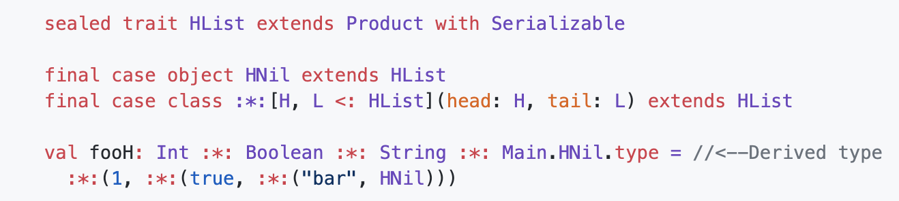
Heterogenous List
Heterogenous List is a list, where all elements with their type maybe (the most efficient for programmer) are fully-known at compile-time.

Slide 16
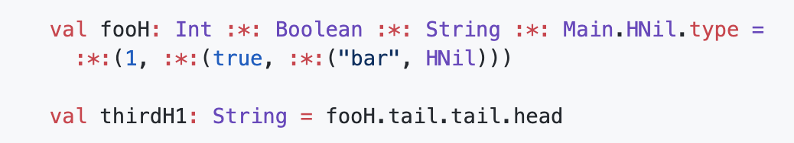
Heterogenous List
Let’s retrieve the third element…

Slide 17
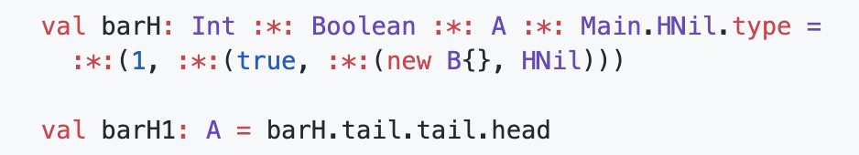
Heterogenous List
Let’s retrieve the third element…But, wait!

Slide 18

Heterogenous List
Let’s retrieve the third element…But, wait!

Slide 19
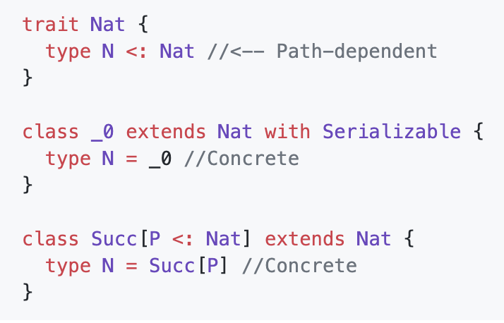
Typelevel Nat

Slide 20
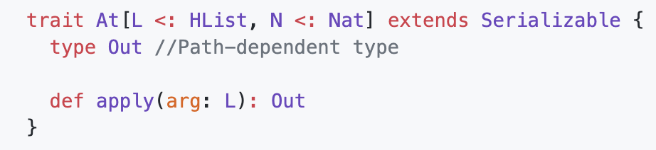
At typeclass

Slide 21
At typeclass
Then we need to define recursion in term of types!

Slide 22
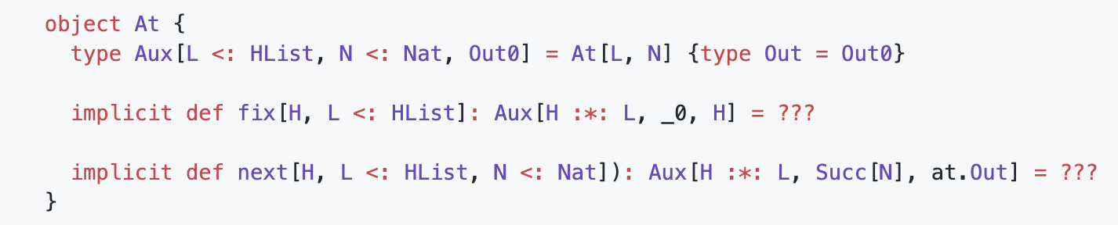
At typeclass

Slide 23
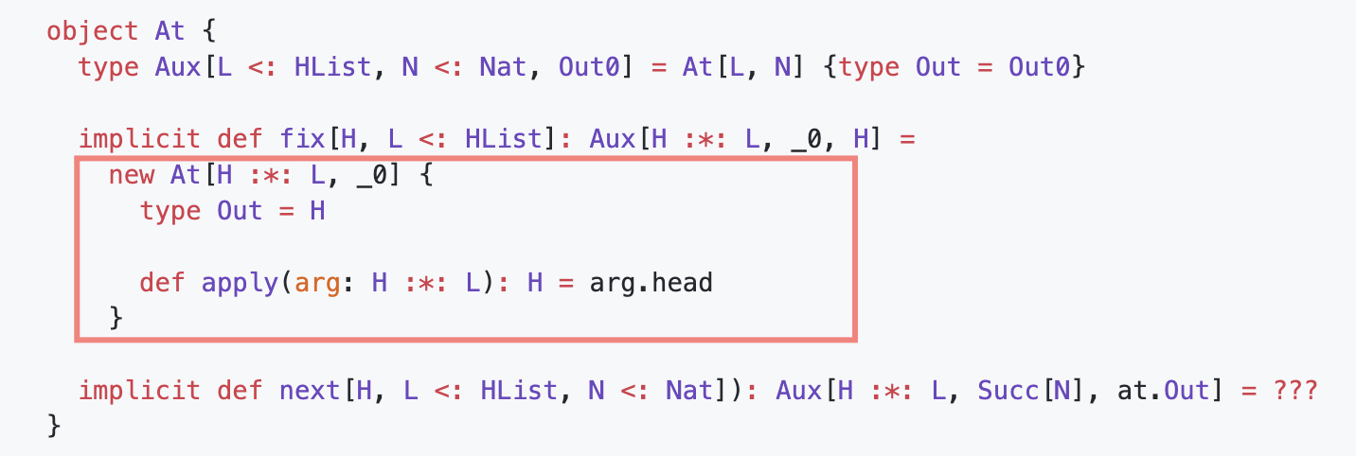
At typeclass

Slide 24
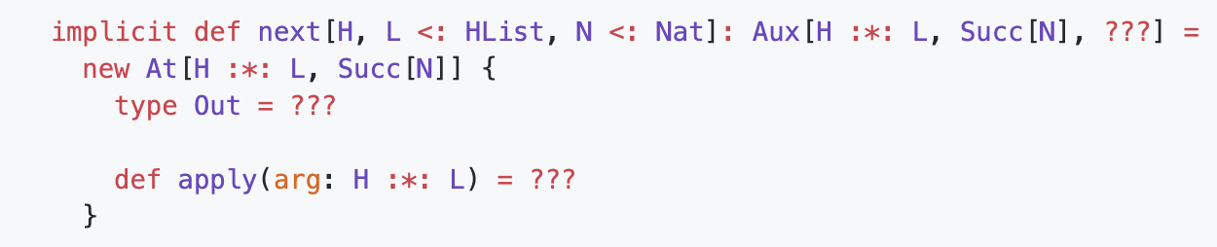
At typeclass

Slide 25
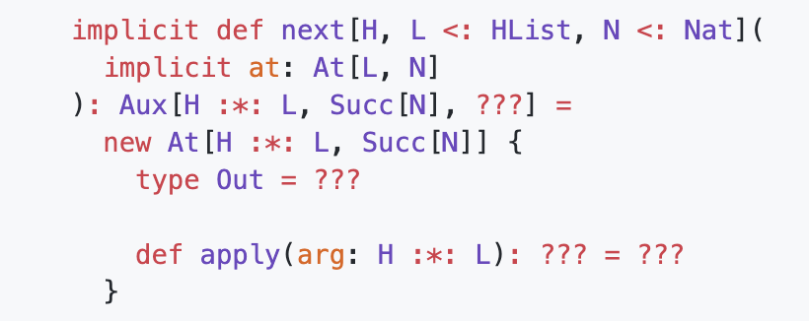
At typeclass

Slide 26
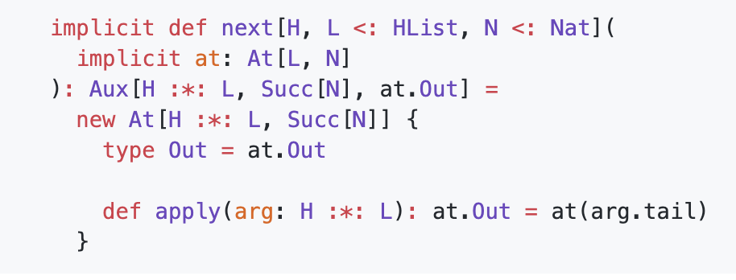
At typeclass

Slide 27
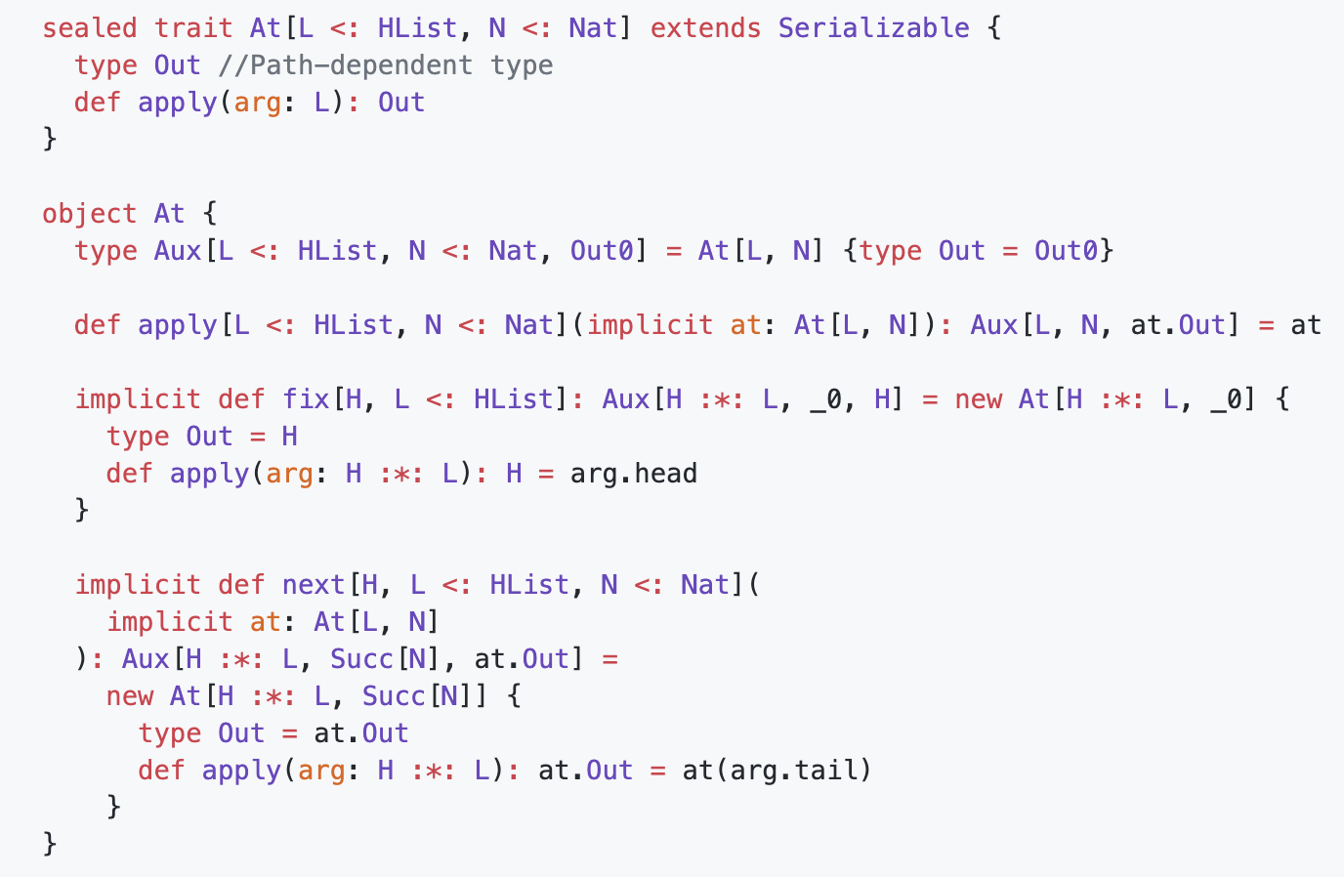
At typeclass

Slide 28
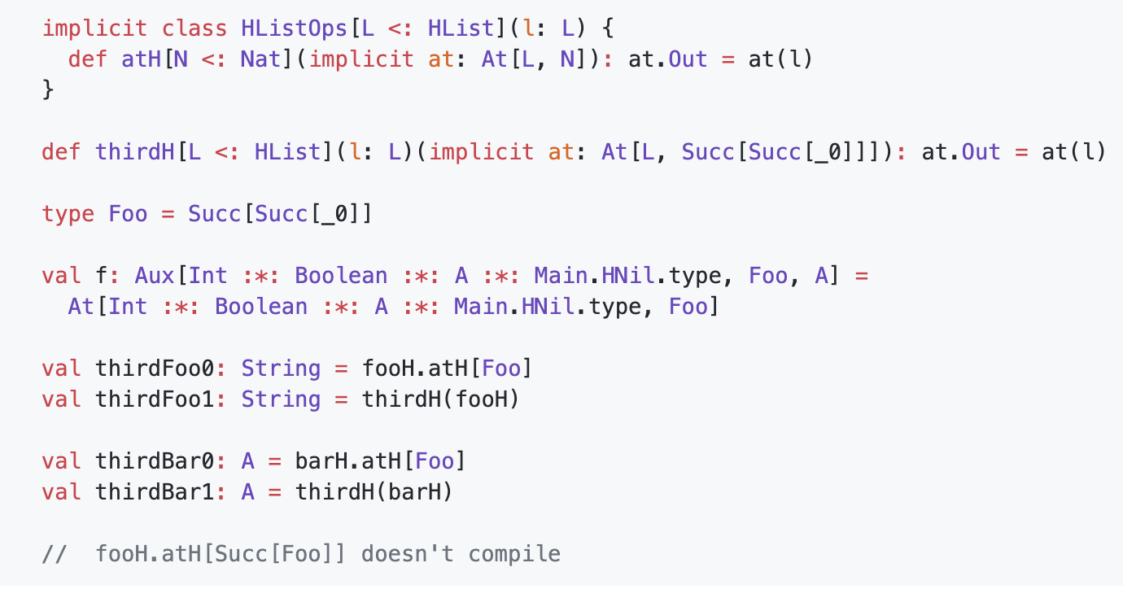
Showcase

Slide 29
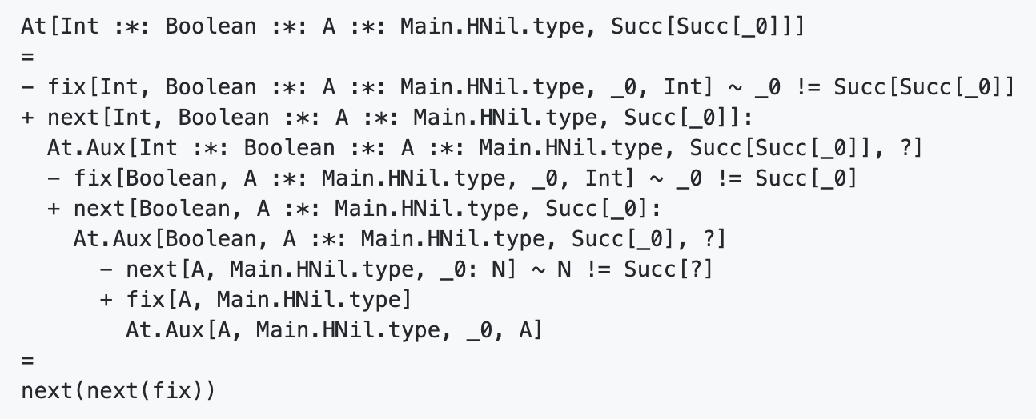
How do it works

Slide 30
Use cases
Derive codecs (as function) to Products, Coproducts
JSON
XML
???
Big state’s extractors instead of optics
Refine types
Deriving DSL
Proof systems
???
Note that all of this is kinda utility code!

Slide 31

Thanks!

