Slide 1
Photons to images
December 17, 2017

Slide 2
Digital imaging pipeline
Photons to electrons
Electrons to voltage conversion
Voltages to gray levels
CCD
ADC
Incident Photon
Released
Electron
Hole
Silicon Atom
CMOS

Slide 3

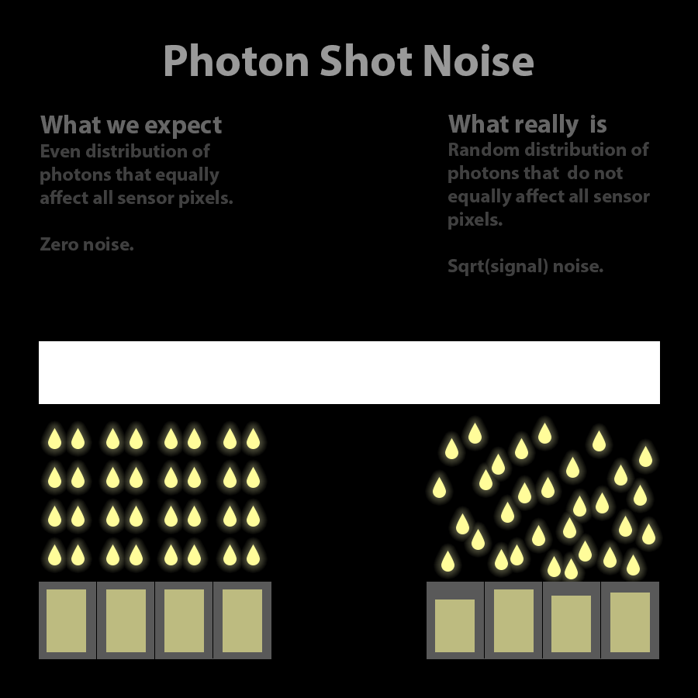

Sources of noise
Photons to electrons
Electrons to voltage conversion
Voltages to gray levels
1. Quantum Efficiency
1. Dark current noise
1. Read noise
$$QE=\frac{\#electrons}{\#photons}$$
Thermally generated
electrons
Thermal noise in
read-out circuitry
2. Photon shot noise
2. Full-well capacity
2. Systematic noise
Fixed-pattern noise
Pixel readout non-uniformity
Hot-pixels
Quantum nature of light
Image saturation
Ignore for now

Slide 4









Per-pixel noise model
scene radiant
power
exposure
time
raw pixel
value
exposure
time
saturation
gain factor
$$Φ$$
$$g=k∗ISO$$
$$t$$
$$I$$
dark current
dark current
$$D$$
photon + dark noise
read noise
ADC noise
$$σ_{s}=\sqrt{(Φ⋅Q_{e}+D)t}$$
$$σ_{read}$$
$$σ_{ADC}$$
linear image formation:
saturation level/full-well
$$I=min⁡(\left(Φ⋅Q_{e}+D\right)t⋅g+n,I_{max})$$
noise

Slide 5

Intensified CCD camera (ICCD): 4 Picos
Name of product: 4 Picos
Highlights:
Gate-time: 200 ps
Single-photon detection
Spectral-sensitivity: UV to NIR
From: Stanford Computer Optics
Example image: Shows that the laser moved approximately $\sim 200 \text{ps}$.

Slide 6

4 picos: Camera specifications
Shutter-time : $200 ps$
Resolution : $1360×1024$
Dynamic-range : $12$ bit
Chip-readout : Dark-current corrected
Pixel-Size $(μm)$ : $4.7×4.7$

