Slide 1
Photons to images
January 3, 2018

Slide 2
Digital imaging pipeline
Photons to electrons
Electrons to voltage conversion
Voltages to gray levels
CCD
ADC
Incident Photon
Released
Electron
Hole
Silicon Atom
CMOS

Slide 3

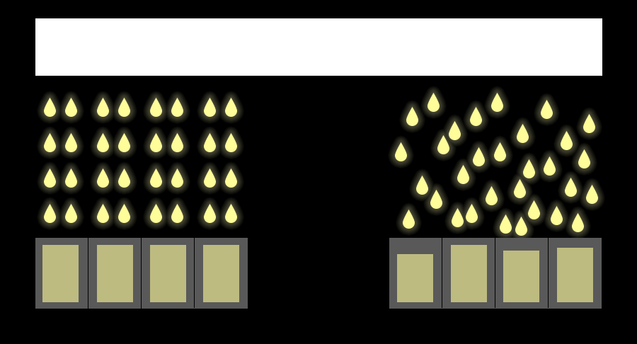

Sources of noise
Photons
Read-noise
Full-well
Dark-current
Photons to electrons
Electrons to voltage conversion
Voltages to gray levels
1. Dark current noise
1. Read noise
1. Photon shot noise
Expectation
Reality
Thermally generated
electrons
Thermal noise in
read-out circuitry
Quantum nature of light
2. Quantum Efficiency
2. Full-well capacity
2. Systematic noise
Fixed-pattern noise
Pixel readout non-uniformity
Hot-pixels
$$QE=\frac{\#electrons}{\#photons}$$
Image saturation
Ignore for now

Slide 4







Per-pixel noise model
Scene radiant power
Exposure time
Saturation
Gain factor
Raw pixel
value
$$Φ$$
$$t$$
$$g=k∗ISO$$
$$I$$
Dark current
$$D$$
Photon + Dark noise
Read noise
$$Poisson(\left(Φ⋅Q_{e}+D\right)t)$$
$$σ_{read}$$
Quantization
linear image formation:
Saturation level/Full-well
$$I=min⁡(g∗(Poisson(\left(Φ⋅Q_{e}+D\right)t)+n),I_{max})$$
Gain
Noise (Read)

Slide 5

Intensified CCD camera (ICCD): 4 Picos
Single-photon sensitivity
Stanford Computer Optics
Temporal Resolution: 200 ps
Example image: Shows that the laser moved approximately $\sim 200 \text{ps}$.

Slide 6


Intensified CCD camera (ICCD): 4 Picos
Intensifier
CCD
Input window
Photons
Stanford Computer Optics
Output window
Photocathode
Phosphor
Multi-channel
Plate (MCP)
Photocathode: $50\%$ (peak)
MCP : $1000×$ electron multiplication
Phosphor : $180$ photons per electron
High-dynamic range : $12$ bits
High TE cooling ($−40°C$): Low-dark current

Slide 7




Intensifier specification
CCD specification
Resolution : $1360×1024$
Dynamic-range : $12$ bit
Pixel-Size $(μm)$ : $4.7×4.7$
Quantum-efficiency : $50 \%$
MCP (amplification) : $1000×$
Phosphor-efficiency : $180$ photons per
electron
Quantum-efficiency : $40 \%$
Dark-current : $0.2\frac{electrons}{pix}/sec$
Read-noise : $7 electrons$
Full-well : $500,000 e^{−}$
Quantization-bits : $12$ bits
Dark-current : $0.2\frac{electrons}{pix}/sec$

Slide 8
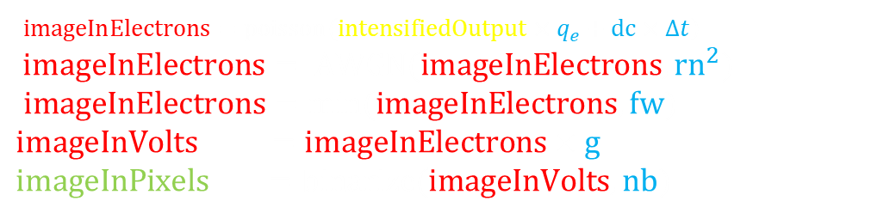













Pseudocode: Forward-model
[$outputImage$] = ScatteringMedium ($PSF,reflectivity$)
$PSF$ : 2D-Point-spread function in $\frac{photons}{unit−time}$
$reflectivity$ : Scene-reflectivity in $[0,1]$
[$imagePixels$] = CCDSensor ($intensifiedOutput,x$)
$intensifiedOutput$ : Intensified output-image in $\frac{photons}{unit−time}$
$outputImage$: Output-image in $\frac{photons}{unit−time}$
$outputImage$ : Output-image in $\frac{photons}{unit−time}$
$outputImage =$imfilter$\left(PSF,Reflectivity,^{′}{same}^{′}\right)$;
$q_{e}$ : $0.4$ (Quantum-efficiency of sensor in $\frac{electrons}{photons}$)
$dc$ : $0. 2$ (Dark-current in $\frac{\frac{electrons}{pixel}}{second}$)
$rn$ : $7$ (Read-noise in $\frac{electrons}{pixel}$)
[$intensifiedOutput$] = ICCDIntensifier ($outputImage$)
$fw$ : $500,000$ (Full-well capacity in $\frac{electrons}{pixel}$)
outputImage : Image incident on intensifier in $\frac{photons}{unit−time}$
$g$ : $x$ (Gain-factor decided by which image saturates)
$nb$ : $12$ (Number of bits in $bits$)
intensifiedOutput: Intensified output-image in $\frac{photons}{unit−time}$
$imageInElectrons=poisson\left(intensifiedOutput×q_{e}+dc×Δt\right)$
$$imageInElectrons= AWGN(imageInElectrons,{rn}^{2})$$
$imageInElectrons=min(imageInElectrons,fw)$
$imageInVolts =imageInElectrons×g$
$imageInPixels =binarize(imageInVolts,nb)$
$q_{e}$ : $0.5$ (Quantum-efficiency of intensifier in $\frac{electrons}{photons}$)
$dc$ : $0. 2$ (Dark-current in $\frac{\frac{electrons}{pixel}}{second}$)
$mcp$ : $1000$ (Amplification of $electrons$)
$pe$ : $180$ (Phosphor-screen efficiency in $\frac{photons}{electrons}$)
$intensifiedOutput =$ $poisson\left(outputImage×q_{e}+dc×Δt\right)×mcp×pe$

Slide 9
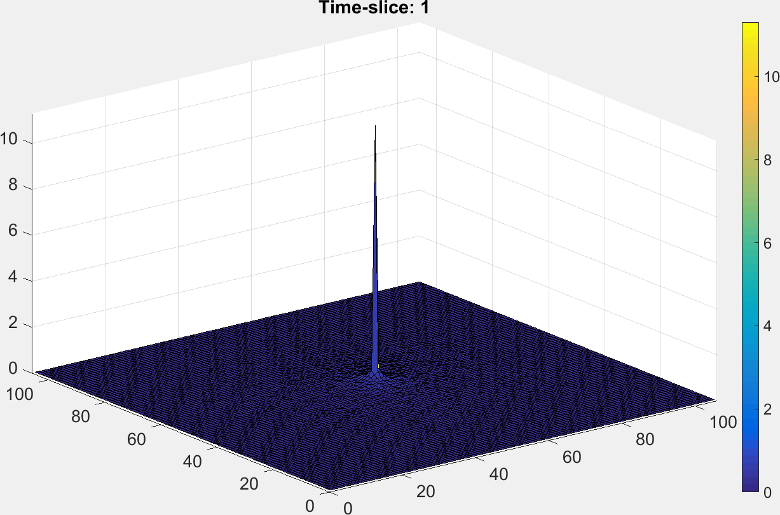
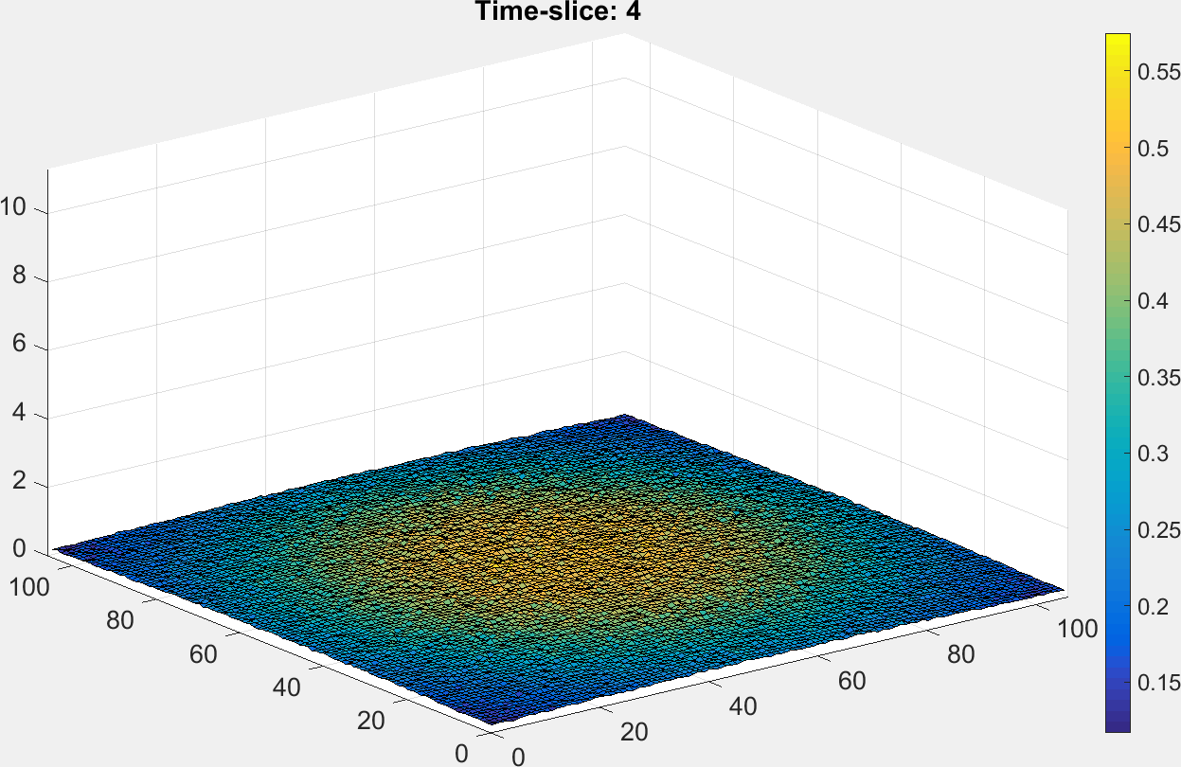
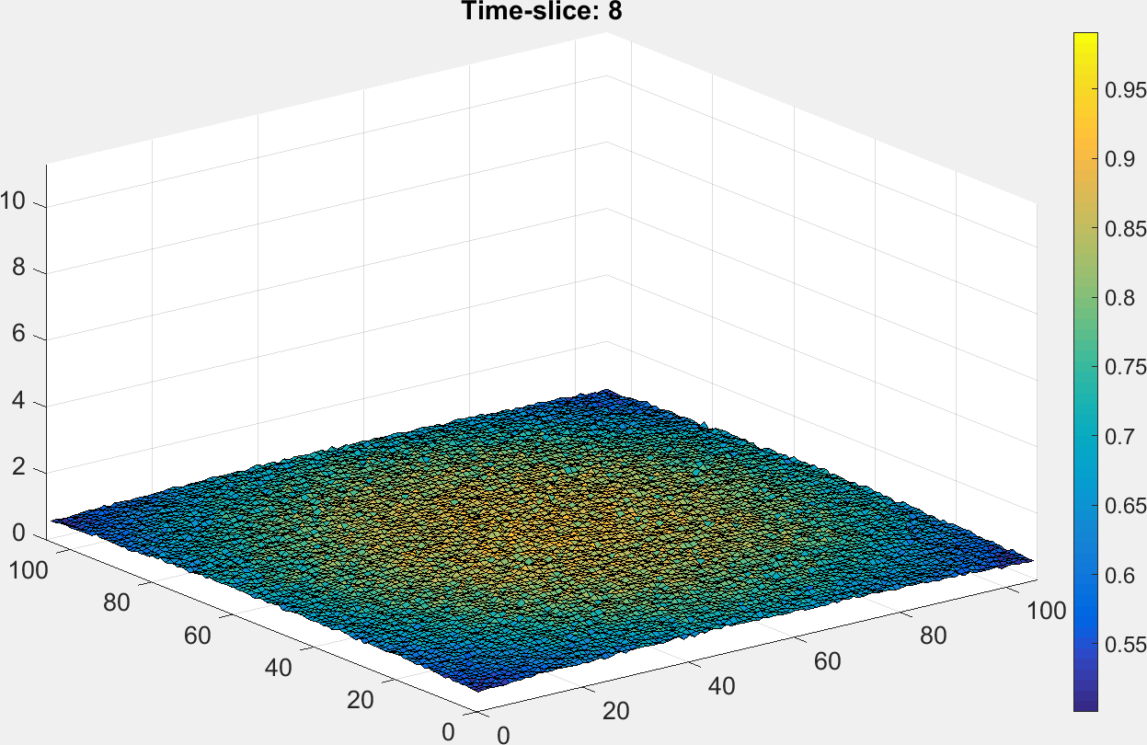
Example forward-model

Slide 10
Example forward-model: Output-image in pixels
Output-slice: 1
Output-slice: 6
Output-slice: 10
Output-slice: 20
(Saturated)

Slide 11
More examples
3D-PSF1
3D-PSF2
3D-PSF3

Slide 12
More examples
3D-PSF1
3D-PSF2
3D-PSF3

Slide 13
More examples
Output-
slice: 1
Output-
slice: 6
Output-
slice: 10
Output-
slice: 20

