Slide 1
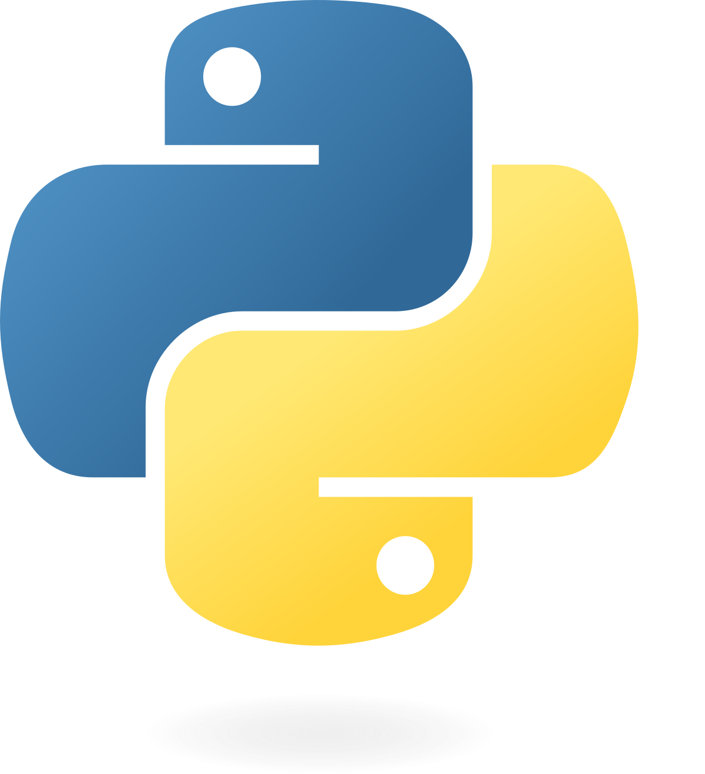
P.O.O.P COURSE
OBJECT ORIENTED PROGRAMMING

Slide 2
WHAT ACTUALLY IS THAT??

Slide 3
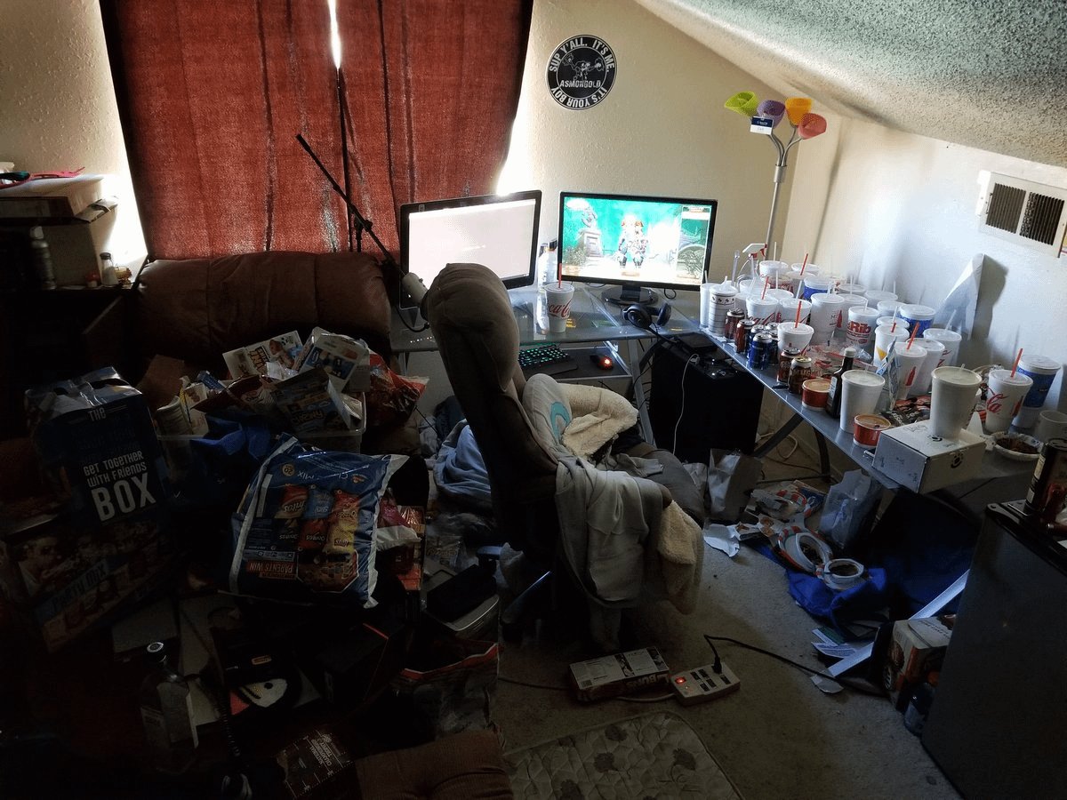

Slide 4
object : A "bundle" of related attributes Ex. phone, cup, book. (variables) and methods (functions) that you need a "class" to create many objects
class : (blueprint) used to design the structure and layout of an object

Slide 5
1. MODEL
Variables
2. OS?
3. OLED?
4. Can It Cure My Depression?

Slide 6
1. Turn ON Phone
Functions
2. Turn OFF Phone
3. Receive Call
4. Make Text

Slide 7
Almost everything in Python is an object, with its variables and methods. A Class is like an object constructor, or a "blueprint" for creating or describing an object.

Slide 8
TOPICS
1. Variable, Method,
Class, and Object
2. Inheritance
3. Encapsulation
4. Setter and Getter

Slide 9
1. Sit Back🪑
2. Grab a
Drink☕
3. Enjoy😁

