Slide 1

Beyond the Numbers: Enhancing Stock Price Prediction with Neural Networks
Neural Networks and Deep Learning Course Project
Presented By: Aiden McLean, Suraj, Lei Wang

Slide 2
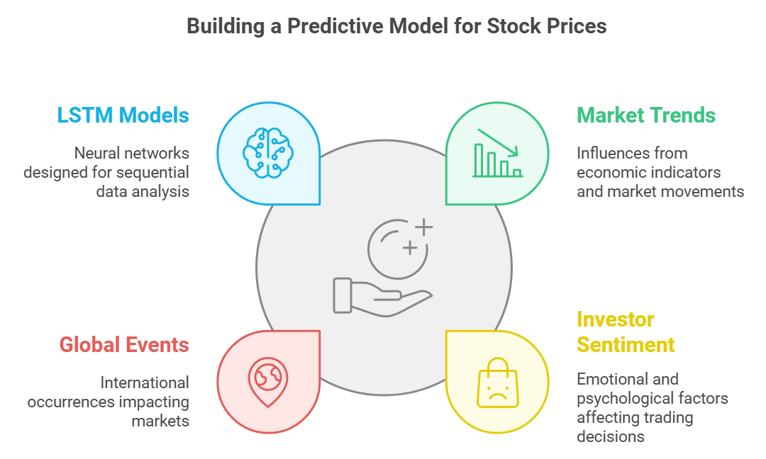
Introduction to Stock Price Prediction
Objective: Use neural networks to predict stock price trends effectively.
Problems:
Stock price movements are highly dynamic and influenced by a range of factors.
Standard models often fail to capture complexities like volatility and external market influences.
Approach:
Experiment with LSTM models for temporal pattern recognition.
Introduce additional features (e.g., sentiment) to enhance predictions.
Notes:
Let’s start by looking at the foundation of our project—predicting stock prices using neural networks.
Our objective was to leverage neural networks, specifically LSTM models, to predict stock price trends effectively.
The problem statement highlights two main challenges:
Stock price movements are highly dynamic and influenced by a variety of factors like market trends, investor sentiment, and global events.
Standard models often fail to capture the complexities introduced by volatility and external market influences.
To tackle this, our approach included:
Experimenting with LSTM models to capture temporal patterns in stock data.
Introducing additional features, such as sentiment analysis, to enhance predictions.
As shown in the diagram, building a predictive model for stock prices requires understanding key factors:
LSTM Models for sequential data analysis.
Market Trends, which reflect economic indicators and market movements.
Global Events, such as geopolitical occurrences that impact markets.
Investor Sentiment, capturing the emotional and psychological factors affecting trading decisions.
These components formed the backbone of our project, and we’ll explore how we approached each in the following slides.

Slide 3
LSTM Model Architecture
Why LSTM?
Designed to process sequential data, making it ideal for time-series prediction.
Can model dependencies across long time horizons.
Model Structure:
Input sequences created from historical stock data.
Architecture:
LSTM Layers to extract patterns over time.
Dropout for regularization.
Fully connected layer for final output.
Training Process:
Loss Function:
Mean Squared Error (MSE).
Optimizer: Adam, to dynamically adjust learning rates.
Notes:
First, why LSTM? LSTMs are specifically designed to handle sequential data, which makes them ideal for time-series prediction tasks like stock price forecasting. They excel at modeling dependencies across long time horizons, which is essential when analyzing trends in historical stock prices.
Now, let’s look at the model structure. We used input sequences created from historical stock data, feeding them into LSTM layers to extract temporal patterns. To prevent overfitting, we incorporated dropout layers. The final output comes from a fully connected dense layer.
For training, we used Mean Squared Error as the loss function to minimize prediction errors and Adam as the optimizer, which dynamically adjusts learning rates for faster convergence.
This setup formed the foundation for our stock price prediction model, which we refined further through experimentation.

Slide 4
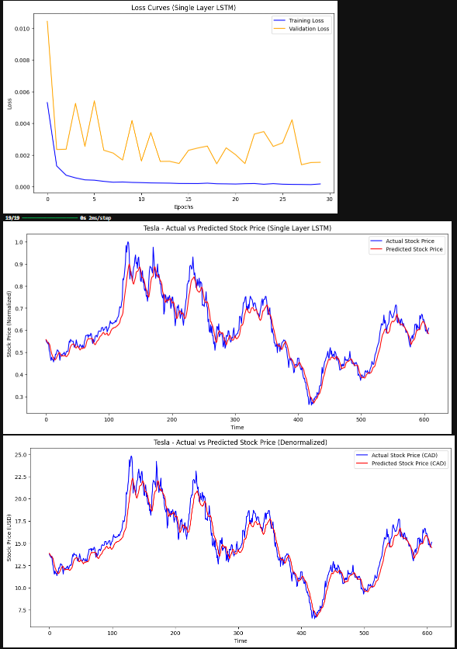
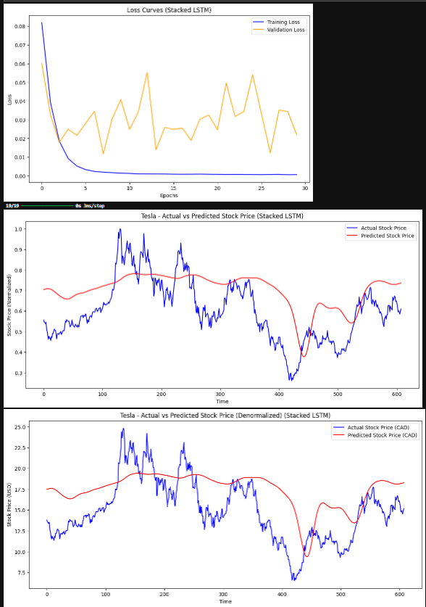
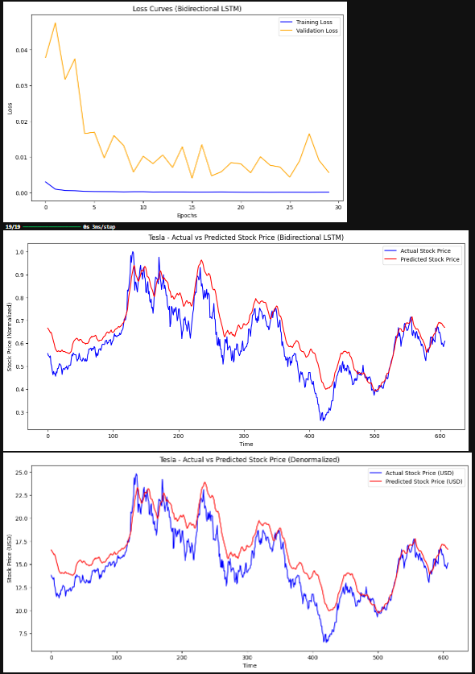
Results and Challenges
Notes:
This slide provides a detailed view of the performance and challenges faced with our LSTM models.
At the top, you can see the loss curves for the single-layer, stacked, and bidirectional LSTMs. While the training loss decreased consistently, the validation loss fluctuated, especially in the stacked and bidirectional models, suggesting potential overfitting or noise in the data.
Below, we have actual vs. predicted stock prices for each model. The single-layer LSTM performed reasonably well in capturing trends but struggled with sharp fluctuations. The stacked and bidirectional models, while more complex, introduced higher variance in predictions, as seen by the divergence between the red and blue lines.
Finally, when we denormalized the predictions, the results revealed that these models were not sufficiently robust for high-volatility scenarios. This highlighted the need to refine our approach and explore additional features, which led us to incorporate sentiment analysis. Let’s look at that next

Slide 5
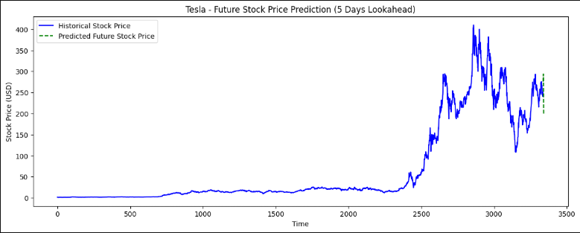
Challenges Continued
Notes:
This chart highlights one of the key challenges we faced during our initial modeling phase with LSTMs. The solid blue line represents the historical stock prices, while the dashed green line shows our model's predicted prices for a 5-day lookahead.
Although the model captures general trends reasonably well, it struggles with sharp fluctuations and high-volatility periods, as seen in this example. This lag in predictions indicates that the model relies heavily on historical data patterns and doesn’t account for external factors that could drive sudden changes.
To address these limitations, we began exploring additional features, such as sentiment analysis, to incorporate more context into the model and improve predictive performance. Let’s take a closer look at that next.

Slide 6
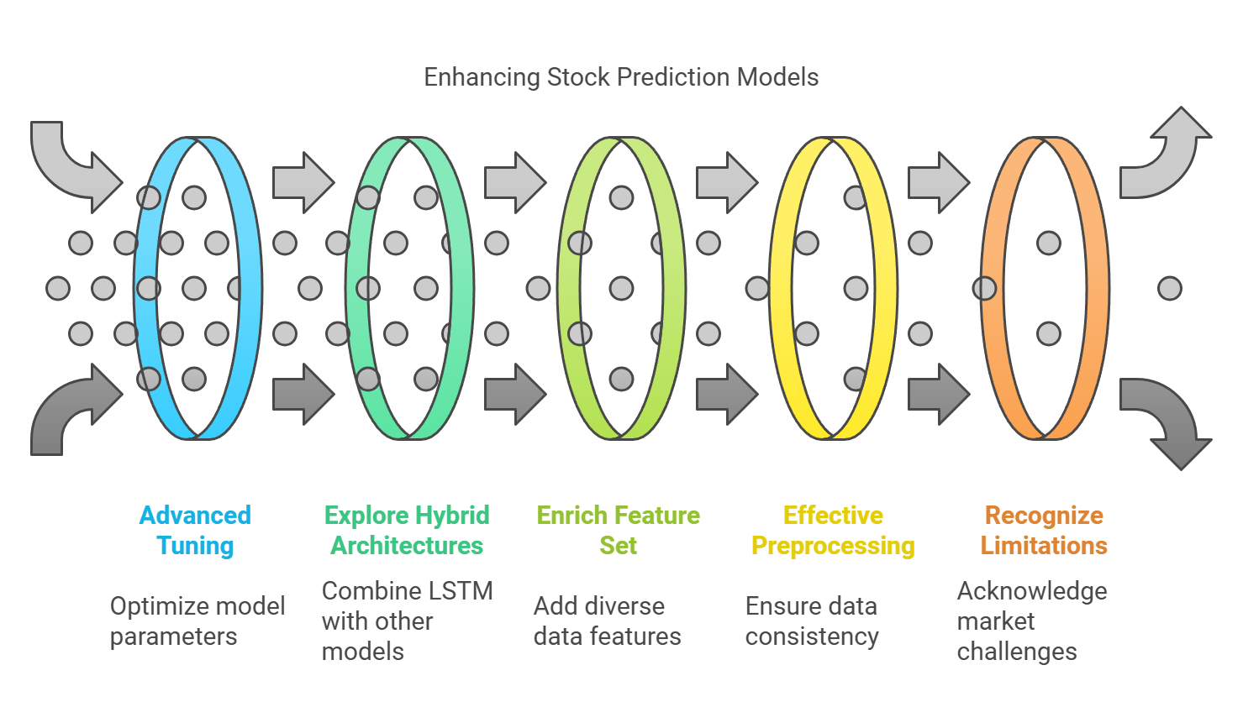
Key Insights
Notes:
Walking Through the Insights
Advanced Tuning
“First, we found that fine-tuning hyperparameters—like learning rates, dropout rates, and batch sizes—played a crucial role in optimizing the LSTM’s performance under diverse market conditions.”
Explore Hybrid Architectures
“Next, exploring hybrid architectures, such as combining LSTMs with CNNs or attention-based models, could allow us to capture both temporal dependencies and more complex relationships within stock data.”
Enrich Feature Set
“One of the most important takeaways was that feature engineering is critical. To make the models more robust, we explored integrating additional data sources, such as economic indicators, trading volume, and sentiment analysis.”
Effective Preprocessing
“Preprocessing is just as vital, as consistent data scaling and alignment, using techniques like MinMaxScaler, ensured input stability and helped the model train effectively.”
Recognize Limitations
“Lastly, it’s important to recognize the challenges of relying solely on historical price data. Volatile markets and external events—factors often outside the scope of traditional models—make it clear that we need to go beyond patterns in historical prices.”
“These challenges pushed us to explore ways to bring external factors into the model. This is where sentiment analysis came into play. By looking at how public sentiment—like Elon Musk’s tweets—might influence stock prices, we aimed to enhance the predictive power of our models. Let’s take a look at how we approached this next step.”

Slide 7
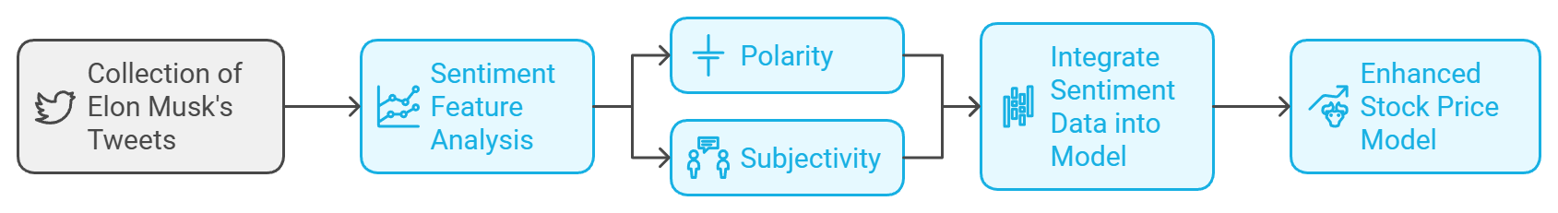
Introduction to Sentiment Analysis
Hypothesis:
Public sentiment, especially from influential figures like Elon
Musk, impacts stock prices (e.g., Tesla).
Sentiment Sources:
Kaggle dataset of Elon Musk’s tweets.
Sentiment features:
Polarity: Positive, neutral, or negative orientation.
Subjectivity: Degree of opinion-based content.
Objective:
Enhance the stock price model by adding sentiment data as features.

Slide 8
Integrating Sentiment Analysis into Stock Price Prediction
Objective:
Extracted polarity (sentiment direction) and subjectivity (opinion intensity) as features.
Combined sentiment data with Tesla stock prices for model training and evaluation.
Musk's tweets, due to his influence as Tesla's CEO, could impact Tesla's stock prices.
Improve the predictive performance of LSTM models by incorporating sentiment analysis from Elon Musk's tweets.
Hypothesis:
Approach:

Slide 9
Sentiment Analysis and Data Preparation
Data Sources::
Tesla Stock Prices: Downloaded via Yahoo Finance API (2010–2023).
Sentiment Analysis:
Polarity: Ranges from -1 (negative) to +1 (positive).
Daily Aggregation:
For multiple tweets per day, select the one with the highest absolute polarity score to represent that day's sentiment.
Preprocessing Challenges:
Tesla's stock data and Musk's tweets covered different date ranges.
Excluded data before December 2011 due to Musk's infrequent tweeting.
Elon Musk's Tweets: Dataset from Kaggle containing tweets from 2010 to 2023.
Used TextBlob to calculate:
Subjectivity: Ranges from 0 (objective) to 1 (subjective).
Filled gaps using linearinterpolation, forward-fill, and backward-fill.
Missing Sentiment Data:

Slide 10
Challenges and Solutions
Date Range Mismatch:
Many tweets were unrelated to Tesla, introducing irrelevant sentiment signals.
Preprocessing steps reduced noise but could not fully address this issue.
Musk's early tweets were in requent, leading to missing sentiment data.
Reduce Tweet Data:
Noise in Sentiment Data:
Filtered both datasets to align their overlapping periods
Excluded periods with insufficient tweets and used interpolation methods to fill gaps

Slide 11
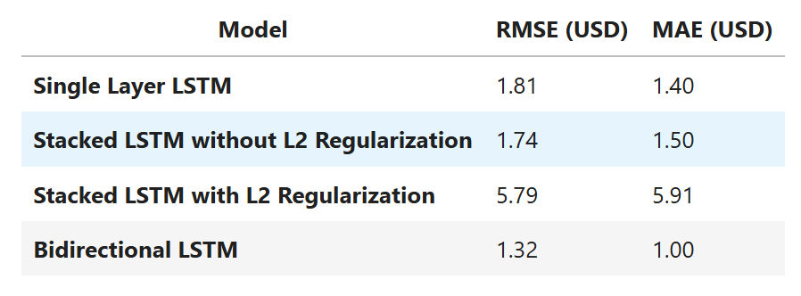
Results and Limitations
Model Performance with Sentiment Analysis:
Sentiment Analysis:
Polarity: Ranges from -1 (negative) to +1
Key Observations:
Adding sentiment features worsened RMSE and MAE for most models.
Models struggled to establish meaningful correlations between sentiment and stock price movements.
Used TextBlob to calculate:
Subjectivity: Ranges from 0 (objective) to 1 (sub

Slide 12
Key Insights and Future Work
Insights
Broaden sentiment analysis to include global news and financial reports.
Future work:
No strong correlation between Musk's tweet sentiment and Tesla stock prices
Use advanced NLP techniques (e.g., topic modeling) to isolate Tesla-related tweets
Sentiment data added noise, likely influenced by external market factors
Although sentiment analysis added a new dimension, it did not improve the model's performance.

Slide 13
Transition to Predicting Buy-Sell Signals
Rationale:
Stock price movements are noisy; actionable signals (buy/sell) may be easier to predict.
Technical Indicators Added:
EMA (Fast, Medium), RSI, MACD, ATR, Bollinger Bands, VWAP.
Signal Definition:
Buy Signal: Triggered by oversold conditions (e.g., RSI thresholds).
Sell Signal: Triggered by overbought conditions or trend reversals.
Data Challenges:
Severe class imbalance (fewer buy/sell signals than no-signal instances).
Integration of multiple timeframes (daily and 5-minute data).

Slide 14
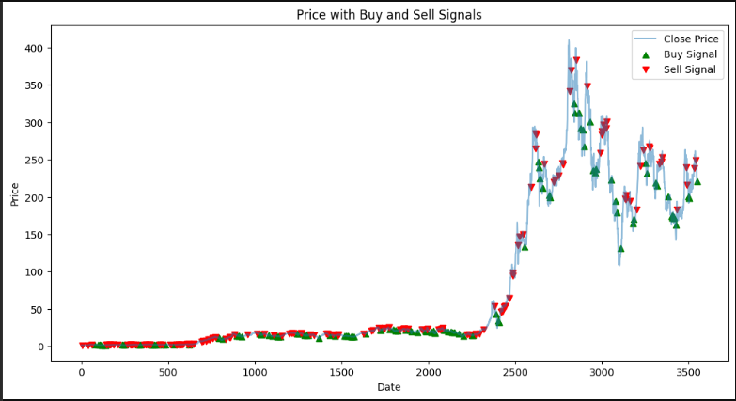
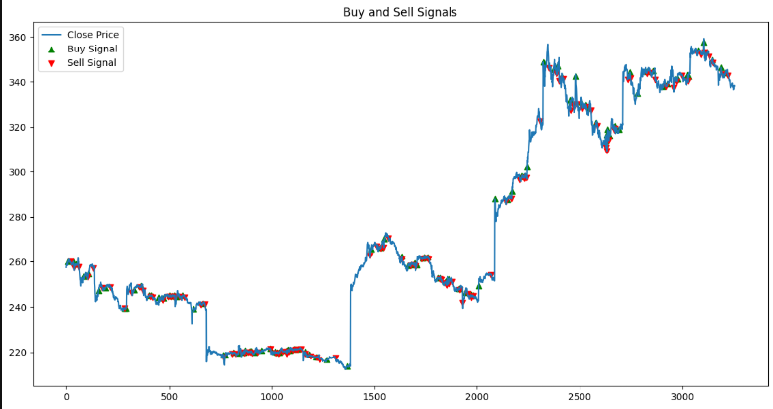
Visualizing

Slide 15
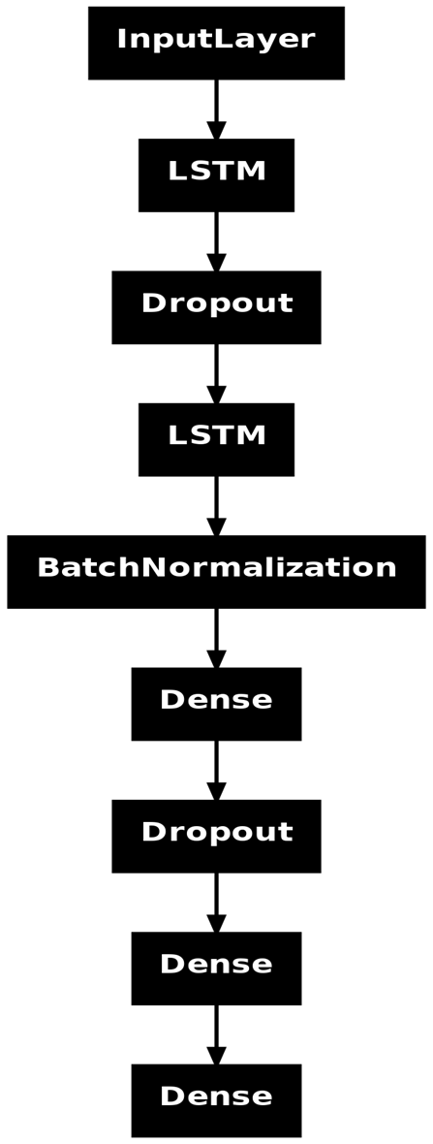

Initial Modeling with Buy-Sell Signals
Approach:
Combined stock price and indicator datasets.
LSTM model with fully connected dense layers to predict signals.
Results:
Low accuracy for both training and validation sets.
Fluctuating validation loss indicates instability and underfitting.
Issues:
Class imbalance caused the model to prioritize the majority (no signal) class.
The complexity of patterns in stock data overwhelmed the simple model structure.

Slide 16
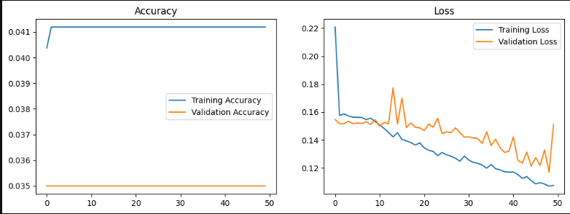
Results

Slide 17
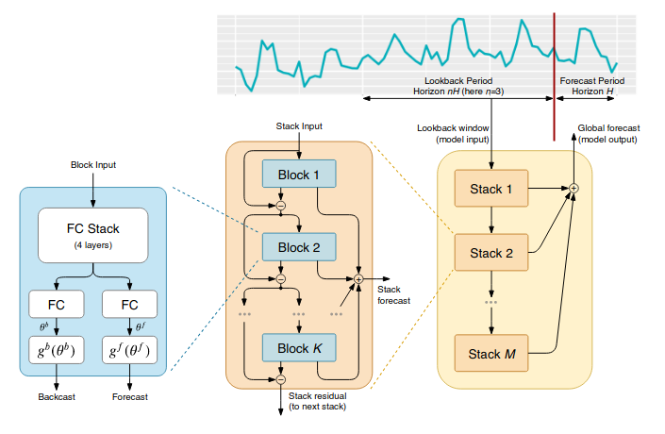
Exploring Advanced Models: N-BEATS
Why Neural Basis Expansion Analysis for Time Series ?
Designed for time series forecasting.
Models trend and seasonality components using fully connected neural networks.
Key Features:
Stack-based architecture for flexible, data-driven pattern learning.
Suitable for multivariate time series without extensive preprocessing.
Implementation Challenges:
High computational requirements for training.
Limited resources forced a halt in experimentation.

Slide 18
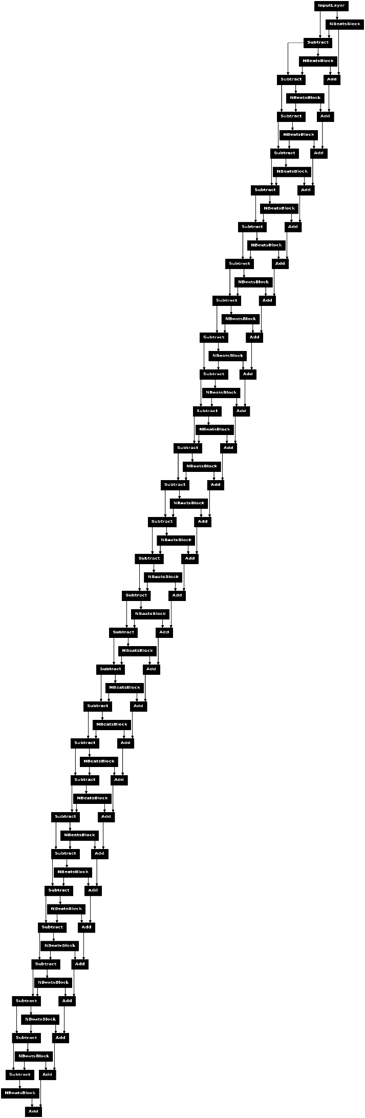
Results of Advanced Modeling
Key Observations:
N-BEATS demonstrated potential for better generalization.
However, severe class imbalance and noisy features limited performance.
Computational limitations prevented full exploration of the model.
Lessons Learned:
Advanced models need substantial resources for effective training.
Signal prediction shows promise but requires robust dataset balancing.

Slide 19
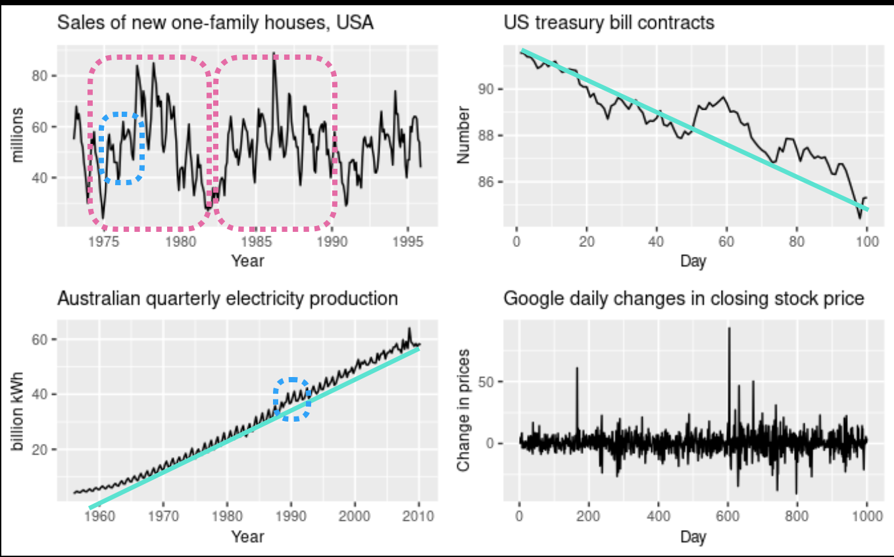
Why? This Happened

Slide 20

Summary of Project Stages
Stage 1
Initial LSTM modeling for price prediction.
Focused on historical data.
Foundational insights but lacked robustness.
Stage 2
Integration of sentiment analysis.
Added a new dimension but didn’t improve prediction accuracy.
Stage 3
Advanced modeling and signal prediction.
Shifted to buy/sell signals with technical indicators.
Explored N-BEATS but faced computational constraints.

Slide 21

Key Challenges and Insights
Challenges:
Volatility and noise in financial data.
Class imbalance in signal datasets.
Resource-intensive nature of advanced models.
Insights:
Feature engineering significantly impacts model performance.
Transitioning from price prediction to signal prediction is promising.
Combining multiple data sources improves understanding but requires careful integration.

Slide 22
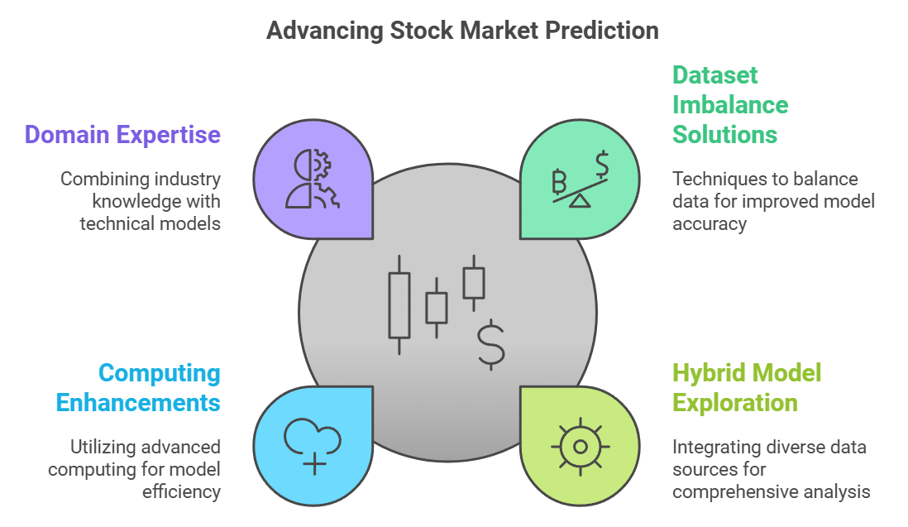
Future Directions
Next Steps:
Address dataset imbalance with oversampling or synthetic data.
Explore hybrid models integrating sentiment, technical indicators, and macroeconomic data.
Leverage cloud-based or distributed computing for advanced models.
Long-Term Vision:
Develop a robust, scalable system for actionable stock market insights.
Combine deep learning with domain-specific expertise for better results.

Slide 23

“Sometimes Not Knowing the future is a benefit. A known future is already the past.”

