Slide 1
Wavelet-based clustering of time series
Kathy Norman, Ssurey Moon, Felix Huang, Josue Kuri

Slide 2
Presentation outline
Time series clustering
Wavelet transformation
Wavelet-based feature extraction
Experimental evaluation
Conclusions

Slide 3
Time series clustering
Time series: sequence of data points indexed by time.
Clustering: Exploratory technique to understand underlying patterns.
Dimensionality reduction.
Feature selection vs feature extraction.
Feature extraction: SVD, DFT, DWT

Slide 4
Wavelet transformation
A time-frequency transformation technique for hierarchical decomposition of signals.
Initially developed for seismic signal analysis.
Decomposition of a signal into:
An approximation of the original signal
Coefficients for increasing levels of detail
Reconstruction
Exact original or approximate depending on number of coefficients used.

Slide 5
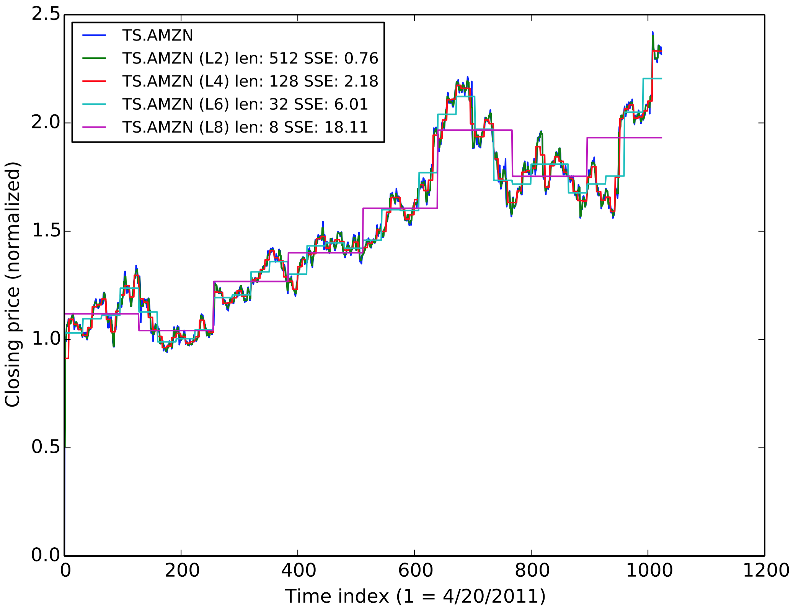
Reconstruction of time series

Slide 6
Wavelet-based feature extraction
Each time series has 1024 elements
For a given level of decomposition r, a discrete wavelet transformation generates:
An A vector of approximation coefficients
r D vectors of detail coefficients
Example: For r=2
An A vector of length 256
A first D₂ vector of length 256
A second D₁ vector of length 512
We use [A,D₂] as the feature vector for the time series

Slide 7
Experimental evaluation
Data sets
Closing stock prices
Currency exchange rates
Earthquake data
Algorithms
Mini-Batch K-Means
Affinity Propagation
Spectral Clustering
Ward
Agglomerative Clustering
Birch
DBSCAN
Evaluation
Silhouette coefficient

Slide 8
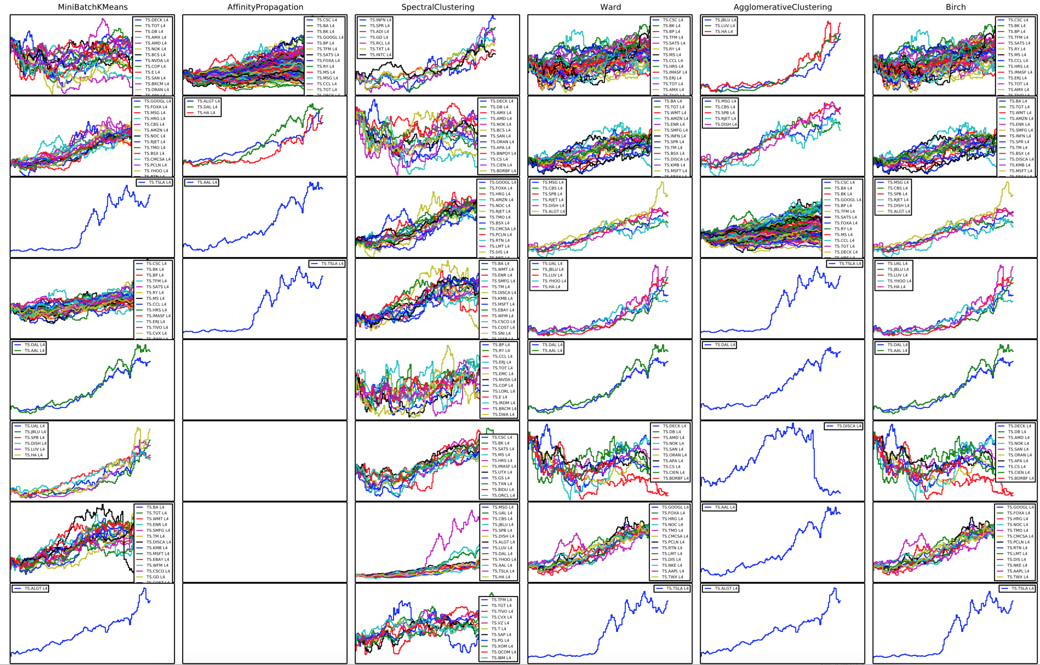
Clustering of stock prices

Slide 9
Conclusions

