Slide 1
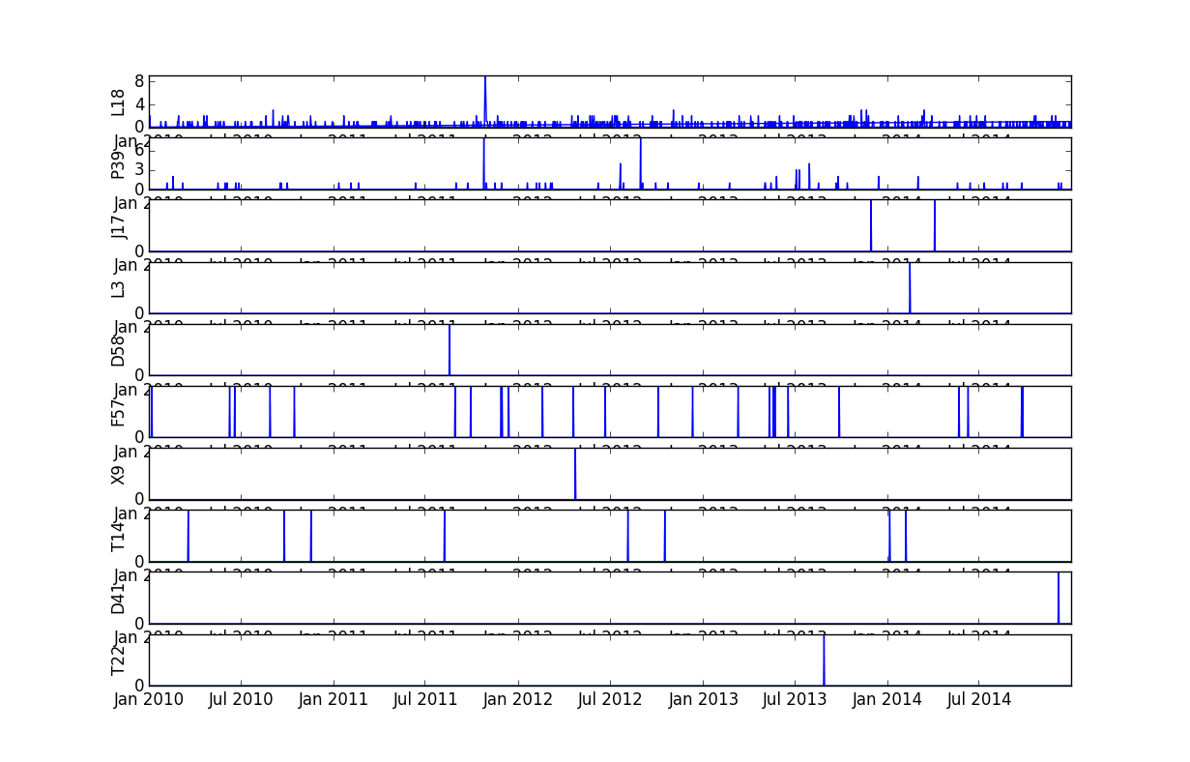
Time-series Earthquake data

