Slide 1
Controller Development
Chan Jau Khang
November 01, 2006

Slide 2
Slides Content
What is controller?
Controller Development Steps
  Appropriateness Assessment
  Scenario Analysis
  Module Skeleton
  Business Event
  Request Translator
  State Handler
  MV Sync
  Screen Flow & Router
  Error Handling in Controller
  View-Controller Integration
  MVC Integration
  Pre-UAT Cleanup

Slide 3
What is Controller ?
Controller interprets the user inputs / requests receives from View and translates into actions to be performed by model.
The outcome of the model actions is followed by selecting and presenting the appropriate View.
It acts like the intermediate tier that integrates both the View and Model.

Slide 4
Controller Development Steps
Appropriate Assessment – C1
Step 1. Appropriate Assessment
Controller integrates View and Model. Therefore a few input information from View and Model are necessary before the coding can start.
You will need 3 items from View :-
    Page-Action Mapping Document
      This is a document that identifies all the possible actions in each screen of the module.
      The document is usually a power-point slide with all the JSP screen captures and action names identified.

Slide 5
Controller Development Steps
Appropriate Assessment – C1
    Page Objects
      Page objects are Java classes with all the user input fields identified.
      Page objects also provides function to retrieve the values of the user input for each field.
    View Objects
      View Objects are important for MV-Sync, from which the controller will response the result back to the View.

Slide 6
Controller Development Steps
Appropriate Assessment – C1
3 items from Model :-
    Value Objects & EDS (Enterprise Data Subject)
      These Java Classes are the response of the Model actions, therefore it is important to be created by Model developers and identified for MV-Sync purpose.
    Class Diagrams of EDS
      Class Diagrams gives Controller developers an overview of how the structure the EDS are and how to retrieve the result in the MV-Sync process.
    Business Object interfaces
      Controller components are actually invoking the services provided by the Model objects via these interfaces (EJB interfaces).

Slide 7
Controller Development Steps
Appropriate Assessment – C1
With all the information collected, Controller developers can now prepare the Page-Field Mapping document.
Purpose : To show where to get the value of the data on the screen and how to pass data into the application.
To prepare the Page-Field Mapping documents :-
  Identify all the user input field and their name in Page object

Slide 8
Controller Development Steps
Appropriate Assessment – C1
  Identify the relevant store procedures, tables and views to be query/update based on the database interfaces document which the action will trigger
  Identify the output data and the object and attributes that the data is stored
  Identify also the fields in the tables / views that the data is stored

Slide 9
Controller Development Steps
Appropriate Assessment – C1
Please refer to the sample Page-Field Mapping documents that reflecting the sample application
CSMS_INDONESIA_PAGE_FIELD_MAPPING.xls

Slide 10
Controller Development Steps
Scenario Analysis – C2
Step 2. Scenario Analysis
In this step, we will design the components of controller base on each scenario.
To identify each scenario, Controller developers will refer to the Page-Field mapping document provided by View developers to identify all the action requests.

Slide 11
Controller Development Steps
Scenario Analysis – C2
There are a few points to note before building the controller to process request:
  What is the input parameters from the user?
    E.g. Customer Search action, the input will be the searching criteria, which will be Name, DOB, Gender, Policy Number, Roles, LOB and Search method.

Slide 12
Controller Development Steps
Scenario Analysis – C2
  What events are required?
    E.g. Customer Search action will require the GetCustomerPolicyListEvent
  Is there any initialization needed for the request?
    E.g. The “Search By” field in the Customer Search is defaulted to “By Customer” when the page first loaded.
  What Business Object methods are required to process the request?
    E.g. Customer Search action requires the CustomerSearchManagerInterface to process the search request.

Slide 13
Controller Development Steps
Scenario Analysis – C2
Next we should consider how to produce the proper response by answering the following questions :-
  What value objects should be returned by business object?
    By identifying the result returned by BO, it helps to plan how to access the result of the request.

Slide 14
Controller Development Steps
Scenario Analysis – C2
  Is MV-Sync necessary? How to achieve this?
    If the request just perform a redirect action, no Business object will be invoked and no data will be returned.
    If data is returned, MV-Sync will be performed. Is agents necessary in this case?
  Is simple screen flow redirection suitable? Or Router is needed?
    Sometimes we need a router to check the state of the application before we can determine the next page that the application should be headed.

Slide 15
Controller Development Steps
Scenario Analysis – C2
After answering all the above questions, we will be able to produce the MVC-design document. (Please refer to appendix section of this document)

Slide 16
Controller Development Steps
Module Skeleton – C3
Step 3. Module Skeleton
We can now implement the skeleton of the slave module. The following packages will be created to place each of the controller components.
The package of the application is defined as :-
    manulife\[country]\[channel]\[module]
    e.g. manulife.id.csms.cim

Slide 17
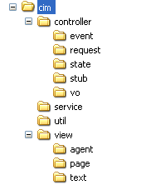
Controller Development Steps
Module Skeleton – C3
The module skeleton is as follow :-
Module Name
Controller Classes
Utility Classes

Slide 18
Controller Development Steps
Module Skeleton – C3
We can now create the common classes of a module under different packages, i.e. :-
  controller:
    SlaveControllerFacade.java
    SlaveEvent.java
    SlaveRequestTranslator.java
    SlaveScreenFlowManager.java
    SlaveTranslatorTemplate.java
    SlaveViewManager.java
    SlaveExceptionInfo.java to hold error codes.
  util:
    SlaveErrorBundle.java
    SlavePageNames.java
    SlaveWebKeys.java

Slide 19
Controller Development Steps
Module Skeleton – C3
  view\text:
    SlaveViewBundle.java
    SlaveViewBundle_xx.java (optional for i18n)
    Text.java
  view\agent:
    ExceptionAgent.java (optional, to update ExceptionInfo when no M-V synchronization of data is required)
  channel_definitions_slave.jsp
    Used to defined the page structure, e.g. csms_definitions_cim.jsp which you will find under the root folder of the web JSP pages.

Slide 20
Controller Development Steps
Module Skeleton – C3
To enable a module to be recognized by the framework, we need to register the module into it using manulife.[country].[channe].master.controller.ModuleManager.java
Below are the steps :-
  Define the slave module name as static final String
  Register SlaveRequestTranslator in method initRequestTranslator
  Register SlaveViewManager in method initViewManager
  Register SlaveScreenFlowManager in method initScreenFlowManager
  Register SlaveControllerFacade in method initControllerFacade
  Enhance methods next(), mapWebKeys(), mapPageNames()

Slide 21
Controller Development Steps
Business Event – C4
Step 4. Business Event
To create the business event, first we have to think what are the user inputs and the application states which are related to the Business Object processing?
  E.g. In customer search, the user input searching criteria such as SearchCategory, name, gender, dob, policy number, role and LOB which are related.
Next we create a business event that extends the SlaveEvent with all the information that identified as the attributes.

Slide 22
Controller Development Steps
Business Event – C4
Finally code the toString() method for debugging purposes.
The main purpose of the event is for transportation across tiers, i.e. convey the user inputs and application states to the handler for invoking the Business Object interfaces.
** It is recommended that different request should have different event as many Model-related processing tasks, like MV-Sync are differentiated using event class.

Slide 23
Controller Development Steps
Request Translator – C5
Step 5. Request Translator
In SlaveRequestTranslator, forward a request to other request translators in sub-directory "request" based on its action request as defined in SlavePageNames.
Request translators are located in manulife\country\channel\slave\controller\request. Their names have no module prefix. But they usually have the Translator postfix.
Request translators usually extends the SlaveTranslatorTemplate and therefore the standard method can be reused.
RequestTranslator performs validations on the user input and generates event.

Slide 24
Controller Development Steps
Request Translator – C5
In RequestTranslator, user inputs that was captured in the page objects will be retrieved and necessary information will be set into corresponding Business Event.
E.g. When Search request (CIM_CS004_01_SEARCH) is invoked, GetCustomerPolicyDetailsTranslator will validate the user inputs (searching criteria) in the performValidation() method. If the validation passed, generateEvent() method will be invoke and set the searching criteria into GetCustomerPolicyDetailsEvent.

Slide 25
Controller Development Steps
Request Translator – C5
Besides validation and setting user input or application state into the event, translators also perform the following :-
  Derive the application state from session and application scopes.
  Page object life-cycle management, for example reset the errors collection.
  Compare user input with default setting, and alter the event generation process.
  Raise application exception to signal validation errors.
  Update objects in session scope with no transactional context.
  Decide if an event should be generated.

Slide 26
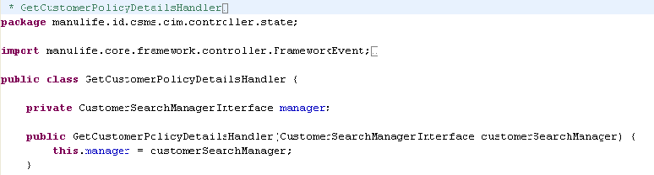
Controller Development Steps
State Handler – C6
Step 6. State Handler
StateHandler carry out processing based on the event value from translator.
StateHandler should be defined to allow its constructor is able to accept the Business Component interfaces as its arguments.
  E.g. GetCustomerPolicyDetailsHandler has the constructor that accepts CustomerSeachManagerInterface as argument.

Slide 27
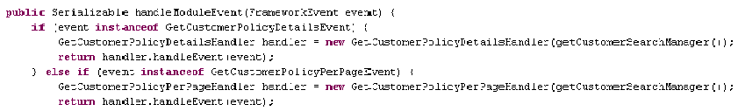
Controller Development Steps
State Handler – C6
In the state handler, the appropriate method of the business component will be invoked.
To involve the StateHandler in the framework, Controller developers have to update the SlaveControllerFacade, so that it will detect the associated event type and instantiate the corresponding StateHandler.
  E.g. When the CimControllerFacade detects that the event is an instance of GetCustomerPolicyDetailsEvent, an instance of GetCustomerPolicyDetailsHandler is created to handle the request.

Slide 28
Controller Development Steps
State Handler – C6
To improve performance, sometimes the SlaveControllerFacade is used to buffer the instance of the business components.

Slide 29
Controller Development Steps
Model View Sync – C7
Step 7: Model View Synchronization
If the use case requires the result of the Model action to be returned and displayed on the View, MV-Sync needs to be performed.
2 ways of doing MV-Sync :-
  Using the View object derived from the VO if only one single View Object to be updated. (The derived object either inherits the VO or composed of the VO)
    For Inheritance relationship :- Usually a method copy() will be created to copy the value from VO to the view object.
    For Composition relationship :- Usually the View Object will implements the FrameworkAgent and implements the performUpdate() method to perform MV-Sync.

Slide 30
Controller Development Steps
Model View Sync – C7
  Using the agent class which implements the FrameworkAgent.
    Usually, Agent class is instantiated in the SlaveViewManager by mapping on the event type.
    It can also be stored in the session.
To perform MV-Sync using the agent, the returned serializable result from Model will be passed to the performUpdate() method by the SlaveViewManager.
The method will perform a validation on the instance type of the serializable object. If the object is an instance type of ExceptionInfo, this means that the result shows an error message.

Slide 31
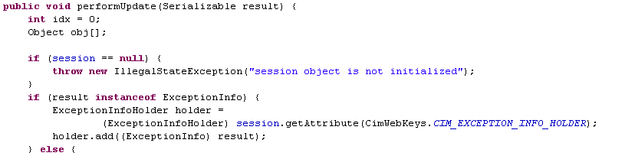
Controller Development Steps
Model View Sync – C7
E.g. For checking in Serializable object.
Else, the appropriate View Object will be retrieved from the session and updated accordingly.

Slide 32
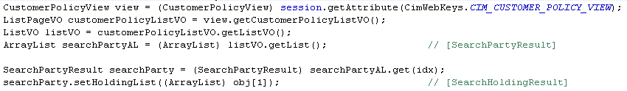
Controller Development Steps
Model View Sync – C7
.
Example.

Slide 33
Controller Development Steps
Screen Flow and Router – C8
Step 8: Screen Flow and Router
SlaveScreenFlowManager play the role of ensuring the response to user request is in the correct page as stated in the Screen flow diagram.
SlaveScreenFlowManager uses the action request to determine the next screen to be displayed.
  E.g. CimScreenFlowManager will redirect user to the JSP page named CimPageNames.CIM_CS004_01 when the action request named CimPageNames. CIM_CS004_MENU_CUSTOMER_SEARCH is sent in.
However, sometimes more complicated screen flow logic is required to determine the next screen, in this case router will be used.

Slide 34
Controller Development Steps
Screen Flow and Router – C8
A router can execute complicated screen flow logic. It assesses the view objects in session and application scopes to decide on the screen flow (requests and application states). ChannelExceptionInfoHolder is often used in router to handle errors.
Router is invoked after MV-Sync. Hence, if the screen flow logic depends on the result of Model action, router should be used. Router has access to the post-transaction data (response from Model object action)
Routers also can be used to set value from View objects into Page objects (e.g. Default value setting upon page loaded). The request usually does not generate any event, and therefore no agent will be invoked. (Whether to invoke agent in SlaveViewManager is based on the instance type of event)

Slide 35
Controller Development Steps
Error Handling – C9
Step 9: Error Handling
Controller validates the user input and also checks the status of the model actions, and finally responses with the appropriate message.
Therefore a set of error code and error message should be identified, and the appropriate page should be redirected when determined.
Manulife Regional OO Framework error handling mechanism involves a few steps :-
    Prepare Error Code and Error Message list
    Prepare Error Message Properties file
    Define ChannelErrorBundle class and SlaveErrorBundle class.

Slide 36
Controller Development Steps
Error Handling – C9
    Register SlaveErrorBundle in SlaveScreenFlowManager.
    Wrap the error in ExceptionInfo and set into the ExceptionInfoHolder.
    Handle ExceptionInfoHolder state in ScreenFlowManager to determine how to present the error.
  Step i) Prepare Error Code and Error Message list
    Define a range of possible error codes for each module. E.g. For module CIM, we use error codes E1001 to E1099; while Login module, we use error codes E0001 to E0099
    Prepare a list of error codes-error message mapping in a Excel files and define comments on the error messages.

Slide 37
Controller Development Steps
Error Handling – C9
  Step ii) Prepare Error Message properties file
    Prepare the properties file with the error code as the key and message as the value.
    If i18n is applied, prepare the same set of properties file with the same error code as key but prepare the message in different languages.
  Step iii) Define ChannelErrorBundle class and SlaveErrorBundle class
    Define the ChannelErrorBundle class which extends from the FrameworkResourceBundle and register in the ApplicationManager.
    Create the necessary SlaveErrorBundle class which extends the FrameworkPropertyBundle. In its constructor, call method super and pass in the name of the properties file: ChannelSlaveError. The same will be performed for other languages.

Slide 38

Controller Development Steps
Error Handling – C9
  Step iv) Register SlaveErrorBundle in SlaveScreenFlowManager
    Register the SlaveErrorBundle in the method initErrorBundleList in SlaveScreenFlowManager.
    E.g. Register the CimErrorBundle in CimScreenFlowManager.
  Step v) Wrap the error in ExceptionInfo and set into the ExceptionInfoHolder
    Whenever the error is caught, set the error with appropriate error code into the ExceptionInfo class and add it into the SlaveExceptionInfoHolder.

Slide 39
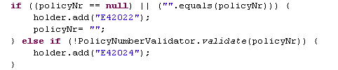
Controller Development Steps
Error Handling – C9
    E.g. when the customer GetCustomerPolicyDetailsTranslator encounter error in validation, error code is set into the ExceptionInfo objects and added into the CimExceptionInfoHolder.
    Step vi) Handle ExceptionInfoHolder state in ScreenFlowManager to determine how to present the error
    After capturing the error, the Controller will decide which page should be presented to display the error message.
    This is done in the SlaveScreenFlowManager by checking whether the SlaveExceptionInfoHolder is empty.

Slide 40
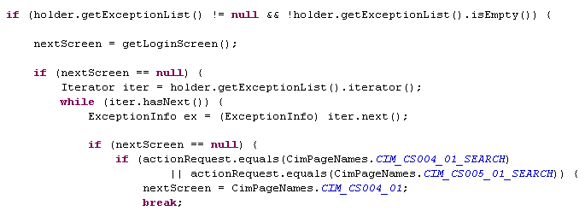
Controller Development Steps
Error Handling – C9
    E.g. In CimScreenFlowManager check if the CimExceptionInfoHolder is empty. If not empty, we will determine the next page to show by checking the action request. The error message will be displayed in the JSP with page name value represented by CimPageNames.CIM_CS004_01.

Slide 41
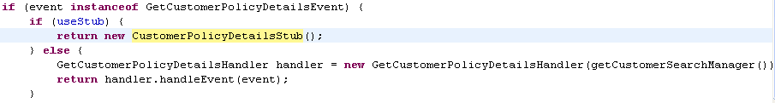
Controller Development Steps
View Controller Integration – C10
Step 10: View Controller Integration
In this stage, we will merge the JSP (done by View developers) with the Controller components.
Set the SlaveControllerFacade to get the stub data instead of invoking the state handler. This can be done by setting the instance variable useStub in the SlaveControllerFacade class to false.
E.g. CimControllerFacade uses the variable useStub to turn on the invocation of stub object instead of state handler.

Slide 42
Controller Development Steps
View Controller Integration – C10
Stub can be designed to simulate different scenarios by returning different set of data objects with different values. We can make use of an external files (e.g. properties file) to store the values.
This will help to test the integration between View and Controller, and also the screen flow logic under different scenarios.
We can also test the request-response path, including the page validations, request translation, event delivery, MV-Sync (data copying by agents) and screen flow logic by routers.

Slide 43
Controller Development Steps
MVC Integration – C11
Step 11: MVC Integration
After complete View Controller integration test, Model will be integrated to perform an end-to-end test.
This can be done by setting the SlaveControllerFacade to use the state handler instead of Stub Data class. This can be easily done by setting the useStub variable to false.
Business event will be passed into state handler to perform Model actions.
Test again for the whole request-response path from end-to-end.

Slide 44
Controller Development Steps
MVC Integration – C11
With the Model developers help, change the Model bean to remote mode by :-
    Set the properties file from local to remote.
    Create EAR file for the application.
Retest all the scenarios in the remote mode.
Finally, if necessary, test the application with different configurations :-
    To have Web-tier and EJB tier and deployed in different OC4J
    OS (Windows and UNIX)

Slide 45
Controller Development Steps
Pre-UAT Cleanup – C12
Step 12: Pre-UAT Cleanup
After all the change and testing are done, the application is ready for UAT.
Before starting UAT, some cleanup needs to be done :-
  Disable right click by options (change screen_template.jsp) to prevent the displaying of source code via web browser.
  Change all logDebug() method in the logging mechanism to logAppDebug() method to log messages.
  Remove unwanted code and comments that were only meaningful for development.
  Remove temporary measures and entry points.

Slide 46
Controller Development Steps
Pre-UAT Cleanup – C12
  Identify sections that required performance monitoring or regression testing.
  The current framework have some built in mechanism that support performance monitoring and regression testing. To trigger this action, we will need to add in additional commands / HTML.
  Identify sections that performance monitoring or regression testing is required. (Notes : The framework itself support some mechanism of performance monitoring and regression test. Some commands / HTML comments need to be added in order to perform the actions successfully.)

Slide 47
Controller Development
Appendix
Appendix
  A. Controller Components
  Prepare Screen Flow Diagram
  Prepare Page-Field Mapping Document

Slide 48
Appendix A
Components in Controller
The controller components in the framework skeleton are :-
    SlaveRequestTranslator
    ActionTranslator
    ActionEvent
    SlaveControllerFaçade
    StateHandler
    SlaveViewManager
    Agent
    SlaveScreenFlowManager
    Router
  ** Slave refers to the module in a channel. Channel refers to the system (e.g. CSMS, AWS, CWS, etc.)

Slide 49
Appendix A
Components in Controller
SlaveRequestTranslator
  Re-direct the action requested to the relevant translator for processing
  The RequestTranslator is extended from RequestTranslatorTemplate of the module
ActionTranslator
  Perform validation on the user input via performValidation() method.
  Translate the request into event to be passed to the handler for further processing by generateEvent() method.
  The user input values are retrieved from the Page object. To enable the translator to get the correct Page object, the web key for the page object is identified in the method getPageObjectKey().

Slide 50
Appendix A
Components in Controller
ActionEvent
  Contains the necessary information to be used by the handler for processing
  Event must be the sub class for the module base-event.
  Eg. GetCustomerPolicyListEvent extends the CimEvent. This is to let the framework recognizes that the event belongs to the CIM module, and redirects the action to the correct ControllerFacade, i.e. CimControllerFacade
  The information in event object is either the user input information or the application state

Slide 51
Appendix A
Components in Controller
SlaveControllerFaçade
  It redirects the event to the appropriate Handler for processing.
  Each module will have one ControllerFaçade and it only recognizes their own module’s event
  ControllerFacade of every module will extend the ModuleControllerFacade in the framework
StateHandler
  Carry out processing based on the event value from translator
  Usually is the end-point of the controller dealing with Model object.
  The output of the StateHandler is a Serialized object

Slide 52
Appendix A
Components in Controller
SlaveViewManager
  Based on the event and redirect the process to the appropriate agent.
  Besides initializing the application, the View manager will also initialize the View and Page object and set them into the session with appropriate web key

Slide 53
Appendix A
Components in Controller
Agent
  Agent will accept the Serialized object that returned by the StateHandler as input parameter.
  Agent implements the FrameworkAgent class in the OO Framework.
  Perform Model-View Synchronization, by setting the output result from model to the View object or setting the application state to the View object.
  By doing this, the data on the screen will be updated when the JSP display the attributes value in the View object.

Slide 54
Appendix A
Components in Controller
SlaveScreenFlowManager
  Based on the action request and redirect to appropriate page.
  The information is available in the Screen Flow diagram.
Router (Optional)
  Help to decide the page to be displayed by checking/validating the output.
  This is useful especially when an action can trigger different pages or output.
  E.g. For first time login users, system requires them to change their password. Router will check the status of the user whether he/she is first time login and redirect he/she to the “Change Password Page” or if he/she is not first time login, redirect to “Landing Page”.

Slide 55
Appendix B
Prepare Screen Flow diagram
Objectives :-
Show usage of Screen Flow Diagram
Show steps to create a Screen Flow Diagram based on use cases

Slide 56
Appendix B
Prepare Screen Flow diagram
Purpose : To show the flow of the application and how the use case is linked to each other.
Study the use cases and examine each of the flow of the screen based on the use case. (E.g. When a search customer action is successful in cim_cs004_01, the page will be redirected to cim_cs005_01)
The circle in the diagram represent the use case, and the arrow describes the action and also showing the flow and directions.
This diagram is important for coding the ScreenFlowManager of the module.

Slide 57
Appendix B
Prepare Screen Flow diagram
CIM Screen Flow (Based on CIM Customer Search)
Trigger from “Search Customer & Last Search Customer” Menu
Search Fail
cim_cs004_01
Trigger from “Last Search Customer” Menu
Search Successfully
Enquiry Customer Information
Select / Deselect Customer & Sort Policy Attribute & Navigate Search Page
cim_cs005_01
cim_cs006_01

Slide 58
Appendix C
Prepare Page-Field Mapping Document
Objectives :-
Show usage of Page-Field Mapping Document
Show steps to create a Page-Field Mapping Document based on the design and analysis of the application

Slide 59
Appendix C
Prepare Page-Field Mapping Document
Purpose : To show where to obtain the data to be shown on the screen and how to pass the data into the application.
To prepare the Page-Field Mapping documents :-
  Identify all the user input field and their name in Page object
  Identify the relevant store procedures, tables and views to be query/update based on the database interfaces document which the action will trigger
  Identify the output data and the object and attributes that the data is stored
  Identify also the fields in the tables / views that the data is stored

Slide 60
Thank you

