Slide 1
View Development
Lim Boon Siong
November 30, 2006

Slide 2
Topic
Introduction to MVC
What is View?
View Development Steps
  V1 – Completeness Assessment
  V2 – Naming
  V3 – Evolving from HTML to JSP
  V4 – Internationalization and Localization
  V5 – Dynamic Contents of Output Fields
  V6 – User Data in Input Fields
  V7 – Client-side Effects
  V8 – Screen Layout
  V9 – JSP Structural Organization
  V10 – Compatibility Test
  V11 – Miscellaneous Support

Slide 3
Introduction to MVC
Business Transactions
Model
business
services
data
User
View
Controller
user
selection
Presentation
Flow (use case)

Slide 4
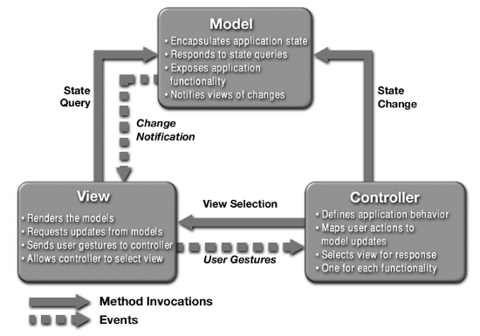
Introduction to MVC

Slide 5
What is View?
View interacts directly with user. It collects user inputs and send them to Controller.
View populates the data returned by Model.
View implements presentation logic such as data format, page layout.
View provides some simple validations on data input by user using JavaScript.
View does not implement business logic.

Slide 6
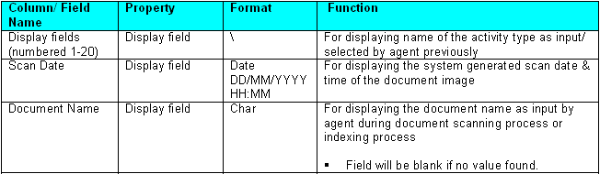
View Development Steps
V1 – Completeness Assessment
Check if the functional specification has covered all necessary screens for the project.
  Gain access to the demo site.
  Functional specifications are normally documented in use case documents. Check if all the screens in demo site are explained in use case documents.
2. Check if all screen layouts are described in Screen Specification document.
3. In Screen Spec, for each field, there should be information on:
  Possible range of values
  Display format
  Default value
  Function description

Slide 7
View Development Steps
V1 – Completeness Assessment
4. For each input field, there should also be information on:
  Editing rules, e.g. empty fields, which are usually dependent on the data type
  Other editing rules, e.g. range checking, illegal characters, format (e.g. email, date) and inter-field dependency, are usually implemented in Controller.
  This information is usually found in Screen Spec. However, in some projects, this information is descript in use case documents.
Identify fields with dynamic look-and-feel. Examples of dynamic look-and-feel are tables with variable number of rows, different images for different data content, etc.
6. Collect prototype screens to be used for developing JSPs.

Slide 8
View Development Steps
V2 – Naming
Assign a unique ID to each screen.
  This ID is also the file name of this JSP.
Assign a unique ID to each HTML input field.
  This IDs will be used in Step V6 later.
3. Assign a unique ID to each button.
4. Assign a unique ID to each hyperlink.
5. Indicate the assigned IDs in a PowerPoint document called Page Action Mapping, which captures all screens of the application.
6. Update <slave>PageNames.java with the newly defined IDs for screen and action request (i.e. button and hyperlink).
7. Naming of action requests has the following standard convention:
  module_usecase_screen-number_button-name(optional index)
  Examples: idm_cs021_01_cancel, idm_cs021_01_go1, fundp_cw001_02_fund_desc

Slide 9
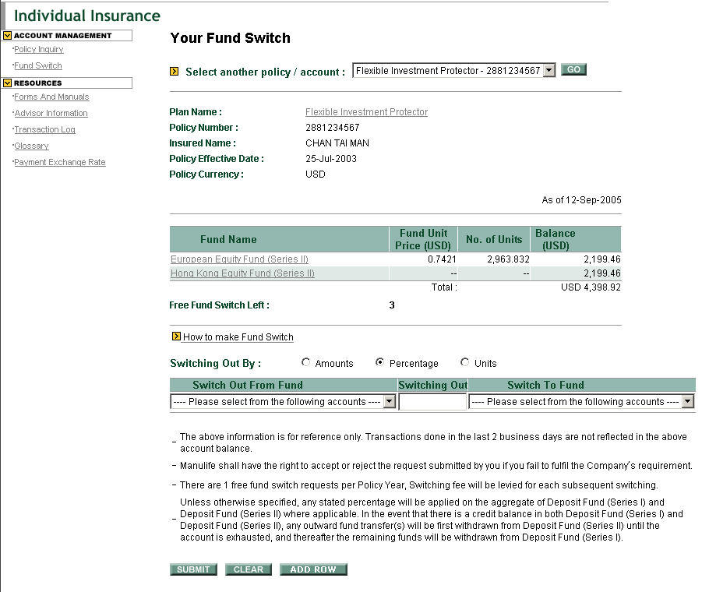
View Development Steps
V2 – Naming : Page_Action_Mapping
Unique ID for this Page: fundp_cw001_02
fundp_cw001_02_go
fundp_cw001_02_plan_desc
This is ActionRequest
fundp_cw001_02_fund_desc
fundp_cw001_02_submit
fundp_cw001_02_clear
fundp_cw001_02_add_row

Slide 10
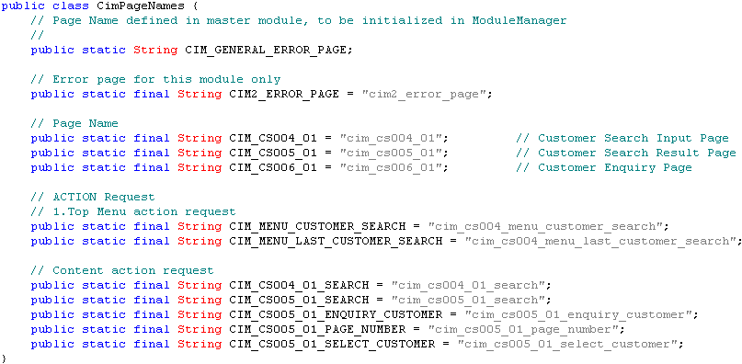
View Development Steps
V2 – Naming : Sample for PageNames.java

Slide 11
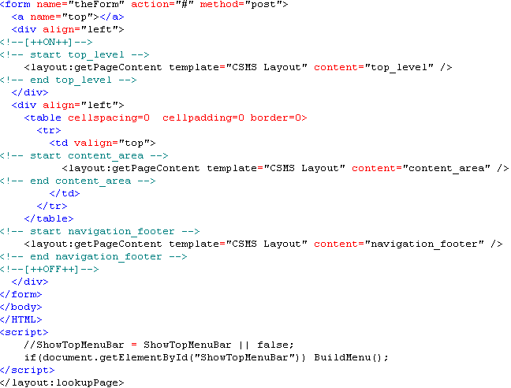
View Development Steps
V3 – Evolving from HTML to JSP
1. Create template JSP and determine the screen partitioning.
  Name the file as <channel>_screen_template.jsp
  Refer to csms_screen_template.jsp as example, extract attached below.
Screen Partitioning

Slide 12
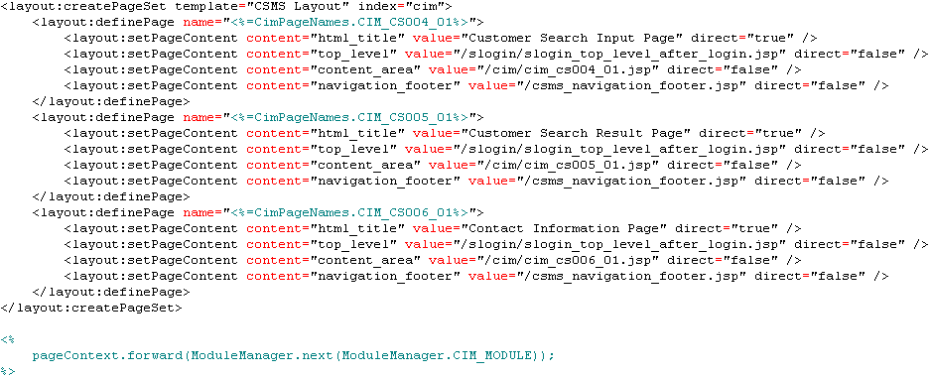
View Development Steps
V3 – Evolving from HTML to JSP
2. Create Screen Definition JSP and determine the layout definition for each screen.
  Create different screen definition JSP for each module (or slave).
  Format: <channel>_definitions_<slave>.jsp
  E.g. csms_definitions_cim.jsp, extract attached here.
This is explained in Step V8.

Slide 13
View Development Steps
V3 – Evolving from HTML to JSP
3. Convert prototype’s HTML files to JSP format
  Remove unnecessary html tags so that it can fit into template’s layout
  Extract hard coded screen labels to properties files
  Add action request and other request parameter names
  Add javascript functions if necessary
  Ensure the max length and size of the input box follows the requirement
4. For fields with associated field error indicators, reserve enough space beside them.
Change the names of input fields, buttons and hyperlinks according to the unique IDs defined.

Slide 14
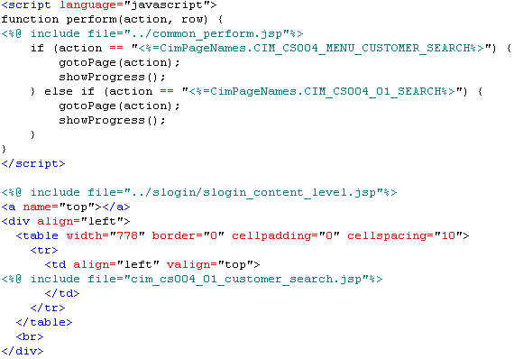
View Development Steps
V3 – Evolving from HTML to JSP
6. All HTML Form submit actions should go through the Front Controller:
Extracted from cim_cs004_01_customer_search.jsp
The submit action is implemented with a Javascript function
Extracted from cim_cs004_01.jsp

Slide 15
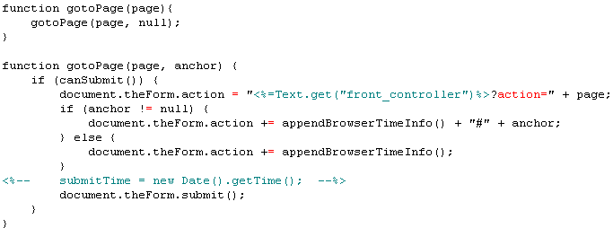
View Development Steps
V3 – Evolving from HTML to JSP
The exact URL of the application should be assembled dynamically from the information specified in a properties file.
Extracted from template_include.jsp
All HTTP requests should be concatenated with appendBrowserTimeInfo().

Slide 16
View Development Steps
V4 – Internationalization and Localization
1. Declare a Locale reference in include.jsp:
  If the channel supports only a single language, assign the Locale reference with the preferred language locale instance, eg. Locale.ENGLISH.
  If the channel supports multiple languages, assign the Locale reference with another locale instance, which should be a session attribute.
  To facilitate the handling of time-out behaviour, the language attribute is also included as a HTTP request parameter. This is necessary only if language switching is required.

Slide 17
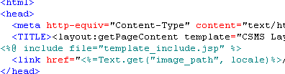



View Development Steps
V4 – Internationalization and Localization
<channel>_screen_template.jsp includes template_include.jsp
template_include.jsp includes include.jsp
Single Language.
Setting Locale reference in include.jsp
Multiple Languages.

Slide 18

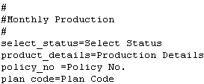
View Development Steps
V4 – Internationalization and Localization
2. Static text. For each supported language of every module:
  Create a text file to store all static text. Each text file supports only one language. The naming convention is <Channel><Module>View_<lang>.properties. The default should be created first (e.g. CsmsAloginView.properties).
  Define a simple class manulife\<country>\<channel>\<module>\view\text\Text.java, which is supported by the corresponding bundle classes in the same directory.
  Replace the static text in JSP by “<%=Text.get(“key”, locale)%>”.
  Meanwhile, add a key=value pair to <Channel><Module>View_<lang>.properties, where key is the key for this label and value is the static text in the specified language.
CsmsAloginView_zh.properties
CsmsIndpiView.properties

Slide 19

View Development Steps
V4 – Internationalization and Localization
3. Images. For each supported language of every module:
  For each locale sensitive resources, such as image, replace the path by “<%=Text.get(“key”), locale)%>”
  Meanwhile, add a key=value pair to <Channel><Module>View_<lang>.properties, where key is the logical path name and value is the physical path. If an identical pair exists already, this step can be skipped.
Example from JSP
Extract from CsmsCimView.properties
image_path=/images/en
Extract from CsmsCimView_zh.properties
image_path=/images/zh

Slide 20
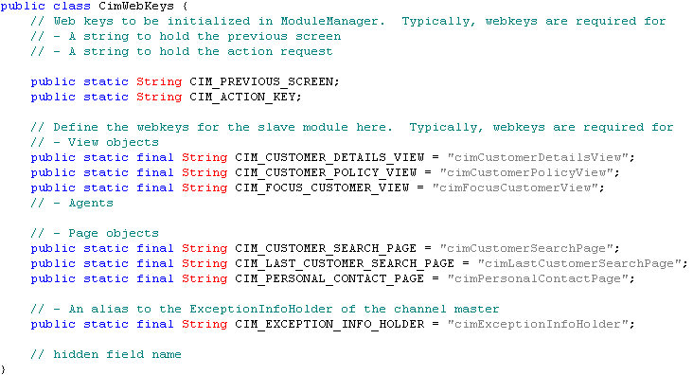
View Development Steps
V5 – Dynamic Contents of Output Fields
Define the necessary View object as a Java class.
  View object is defined as a composite value object from multiple data sources.
  View object is used to hold data to be displayed for a particular page.
  View object is stored in session.
Define the web-key for the View object in <module>WebKeys.java.
  “web-key” is the key for objects stored in session.
  Each module will have its own <module>WebKeys.java.

Slide 21
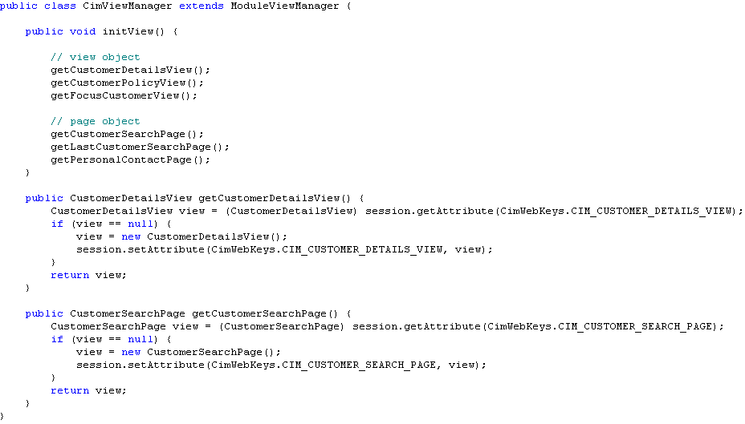
View Development Steps
V5 – Dynamic Contents of Output Fields
3. Create the View object in <slave>ViewManager.java, usually in the initView() method.

Slide 22
View Development Steps
V5 – Dynamic Contents of Output Fields
Code stub data object according to the definition of view object.
  Stub data object has the same definition as the view object, with some stub data hardcode into the object.
Using stub data object to test JSP.
  In order to test multiple scenarios, stub can read the configuration from a properties file. E.g. stub that returns 0, 1, >1 pages, multiple pages of records.
  There are few ways to test JSP using stub data. Please refer to Appendix A for more discussions.
A View object is accessible with session.getAttribute(). Alternatively, add useBean tag in JSP to use the view object.
CustomerDetailsView view = (CustomerDetailsView)session.getAttribute(CimWebKeys.CIM_CUSTOMER_DETAILS_VIEW)

Slide 23
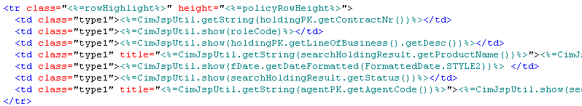
View Development Steps
V5 – Dynamic Contents of Output Fields
7. Replace the string variable assignments with dynamic contents from the view object.
8. Add looping and control statements to display iterative contents.
9. Apply proper formatting methods if necessary.
10. Display different error messages by simulating possible error conditions in ExceptionInfoHolder.java. Theses error messages are usually specified by the Controller developer.
Formatting Methods

Slide 24
View Development Steps
V5 – Dynamic Contents of Output Fields
Advantages of using Stub Data
View can be tested with variety of data before the model is developed. E.g. stub can return 0, 1, >1 pages, multiple pages of records.
Reduce the dependencies of View and Model developments. Therefore, View and Model can be developed by 2 different developers.
  Once Model is developed, replaces stub with data returns from Model.
Please refer to Appendix A for more discussions on using stub data.

Slide 25
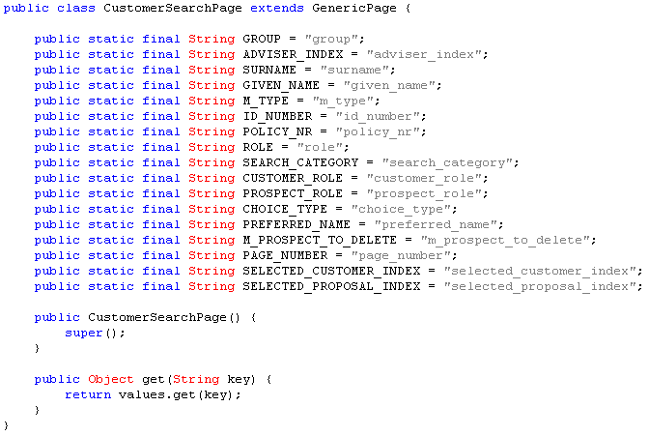
View Development Steps
V6 – User Data in Input Fields
1. Make sure all input fields that require server processing are defined as HTML FORM parameters.
2. Define a Page object that holds all input entries as a Java class. Page objects are usually derived from GenericPage.java.
3. Use prefix “m_” for all input fields as array type HTTP parameters. Use prefix “c_” for all input fields with chinese characters. The handling of these prefix are defined in GenericRequestTranslator and can be overrided in <Slave>TranslatorTemplate.
4. Define field name as static constants in Page object.
Field name as static constants

Slide 26
View Development Steps
V6 – User Data in Input Fields
5. Define the web-key for the page object in WebKeys.java.
Create the page object in <slave>ViewManager.java.
7. A page object is accessible with session.getAttribute(). Alternatively, add useBean tag in JSP to access the page object.

Slide 27
View Development Steps
V6 – User Data in Input Fields
8. Display input fields by simulating default values in the associated page object.
9. Use Javascript to implement field level editing rules, if necessary.
10. Use Javascript to implement simple page level validation rules, if necessary.
11. Capture input data in Controller translators.
12. By manipulating the page object, test the handling of server-side field validation errors. Field error indicators are usually used to show the error fields.

Slide 28
View Development Steps
V7 – Client-side Effects
1. Examine each screen for the need of Javascript effects.
2. Implement the feature. Sophisticated client-side solutions usually require the manipulation of DOM.
3. It is common practice to copy existing solutions from public domain instead of writing the function from scratch.

Slide 29
View Development Steps
V8 – Screen Layout
1. Identify the required visual elements: html_title, top_level, divisional, content_level for a screen, which is called content_area.
2. If the screen has unique ID defined in <slave>PageNames.java, specify the mapping of visual elements in <channel>_definitions_<module>.jsp.
3. Update next() method in ModuleManager.java. With module name as input, the next <channel>_definitions_<module>.jsp is returned.
Each module will have one <channel>_definitions_<module>.jsp.
However, if a <channel>_definitions_<module>.jsp is too big, break it down to smaller files. Arrange them in a daisy chain by forward().

Slide 30
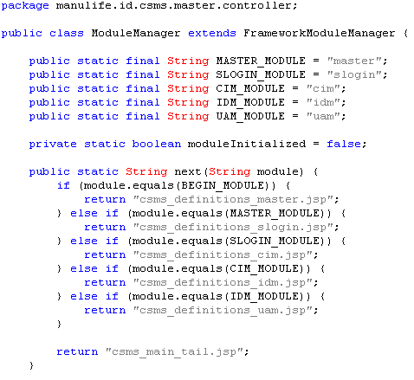
View Development Steps
V8 – Screen Layout
Extract of ModuleManager.java
JSP Flow according to ModuleManager.java
csms_main.jsp
csms_definition_master.jsp
csms_definitions_slogin.jsp
csms_definitions_cim.jsp
csms_definitions_idm.jsp
csms_definitions_uam.jsp
csms_main_tail.jsp

Slide 31
View Development Steps
V9 – JSP Structural Organization
CSS Stylesheet
  Define new styles in stylesheet if necessary.
Images
  Organize images in proper directories:
    Any commonly used image files should be stored at the same level as <channel>_screen_<template>.jsp.
    Any module specific image files should be stored inside the module directory.
    Any locale sensitive image files should be stored in separated directories with identical hierarchy, e.g. images\en and images\zh.
Common JSP
  Define common strings, image file locations and other mappings in a separate JSP. Refactor common features to a separate JSP, which is to be included by others.
JS File
  Refactor common Javascript to separated JS.
5. Create new directories for the project files and images according to standard conventions.

Slide 32
View Development Steps
V10 – Compatibility Test
Encoding Schemes
  Test with different encoding schemes: e.g. Western, Chinese Traditional, etc...
Screen Resolutions
  Test with different screen resolutions: e.g. 800 x 600 (default), 1024 x 768, etc...
Operating System
  Test with different operating systems: e.g. Windows XP, Windows 2000, Chinese Windows, etc...
Browser
  Test with different browsers: e.g. Microsoft Internet Explorer, Mozilla, etc...
Browser Version
  Test with different browser versions: e.g. IE 5.5, IE 6.0, IE 7.0, etc...

Slide 33
View Development Steps
V11 – Miscellaneous Support
1. To facilitate regression test, insert the on/off controls in the form of HTML comment to the JSPs.
2. Log messages can be added to allow detailed classification of a request action.
3. General JSP error pages should be implemented and tested.
The above can be skipped for the moment. Add in those features when necessary, maybe at later stage of development.

Slide 34
Appendix A
Stub
There are 3 stages in using stub
  Testing for individual JSP
  Testing for simple JSP flow (without event)
  Testing for JSP flow (with event)

Slide 35
Appendix A
Stub - Testing for individual JSP
This is the simplest way of using stub.
The main purpose is to test for that individual JSP only.
The stub is instantiated in the JSP and used locally.
CustomerDetailsView view = new CustomerDetailsView_Stub();
Define string variables for dynamic data, and fill them with stub data for testing. The string variables should also be tested with stub data being set to null.
Change the stub data to maximum field length to ensure enough space is allocated.
Invoke this JSP using <a href=“xxx.jsp”>

Slide 36
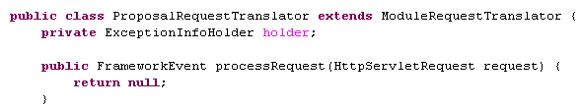

Appendix A
Stub - Testing for simple JSP flow (without event)
Knowledge on Controller is required to do the following suggestion. Please go through the training material for Controller first.
In <slave>RequestTranslator, make the processRequest() method to return null.
return null
In <slave>ScreenFlowManager, make the getScreen() method to return the specific JSP.
return specific JSP
Instantiates the stub in JSP and used locally.
CustomerDetailsView view = new CustomerDetailsView_Stub();

Slide 37
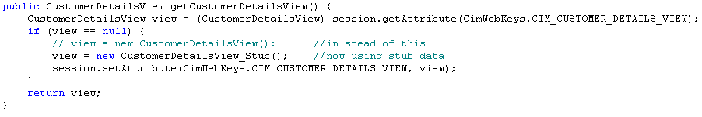
Appendix A
Stub - Testing for JSP flow (with event)
Knowledge on Controller is required to do the following suggestion. Please go through the training material for Controller first.
In <slave>RequestTranslator, make the processRequest() method to return appropriate event.
In <slave>ScreenFlowManager, make the getScreen() method to return the appropriate JSP.
Copy stub data object to view object in <slave>ViewManager.java.
In JSP, get the view object from session.
CustomerDetailsView view = (CustomerDetailsView) session.getAttribute(CimWebKeys.CIM_CUSTOMER_DETAILS_VIEW);
This will return CustomerDetailsView_Stub

Slide 38
Thank you

