Slide 1
Scaping Data with R
Application Programmeable Interface (API)

Slide 2
Agenda
3 mins
Left: 72 mins
Total: 75 mins
What are APIs?
Getting data from REDCap: Intro of HTTP methods
Getting data from Google sheet
Getting data from NCBI database
Classwork #1
Unit 2 Mini project – progress follow-up

Slide 3

7 mins
Left: 65 mins
Total: 75 mins
Reference: https://www.youtube.com/watch?v=OVvTv9Hy91Q

Slide 4
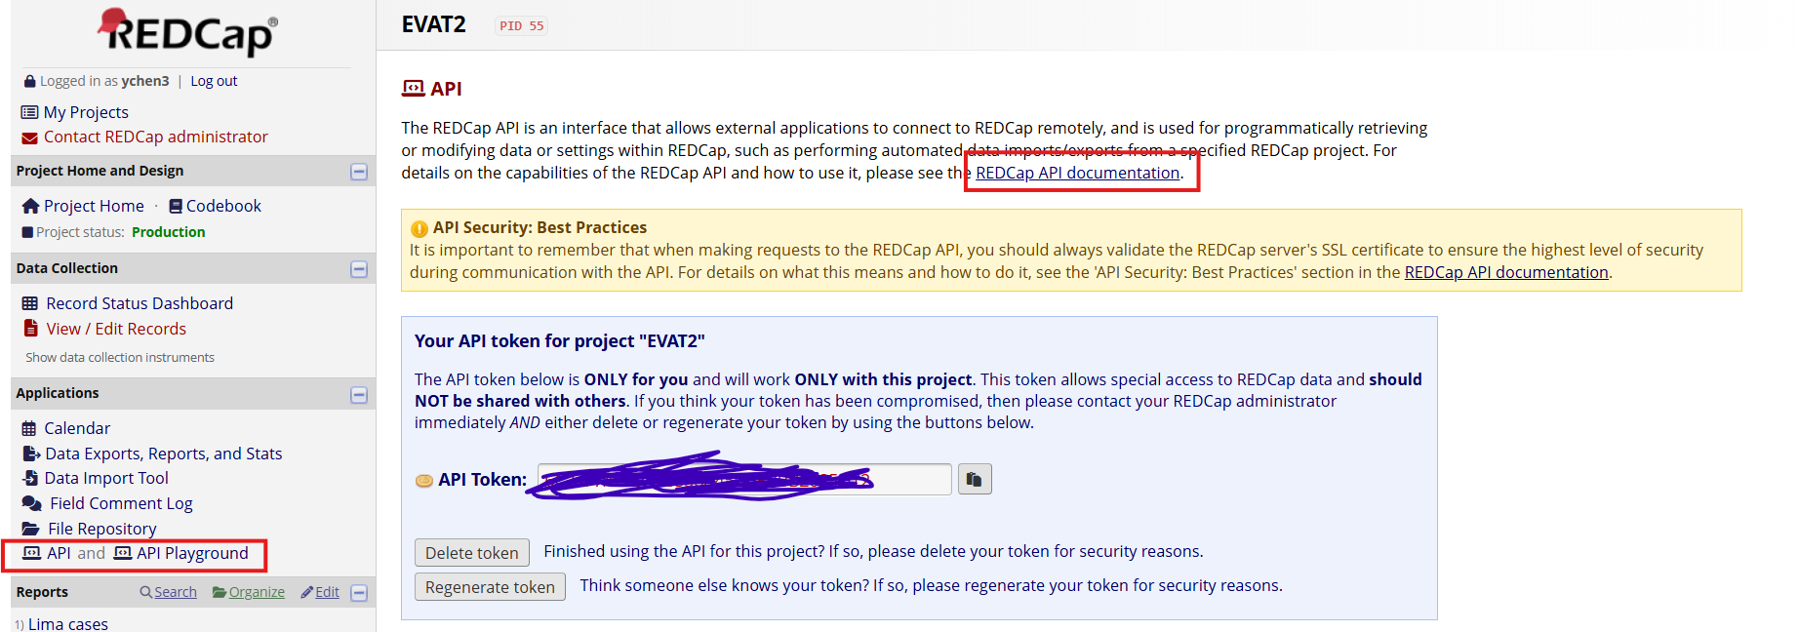
Getting data from REDCap: Intro of HTTP methods
15 mins
Left: 40 mins
Total: 75 mins
Request REDCap API Token
REDCap API Document

Slide 5
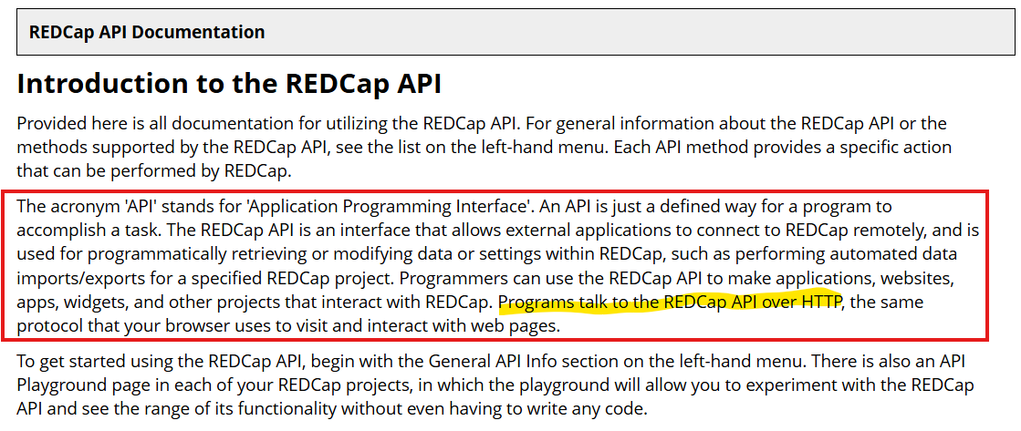
Getting data from REDCap: Intro of HTTP methods (cont.)

Slide 6
Getting data from REDCap: Intro of HTTP methods (cont.)
HTTP methods define the type of action a client wants to perform on a resource identified by a URL. These methods are fundamental to how web services and APIs function, enabling interactions like creating, reading, updating, and deleting data
Client = Application (e.g. R)
Resource = REDCap API
Action = create, read, update, delete data, etc.
The most commonly used HTTP methods include: GET, POST, PUT, DELETE, etc.
Reference: google HTTP methods

Slide 7
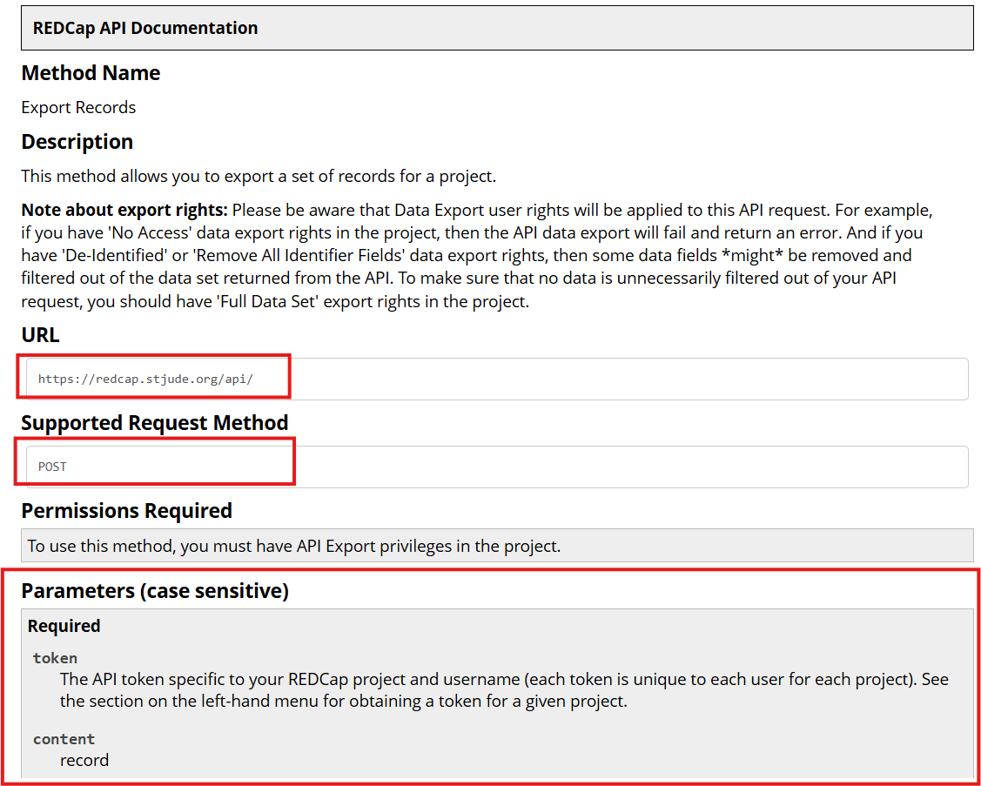
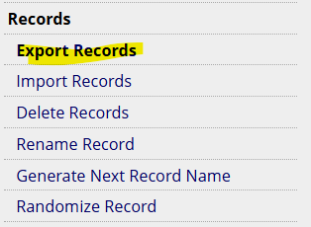
Getting data from REDCap: Intro of HTTP methods (cont.)

Slide 8
Getting data from REDCap: Intro of HTTP methods (cont.)
REDCap API Playground

Slide 9
Getting data from Google sheet
5 mins
Left: 35 mins
Total: 75 mins
Google Sheet → Google API → R
URL, token, parameters, HTTP method, etc..
Google Sheet →R package: googledrive, googlesheets4
Tidyverse developers simply the API process for us. They developed another API (tidyverse API) which can be used to wrap up url, token, parameters, methods for Google API
Google Sheet → Google API → Tidyverse API → R
More dependency, less flexible
Reference: https://googlesheets4.tidyverse.org/

Slide 10
Getting data from NCBI database
10 mins
Left: 25 mins
Total: 75 mins
The National Center for Biotechnology Information (NCBI) provides many useful products, including PubMed, PubMed Central, PubChem, Gene, and Genome. In addition to the web interfaces to these products, NCBI also provides an API allowing programmatic access to the underlying databases and search technology.
Most NCBI databases, including PubMed, are hosted on the Entrez platform. All Entrez databases use the same API interfaces, referred to as the Entrez Programming Utilities, or E-utilities.
Getting started with the PubMed API: https://library.cumc.columbia.edu/kb/getting-started-pubmed-api
E-Utilities Introduction: https://www.youtube.com/watch?v=BCG-M5k-gvE

Slide 11
Getting data from NCBI database (cont.)
NCBI Database (Entrez)→ Entrez API → R
URL, token, parameters, HTTP method, etc..
NCBI Database (Entrez)→ R package: rentrez
More dependency, less flexible

Slide 12
Getting data from NCBI database (cont.)
entrez query
https://pubmed.ncbi.nlm.nih.gov/advanced/
Example
Title includes: childrens oncology group
Language: English
Publication type: journal article
Publication date: 2000 - 2020

Slide 13
Classwork #1
15 mins
Left: 10 mins
Total: 75 mins
Option 1:
Create a googlesheet and read it into R through API
Create a second tab in the google sheet, explore how to read the second tab into R through API
Option 2:
Set up an entrez query in PubMed and search
Do the same esearch in R through API
Get abstract for one result article

Slide 14
Unit 2 Mini Project
10 mins
Left: 0 mins
Total: 75 mins
Progress follow-up

