Slide 1
SQL Connection Testing
Yichen Chen
9/11/2025

Slide 2
SQL Connection Testing
Connecting to DataWrangling2025 SQL Server through SSMS
Connecting to DataWrangling2025 SQL Server through R
Connecting to DataWrangling2025 SQL Server through SAS Server

Slide 3
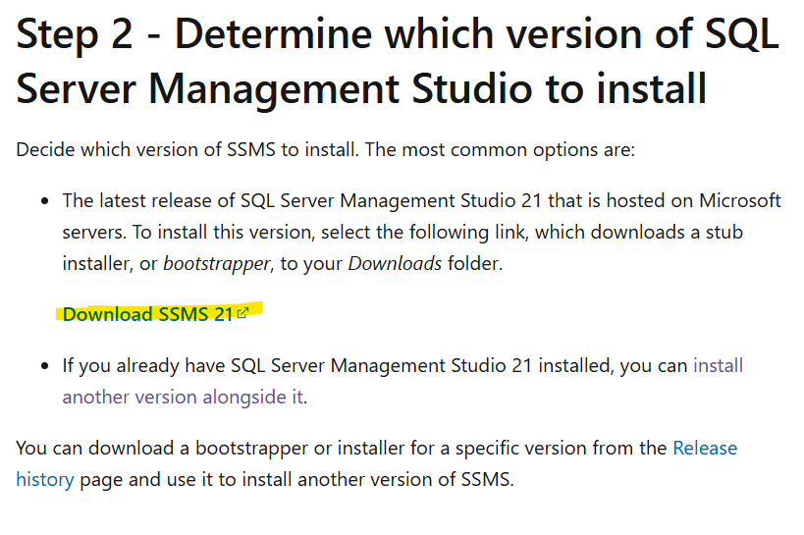
Connecting to DataWrangling2025 SQL Server through SSMS
Install SSMS (https://learn.microsoft.com/en-us/ssms/install/install)

Slide 4
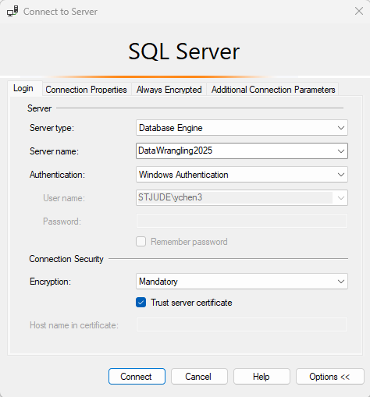
Connecting to DataWrangling2025 SQL Server through SSMS (cont.)
Login
information

Slide 5
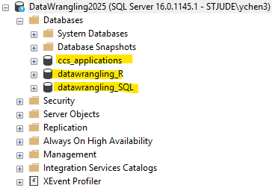
Connecting to DataWrangling2025 SQL Server through SSMS (cont.)
Expected result: You should see three databases

Slide 6
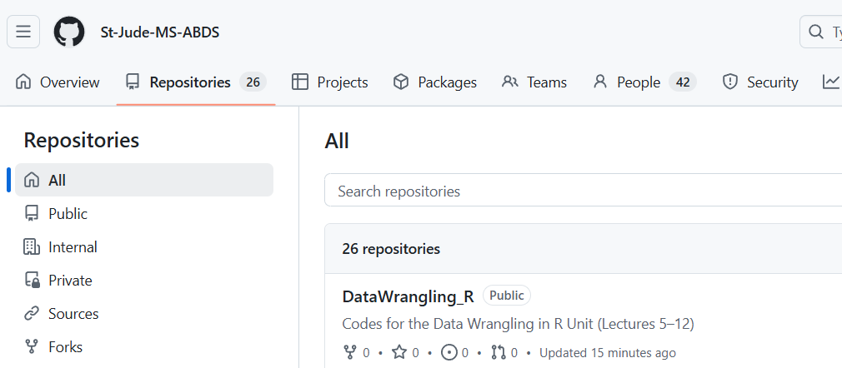
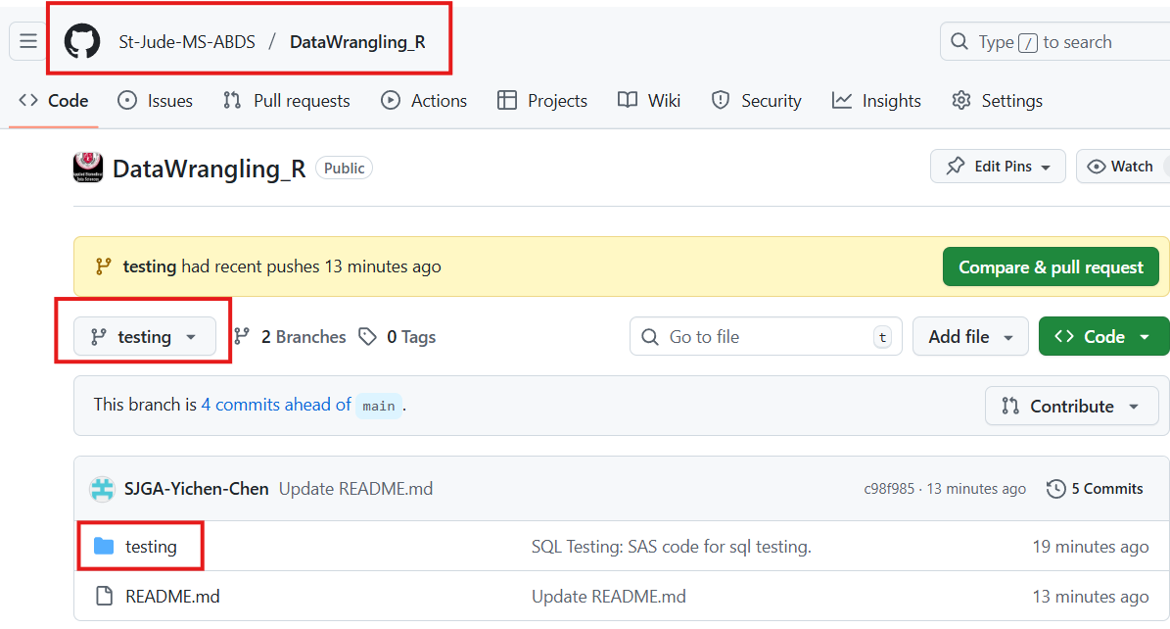
Connecting to DataWrangling2025 SQL Server through R
Repository DataWrangling_R in St. Jude MS ABDS, Github
Branch testing

Slide 7
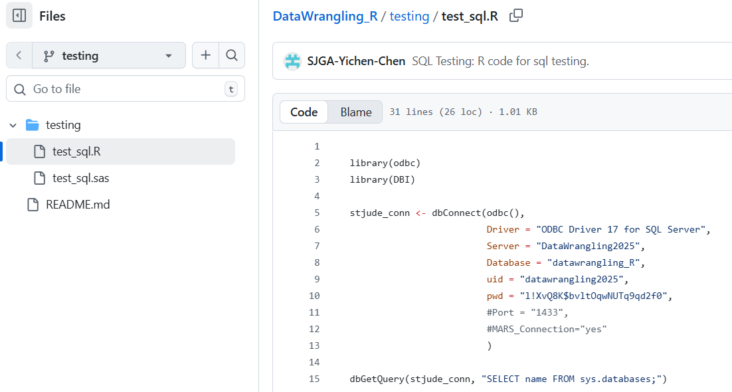
Connecting to DataWrangling2025 SQL Server through R (cont.)
Run test_sql.R in RStudio on your laptop
See next slide for the expected output
If you do not see the expected outputs, email Yichen.chen@stjude.org with screenshot

Slide 8
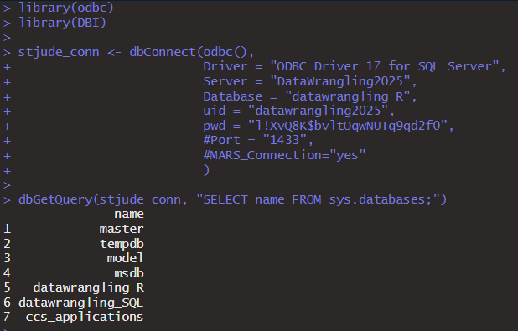
Connecting to DataWrangling2025 SQL Server through R (cont.)
Expected output from test_sql.R

Slide 9
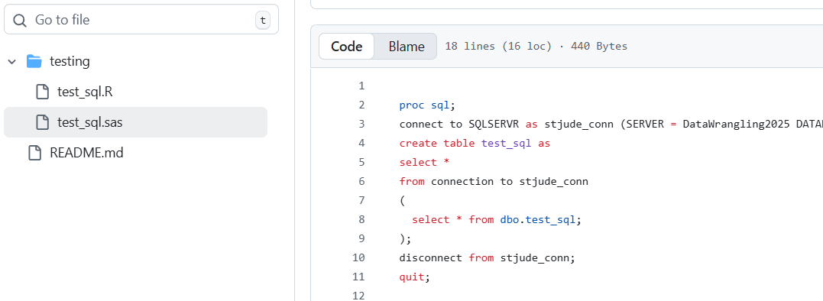
Connecting to DataWrangling2025 SQL Server through SAS Server
Run test_sql.sas in SAS Studio
See next slide for the expected output
If you do not see the expected outputs, email Yichen.chen@stjude.org with screenshot

Slide 10
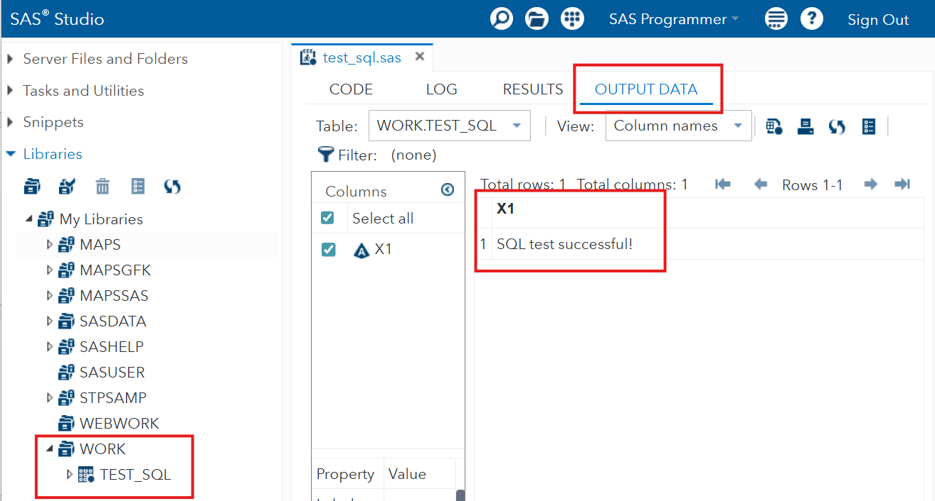
Connecting to DataWrangling2025 SQL Server through SAS Server (cont.)
Expected output from test_sql.sas

