Slide 1
Data Wrangling in R
Yichen Chen & Lei Wang
10/8/2025 (Wed) – 10/13/2025 (Mon)

Slide 2
5 mins
Left: 70 mins
Total: 75 mins
Unit 2: Data Wrangling in R
Faculty: Yichen Chen, Lei Wang
Timeframe: This unit is delivered over 4 days with 8 sessions (October 8-13, 2025)
Overview:
This unit provides a comprehensive introduction to essential data handling skills in R, from importing data through files, SQL, and APIs to organizing it with data frames. Students will develop techniques for managing text, categorical, and date data, while also learning strategies to address missing values and outliers. The unit concludes with reshaping and combining datasets, equipping learners with practical tools to prepare and structure data for effective analysis and modeling.
Tasks to Complete:
Importing data into R through files, SQL and APIs
Working with different data types in R – data frame, string, factor, time and date
Handling Missing Data & Outliers in R
Reshaping and combining data in R
Complete the Mini Project – Data Wrangling in R (Unit 2): insert R lines into an R Markdown file to import data, manipulate data and handle missing data and outliers by following instructions.
Unit 2 has no quiz. Unit score distributed as Participation (10%), in-class work (20%) and mini project (70%)

Slide 3
Importing Data into R
File reading and SQL basic
Yichen Chen
10/8/2025

Slide 4
Agenda
2 mins
Left: 68 mins
Total: 75 mins
Review R Environment
Reading files into R: excel and SAS
Loading and saving R data
Classwork #1
SQL Basics
Pulling data from SQL to R
Classwork #2
Unit 2 Mini Project

Slide 5
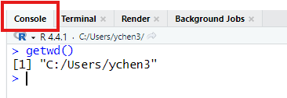
Review R Environment - Working Directory
5 mins
Left: 63 mins
Total: 75 mins
What is working directory?
The working directory in R refers to the default location where R will look for files you want to load and where it will save any files you create. It is essentially the "home base" for your R session.
Check current working directory: getwd()
R always has a current working directory even without your setting.
Change working directory: setwd()

Slide 6
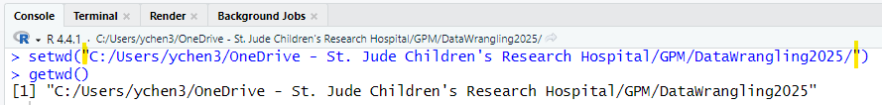
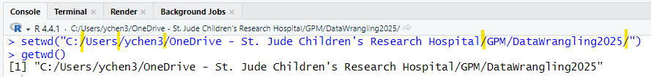
Review R Environment - Working Directory (cont.)
Change working directory: setwd()
Input path in R
Path should be provided in quote (double quote is suggested)
Use forward slash (/) in path, since backward slash is a reserved keyword in R

Slide 7
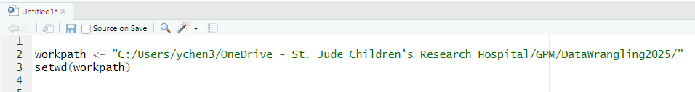
Review R Environment - Working Directory (cont.)
Best practice: always set up working directory at the top of your R code
Working directory in R Markdown code:
No need to manually set up working directory in R Markdown code (.rmd)
R studio automatically uses storage location of a .rmd file as its working directory

Slide 8
Reading Excel file into R - CSV
8 mins
Left: 55 mins
Total: 75 mins
read.csv(file, header = TRUE, na.strings = "NA", skip = 0, check.names = TRUE, stringAsFactors = FALSE)
Arguments (commonly used)
header | a logical value indicating whether the file contains the names of the variables as its first line. If missing, the value is determined from the file format: header is set to TRUE if and only if the first row contains one fewer field than the number of columns.
na.strings | a character vector of strings which are to be interpreted as NA values. Blank fields are also considered to be missing values in logical, integer, numeric and complex fields. Note that the test happens after white space is stripped from the input (if enabled), so na.strings values may need their own white space stripped in advance
skip | integer: the number of lines of the data file to skip before beginning to read data.
check.names | logical. If TRUE then the names of the variables in the data frame are checked to ensure that they are syntactically valid variable names. If necessary they are adjusted (by make.names) so that they are, and also to ensure that there are no duplicates.
stringAsFactors | logical: should character vectors be converted to factors? Note that this is overridden by as.is and colClasses, both of which allow finer control.
Get help in R: type ?read.csv in Console pane

Slide 9
Reading Excel file into R – XLSX and XLS
5 mins
Left: 50 mins
Total: 75 mins
library(readxl)
readxl::read_xlsx(path, sheet=NULL, range=NULL, col_names = TRUE, na="", skip = 0)
readxl::read_xls()
readxl::read_ excel()
Arguments (commonly used): range, col_names, na, skip
Reference: https://readxl.tidyverse.org/
Get help in R: type ?readxl::read_xlsx in Console pane

Slide 10
Reading SAS file into R
2 mins
Left: 48 mins
Total: 75 mins
library(haven)
haven::read_sas(data_file)
Get help in R: type ?haven::read_sas in Console pane

Slide 11
Saving R Data
3 mins
Left: 45 mins
Total: 75 mins
Save entire workspace (i.e. all objects in the Global Environment) to R data
save.image(file=“xxx.RData”)
Save specific objects to R data
save(list = character(), file=“xxx.RData”)
Get help in R: type ?save.image in Console pane

Slide 12
Loading R Data
5 mins
Left: 40 mins
Total: 75 mins
Load R data to Global Environment
load(“xxx.Rdata”)
Create an environment and load R data to the new environment
myenv <- new.env()
load(“xxx.Rdata”, envir=myenv)
mydata <- myenv[[“mydata”]]
# “copy” mydata from myenv to global environment

Slide 13
Classwork #1 Reading files into R
10 mins
Left: 30 mins
Total: 75 mins
Download CSV and SAS data from Github DataWrangling_R
Set working directory
Reading CSV into R
Skip row 1 and 2
Use row 3 as column name
Treat periods (.) as missing values
Keep the column name "diagnosis date" exactly as it appears (disable check.names)
Reading SAS into R, print dimension and column names of the data
Save imported CSV and SAS data to a .RData

Slide 14
SQL Basic
Pulling data from SQL to R

Slide 15
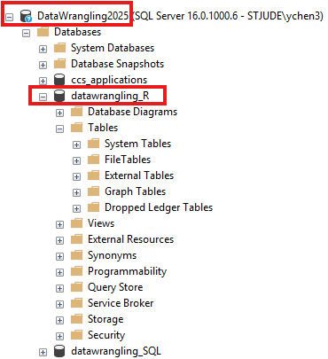
SQL Basic
5 mins
Left: 25 mins
Total: 75 mins
SQL – Structured Query Language
The standard language (ANSI 1986, ISO 1987) for accessing and manipulating databases
SQL database: SQL’s core syntax is largely consistent across different relational database management system (RDBMS), like Microsoft SQL Server, MySQL, Oracle, etc.
Basic structure: schema, tables
Reference: SQL introduction from W3Schools.com
Notes:
In this short session, we’ll get a high-level introduction to SQL — what it is, why it’s important — and how we connect applications to databases using ODBC and DSN.
"SQL stands for Structured Query Language. It’s the standard language used to interact with relational databases — systems that store data in tables with rows and columns. The power of SQL lies in its universality — the same basic commands work across different database systems."

Slide 16
SQL Basic (cont.)
ODBC - Open Database Connectivity, a standard way to access data from various database management systems.
DSN - Data Source Name, stores the connection details needed by ODBC to connect to a specific database
Application <----> ODBC Driver (DSN) <----> Database
Notes:
Application <----> ODBC Driver <----> Database
"Now, how does your application — say, Excel, Python, or a web app — talk to a database? This is where ODBC — Open Database Connectivity — comes in. Think of ODBC as a translator between your application and the database. You don’t need to write different code for each database — ODBC drivers handle that for you."
"Each database system (like MySQL, SQL Server, or Oracle) provides its own ODBC driver. As long as the driver is installed, your app can use standard ODBC calls to connect and run SQL queries.“
Application
↓
ODBC
↓
DSN (Connection Settings)
↓
Database
"To make connecting easier, we use a DSN, or Data Source Name. A DSN stores the connection details needed by ODBC to connect to a specific database — things like:
Database type
Server name or IP
Database name
Authentication details (username/password)
Driver being used"
"You can set up DSNs at three levels:
User DSN: Only visible to the current user
System DSN: Available to all users on the machine
File DSN: Stored in a .dsn file, portable between systems"

Slide 17
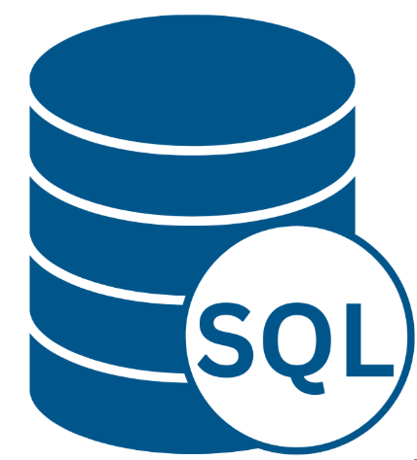

SQL Basic (cont.)
ODBC
Application:
You
ODBC:
Wireless service
Database:
Your friend John
Notes:
ODBC is like the telephone network — it knows how to make the call happen, regardless of which phone brand (database type) your friend is using.
Each type of phone (MySQL, SQL Server, Oracle) might need its own protocol — that’s like an ODBC driver.
🗣️ You say, “Call John,” and ODBC handles the technical part of dialing, connecting, and transmitting the voice.

Slide 18
SQL Basic (cont.)
ODBC:
Wireless service
ODBC
DSN
DSN:
John’s contact in
your phone book
Application:
You
Database:
Your friend John
Notes:
2. DSN = The Contact Name in Your Phone
Instead of remembering and typing your friend’s full phone number every time, you save it as a contact — e.g., “John” in your phone book.
The contact stores details like:
Phone number
Country code
Type of phone (mobile, home, work)
📇 In database terms, DSN stores:
Server name or IP
Database name
Driver to use
Username/password
So now you just say, “Call John”, and your phone automatically uses all the stored details.

Slide 19
SQL Query for Data Pulling
5 mins
Left: 20 mins
Total: 75 mins
SELECT * from [schema].[table]
* Select all columns from the table
SQL Query in R
stjude_conn <- dbConnect(odbc(), dsn = "DW_R")
dbGetQuery(statement = "SELECT * from [schema].[table]",
conn = stjude_conn)

Slide 20
Classwork #2 Pulling data from SQL to R
10 mins
Left: 10 mins
Total: 75 mins
Connect to SQL Server DataWrangling2025, database datawrangling_R (DSN DW_R)
Pulling dbo.cleveland by using SQL query

Slide 21
Unit 2 Mini Project
10 mins
Left: 0 mins
Total: 75 mins
https://stjude.instructure.com/courses/2234/assignments/12383

