Slide 1
SQL Connection Testing
Yichen Chen
Last update 9/24/2025

Slide 2
SQL Connection Testing
Connecting to DataWrangling2025 SQL Server through SSMS
Repository DataWrangling_R in St. Jude MS ABDS, Github
Connecting to DataWrangling2025 SQL Server through SAS Server
Using data source name (DSN)
Using proc sql
Connecting to DataWrangling2025 SQL Server through R
Adding DSN into Windows OS
Using DSN

Slide 3
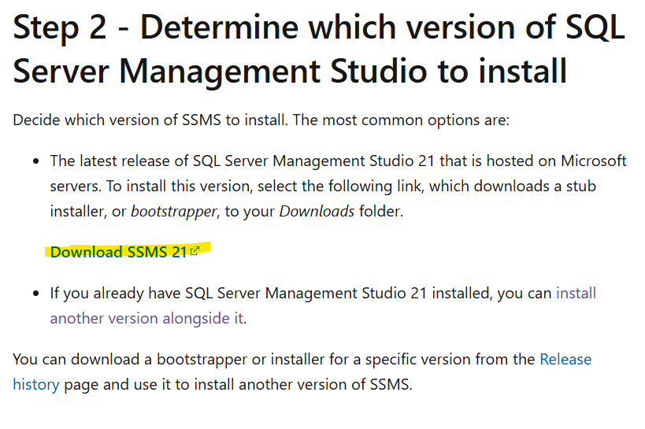
Connecting to DataWrangling2025 SQL Server through SSMS
Install SSMS (https://learn.microsoft.com/en-us/ssms/install/install)

Slide 4
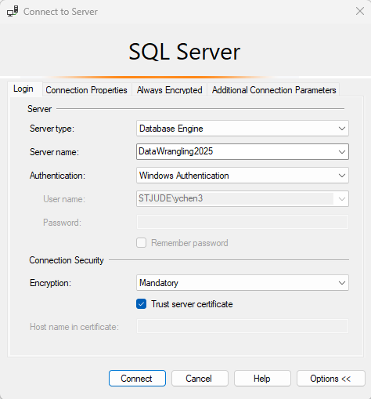
Connecting to DataWrangling2025 SQL Server through SSMS (cont.)
Login
information

Slide 5
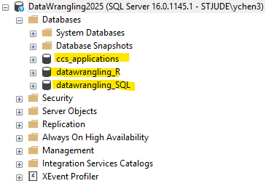
Connecting to DataWrangling2025 SQL Server through SSMS (cont.)
Expected result: You should see three databases

Slide 6
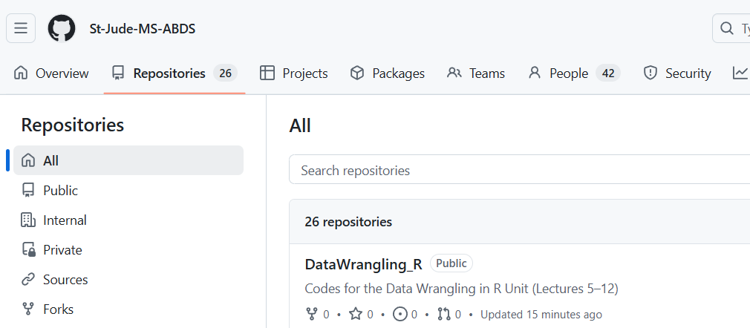
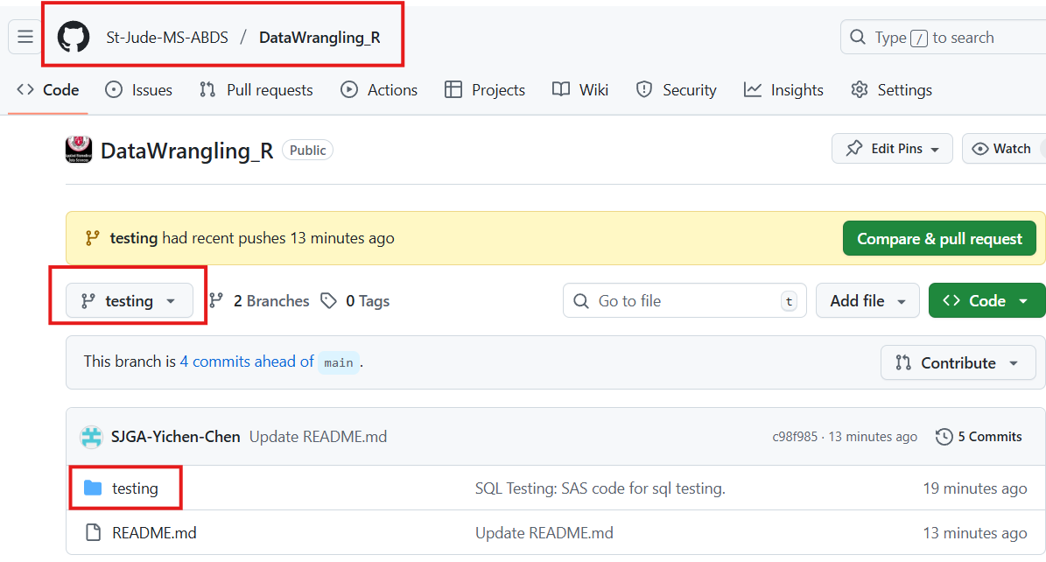
Repository DataWrangling_R in St. Jude MS ABDS, Github
Repository DataWrangling_R in St. Jude MS ABDS, Github
Branch testing

Slide 7
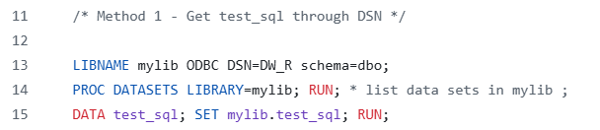
Connecting to DataWrangling2025 SQL Server through SAS Server
Using data source name (DSN)
Run test_sql.sas (lines 13-15) in SAS Studio
See next slide for the expected output
If you do not see the expected outputs, email Yichen.chen@stjude.org with screenshot

Slide 8
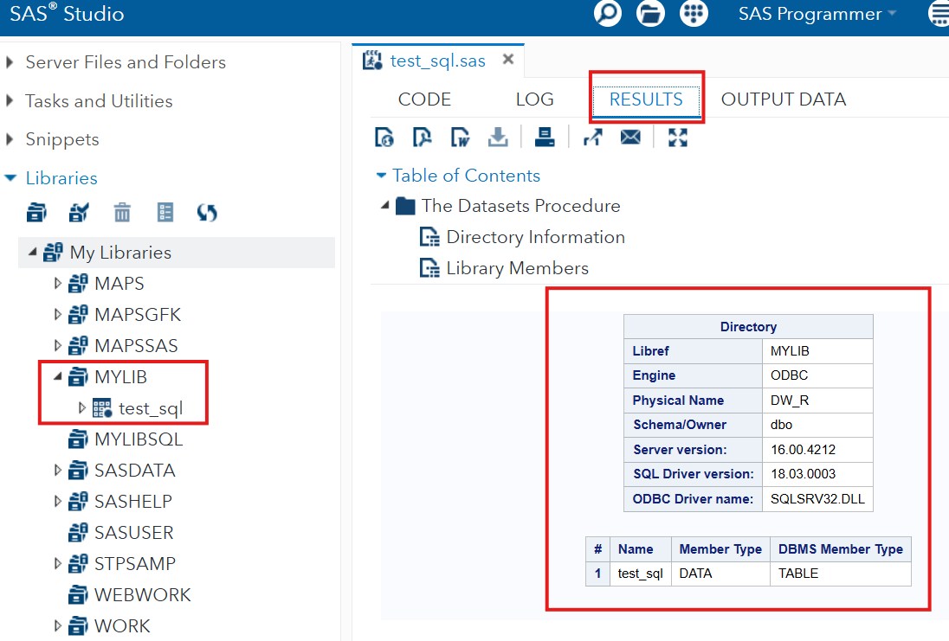
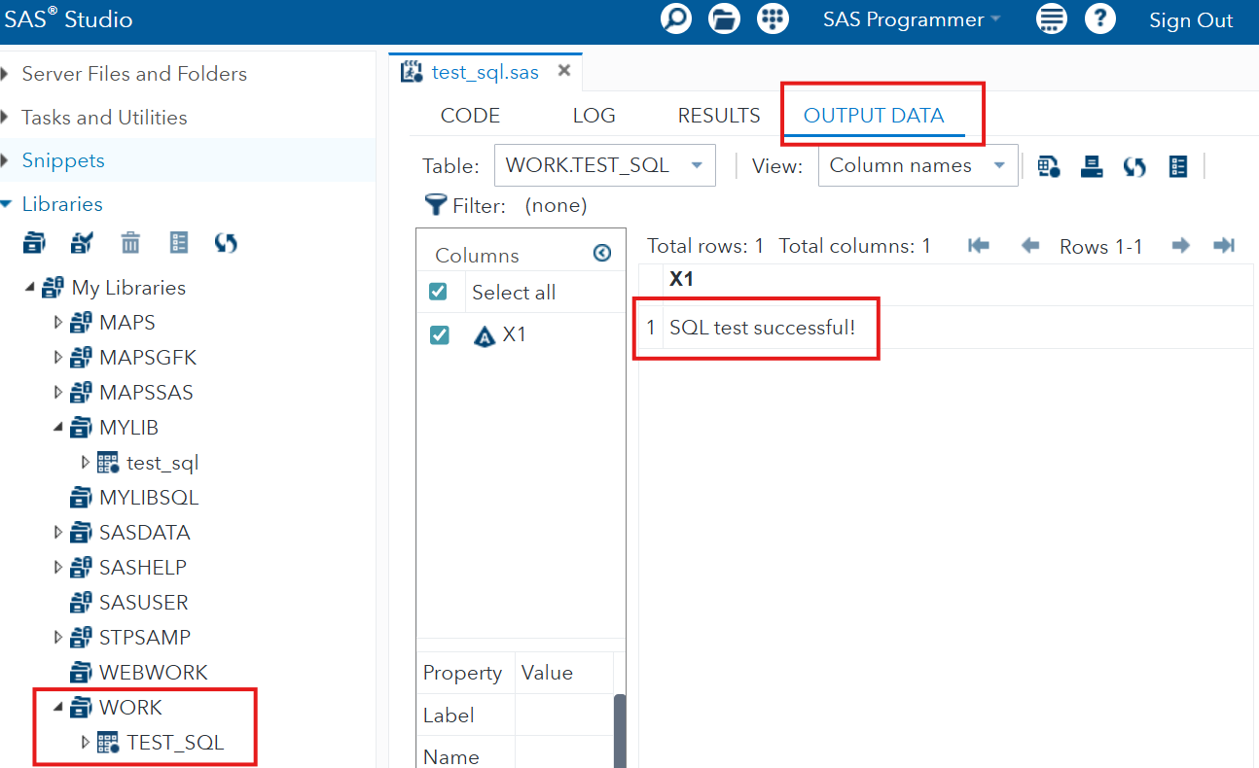
Connecting to DataWrangling2025 SQL Server through SAS Server (cont.)
Expected output from method 1 - DSN

Slide 9
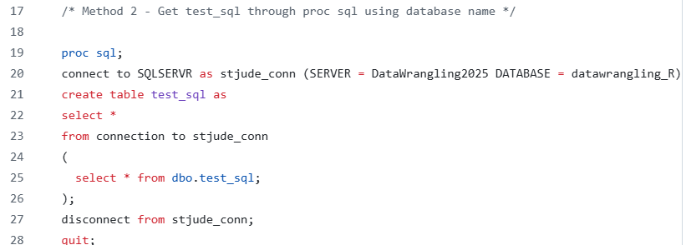
Connecting to DataWrangling2025 SQL Server through SAS Server (cont.)
Using proc sql
Run test_sql.sas (lines 19-28) in SAS Studio
See next slide for the expected output
If you do not see the expected outputs, email Yichen.chen@stjude.org with screenshot

Slide 10
Connecting to DataWrangling2025 SQL Server through SAS Server (cont.)
Expected output from method 2 – proc sql

Slide 11
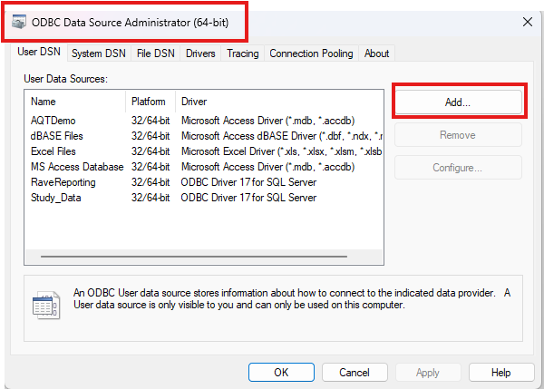
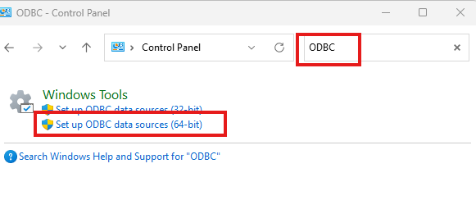
Connecting to DataWrangling2025 SQL Server through R
Adding DSN - DW_R into Windows OS
Control panel -> ODBC Data Source Administrator -> Add

Slide 12
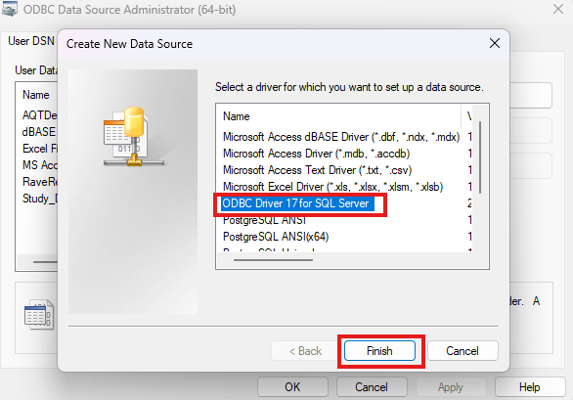
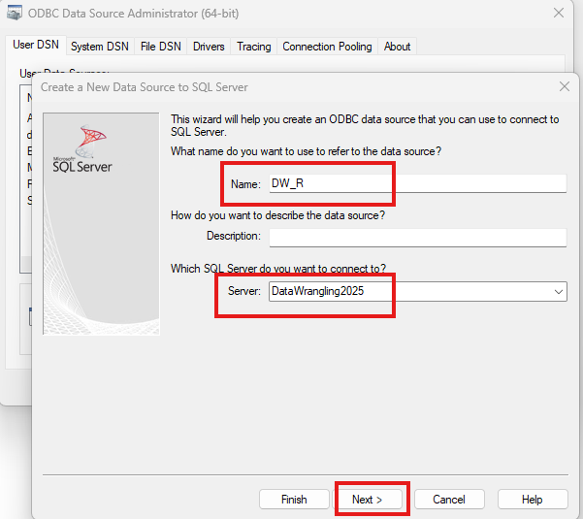
Connecting to DataWrangling2025 SQL Server through R (cont.)
Adding DSN - DW_R into Windows OS
2. Select “ODBC Driver 17 for SQL Server” -> Finish
3. Name: DW_R -> Server: DataWrangling2025 -> Next

Slide 13
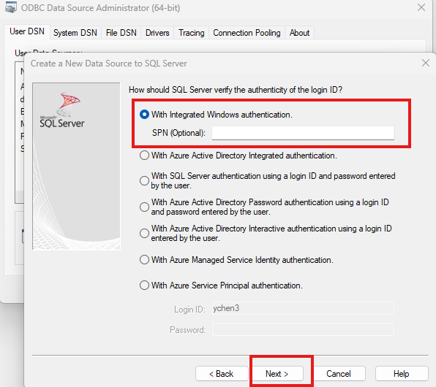
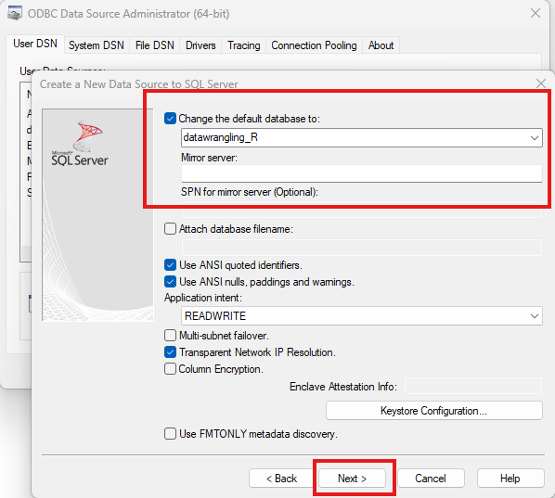
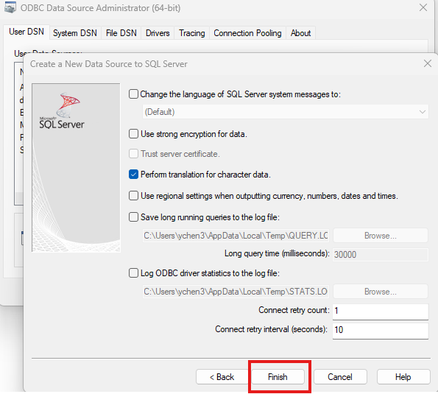
Connecting to DataWrangling2025 SQL Server through R (cont.)
Adding DSN - DW_R into Windows OS
4. Windows authentication -> Next
5. Check “Change the default database to” -> select datawrangling_R -> Next
6. Click “Finish”

Slide 14
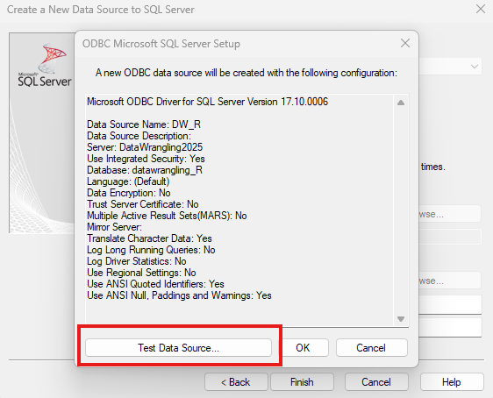
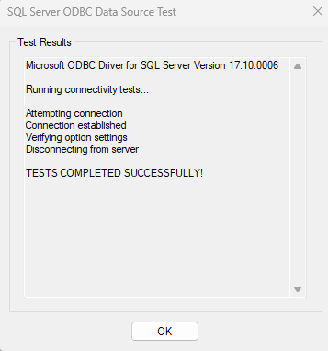
Connecting to DataWrangling2025 SQL Server through R (cont.)
Adding DSN - DW_R into Windows OS
7. Test data source -> “Test completed successfully!” -> OK -> OK

Slide 15
Connecting to DataWrangling2025 SQL Server through R (cont.)
Adding DSN - DW_SQL into Windows OS
Control panel -> ODBC Data Source Administrator -> Add
Select “ODBC Driver 17 for SQL Server” -> Finish
Name: DW_SQL -> Server: DataWrangling2025 -> Next
Windows authentication -> Next
Check “Change the default database to” -> select datawrangling_SQL -> Next
Click “Finish”
Test data source -> “Test completed successfully!” -> OK -> OK

Slide 16
Connecting to DataWrangling2025 SQL Server through R (cont.)
Adding DSN - DW_CCS into Windows OS
Control panel -> ODBC Data Source Administrator -> Add
Select “ODBC Driver 17 for SQL Server” -> Finish
Name: DW_CCS -> Server: DataWrangling2025 -> Next
Windows authentication -> Next
Check “Change the default database to” -> select ccs_applications -> Next
Click “Finish”
Test data source -> “Test completed successfully!” -> OK -> OK

Slide 17
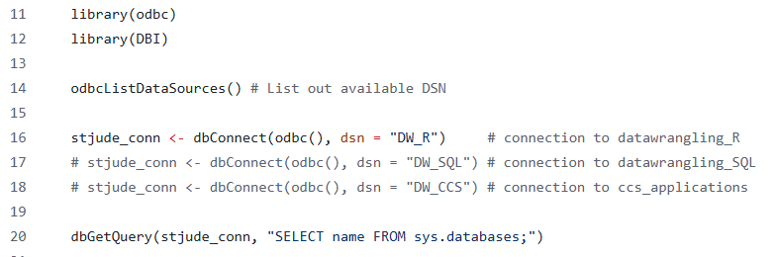
Connecting to DataWrangling2025 SQL Server through R (cont.)
Run test_sql.R in RStudio on your laptop
See next slide for the expected output
If you do not see the expected outputs, email Yichen.chen@stjude.org with screenshot

Slide 18
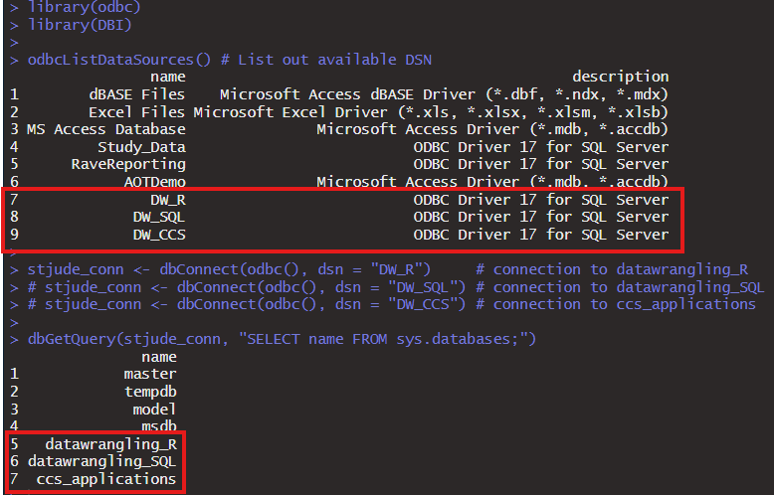
Connecting to DataWrangling2025 SQL Server through R (cont.)
Expected output from test_sql.R

