Slide 1

NepAirWatch
Real-time air-quality monitoring & early warning for Nepal
with Apache Kafka + Apache Spark
[Student Name 1] · [Student Name 2]
Big Data — Implementation Task · Demo
Notes:
Introduce the team and the one-line pitch: a big-data platform that turns raw air-quality data into real-time alerts and 6-hour forecasts for 15 Nepali cities.

Slide 2
Nepal breathes unsafe air on most days of the year
270
days Biratnagar broke Nepal's 24-h PM2.5 standard (40 µg/m³)
174
days Kathmandu broke the national standard
204
days even "clean" Pokhara exceeded the WHO guideline
Notes:
Problem: winter inversions in the Kathmandu bowl, Indo-Gangetic haze in the Terai, brick kilns, traffic, burning. Few ground stations, no city-level early warning, no Nepali advice. These numbers come from our own Spark analysis of one year of data.

Slide 3




Problem definition: what is missing today
Sparse monitoring
No early warning
Reference stations sit mostly in Kathmandu Valley; Terai and far-west cities are largely unmonitored.
Schools, hospitals and outdoor workers learn about bad air only after they are exposed.
Numbers, not advice
No policy evidence
µg/m³ means little to citizens. People need colour categories and advice in Nepali.
Authorities lack long-term, multi-city evidence of when and where standards are breached.
Notes:
Goal: a unified, real-time, nationwide system that monitors, explains, warns ahead of time and builds policy evidence. Stakeholders: citizens, schools, hospitals, DoEnv, MoHP, municipalities.

Slide 4



Data sources: 15 cities across all 7 provinces
Open-Meteo Air-Quality API
Copernicus CAMS model · PM2.5, PM10, CO, NO₂, SO₂, O₃, dust · hourly
131,775
city-hour records ingested (1 year)
Open-Meteo Weather APIs
17
Temperature, humidity, wind, rain, boundary-layer height · hourly
attributes per record
Extensions (same topic)
5,707 files · 47.2 MB
DoEnv ground stations · low-cost IoT sensors · NASA FIRMS fires
partitioned Parquet lake
Koshi: Biratnagar, Dharan · Madhesh: Janakpur, Birgunj · Bagmati: Kathmandu, Lalitpur, Bhaktapur, Hetauda, Bharatpur · Gandaki: Pokhara · Lumbini: Butwal, Nepalgunj · Karnali: Surkhet · Sudurpashchim: Dhangadhi, Mahendranagar
Notes:
Free public APIs, no key, fully reproducible. Producer merges air quality + weather per city-hour into one JSON message. Velocity: hourly per city, live polling every 15 min; volume grows without bound; variety: pollutants + meteorology + future sensors.

Slide 5






Important features considered in the design
Scalability
Low latency
Fault tolerance
Kafka partitions (key = city) + Spark executors scale out horizontally
Structured Streaming micro-batches every 5–10 s → dashboard in seconds
Kafka 7-day retention + Spark checkpoints → resume or replay anytime
Idempotent results
Event-time correctness
Data quality
Upserts on (city, event_ts) and lake de-duplication → no double counting
Daily windows aligned to Nepal time (UTC+5:45), 3 h watermark
Schema-on-read, null and range checks (0–1000 µg/m³)
Notes:
Data features: PM2.5 (main), PM10/CO/NO2/SO2/O3/dust for source fingerprinting, boundary-layer height for inversions, wind, rain, humidity, temperature, city/province, event time, and derived AQI, lags and rolling means. Plus extensibility and Nepali localisation.

Slide 6
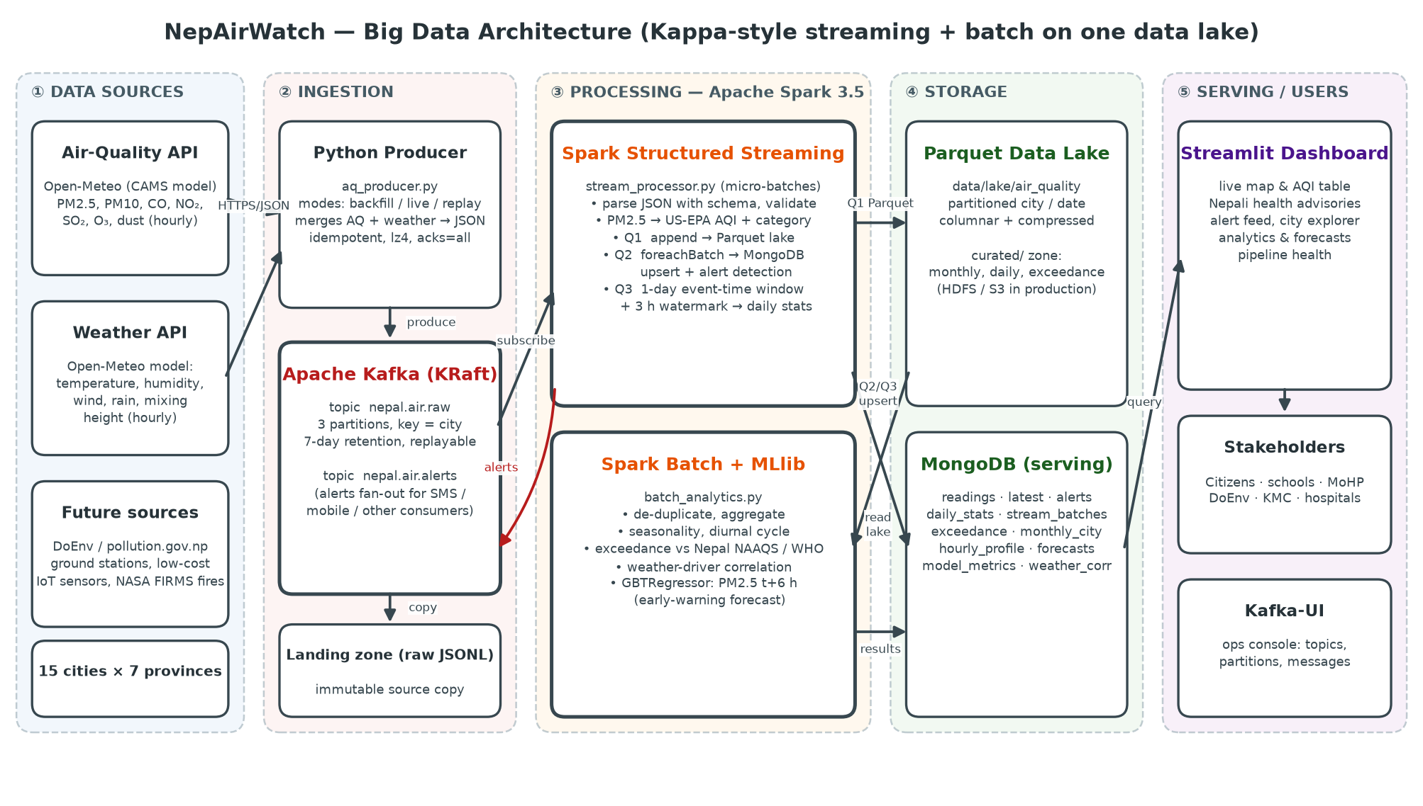
Architecture: Kafka ingests, Spark processes
Notes:
Walk left to right: sources → producer → Kafka topic nepal.air.raw → Spark Structured Streaming with three queries (lake, MongoDB+alerts, daily windows) → Parquet lake and MongoDB → Streamlit dashboard. Batch Spark + MLlib reads the lake and writes analytics and forecasts. Alerts go back to Kafka for SMS/app consumers. Kappa-style: one stream, replayable.

Slide 7
Why Kafka and Spark (vs. other ecosystem tools)
Need | Chosen | Alternatives | Why
Ingestion | Apache Kafka | Flume, RabbitMQ, Sqoop | Durable, partitioned, replayable log; many independent consumers
Stream processing | Spark Structured Streaming | Flink, Storm, Kafka Streams | One engine for stream + batch; event-time windows, watermarks, checkpoints
Batch + ML | Spark SQL + MLlib | MapReduce, Hive, Mahout | In-memory, much faster than disk MapReduce; SQL + distributed ML
Data lake | Parquet (HDFS / S3) | HBase, Hive on ORC | Columnar, compressed, partition pruning, engine-neutral
Serving DB | MongoDB | Cassandra, HBase, PostgreSQL | Flexible documents, secondary indexes, ms reads
Notes:
The two core big-data tools are Kafka and Spark. Parquet/HDFS and MongoDB are the storage components. Flink would give lower latency, but hourly data does not need it, and Spark gives one API for streaming, batch and ML.

Slide 8
Storage: each tier matches an access pattern
Kafka log
nepal.air.raw · nepal.air.alerts
append-only, 3 partitions, 7-day replay
Landing zone
raw JSON-Lines per city
immutable audit copy
Parquet lake
air_quality/city=…/date=…
columnar scans by Spark (→ HDFS/S3)
Curated zone
monthly · daily · exceedance
analytics-ready tables
MongoDB
readings · latest · alerts · forecasts …
indexed ms queries for dashboard
Change one setting (LAKE_PATH=hdfs://namenode:9000/nepairwatch) to move the lake onto HDFS with 3× replication. No code changes.
Notes:
Polyglot persistence: Kafka is the hot buffer and single source of truth; Parquet lake for cheap, scalable history; MongoDB for low-latency serving. The dashboard never scans the lake.

Slide 9
Spark Structured Streaming: one source, three queries
Kafka source
Parse + validate
Enrich
Q1 · Lake sink
subscribe nepal.air.raw
maxOffsetsPerTrigger 25k
from_json with schema
range & null checks
PM2.5 → AQI + category
(native Spark expression)
append Parquet partitioned by city / date (every 10 s)
Q2 · Serving + alerts
131,775
records streamed from Kafka through Spark into the lake and MongoDB
40,320
alert events published to the nepal.air.alerts topic
foreachBatch → MongoDB upserts, latest per city, AQI ≥ 151 → alerts (MongoDB + Kafka topic)
Q3 · Event-time window
1-day tumbling window aligned to Nepal midnight, 3 h watermark → daily_stats
Notes:
Idempotent: Q2 upserts on (city, event_ts), so replays don't double count. Checkpoints give exactly-once offset tracking. Alerts are fanned back out to Kafka so an SMS gateway can subscribe.

Slide 10
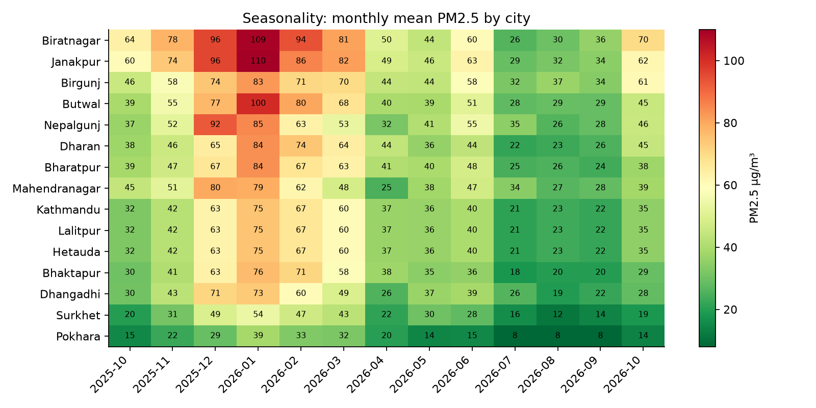
Pollution is seasonal: dry winter and spring are worst
Dec – Apr
Peak PM2.5: inversions, crop and forest fires, brick-kiln season
Jun – Sep
Monsoon rain washes particles out (wet deposition)
Terai > Valley > Hills
Indo-Gangetic haze makes Biratnagar, Janakpur and Birgunj the worst
Notes:
Spark batch aggregation of the full lake by city and month. Policy implication: time interventions such as kiln restrictions and school schedules to the dry season.

Slide 11
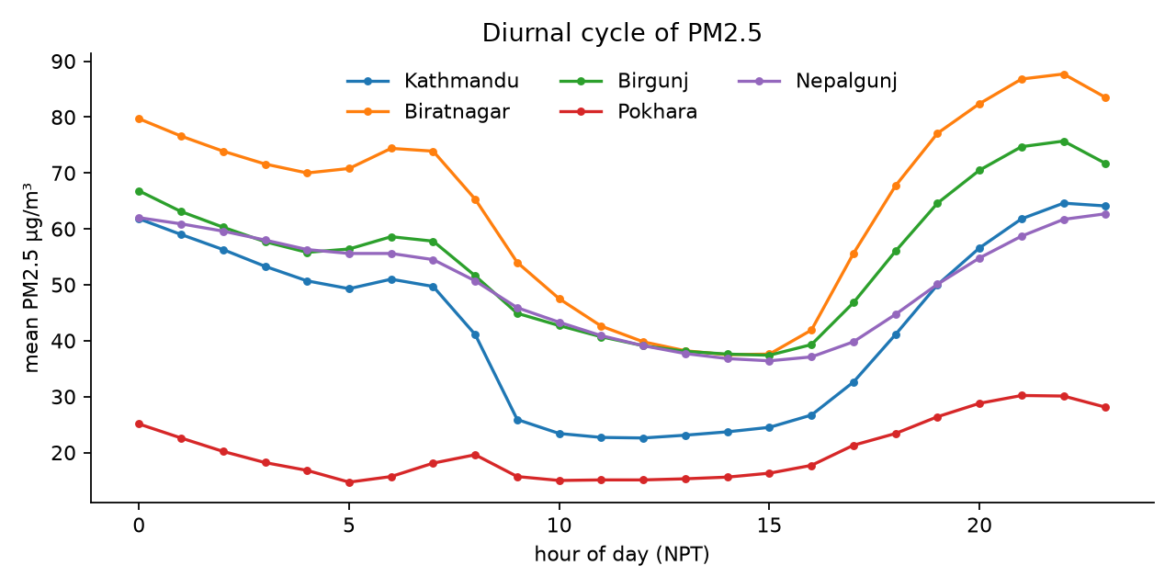
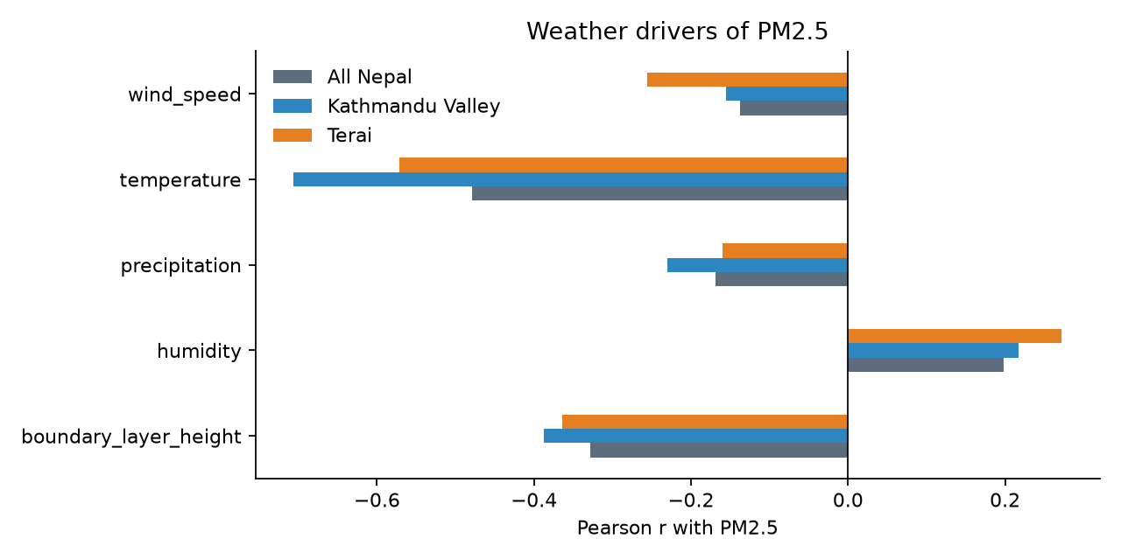
Weather explains the episodes
Night-time peak, midday dip: PM2.5 builds up after sunset when the boundary layer collapses and clears when the sun deepens the mixing layer.
Boundary-layer height r = -0.387 (Kathmandu Valley): this confirms the inversion mechanism, so weather forecasts can predict pollution.
Notes:
Pearson correlations computed with Spark DataFrame stat.corr across all city-hours, separately for the Valley and the Terai.

Slide 12
6-hour early warning with Spark MLlib
39%
lower RMSE than the
persistence baseline
0.67
R² on unseen data
(baseline 0.124)
10.31
RMSE µg/m³
(baseline 16.82)
GBTRegressor · 105,060 train / 26,265 test rows · time-based split · features: lags 1/3/6/24 h, 24 h mean, weather, hour, month, city
Notes:
Pipeline: StringIndexer → OneHotEncoder → VectorAssembler → GBTRegressor. A chronological split avoids leakage. The newest observation of each city is scored and shown as a 6-hour forecast on the dashboard.

Slide 13
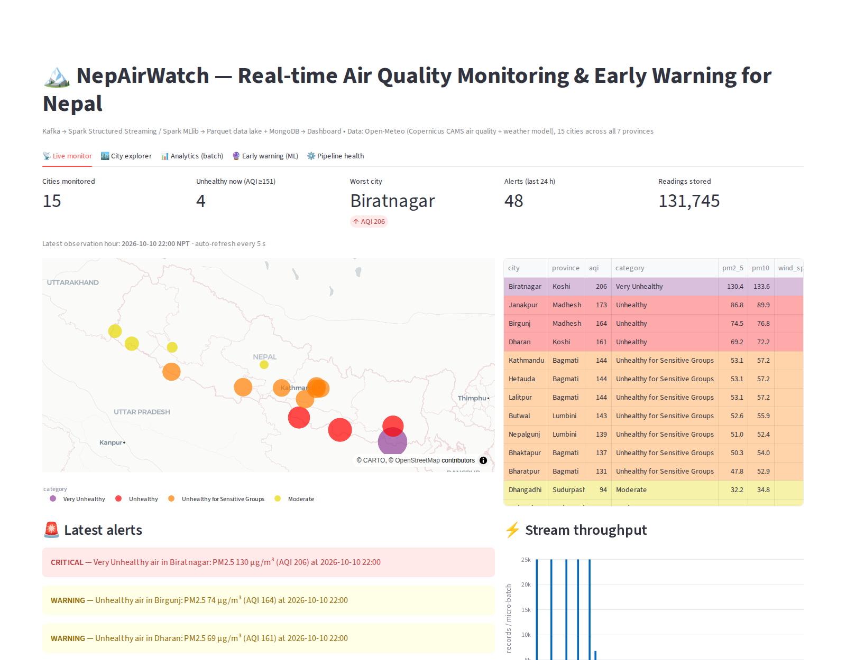
Live demo: the NepAirWatch dashboard
Demo flow
Kafka-UI: topic, partitions, messages
Start replay producer → Spark micro-batches
Live map, AQI table, Nepali advice
Alerts in dashboard + alerts topic
City explorer: inversion effect
Analytics and 6-hour forecast
Pipeline health: offsets, lake
Notes:
Commands: docker compose run --rm replay ; docker compose logs -f spark-streaming ; open localhost:8501 (dashboard), localhost:8080 (Kafka-UI), localhost:4040 (Spark UI).

Slide 14




Limitations and next steps
Fuse ground sensors
CAMS is a ~40 km model, so Kathmandu, Lalitpur and Hetauda share one grid cell. Add DoEnv stations and IoT sensors and apply bias correction.
Scale out
3-broker Kafka (RF 3), Spark on YARN or Kubernetes, lake on HDFS or S3, Parquet compaction or Delta Lake.
Deliver alerts
An SMS/Viber/push consumer on nepal.air.alerts for schools, hospitals and citizens.
Richer forecasts
NASA FIRMS fire counts, kiln calendars and traffic as features; longer horizons.
Notes:
Be honest about the model-resolution limitation; the architecture already supports adding sources through the same topic and schema.

Slide 15
Conclusion
Real problem
Two big-data tools
Unsafe PM2.5 on most days in the Terai and almost half of days in Kathmandu
Kafka (ingestion, replay, pub/sub) + Spark (streaming, SQL, MLlib)
Real-time + history
Early warning
Alerts in seconds; one year analysed from a partitioned data lake
6-hour PM2.5 forecast, 39% lower error than persistence
धन्यवाद · Thank you. Questions?
Notes:
Close with the impact: with ground-sensor fusion and SMS delivery this could serve as a national early-warning system.

