Slide 1



Bioinformatics project
Machine learning to infer active open chromatin regions from transcription initiation events
Student: Stefano Pellegrini
Supervisors: Robin Andersson, Marco Salvatore

Slide 2
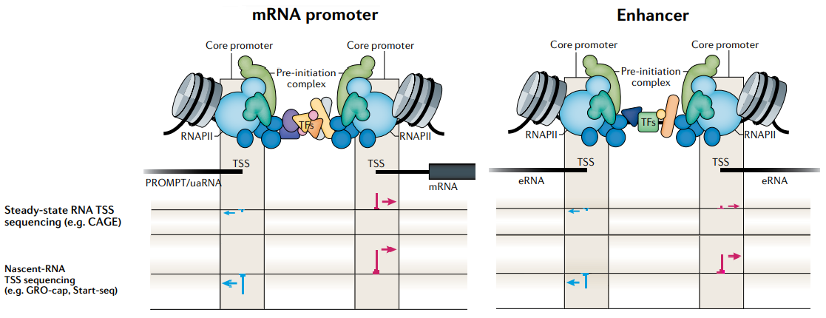
Background
Gene regulation Development and homeostasis
Transcriptional regulatory elements (TREs):
Promoter
Enhancer
Insulator
dREG (Danko et al. 2015)
Divergent transcription
Established genomic assays (e.g., Dnase-Seq, ChIP-Seq) often predict inactive elements
Robin Andersson and Albin Sandelin, 2020, Nature Review
Machine learning to detect characteristic patterns at TREs from GRO-Seq and PRO-Seq
Prediction of potential active TREs
Notes:
* GR is a foundamental process in all life form
* Prediction of TREs is an active topic in research
* Estabilished genomic assays for TREs identification such as ChIP-Seq and DNase-Seq do not provide direct evidence of transcription and often detect TREs that are not actively transcribed
* Describe image, mention what the pattern in normal cell

Slide 3
Aim of the study
Investigate the feasibility of using alternative approaches for the identification of potential active TREs from RNA TSS sequencing data
Use a single experiment (e.g. CAGE) to:
Measure gene expression by TSS quantification
Identification and quantification of potential active TREs
Our method
CAGE ATAC-Seq Supervised machine learning
Random forest
Gradient boosting based on decision trees (LightGBM)
Support vector machine
Notes:
* We will use the intersection between CAGE and ATAC-Seq data to label the data
* CAGE: to profile transcription initiation activity
* ATAC-Seq: to determine open chromatin regions
* ML: to train a model to detect characteristic patterns of divergent transcription initiation at TREs

Slide 4
Methods overview
Input extraction
ATAC-Seq data
Genome-wide detection of open chromatin regions
(removing hg38 blacklist overlaps)
GM 12878
ATAC-Seq positive regions
(Peaks extended both side)
ATAC-Seq nonoverlapping negative regions
(hg38 – ATAC positive)
CAGE profiles extraction
CAGE data
Positive set
Negative set
Remove intra-overlaps
(Rank approach)
Minimum requirement of transcription
(TSS score of 2)
Sampling
Final positive set
Final negative set
(equal size of positive set)
Negative set
(half size of positive set)
Negative set
(∼2.5 times larger than positive set)

Slide 5
Methods overview
Model development and evaluation
Final positive set
Final negative set
(equal size of positive set)
Multiscale feature vector
Split by chromosomes
Train set
Random forest
LightGBM
SVM
CV
Hyperparameters tuning
Final models
Test set
Models' evaluation
Notes:
Just say that for clarity I omitted to show here that all three datasets were used to train and evaluate the models, I only show the one that I chose cause that obtained the optimal results

Slide 6
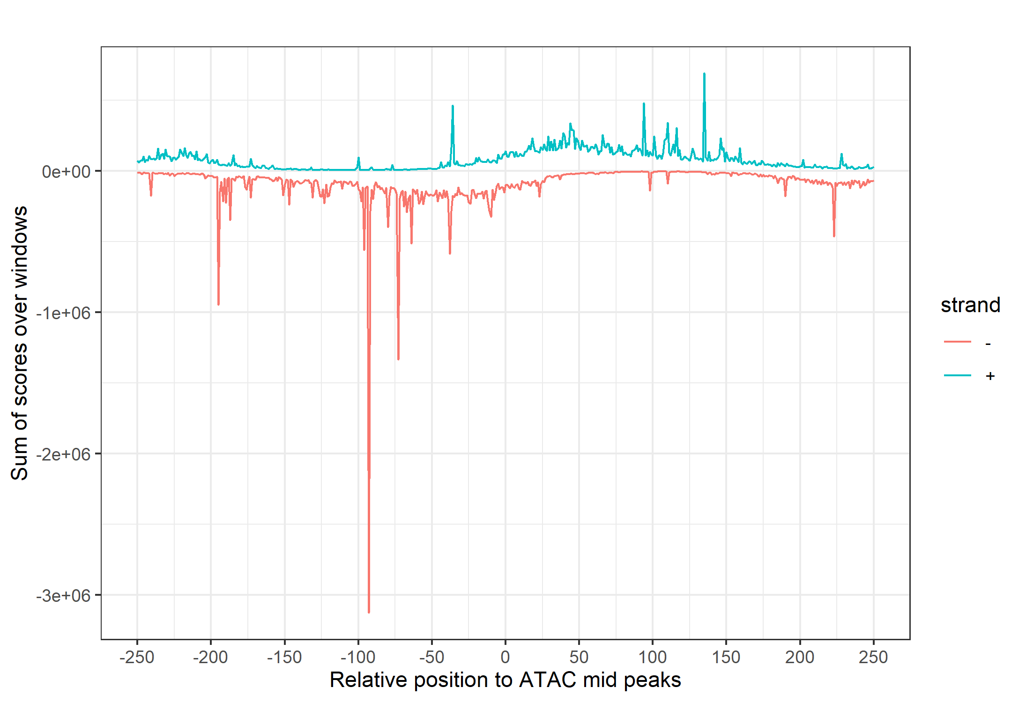
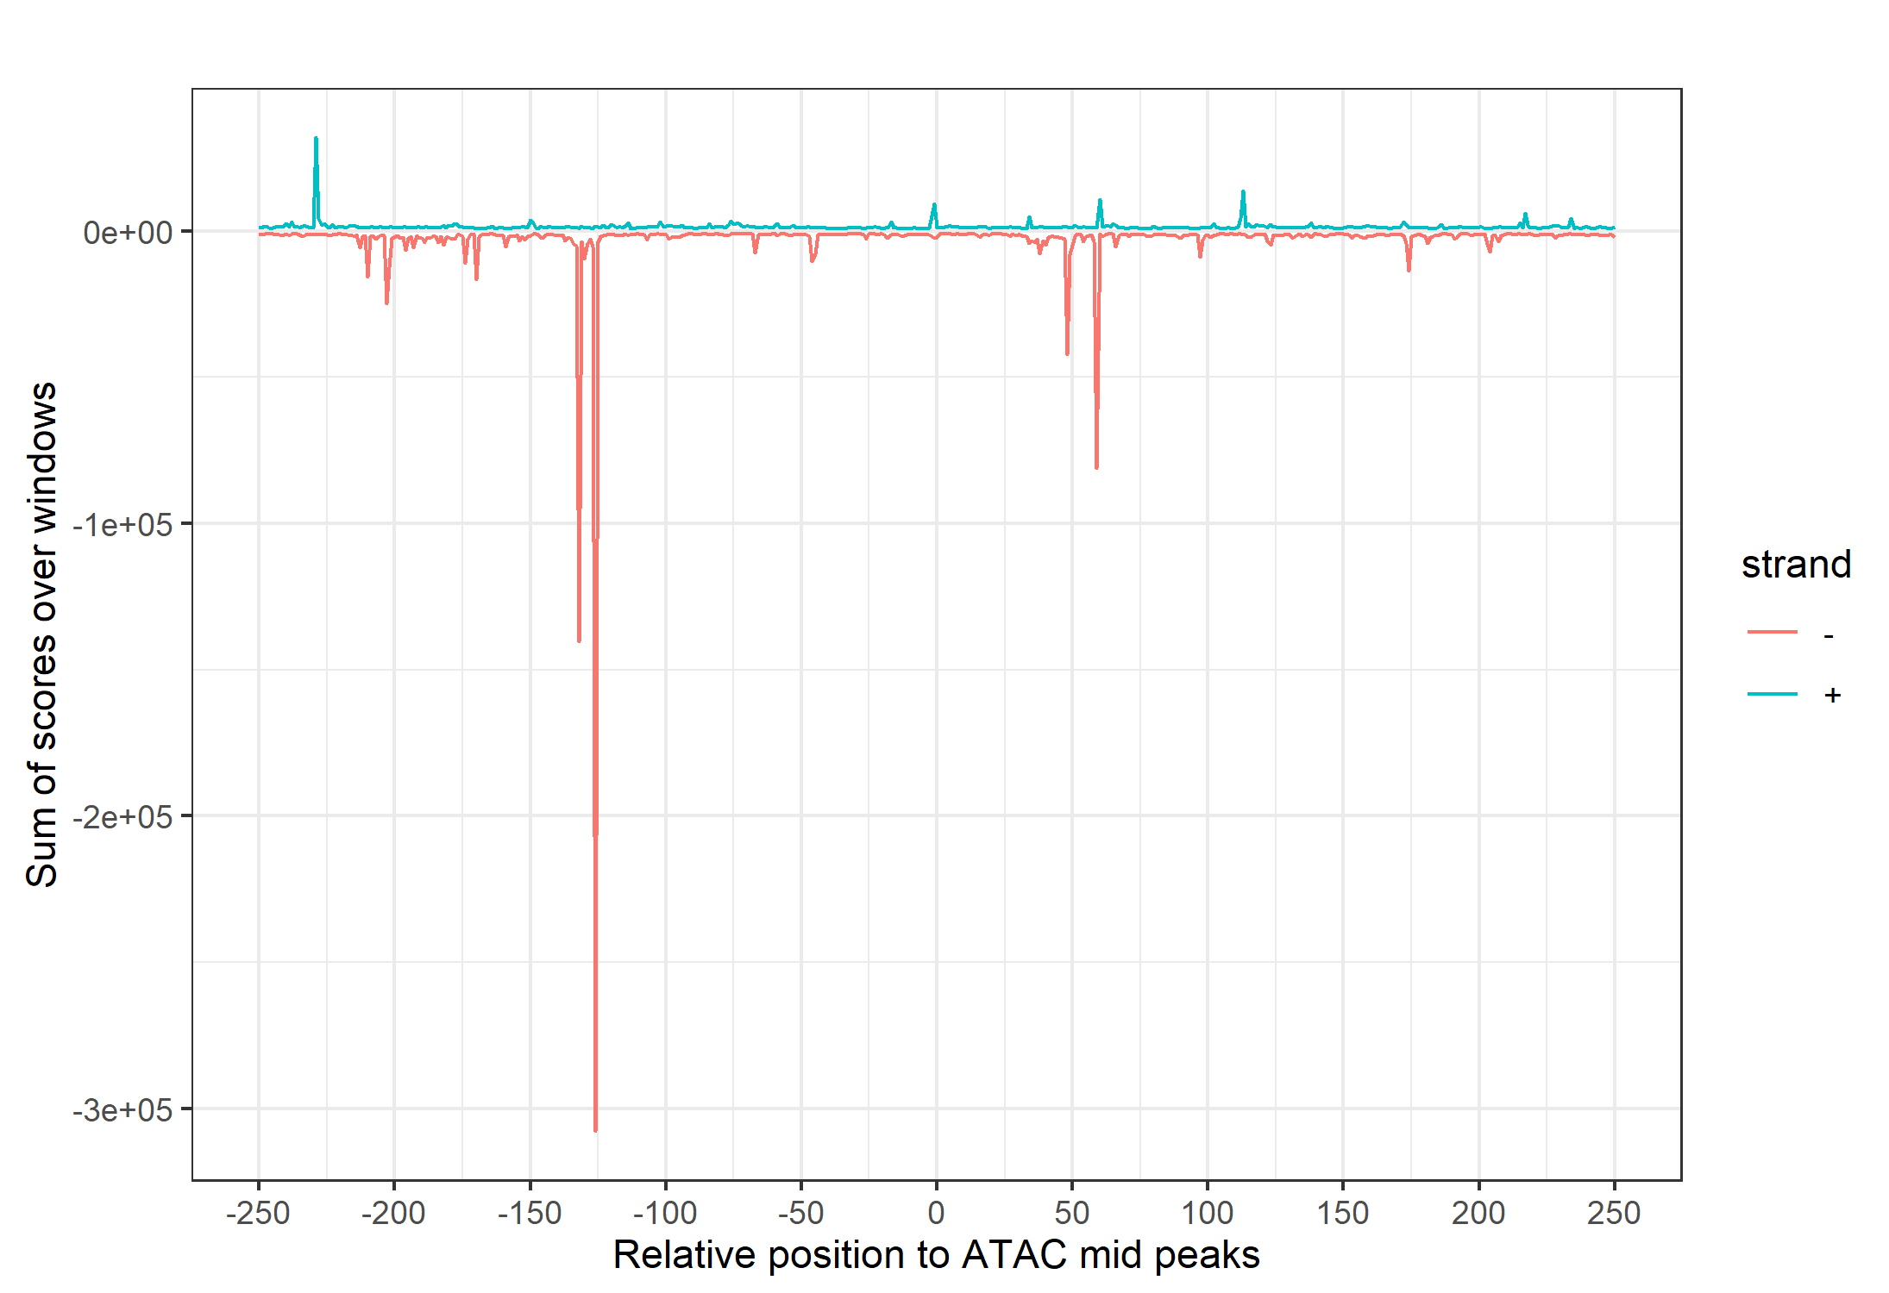
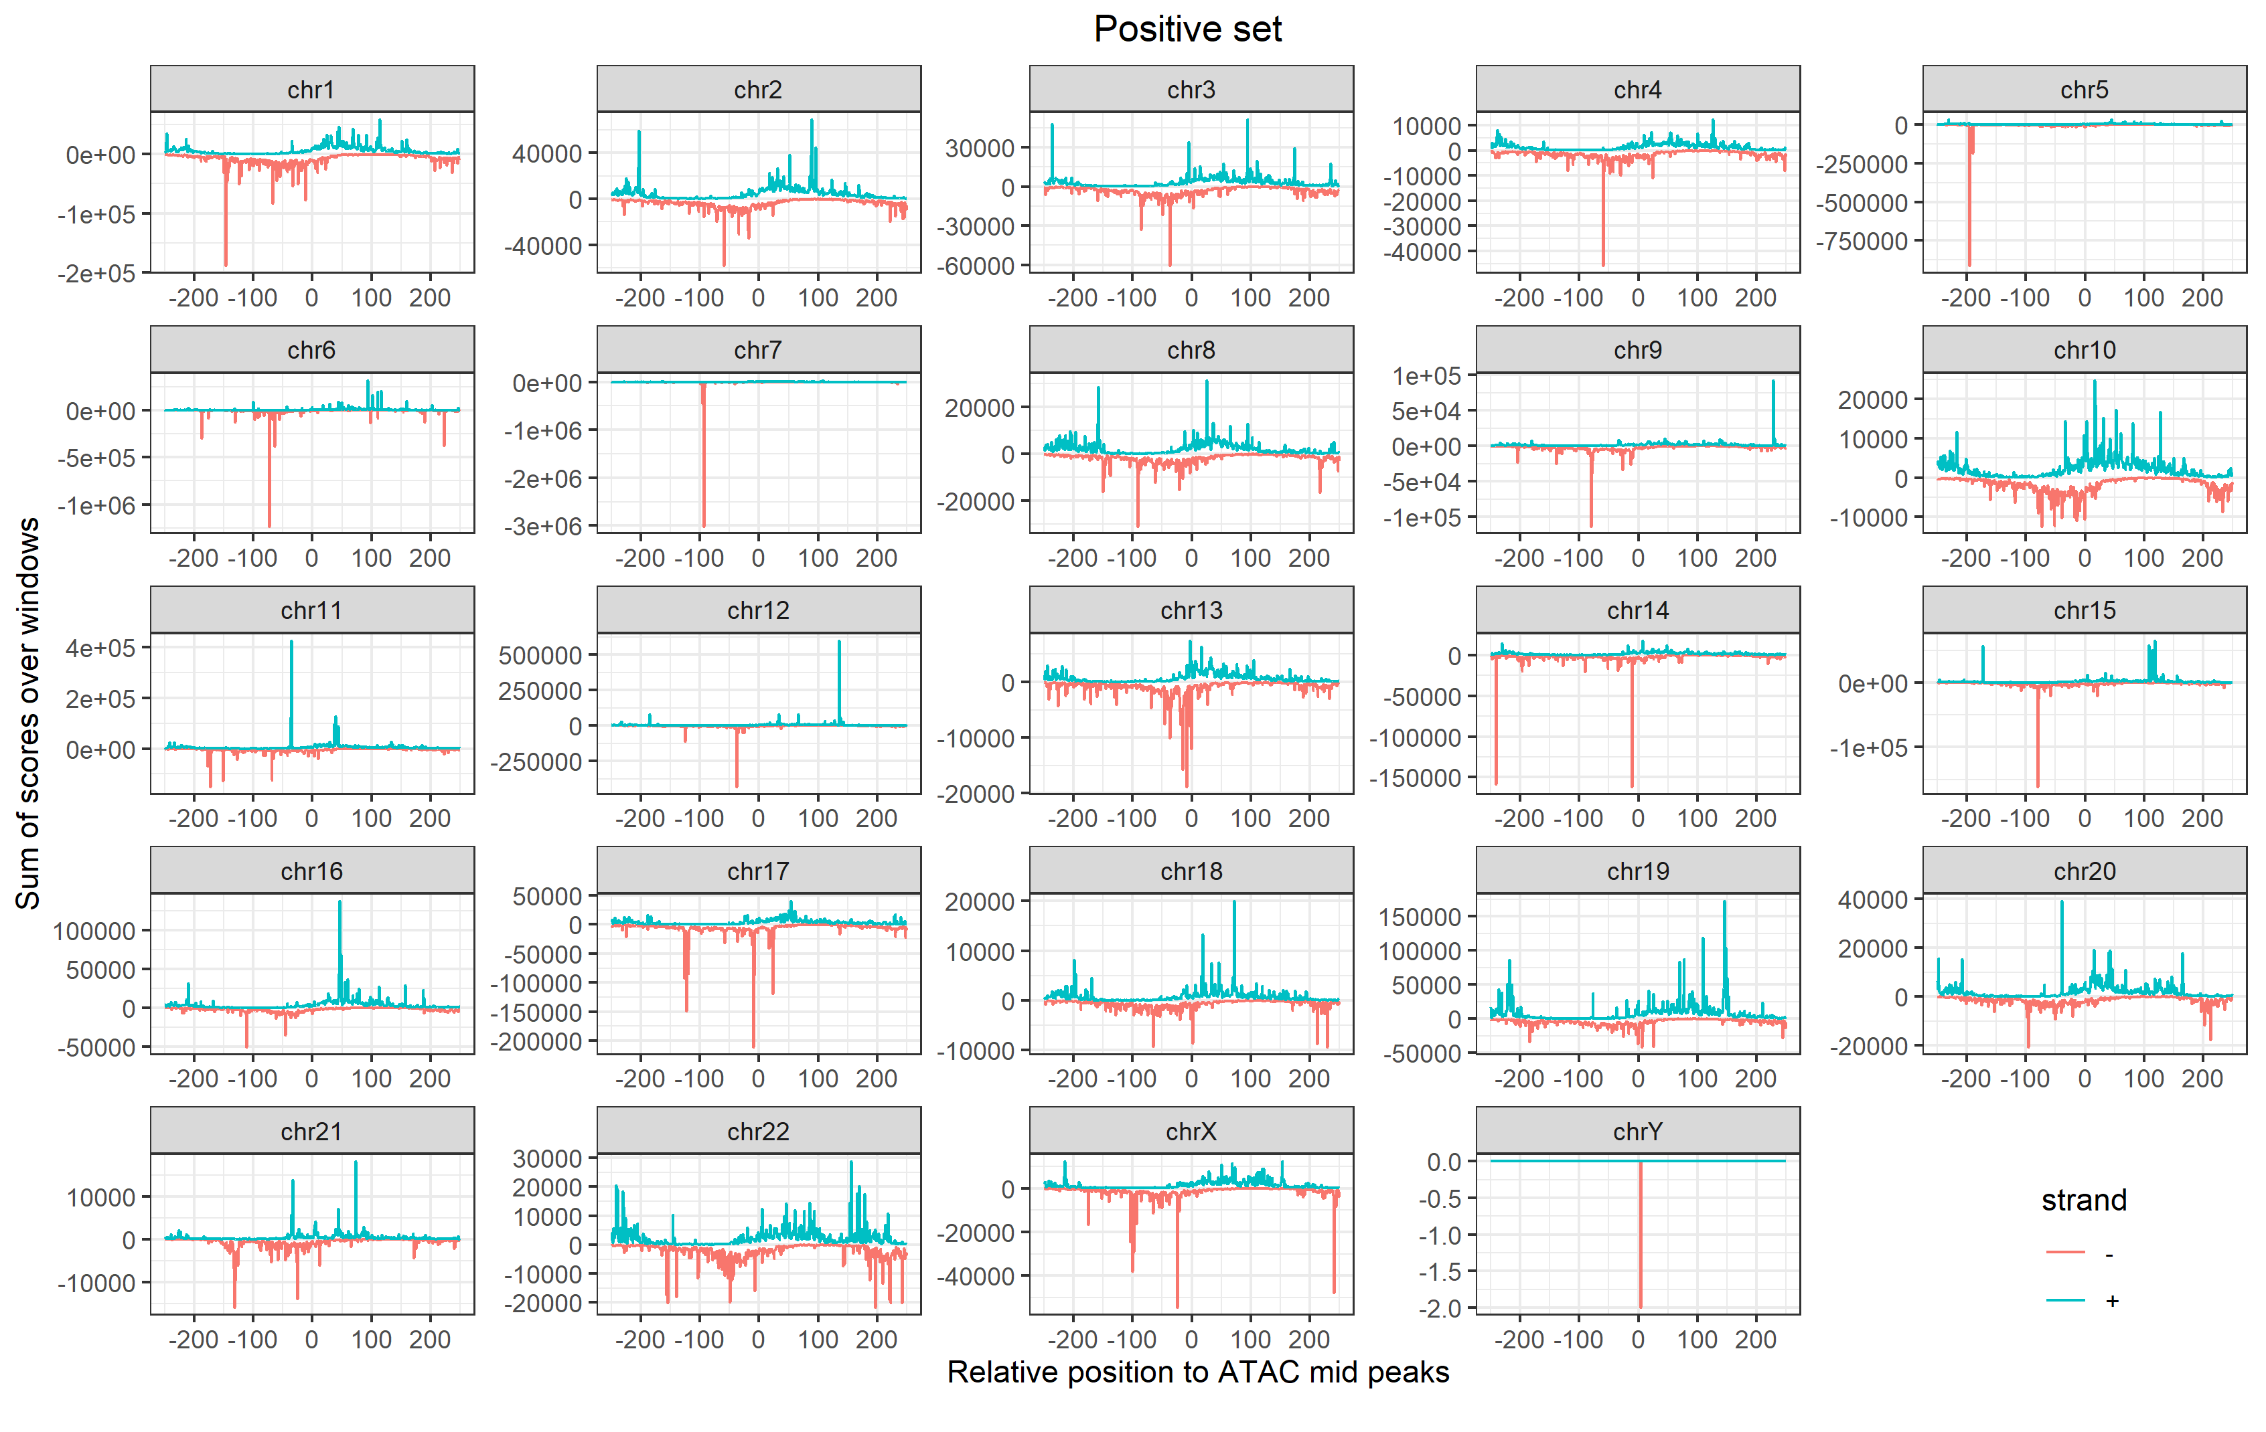
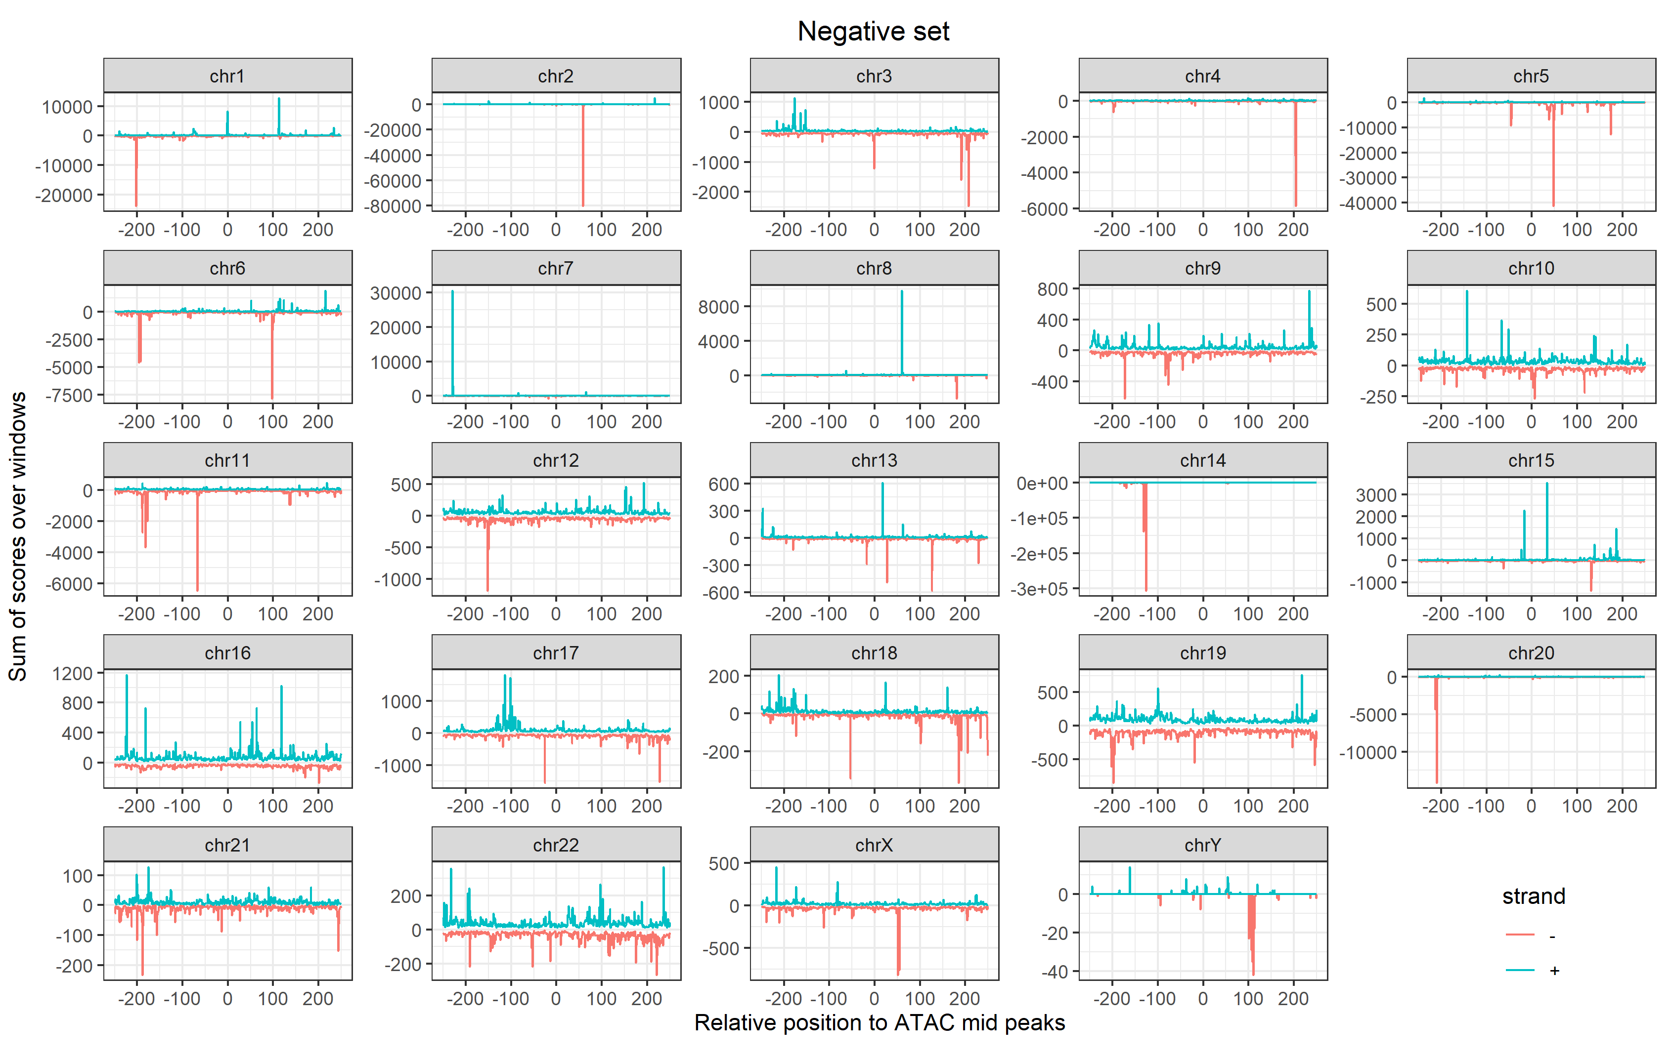
CAGE signal profiles
Positive set
Negative set
Notes:
* The CAGE signal profile of the positive samples shows a bidirectional transcriptional initiation pattern
* The negative one is uniformly distributed over the windows positions
* Same patterns can be seen at chromosomes resolution, apart some shapes that are hidden by spikes of the signal
* Chromosome Y is very low expressed

Slide 7
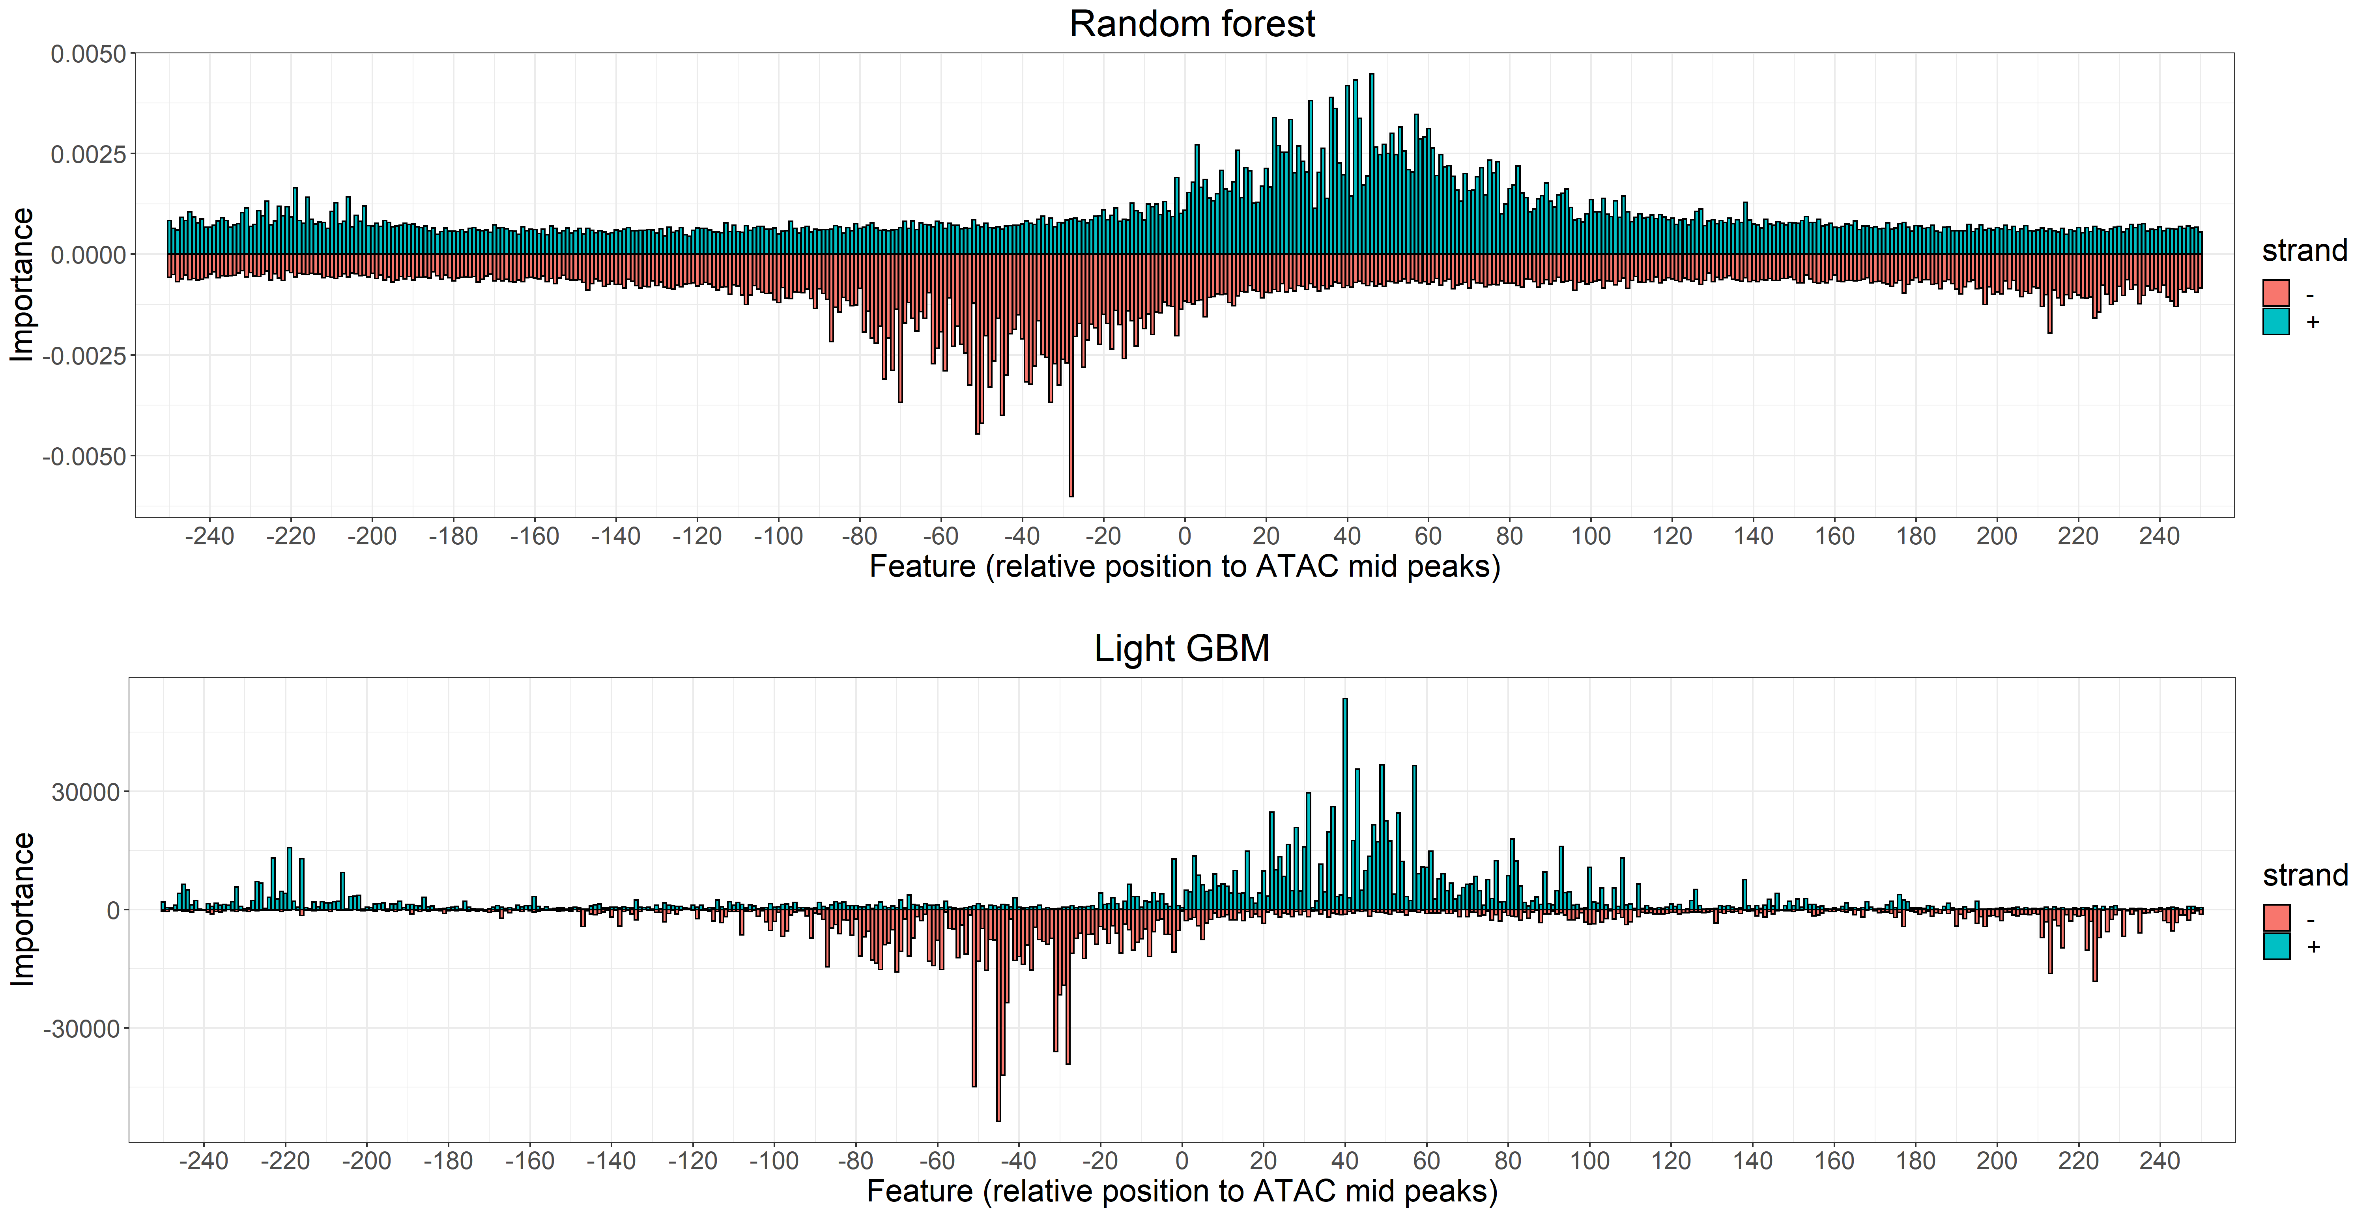
Feature importance
Notes:
* Most important features are the ones highly expressed in the positive windows -> extraction of the positive samples is very important
* LGBM do not consider the negative features at all, and as we will see it will predict the nefative samples better than the positive ones

Slide 8
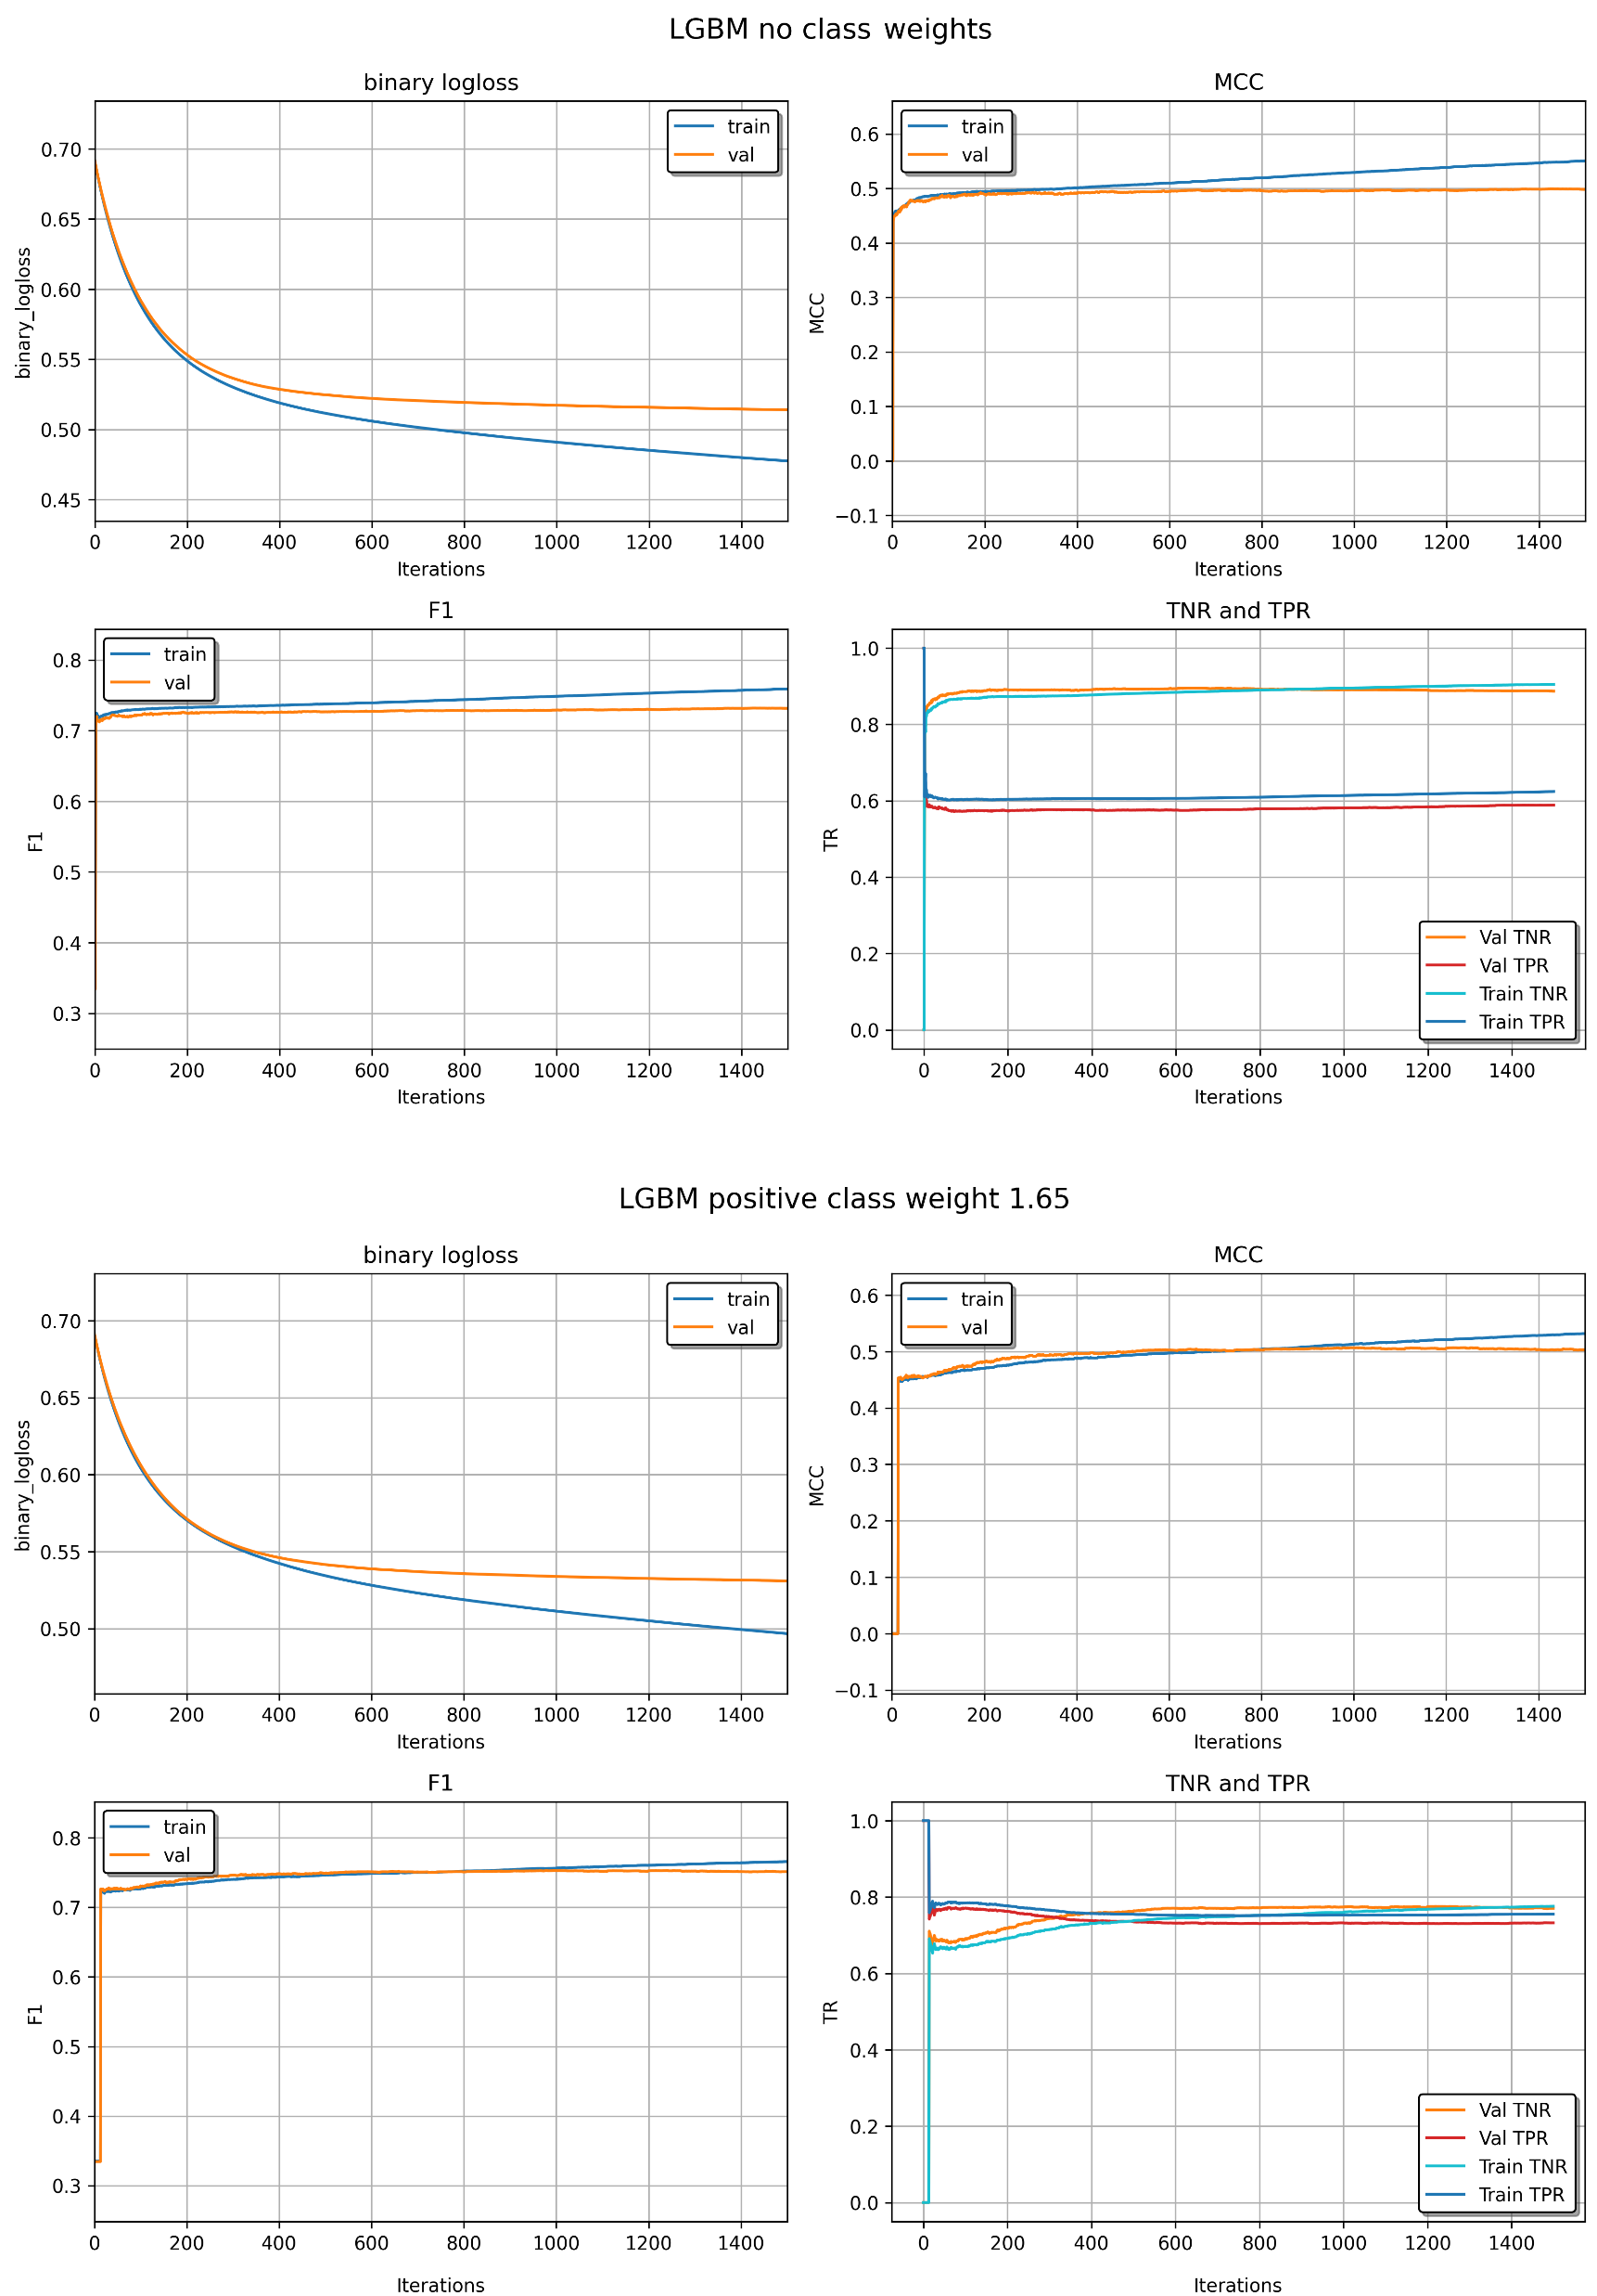
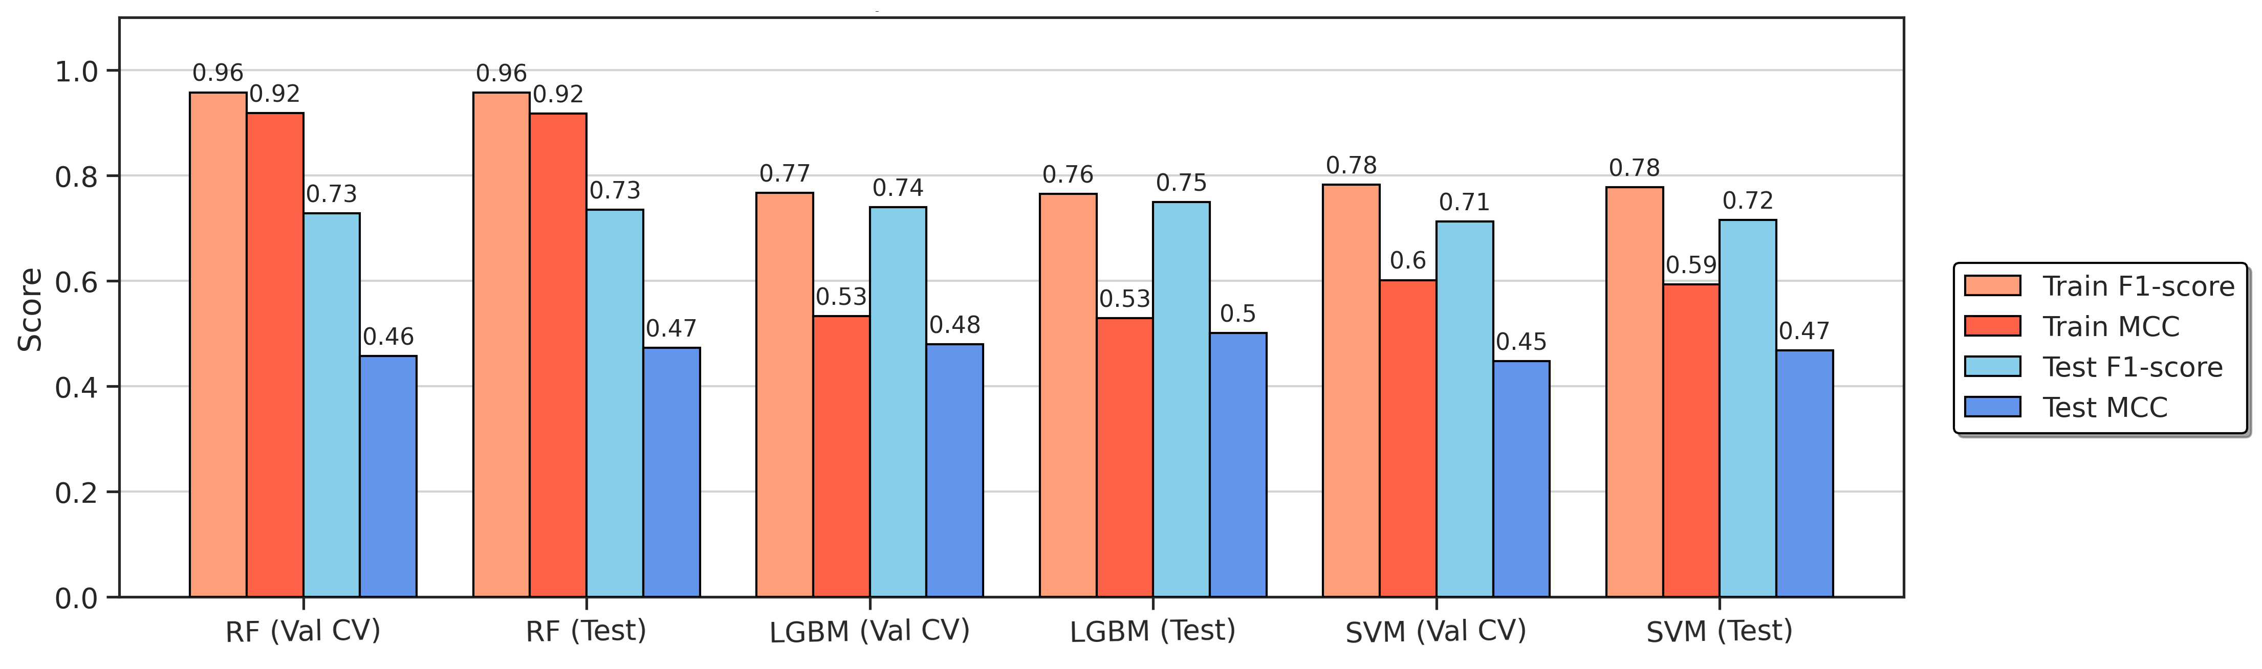
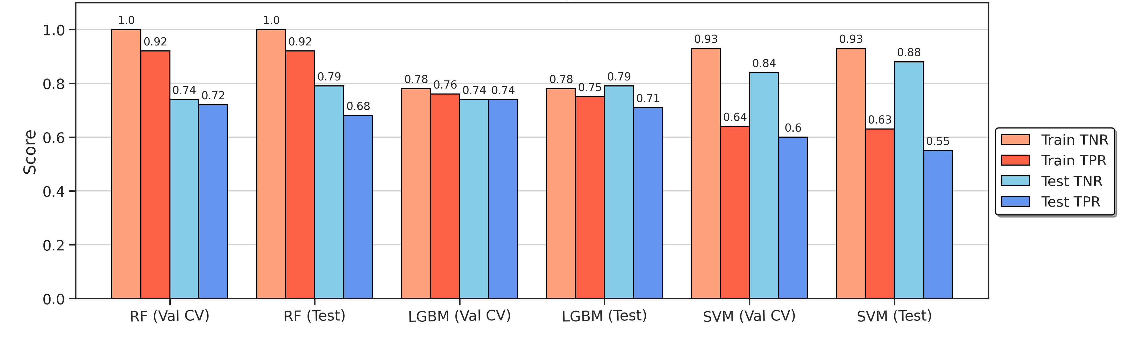
Model evaluation
LightGBM training evaluation
Models evaluation
Models evaluation at classes resolution
Notes:
* LGBM predict the negative samples better than the negative ones
* LGBM is the best model, RF overfits the training data, SVM got the worst out-of-sampe performance
* LGBM obtained the most balanced classification performance, SVM the most unbalanced one, RF got the most balanced classification performance without using weigths
* Overall the models predict the negative samples better than the positive ones

Slide 9
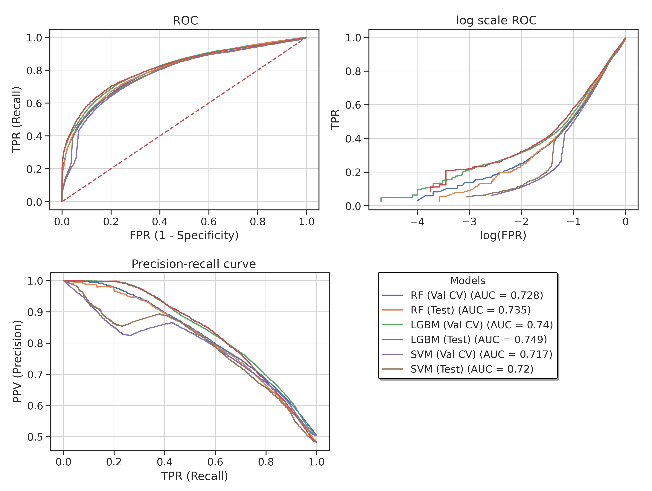
Model evaluation
ROC and precision-recall curves
CV duration
Random forest | LightGBM | SVM
00h:45m:27s | 00h:08m:58s | 15h:00m:44s
Notes:
LGBM is confirmed the best mode, SVM got the worst preformance
There is no much difference between Validation and Test -> actually the predictions on the test set are better
This was kind of expected because we only tuned a few hyperparameters and because the final model was trained on the complete training data
CV duration

Slide 10
Summary
Bidirectional transcription initiation patterns positive samples
Uniform distribution of the signal in negative samples
Multiscale feature vector from CAGE and ATAC-Seq
LightGBM showed robust and fast learning ability, no sign of overfitting, best overall performance, and tuned ability to balance its predictions
Promising results for a future implementation of a solid framework for the prediction of active TREs from TSS-focused data
The quality and the quantity of the data should be increased
Model selection
Evaluate performance by enrichment analysis of predicted TREs
Increase model generalization ability
Notes:
* Most important features matched the most expressed sites on the positive profiles and increasing the negative set sample size did not increase model performance
* The models predicted the negative samples better than the positive ones
Why? -> The negative samples might not carry learnable information and the reason why they are predicted with more accuracy might be that the model just understand that they do not carry the pattern it learned from the positive samples. Therefore the negative might be noisy data.

Slide 11
Thanks for your attention

Slide 13
Summary
Bidirectional transcription initiation patterns positive samples
Uniform distribution of the signal in negative samples
Multiscale feature vector from CAGE and ATAC-Seq
LightGBM showed robust and fast learning ability, no sign of overfitting, best overall performance, and tuned ability to balance its predictions
Alternative strategy for
input extraction
Promising results for a future implementation of a solid framework for the prediction of active TREs from TSS-focused data
The quality and the quantity of the data should be increased
Signal smoothing
Data augmentation
Model selection
Hyperparameter tuning
Test alternative ML algorithms
Evaluate performance by enrichment analysis of predicted TREs
Increase model generalization ability
Notes:
* Most important features matched the most expressed sites on the positive profiles and increasing the negative set sample size did not increase model performance
* The models predicted the negative samples better than the positive ones
Why? -> The negative samples might not carry learnable information and the reason why they are predicted with more accuracy might be that the model just understand that they do not carry the pattern it learned from the positive samples. Therefore the negative might be noisy data.

