Slide 1
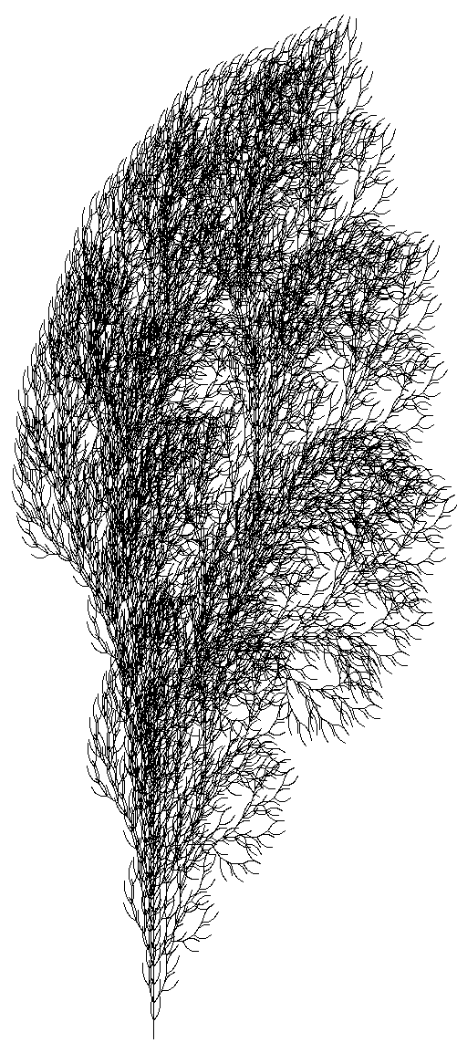
Data structures
Sten Hulsbergen

Slide 2
L-system
Axiom
Initial string
Productions
Rules
Character
Replacement string

Slide 3
L-system
Template
Split up
Hash for productions
Unordered_set
Python script
Display output
Tests
Complete L-system
Reset

