Slide 1
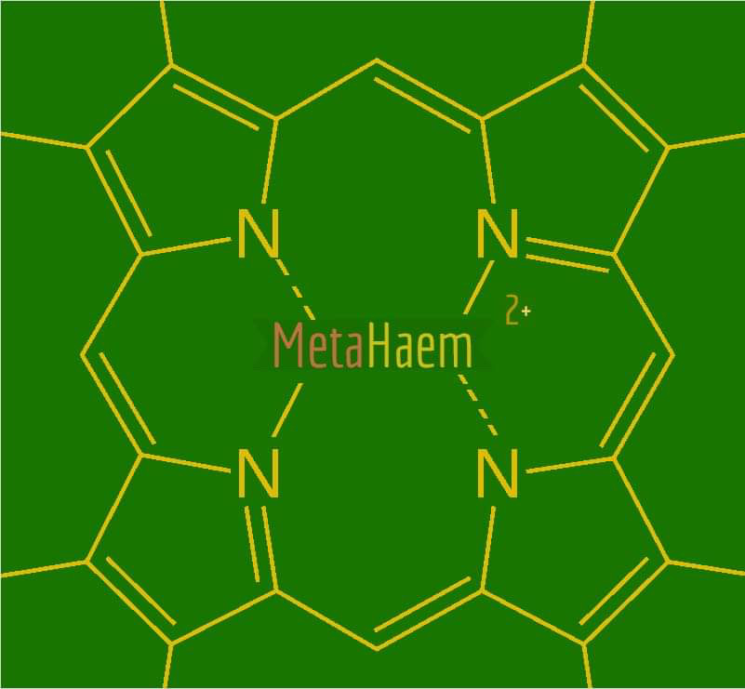
Caius Gibeily
Pablo Nilsson
Mitchell McDougall
Harry Tibbetts
Rol-J Williams

Slide 2
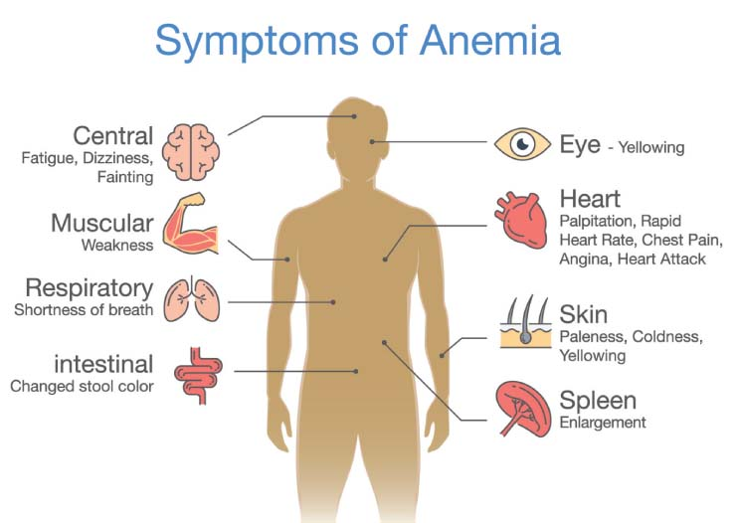
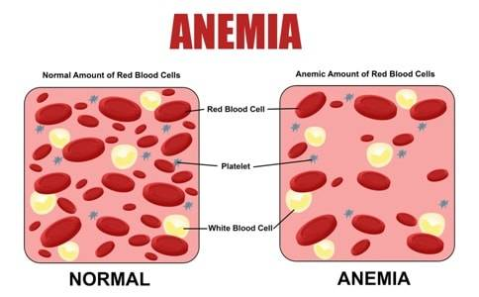
Global Health Problem
Anemia affects around 1.6 billion people worldwide. 30%-50% due to iron deficiency.
Anemia occurs when the blood does not have enough red blood cells to carry oxygen to the tissues of the body.
Anemia due to iron deficiency is common in women (menstruation and pregancy), children (malnutrition) and the elderly (poor nutrition).

Slide 3
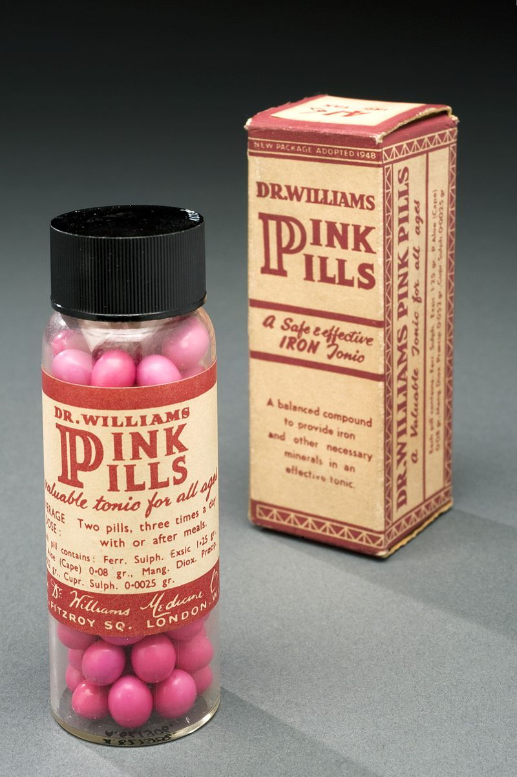
Current palliative solutions to iron deficiency
Iron supplements have been used in excess of 320 years
The primary mode of action is via soluble iron salts
Common salts include ferrous fumarate, ferrous gluconate and ferrous succinate

Slide 4
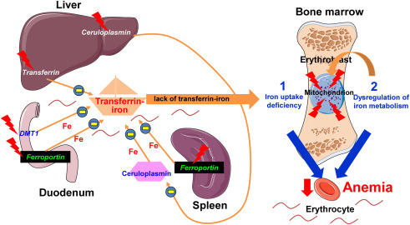
Drawbacks of traditional iron pills Caveat emptor
Iron supplements introduce discrete packets of 'iron loading' into the digestive tract
Slow release treatments ineffective
Haemosiderosis and haemochromatosis incompatible
Increased risk of bacterial infection
Iron overload pathology

Slide 5
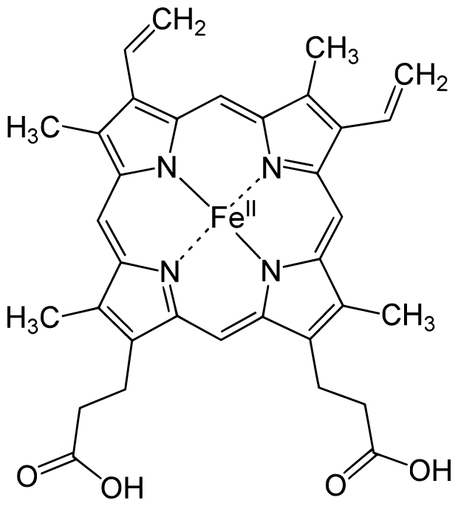
Haem Iron vs. Non-Haem Iron
Haem is important for its ability to allow hemoglobin to bind to oxygen because of the iron atom.
Haem iron is found in foods that contain animal proteins like meat, seafood and poultry. Haem B is one of the most abundant forms of haem.
Non-Haem iron is found plant-based foods like fruits, vegetables, nuts and beans. Human body can only incorporate up to 10% of non-haem iron.
Haem B Molecule

Slide 6
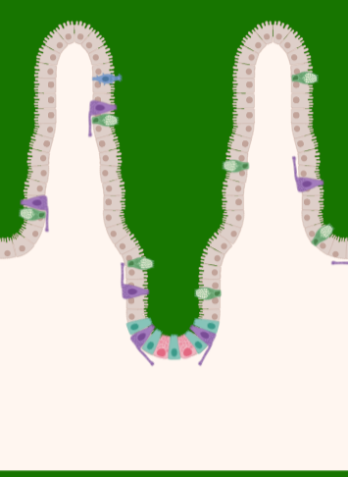
MetaHaem
Genetically engineered strain of Nissle Escherichia coli we call MEta coli
MetaHaem delivers a haem-metabolising agent to the microbiome of the duodenum and mid-upper intestinal tract
Haem switch: synthesised in response to elevated extracellular glucose
Reliable conversion of free iron (non-haem) into haem-iron
Efficiency of iron uptake increased by up to 60%
Villi

Slide 7
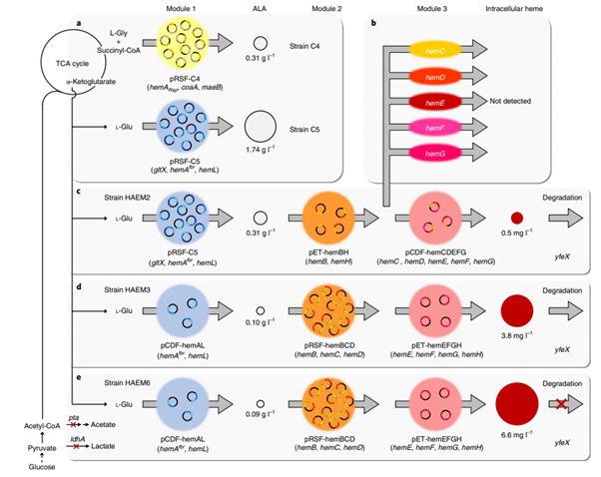
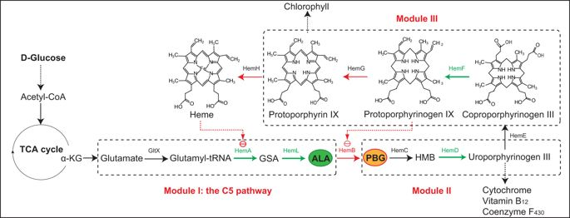
Nature Catalytic Xin Rui Zhao1 , Kyeong Rok Choi 1 and Sang Yup Lee (2018)
Scientific Report
Our proposed methodology is founded on research conducted in the past 5 years
HAEM6: Overexpression of intermediate genes HemA, L, B, C, D and knockout of yfeX
(Junli Zhang et al, 2015)

Slide 8
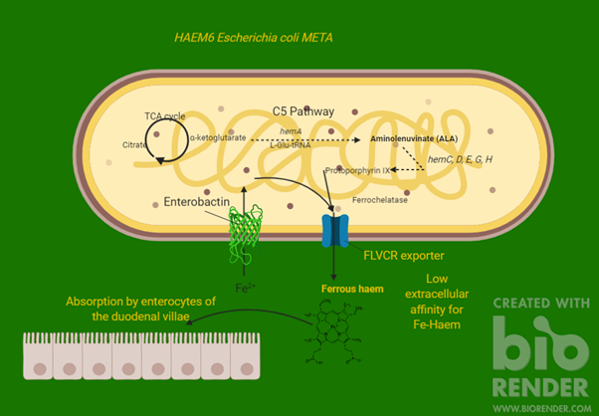
How does MetaHaem work?
Xin assay not responsive to extracellular glucose stimulus
MetaHaem would modify the HAEM6 strain analogue in Nissle strain
Introduce haem exporter protein, FLVCR1
Fully safe and non-pathogenic

Slide 9
The Business Model
Promotion
Elderly
Non-Governmental
Organizations
Full Cost
(Vegan)
Women
Children
Support

Slide 10
Targeting Full Cost Consumers
Advertising will consist of targeting social media profiles of young women and local television broadcasting for the elderly: “Are you feeling tired? Lacking the strength to take on the day to day and sick of popping supplements that don’t help?”
Vegans demonstrate higher iron deficiency and they are a growing market
The Iron Supplement Market was valued at over 3 Billion USD in 2015 and is projected to reach over 6.5 Billion USD by 2025 according to Credence Research
Marketing strategy of “Buy one, give one”

Slide 11




Why Non-Governmental Organisations?
Many people around the globe need iron-deficiency treatment but cannot afford it at full cost.
Good experience and knowledge of particular regions/social classes we are targeting.
Have no political agendas; display continuous interest in project.
Already have infrastructure and bureaucratic matters settled.

Slide 12
IRON UP!
References
Dailey, H.A., Dailey, T.A., Gerdes, S., Jahn, D., Jahn, M., O'Brian, M.R. and Warren, M.J., 2017. Prokaryotic heme biosynthesis: multiple pathways to a common essential product. Microbiol. Mol. Biol. Rev., 81(1), pp.e00048-16.
Khan, A.A. and Quigley, J.G., 2013. Heme and FLVCR-related transporter families SLC48 and SLC49. Molecular aspects of medicine, 34(2-3), pp.669-682.
Lewis E. Heme Iron vs. Non Heme Iron in Food, available online from: https://hemochromatosishelp.com/heme-iron-vs-non-heme-iron/ [accessed Nov 2019]
Zhang, J., Kang, Z., Chen, J. and Du, G., 2015. Optimization of the heme biosynthesis pathway for the production of 5-aminolevulinic acid in Escherichia coli. Scientific reports, 5, p.8584.
Zhao, X.R., Choi, K.R. and Lee, S.Y., 2018. Metabolic engineering of Escherichia coli for secretory production of free haem. Nature Catalysis, 1(9), p.720.
https://www.credenceresearch.com/report/iron-supplements-market
Pawlak, R., Berger, J. and Hines, I., 2018. Iron status of vegetarian adults: A review of literature. American journal of lifestyle medicine, 12(6), pp.486-498.
En.m.wikibooks.org. (n.d.). Structural Biochemistry/Protein function/Heme group - Wikibooks, open books for an open world. [online] Available at: https://en.m.wikibooks.org/wiki/Structural_Biochemistry/Protein_function/Heme_group [Accessed Nov. 2019].
En.wikipedia.org. (n.d.). Heme`. [online] Available at: https://en.wikipedia.org/wiki/Heme [Accessed Nov. 2019].
Gonzales, E. (2018). Is anemia normal in the elderly?. [online] Manila Bulletin Lifestyle. Available at: https://lifestyle.mb.com.ph/2018/01/23/is-anemia-normal-in-the-elderly/ [Accessed Nov. 2019].
Hemochromatosis Help. (n.d.). Heme Iron vs Non-Heme Iron in Foods. [online] Available at: https://hemochromatosishelp.com/heme-iron-vs-non-heme-iron/ [Accessed Nov. 2019].
Mayo Clinic. (n.d.). Iron deficiency anemia - Symptoms and causes. [online] Available at: https://www.mayoclinic.org/diseases-conditions/iron-deficiency-anemia/symptoms-causes/syc-20355034 [Accessed Nov. 2019].
Miller, J. (2013). Iron Deficiency Anemia: A Common and Curable Disease. Cold Spring Harbor Perspectives in Medicine, [online] 3(7), pp.a011866-a011866. Available at: https://www.ncbi.nlm.nih.gov/pmc/articles/PMC3685880/.
Practo.com. (n.d.). Anemia: Meaning, Symptoms, and Types. [online] Available at: https://www.practo.com/health-wiki/anemia-meaning-symptoms-and-types/93/article [Accessed Nov. 2019].
Who.int. (2019). WHO | Global anaemia prevalence and number of individuals affected. [online] Available at: https://www.who.int/vmnis/anaemia/prevalence/summary/anaemia_data_status_t2/en/ [Accessed Nov. 2019].

Slide 13
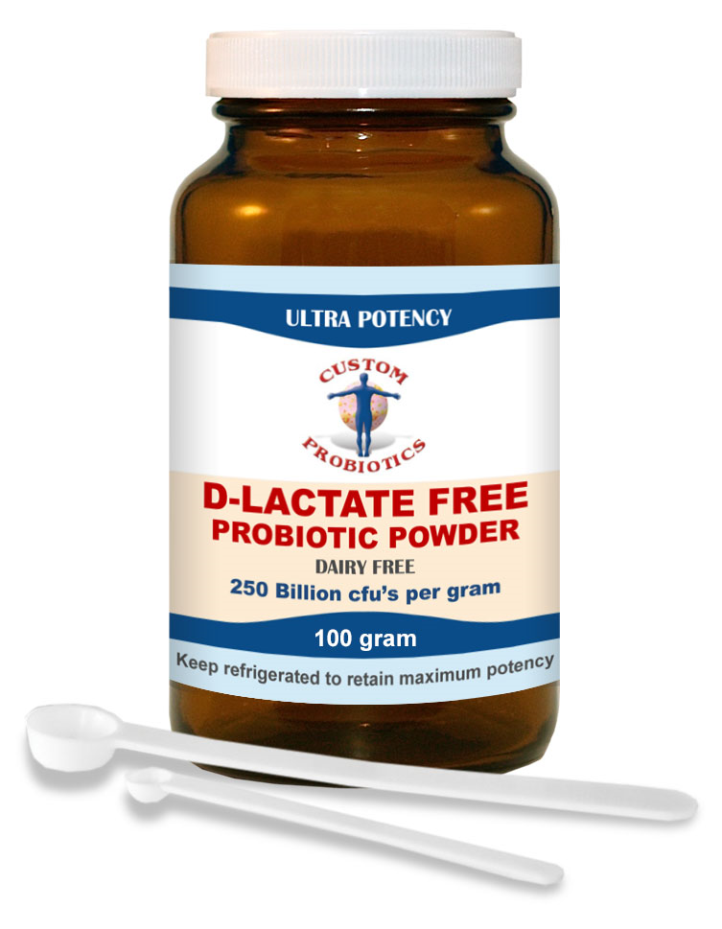

MetaHaem probiotic
Live micro-organisms supplementing the diet
Modification of the microbiome by altering levels of epistatic bacteria on the walls of the intestinal lumen
MetaHaem formula:
Maltodextrin, hydroxypropyl methylcellulose (capsule shell), Meta coli powder, alginate
Safe for vegans
Exemplar probiotic, Custom Probiotics

Slide 14
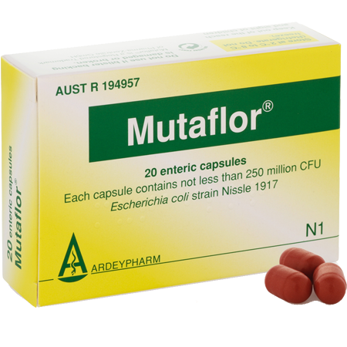
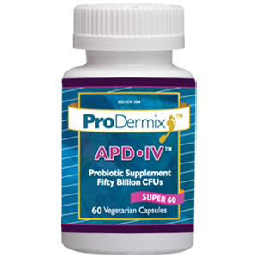

Slide 15
Nature Catalytic Xin Rui Zhao1 , Kyeong Rok Choi 1 and Sang Yup Lee (2018)
Xin et al. trialled multiple strains of BL21(DE3) E. coli
Three recursions of transient vector transformation were performed
T7 plasmids pCDF, pRSF and pETs allow control of copy-number
Degradation of yfeX, a dechalator enzyme, produces maximum yield of haem B
Not sustainable in vivo: threshold haem concentration before elution not practical for the environment of the microbiome

