Slide 1

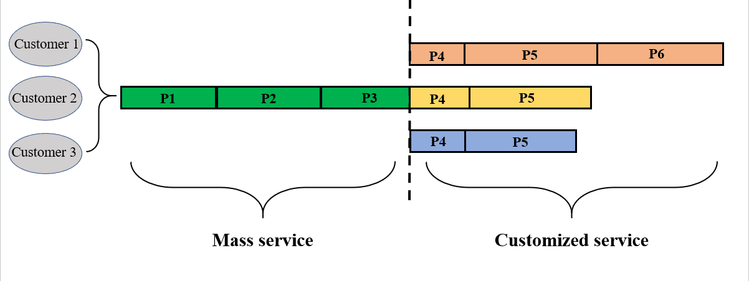




Scheduling Model Design
With Relationship Between Two Time Windows
Without Relationship Between Two Time Windows
Allowing Out-of-Range, Extra Cost
2-echelon service supply chain
Algorithm Still Works!
MC-mode and CODP Selection
Scheduling without stagnation
Evaluation:
Compare with Genetic Algorithm
Understanding Problem Nature
Applying Multi-Objective
Mathematical
Formulation
Programming
Multi-Objective Programming
Testing and
Visualization
And
Local Search
Local Search In
Convert
to
Define Neighborhood
Scheduling Model Design
Ideal Point Method
Finding Feasible Solution
Of Logistics Service
O(n³)
Single-Objective Programming
Discrete
Problem
O(c²n^{4.5})
Supply Chain
Moving and Optimizing
O(c²n⁴)

