Slide 1
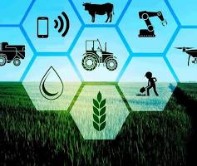
AgriGuard Project
Here to advance Agriculture using Technical Tools of our generation (PL/SQL). Modernize Agriculture.

Slide 2

AgriGuard + Smart Agricultural Disease Management System
Student: Sonia Ineza
Student ID: 27852
Group: Monday
Course: Database Development with PL/SQL(INSY 8311)
Date: November 2025
Institution: AUCA

Slide 3
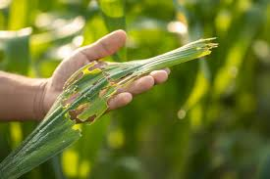
The Agricultural Challenge
Late disease detection leads to 30-40% crop loss in small farms
Manual treatment recording results in repeated mistakes and over-treatment
No centralized tracking of crop cycles, chemical usage, or treatment history
Farmers rely on guesswork instead of data-driven decisions
Limited analytics prevent early warning and productivity improvement

Slide 4
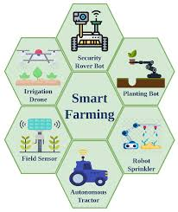
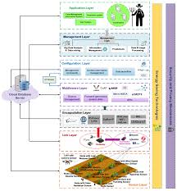
AgriGuard+ Smart Solution
What: PL/SQL-powered agricultural management system
Where: Small to medium-scale farms in Rwanda/East Africa
How: Automates disease detection, treatment management, and inventory control
Technology: Oracle Database with advanced PL/SQL features

Slide 5
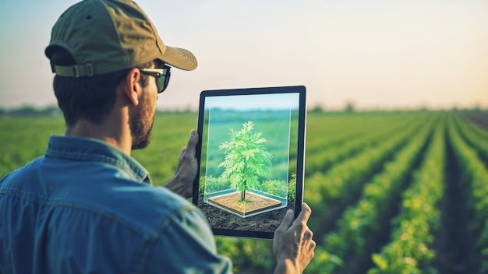
Who Benefits?
Primary Users: Smallholder farmers and agricultural cooperatives
Secondary Users: Agricultural extension officers and farm managers
Government: Ministry of Agriculture for disease surveillance
Expected Outcomes:
  Reduce crop loss by 25-35%
  Optimize chemical usage and reduce costs
  Enable data-driven farming decisions
  Build historical treatment records

Slide 6
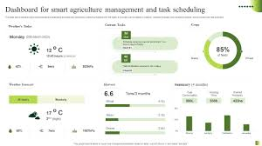
Goals & Business Intelligence Integration
Project Goals:
  Automate disease-treatment workflow
  Track complete crop lifecycle from planting to harvest
  Implement smart inventory management with alerts
  Create comprehensive audit trail for all farm activities
BI Potential:
  Disease recurrence dashboards
  Chemical consumption analytics
  Yield prediction models
  Early warning system for disease outbreaks
  Field performance comparisons

Slide 7
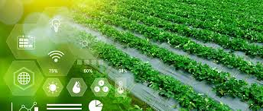
Thank You
  inezasonia100@gmail.com
  https://github.com/StID-27852

