Slide 1
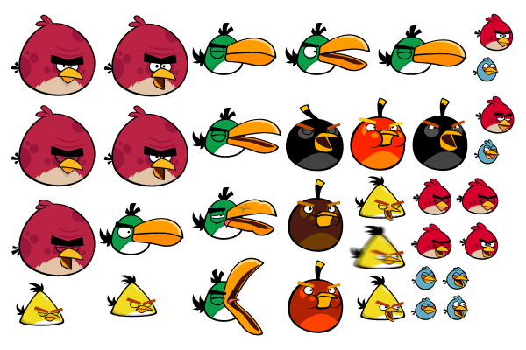
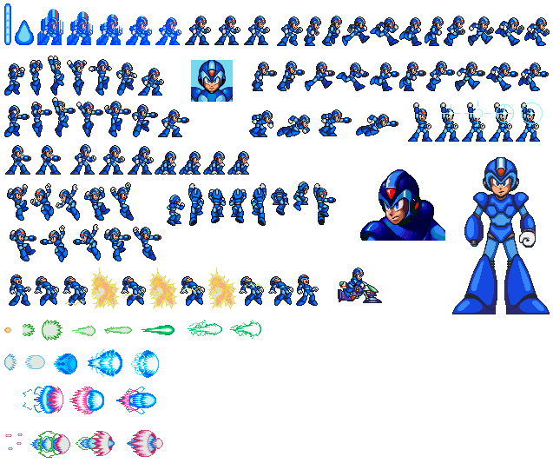

Sprite Sheets from Illustrator
St. John’s Santa Code 2014

Slide 2
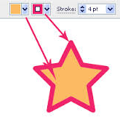
Why
Ability to have art references in Flash
Flash can source a single file (e.g. character.png) and we can dynamically replace that sprite sheet with any number of characters from our Asset Server without an artist having to open flash.
This gives us a complete separation of Art & Animation. Allowing us to completely change the look and feel of artwork without the risk of breaking the animation.
Greater control over color (hair, eyes, skin, etc..)
Flash can only set colors on shapes created through action script at run-time. There is no way to change fills or strokes with jsfl. But we can do that easily in Illustrator & jsx.
Much more optimized for HTML5.
What you see is what you get.
Substantially less files to load from the server.
Eliminates most Flash->HTML5 compatibility problems.
More!
Toggle layers (left/Right, Ties/noTies, Medical/Military/bsCasual/Street etc…).
Effects like blur & glow will be baked in - eliminates Illustrator->Flash compatibility problems.

Slide 3
What I learned about RECTs & Collisions
Sometimes, it’s easier to prove the antitheses.

Slide 4
My Approach
New Artboard 512x512
Increase Artboard by 512 until its area is greater than the sum area of all sprite-sheet elements.
Array of objects for each sprite-sheet element.
Order array from largest to smallest
Place objects (last to first/ right to left, Top-Right) & (first to last/left to right, Bottom-Left)

Slide 5
Queue
4.9284
4.676
2.2801
Fits in Art-Board:
No Collisions:
Placed Items:
1.0492

Slide 6
Queue
1
4.676
2.2801
Fits in Art-Board:
No Collisions:
Placed Items: Square,
1.0492

Slide 7
Queue
1
4.676
2.2801
Fits in Art-Board:
No Collisions:
Placed Items: Square,
1.0492

Slide 8
Queue
2
2.2801
Fits in Art-Board:
No Collisions:
Placed Items: Square, Trapezoid,
1.0492

Slide 9
Queue
1
2.2801
Fits in Art-Board:
No Collisions:
Placed Items: Square, Trapezoid,
1.0492

Slide 10
Queue
2
Fits in Art-Board:
No Collisions:
Placed Items: Square, Trapezoid, Circle
1.0492

Slide 11
Queue
1
Fits in Art-Board:
No Collisions:
Placed Items: Square, Trapezoid, Circle
1.0492

Slide 12
Queue
2
Fits in Art-Board:
No Collisions:
Placed Items: Square, Trapezoid, Circle
1.0492

Slide 13
Queue
3
Fits in Art-Board:
No Collisions:
Placed Items: Square, Trapezoid, Circle
1.0492

Slide 14
Queue
4
Fits in Art-Board:
No Collisions:
Placed Items: Square, Trapezoid, Circle
1.0492

Slide 15
Queue
5
Fits in Art-Board:
No Collisions:
Placed Items: Square, Trapezoid, Circle
1.0492

Slide 16
Queue
6
Fits in Art-Board:
No Collisions:
Placed Items: Square, Trapezoid, Circle, Pentagon

Slide 17
Queue
Fits in Art-Board:
No Collisions:
Placed Items: Square, Trapezoid, Circle, Pentagon

Slide 18
Challenges to overcome
Still need to create working proof of reconstructing the sprite sheet in Flash.
How to handle exporting sprite sheets at different resolutions and their reconstruction in flash

