Slide 1

RAM and COMPENENTS
St Patrick Currey

Slide 2
What Is RAM?
RAM (random access memory) is a computer's short-term memory, where the data that the processor is currently using is stored. Your computer can access RAM memory much faster than data on a hard disk, SSD, or other long-term storage device, which is why RAM capacity is critical for system performance.

Slide 3
Types of Ram
DRAM (pronounced DEE-RAM), is widely used as a computer’s main memory. Each DRAM memory cell is made up of a transistor and a capacitor within an integrated circuit, and a data bit is stored in the capacitor. Since transistors always leak a small amount, the capacitors will slowly discharge, causing information stored in it to drain; hence, DRAM has to be refreshed (given a new electronic charge) every few milliseconds to retain data.
SRAM (pronounced ES-RAM) is made up of four to six transistors. It keeps data in the memory as long as power is supplied to the system unlike DRAM, which has to be refreshed periodically. As such, SRAM is faster but also more expensive, making DRAM the more prevalent memory in computer systems.

Slide 4
RAM Performance
Random-access memory (RAM) plays an integral role in mobile devices and desktop computers. It determines the operating capacity of a device at any given time. A computer processes data using RAM as a digital workspace for placing programs temporarily. In turn, your computer’s processor gains access to the relevant data quickly and easily.
Larger RAM space translates to more computing power, thanks to the larger space available to active programs. The computer processes information faster than a device with less RAM. For this reason, your PC can benefit from adding more RAM. You will find it easier to interact with resource-intensive apps and programs like video editing tools.

Slide 5
RAM Performance Ctd.
As a result, your computer can still operate optimally, even when running two or more heavy programs. With increased RAM, the apps can function properly without competing for workspace. The operating system (OS) no longer needs to perform increased code and data swapping between the resource access memory and the hard drive. Swapping is a common cause of poor processing performance.
Also, increased RAM enhances your ability to multitask using resource-intensive apps like Photoshop and Outlook. You can switch from one program to another without the operating system resorting to the page file to write the process memory. The page file relies on a slower hard drive for data storage.

Slide 6
Processor Types
What is a processor?
The processor is a chip or a logical circuit that responds and processes the basic instructions to drive a particular computer. The main functions of the processor are fetching, decoding, executing, and write back the operations of an instruction.

Slide 7
Processor Types Ctd.
Microprocessor - The processor is a chip or a logical circuit that responds and processes the basic instructions to drive a particular computer. The main functions of the processor are fetching, decoding, executing, and write back the operations of an instruction.
Microcontroller - The microcontroller is basically a computer that comes in various packages and sizes. The reading input and responding to output is the basic function of the microcontroller. Generally, it is known as General Purpose Input Output (GPIO). Some of the microcontrollers are Microchip Atmega328-AU, Microchip P1C16F877A-I/P, Microchip P1C16F1503-I/P, Microchip P1C16F671-I/SN, Microchip P1C18F45K22-I/P, etc.

Slide 8
Processor Types Ctd.
Embedded Processor - An embedded processor is one type of processor which is designed to control mechanical functions and electrical functions. It consists of several blocks they are the processor, timer, an interrupt controller, program memory and data memory, power supply, reset and clock oscillator circuits, system application-specific circuits, ports and interfacing circuits.
Digital Signal Processor - The digital signal processor is one type of processor used for measuring, filtering and/or compress digital or analog signals. The signal processing means analysis and manipulation of signal. This processing can be done via computer or Application Specific Integrated Circuits (ASIC), Field Programmable Gate Array (FPGA) or Digital Signal Processor (DSP) to obtain the clear signal. The DSP processors are used in an oscilloscope, barcode scanners, mobile phones, printers, etc. These processors are fast and use for real-time applications. The typical DSP system is shown in the below figure.

Slide 9
Processor Types Ctd.
Media Processor - The image/video processor is the media processor that is designed or created to deal with the data in real-time. The voice user interface and professional audio are the applications of the audio processor. Some of the media processors are TN2302AP IP, IN2602 AP IP, DM3730, DM3725, DM37385, DM388, TMS320DM6467, TMS320DM6431, etc
Application-Specific System Processors (ASSPs) - The application-specific system processor is a semiconductor integrated circuit product used to implements a specific function. The performance, characteristics and die size of the application-specific system processor is the same as the ASIC. The ASSP’s are used in various types of industries to perform video encoding or decoding and audio encoding or decoding. In place of embedded software, the application-specific system processor is used to run the application and it provides the solution faster. Example: IIM7100, W3100A

Slide 10
Processor Types Ctd.
Application-Specific Instruction Set Processors (ASIPs) - The application-specific instruction-set processors are designed for specific applications. These processors have low power consumption, high computational speed, and good flexibility. Due to programmability, the data path utilization is high in ASIPs, and the performance of this instruction set processor is good.
ASIC Processors - The application-specific integrated circuits are built for specific applications. These chips are small in size and consume low power. The design cost of ASIC is high and this is the main disadvantage. The application-specific integrated circuit chips are used in satellites, modems, computers, etc. Some of the top ASICs manufacturer companies are Ams AG. Listed Company, Bitfury. Private Company, XMOS Semiconductor Private Company, Analogix Semiconductor Private Company, EDAptive Computing Private Company, Lumen Radio Private Company, Integrated Device Technology, Hookit. Private Company, etc.

Slide 11
Processor Types Ctd.
Multiprocessor - The multiprocessor is a computer with more than one CPU, each shares main memory, a computer bus, and peripherals to simultaneously process the programs and these systems are also known as tightly coupled systems. The advantages of multiprocessors are increased throughput, increased reliability and economy of scale. These processors are used when very high speed is required to process a large volume of data. The symmetric multiprocessor is shown in the below figure.

Slide 12
Processor Core
A core, or CPU core, is the "brain" of a CPU. It receives instructions, and performs calculations, or operations, to satisfy those instructions. A CPU can have multiple cores.

Slide 13
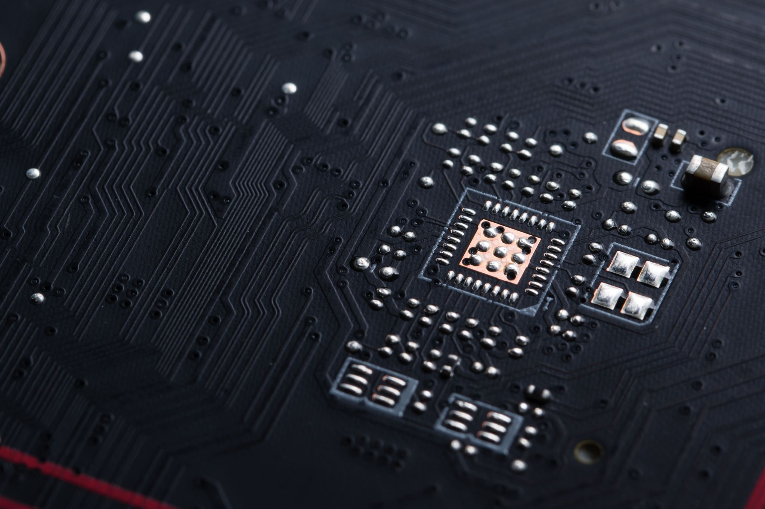
Types of Processor Cores

Slide 14
Types of Processor Cores
Single-core CPU - It is the oldest type of CPU which is available and employed in most of the personal and official computers. The single-core CPU can execute only one command at a time and its not efficient in multi-tasking. It signifies that there is a markable declination in performance if more than a single application is executed. If one operation is started, the second process should wait until the first one is finished. But if it is fed with multiple operations, the performance of the computer is drastically reduced. The performance of a single-core CPU is based on its clock speed by measuring its power.
Dual-core CPU - It is a single CPU that comprises of two strong cores and functions like dual CPU acting like one. Unlike the CPU with a single core, the processor must switch back and forth within a variable array of data streams and if or more thread is executed, the dual-core CPU manages the multitasking effectively. To utilize the dual-core CPU effectively, the running programs and operating system should have a unique code called simultaneous multi-threading technology embedded in it. Dual-core CPU is rapid than a single core but it is not robust as quad-core CPU

Slide 15
Types of Processor Cores Ctd.
Quad-core CPU
The quad-core CPU is a refined model of multiple core CPU features and design with four cores on a single CPU. Similar to dual-core CPU, that divides the workload in between the cores, and quad-core enables for effective multitasking. It doesn’t signify any single operation which is four times faster rapid than others. Unless the applications and program executed on it by SMT code will fasten the speed and becomes unnoticeable. Such types of CPU are used in people who need to execute multiple different programs at the same time as gamers, series of supreme commander that is optimized in multiple core CPU.
Hexa Core processors
It is another multiple core processor which is available with six cores and can execute the task which works rapidly than the quad-core and dual-core processors. For users of the personal computer, the processors of Hexacore is simple and now the Intel is launched with Inter core i7 in 2010 with Hexa core processor. But here the users of smartphones use only quad-core and dual-core processors. Nowadays, smartphones are available with hexacore processors.

Slide 16
Types of Processor Core
Octa-core processors
The dual-core is built with two cores, four cores are built-in quad-core, Hexa comes with six cores where the octa processors are developed with eight independent cores to execute an effective task that is efficient and even acts rapidly than quad-core processors. Trending octa-core processors comprises of a dual set of quad-core processors that divides different activities between the various types. Many times, the minimum powered core sets are employed to produce advanced tasks. If there is any emergency or requirement, the rapid four sets of cores will be kicked in. In precise, the octa-core is perfectly defined with dual-code core and adjust it accordingly to give the effective performance.
Deca-core processor
The processor with double core comprises two cores, 4 cores are available with quad cores, six cores are available in hexacore processors. Deca-core is available with ten independent systems that are deployed to execute and manage the task that is successful than other processors that are developed until now. Owning a PC, or any device made with a deca-core processor is the best option. It is faster than other processors and very successful in multi-tasking. Deca-core processors are trending with its advanced features. Most of the smartphones are now available with Deca core processors with low-cost and never become outdated. Surely, most gadgets in the market are updated with new processors to give more useful purposes to people.

Slide 17
What Is A Thread?
Thread is a single sequential flow of control in a program that allows multiple activities within a single process. However, single-threaded processes are based on the execution of programs (or instructions) in a single sequence. In simple words, a single thread is like one command that runs at a time.

Slide 18
Relationship Between Core and Thread
Core is a physical hardware component whereas thread is the virtual component that manages the tasks of the core. Cores enable completion of more work at a time, while threads enhance computational speed and throughput. Cores use content switching but threads use multiple processors for executing different processes

Slide 19
Processor – RAM Relationship
RAM stands for Random Access Memory, and is used as a short-term memory storage space. The processor, also known as the CPU, provides the instructions and processing power the computer needs to do its work.

Slide 20
Motherboard

Slide 21
What is a motherboard?
A motherboard is the main printed circuit board in general-purpose computers and other expandable systems. It holds and allows communication between many of the crucial electronic components of a system, such as the central processing unit and memory, and provides connectors for other peripherals.

Slide 22
Different slots in the motherboard
PCI Slot
A PCI slot is an interface on the motherboard that allows you to put in a device that requires power, famous for coming with the first Intel Pentiums in 1993.
The PCI stands for ‘peripheral components interconnect’, a standard computer bus to connect peripheral devices directly to your motherboard. Its name comes from its physical location between two other elements and from the electrical signals it sends and receives.
PCI-X
As a presence of the PCI slot, the PCI-X slot was also developed. You should not confuse these acronyms with PCI Express. The ‘X’ in this case refers to ‘expanded’.

Slide 23
Motherboard slots continued
AGP
The acronym AGP stands for ‘Advanced/Accelerated Graphics Port’, and they are mainly designed to support video/graphic cards with high bandwidth requirements. The main advantage of these slots type is that they support a simple direct connection between the CPU and the motherboard without any connectors or cables needed.
AGP slots are a type of motherboard used for personal computers which were popular in the early 2000s. Initially, AGP slots were designed as an upgrade to plain PCI slots. Now, this slot is the successor to the original PCI.
ISA
ISA expansion slots are the oldest types of slots on the motherboard. ISA stands for ‘Industry Standard Architecture’ because no other slots were invented at that time. The components designed to install on ISA slot were huge in size and among the first slots to be used in personal computers.
Network cards, video cards, and other extended hardware are installed with the help of ISA slots.

Slide 24
Motherboard slots continued
EISA
The EISA ‘Extended Industry Standard Architecture’ slots were introduced to compete with Micro Chanel Architecture by IBM.
Are you looking for a new motherboard that can support more than 4 ESIA Slots? Luckily, most motherboards nowadays include five or more ESIA slots built-in.
The main thing to remember when it comes to ESIA Slot configurations is that they range from 1x to 16x. That’s because the number in front of the x denotes how many cards are in one slot.
VESA
VESA stands for ‘Video-Electronics Standards Association’, it is a group of monitor and graphics card manufacturers that establish video bus and display standards. The aim of VESA slots is to optimize the video operations.
Although, VESA slots were only used in the PCs for a little amount of time. VESA Company introduced these slots but after some time, ISA Bus replaced VESA.

Slide 25
Motherboard slots continued
RAM Slot
The RAM slot on the motherboard determines the type of RAM your computer can utilize. Depending on the motherboard, typically numbering 2 or 4 (sometimes more on high-end motherboards), usually located at the motherboard’s upper-right corner.
Although the RAM slots are the last thing that comes to your mind when you’re purchasing your computer, it would be good to check that out too. Sometimes a motherboard can be a bit older, meaning that you can’t plug in the latest RAM modules to upgrade.
AMR Slot
The AMR ‘Audio/Modem Rise’ slots are generally found on Pentium 3 and Pentium 4 computers on some of the motherboards. Intel designed these expansion slots to communicate with the motherboard by offering analog capability. These slots are used to install modems and sound cards.
This specification allows the motherboard to be manufactured at a lower cost and frees up industry-standard expansion slots in the system for additional compatible peripherals.

Slide 26
Motherboard slots continued
CNR
Communications and networking slot or CNR slot is only used by the customized systems for networking. It is a specification that supports audio, modem, USB, and LAN interfaces on core logic chipsets.
Today this slot is no longer found on motherboards and has been replaced by PCI and PCIe.

Slide 27

Cache

Slide 28
What Is Cache Memory?
Cache memory is a small-sized type of volatile computer memory that provides high-speed data access to a processor and stores frequently used computer programs, applications and data.
A temporary storage of memory, cache makes data retrieving easier and more efficient. It is the fastest memory in a computer, and is typically integrated onto the motherboard and directly embedded in the processor or main random access memory (RAM).

Slide 29
Types of Cache Memory
Level 1 (L1) cache or Primary Cache
L1 is the primary type cache memory. The Size of the L1 cache very small comparison to others that is between 2KB to 64KB, it depends on computer processor. It is an embedded register in the computer microprocessor(CPU).The Instructions that are required by the CPU that are firstly searched in L1 Cache. Example of registers are accumulator, address register,, Program counter etc.

Slide 30
Types of Cache Memory Ctd.
Level 2 (L2) cache or Secondary Cache
L2 is secondary type cache memory. The Size of the L2 cache is more capacious than L1 that is between 256KB to 512KB.L2 cache is Located on computer microprocessor. After searching the Instructions in L1 Cache, if not found then it searched into L2 cache by computer microprocessor. The high-speed system bus interconnecting the cache to the microprocessor.

Slide 31
Types of Cache Memory Ctd.
Level 3 (L3) cache or Main Memory
The L3 cache is larger in size but also slower in speed than L1 and L2, it’s size is between 1MB to 8MB. In Multi core processors, each core may have separate L1 and L2,but all core share a common L3 cache. L3 cache double speed than the RAM.

Slide 32
Compare and contrast the cache memory in mobile and system
there are different levels of caching, different phone vendors use different cache size hence it is hard to generalize . But a typical modern day may have anywhere between 32KB - 512KB of L1 and L2 cache.
Now this does not stop here. This is only two level caching supported by software, but Android supports software or virtual caching too same way Linux does (Because under the hood. Android is Linux but highly optimized one. )

Slide 33
Where is cache memory available
Cache memory is sometimes called CPU (central processing unit) memory because it is typically integrated directly into the CPU chip or placed on a separate chip that has a separate bus interconnect with the CPU.

Slide 34
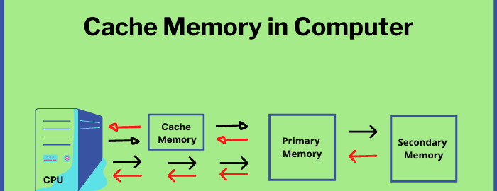
How Cache Works

Slide 35
RAM & Cache memory relationship
RAM stands for random access memory. Any file or application actively in use on a computer is stored in RAM primary memory. Cache is a smaller memory configuration reserved from main memory to make computer operations more efficient.

