Slide 1

Intro to Dependency Injection
With Unity, Ninject, and Autofac

Slide 2
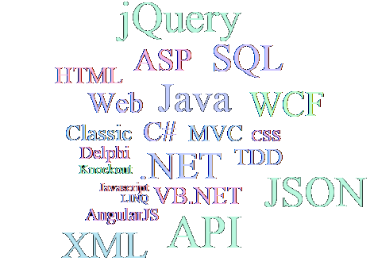
John Callaway
Professional developer since 1999
Specialize in web technologies
Primarily with line-of-business
Enjoy learning new tech

Slide 3

What is Dependency Injection
In software engineering, dependency injection is a software design pattern that implements inversion of control for resolving dependencies. A dependency is an object that can be used (a service). An injection is the passing of a dependency to a dependent object (a client) that would use it.

Slide 4

Martin Fowler says:
The basic idea of the Dependency Injection is to have a separate object, an assembler, that populates a field in the [target] class with an appropriate implementation for the finder interface

Slide 5
Let’s look at some code!
Ex01 - File => New Project
Ex02 - “new” everywhere!
Ex03 - Field level service
Ex04 - Poor Man’s DI
Ex05 - Poor Man multi-layer
Ex06 - Unity
Ex07 - Ninject
Ex08 - Autofac
Ex09 - Put it all together

Slide 6
DI vs IoC
Dependency Injection is a tool that Inversion of Control uses.
If you’re doing Inversion of Control then you’re doing Dependency Injection.
If you’re doing Dependency Injection you may not necessarily be doing IoC.
The distinguishing feature of IoC is instead of the dependency flowing from top to bottom, the flow is from bottom to the top. In other words, the data layer would depend on the business layer, your business layer depends on UI, etc.
Inversion of Control is a topic for another time.

Slide 7


Intro to Dependency Injection
John Callaway
@matsubonsai
www.1north.com

Slide 8
Appendix - Links
Wiki - https://en.wikipedia.org/wiki/Dependency_injection
Martin Fowler - http://www.martinfowler.com/articles/injection.html
Unity - https://github.com/unitycontainer/unity
Ninject - http://www.ninject.org/
Autofac - http://autofac.org/
Moq - https://github.com/Moq/moq4/wiki/Quickstart

