Slide 1
Data Dialog
Conversational intelligence for Snowflake data ecosystems
UTDallas Capstone • Fall 2025

Slide 2
Presentation Roadmap
Who we are
Problem we are solving
Solution vision and technical strategy
Delivery plan and current progress
Demo preview and what is next

Slide 3
Problem Statement
Snowflake estate spans hundreds of tables with limited institutional memory
Subject matter experts become bottlenecks for answering basic data questions
Business partners cannot self-serve insights without SQL fluency
Manual research delays critical underwriting and claims decisions

Slide 4
Solution Vision
Build Data Dialog as a conversational assistant for Snowflake knowledge
Serve tailored experiences for DBA, developer, and analyst personas
Deliver narrated insights that explain what the data means and why it matters
Extend to automated reporting so outputs are stakeholder ready

Slide 5
High-Level Solution and Tooling
React and Tailwind front end delivers responsive chat and landing experiences
Express with TypeScript streams Snowflake Cortex responses via SSE for low latency
Snowflake Cortex agent defined and tested directly in Snowsight for closed-loop dev
TanStack Query, React Query, and Lucide icons provide modern UX foundations

Slide 6
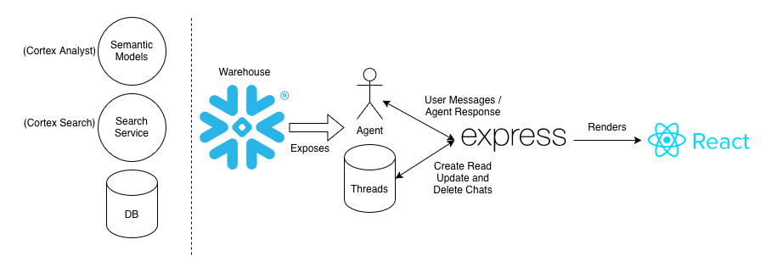
How Everything Fits Together

Slide 7
Phase 1 Implementation Plan
1 Establish Snowflake Cortex agent and secure Express gateway
2 Deliver chat experience with persona modes and streaming responses
3 Capture insights and reporting scaffolding while hardening DevOps

Slide 8
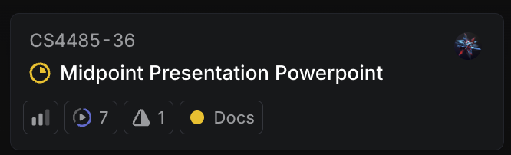
Delivery Workflow
Linear board manages discovery, build, and validation swimlanes
Weekly planning syncs map tickets to Snowsight agent iterations
GitHub PR reviews enforce coding standards and demo readiness
Insert screenshot of Linear board highlighting current sprint

Slide 9
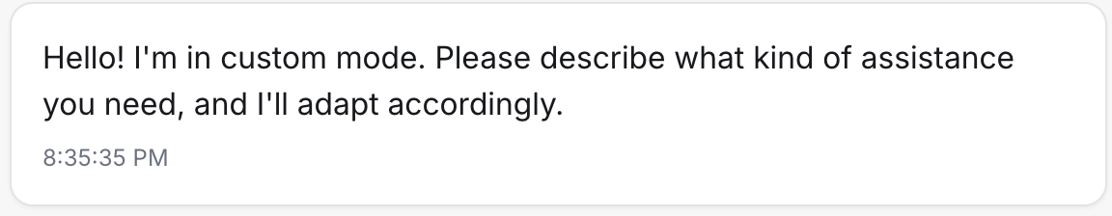
Snowflake Agent Integration
Normalized Cortex status events into assistant friendly updates
Persisting thread IDs per client cookie for conversation continuity
Streaming responses over SSE with graceful error recovery
Insert screenshot of Snowsight agent run or streaming logs

Slide 10
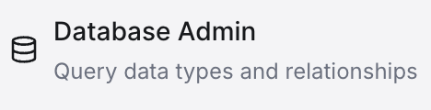
Multi-Role Chat Experience
Persona selector tailors prompts for DBA, developer, and analyst workflows
Animated chat surface renders streaming responses with markdown styling
New chat creation spawns Cortex threads on demand with optimistic UI

Slide 11

Conversation Management and Status UX
Thread list hydrates from Cortex history with rename and delete controls
Inline status ticker translates tool usage to plain language updates
Scroll management keeps users anchored on the latest insight

Slide 12
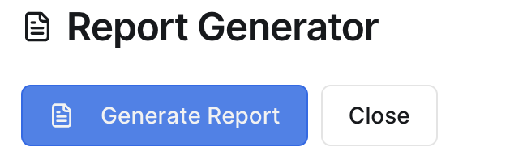
Report Generator Foundations
Modal drives summary, detailed, and technical report paths
Report exports to downloadable briefs with insight and action sections
Toast feedback and validation protect against empty conversations

Slide 13
Landing and Onboarding Experience
Hero section communicates value proposition with motion design
Feature cards outline core capabilities aligned to personas
Role selection cards educate stakeholders on tailored workflows

Slide 14
Demo Preview
Walk through persona selection and first query
Highlight live status updates and report generation
Share key insights stakeholders should watch for

Slide 15
Phase 2 Roadmap
Complete /api/report service for PDF and dashboard-ready exports
Add authentication, auditing, and observability for enterprise readiness
Run pilot sessions with business analysts to capture usability feedback
Model Evaluation

Slide 16
Questions?

Slide 17
Thank You

