Slide 1
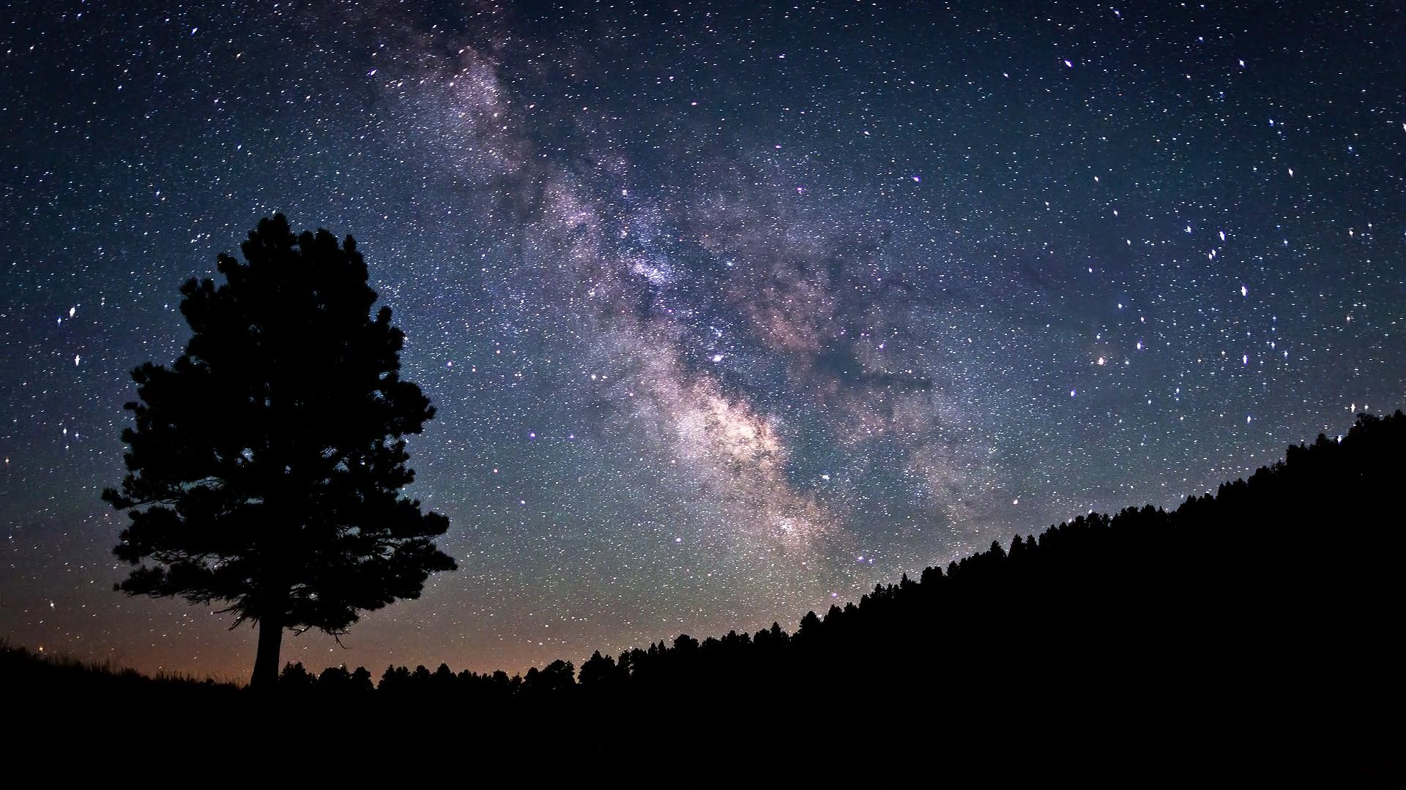
Stars
Zafeiri Stamatia Varvara

Slide 2
Game Concept
Player travels from planet to planet
Discovers and forms constellations
Learns interesting facts about them
The objective of the game is to unlock all planets and form all the constellations

Slide 3
Player’s role
Player’s role is to find each constellation and connect the stars to form it.
Game is not avatar based.
Player’s main challenge to complete the levels
Player’s main activity is pairing stars

Slide 4

Game genre
Single player
Educational game
Logical game
Puzzle game
Interactive items (e.g. planets, stars)
Not based on competition
Unlockable new levels

Slide 5
Target group
1st - 6th grade students
(6 - 12-year-old students)

Slide 6
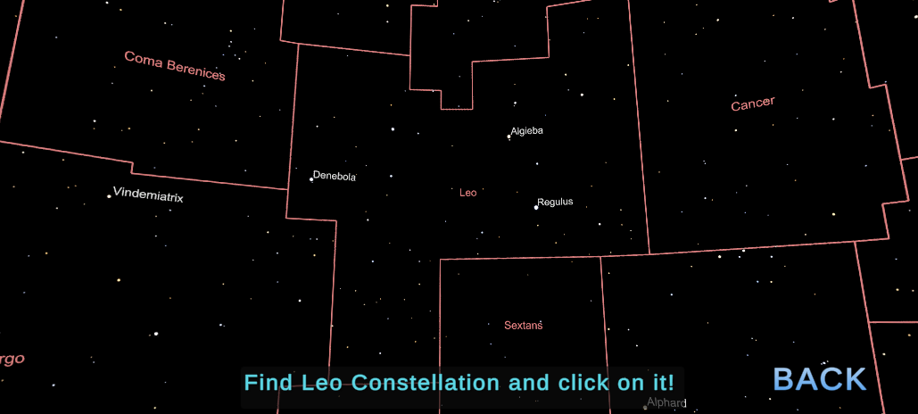
Game world
3D game
Skybox
2D background image with 3D objects
Camera is 3D straight to the game Canva and does not move.

Slide 7
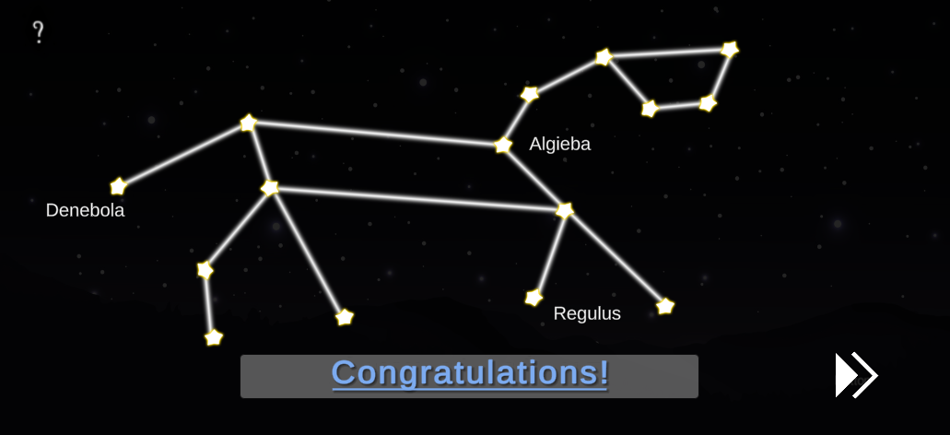
Gameplay
The main challenge is to unlock all levels
Forming the constellations can be defined as second level challenges
Third level challenges are mainly related with exploring the skybox (sky and stars)
Player can: - Select a planet (level)
- Navigate around stars and constellations
- Select and deselect stars

Slide 8

Characters
Luna (main character)
Miss Smith (non-player characters)
Luna’s mum (non-player characters)
Non avatar characters

Slide 9
Story
Today kids were discussing about the meanings of their names in class.
Luna’s name means moon in Latin
Luna was born on a full moon
As little Luna drifts to sleep she dreams about the night sky and the stars

Slide 10
Game structure
9 main levels (planets)
When a level is completed the next one is unlocked

Slide 11
Game world
Game takes place in space
The solar system is based on real life
In the background we can see the milky-way.
Each planet is a level and unlock one after the other
Stars and text are cartoon like
In this game there is no failure, it’s a safe and happy environment that helps the player relax.

Slide 12

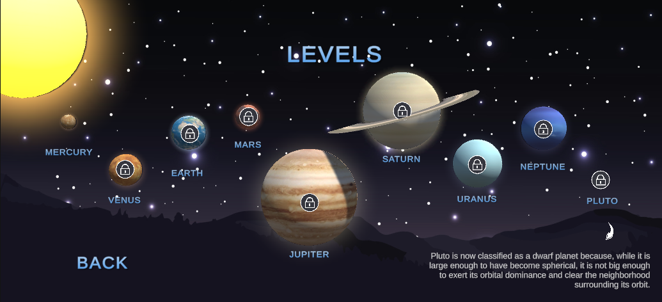
User interface

Slide 13
Hardware requirements
OS: Linux x86_64
CPU: Intel Pentium 4
GPU: OpenGL-capable GPUs
MEMORY: 1GB RAM
HARD DRIVE: 2GB available space

Slide 14
Marketing
Promotion through
Social media (e.g. Facebook, Instagram)
Gaming platforms (e.g. Steam , Epic Store)
Educational and school exhibitions
Testing in the classroom
Feedback to upgrade the game through suggestions

Slide 15


Unity project’s files & source code
https://drive.google.com/drive/folders/149rcpktueKwdIFyMuPuv9CD7x3cLu76U?usp=sharing

Slide 16
Thank you for your attention!

