Slide 1









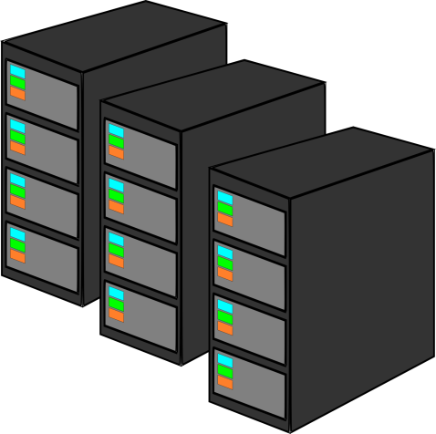
Integrating bioinformatics into State PHL testing
State PHL Functions
Send samples
Sentinel labs
Homes
Send test kits
Send results
Public Health Laboratory
Shops
Restaurants
Potential Workflow for Next Generation Sequencing (NGS)
Laboratory Testing
Bioinformatics Analyses
Epidemiology
Current Workflow for PulseNet
1 2 3
Send results via BaseSpace
Send results via BioNumerics
1
2
3
Laboratory culture, PFGE, and sequencing
wgMLST on CDC servers
Report trees to epidemiologists

