Slide 1
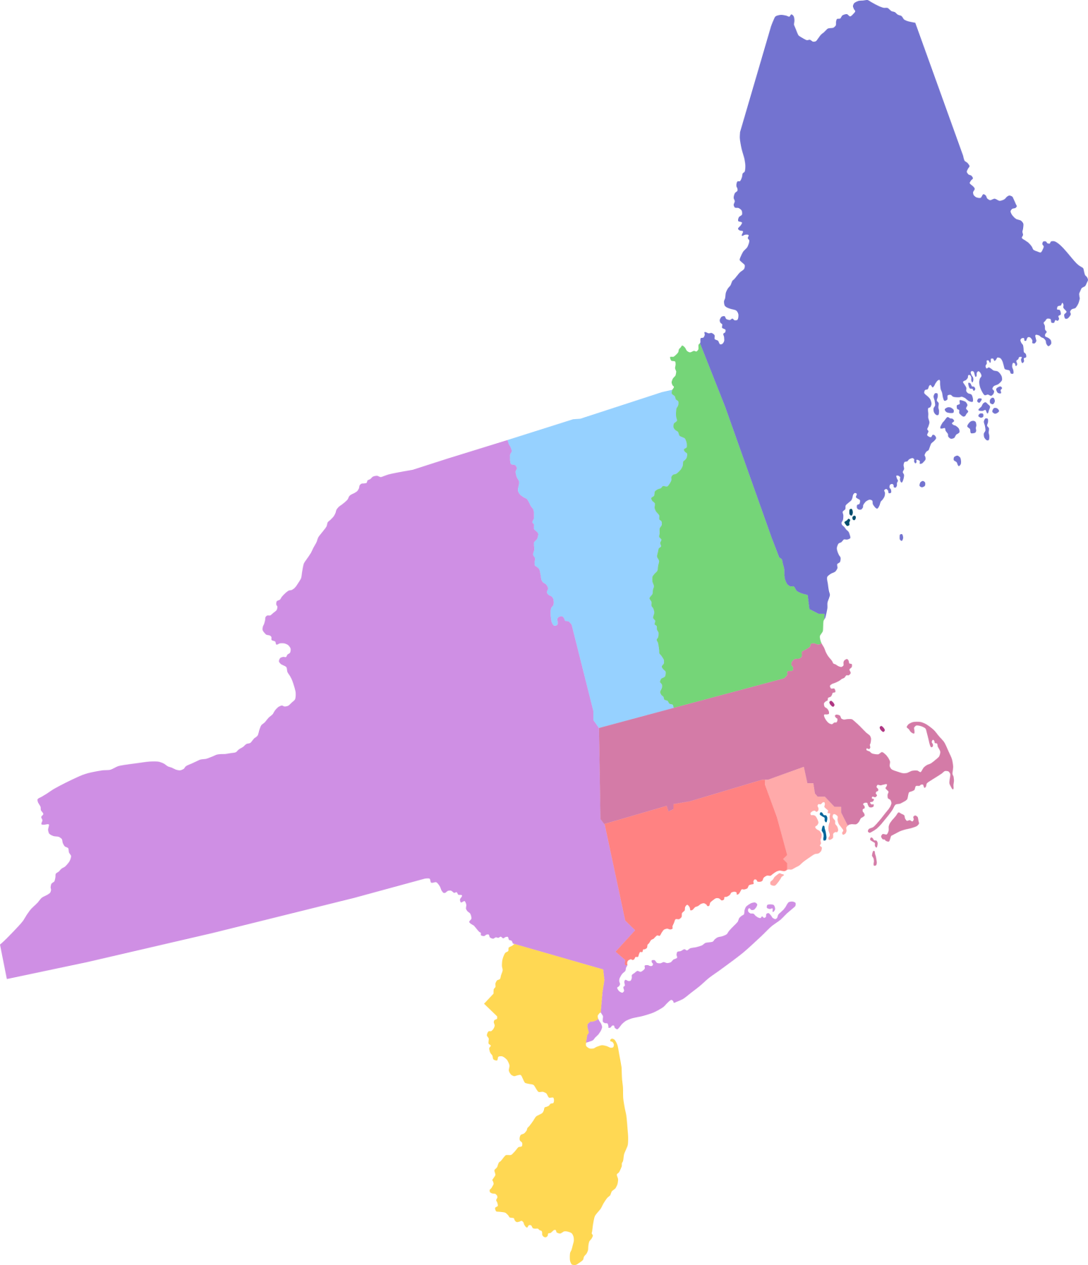



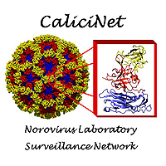

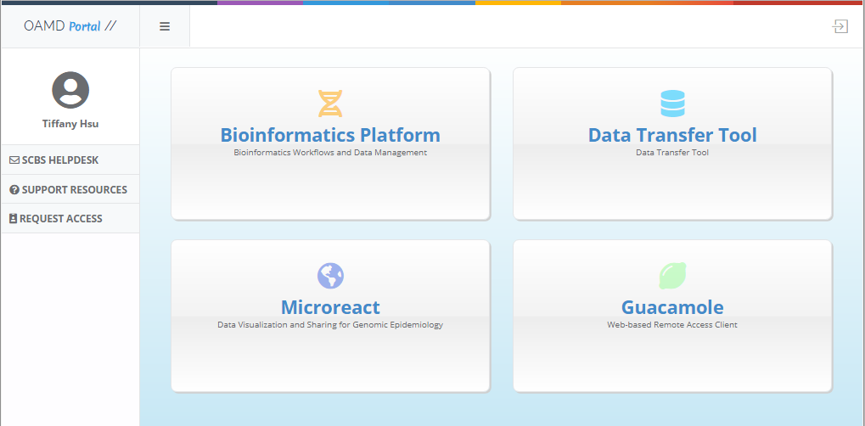

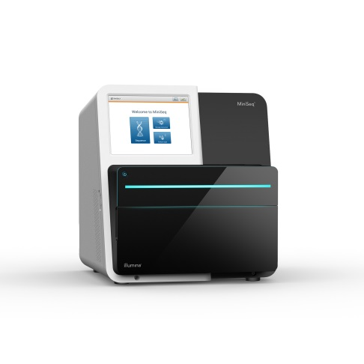

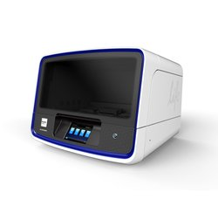
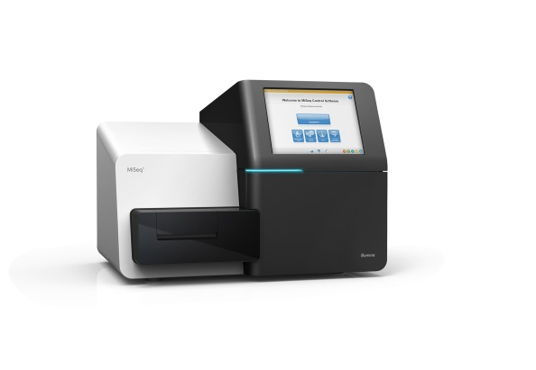
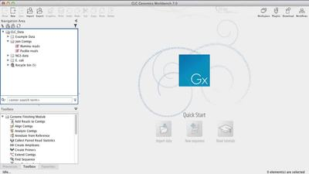


Call Results
What sequencing projects are currently being carried out?
What is your bioinformatics capacity?
Working with IT
ME
2 states have in-house bioinfomaticians, 1 has a consultant
NYS has a bioinformatics core (n=3)
Only these 4 SPHLs have Linux machines
Most states have 2 networks, an instrument network and state network.
Mostly likely, bioinformatics will need to be on a separate network
Most states have difficulty convincing IT to provide Linux support and allow for cloud use (BaseSpace)
VT
NH
GHOST
NYS
MA
RI
Resources from CDC and APHL
CT
NYC
APHL-AIMS Cloud
Global Hepatitis Outbreak and Surveillance Technology
Surveillance of Legionella pneumophila through wgMLST
NJ
Undetected Respiratory Disease Outbreaks (URDO)
BaseSpace
FTP
OAMD Portal
Storing and reporting data
What is your sequencing capacity?
CDC High Performance Compute Cluster
CDC-Specific Projects
State-Specific Projects
MA collaborating with Broad to sequence rabies
CT developing deep sequencing for HIV and for carbapenem resistance
NYS has in house protocols for mumps, zika, adenoviruses, pan-viral NGS, detecting drug resistance in malaria, characterizing Mycobacterium tuberculosis
Ion Chef
MiSeq
MiniSeq
Resources in-house
Most New England states do not have a data policy
Most files are stored on hard drives
Only NYS has started considering how to report to epidemiologists
All New England states have MiSeqs (ranging from 1-8)
NYS also has 2 Ion Chefs , 2 S5 Ion Torrents, HiSeq, and NextSeq, while CT has a miniSeq.
CLC Genomics Workbench (ME, MA, CT, NYS)
BioNumerics (most states)
Geneious (NYS)

