Slide 1
The predictions your home-buyers will pay a premium for
Notes:
Today we will be updating you on the progress we have made on the energy usage dashboard since our last meeting.

Slide 2
Selling points for your home-buyers
Control and save money
Predict usage for better budgeting
Notes:
You will recall from our last meeting that we concluded that homebuyers will pay more for a home that is eco-friendly and enables them to:
Control their energy usage and save money
Predict usage so they can budget better

Slide 3
Retrospective information
Past spend for the house as a whole
Energy usage for each sub-meter and the house as a whole on:
a particular day
the preceding days in the month
the year so far.
Control and save money
Notes:
As a quick reminder, controlling and saving money is based on retrospective information – the energy usage and spend in the past.
And we showed you the mock up of the dashboard with past spend for the house as a whole and the energy usage on a particular day, preceding days in the month and the year so far.

Slide 4
Issues resolved
Replaced missing data with an average.
The data for November 2010 in the dashboard has been created from the averages for November in past years.
Created one dataset for the parts of the house without submeters
Notes:
Before talking in more detail about the predictions, you’ll remember there were a couple of issues with the data and I wanted to tell you how we resolved them.
Some data was missing and we replaced the missing information with an average of the total for that variable.
The observations finished just before the end of November 2010 and we have replaced November 2010 with the average of all Novembers in the dataset.
We also created the data for the area of the house not covered by the three submeters.

Slide 5
Possible predictive information
Energy usage and cost for the house as a whole and individual sub-meters for upcoming:
day
week
month
year
Predict usage for better budgeting
Notes:
This presentation looks at what reliable predictions can be made from the data that you gave us to work with.
Predictive information about energy usage and costs could relate to the next day, week, month or year or any other timespan

Slide 6

Some predictions are better than others
Low error rate
Better accuracy
Notes:
You can make predictions for any time period but some predictions are better than others.
But what you really want in the dashboard is to include only the most accurate predictions.
So that your buyers are satisfied.
The predictions we recommend are those with a low error rate in the predictive model that we created.
So, for example, we wouldn’t recommend including the next day’s energy usage in the dashboard. This is easy to imagine because we can’t predict that someone will use a tumble dryer on a specific day.

Slide 7
Reliable predictions
The next month
Notes:
What we do recommend is focusing on offering predictions for the months ahead. Because, using the same example, predicting the laundry room’s energy usage will increase a certain number of times in a month has a low error rate.
You’ll see in the dashboard that predictions for energy usage and costs can be made for up to 12 months in advance and to ensure homebuyers’ trust in the predictions we have given these predictions as a range.

Slide 8
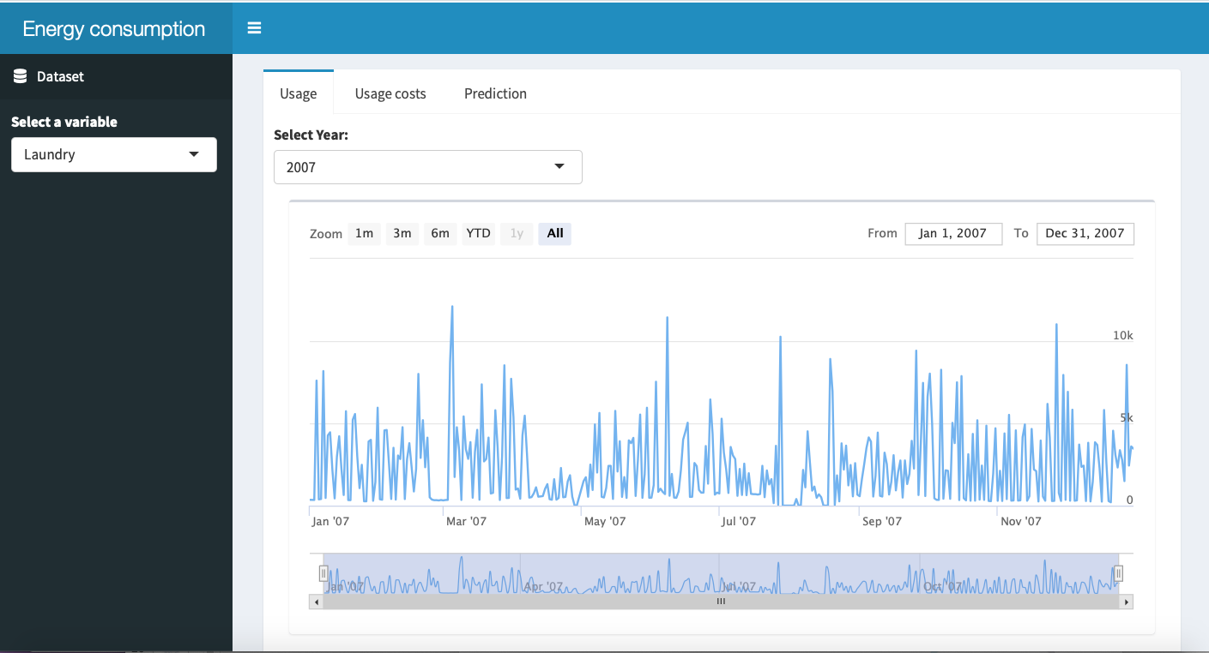

Slide 9
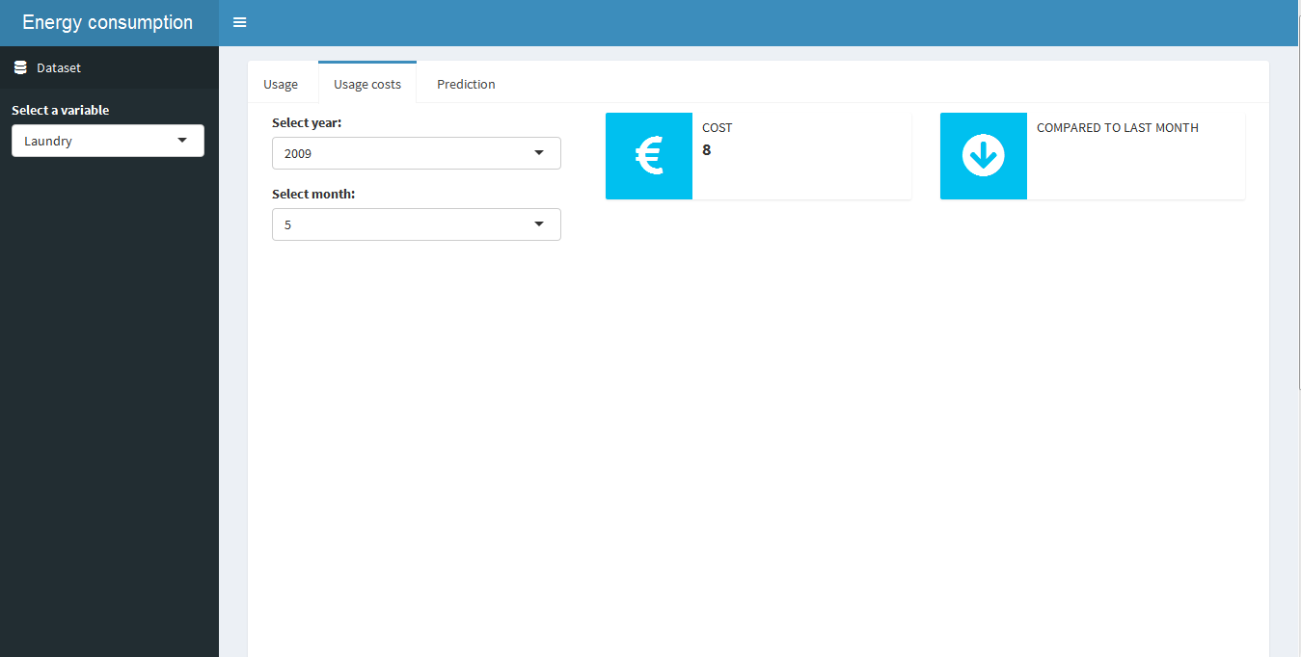

Slide 10
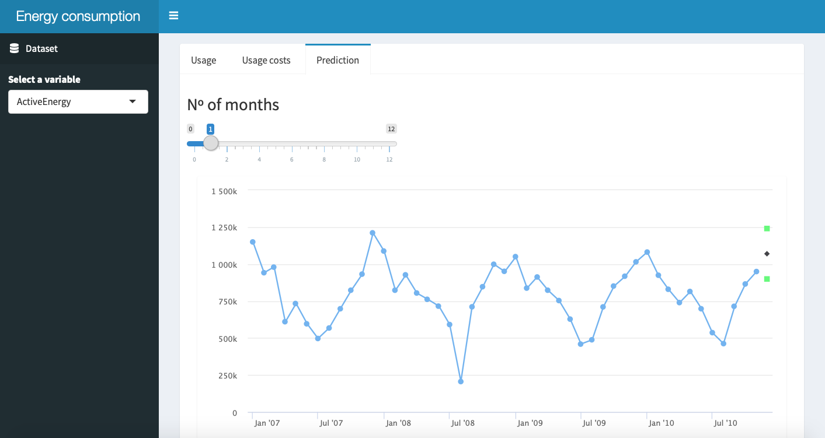

Slide 11
Summary
Reliable predictions mean your homebuyers will be happy with their purchase
Your reputation for selling homes with reliable and useful energy usage dashboards is secured
Notes:
In summary, good predictions allow you to add a premium to the purchase price because the homebuyer will make savings on their energy bills in the future.
The home buyer is happy with their purchase and your reputation for selling homes with reliable and useful energy usage dashboards is secured.

Slide 12
Next steps
Refine the look and feel of the dashboard with your feedback
Additional submeters to measure individual appliances
Smart phone compatibility
Instant notification of anomalies
Monitor dashboard data with homebuyers’ agreement to inform where the service can be developed further in the future
Notes:
In summary, good predictions allow you to add a premium to the purchase price because the homebuyer will make savings on their energy bills in the future.
The home buyer is happy with their purchase and your reputation for selling homes with reliable and useful energy usage dashboards is secured.

Slide 13
Thank you
Shiny Happy People

