Slide 1

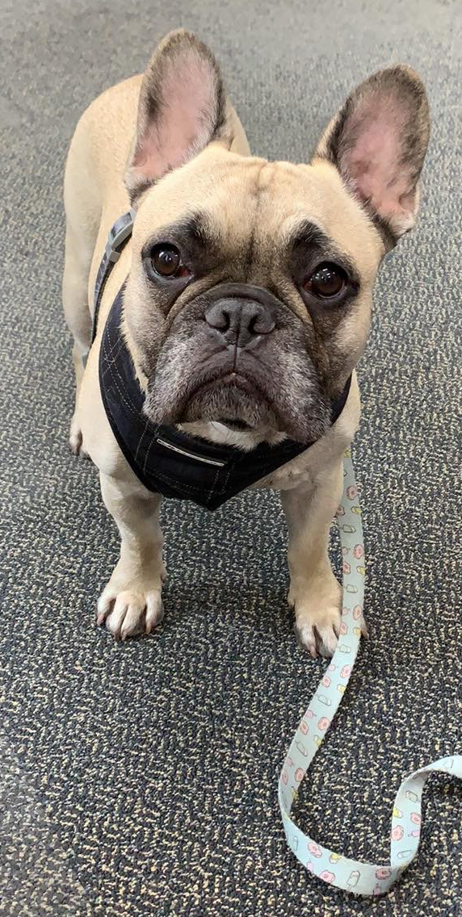
WALKIES
Login
Create New Account

Slide 2
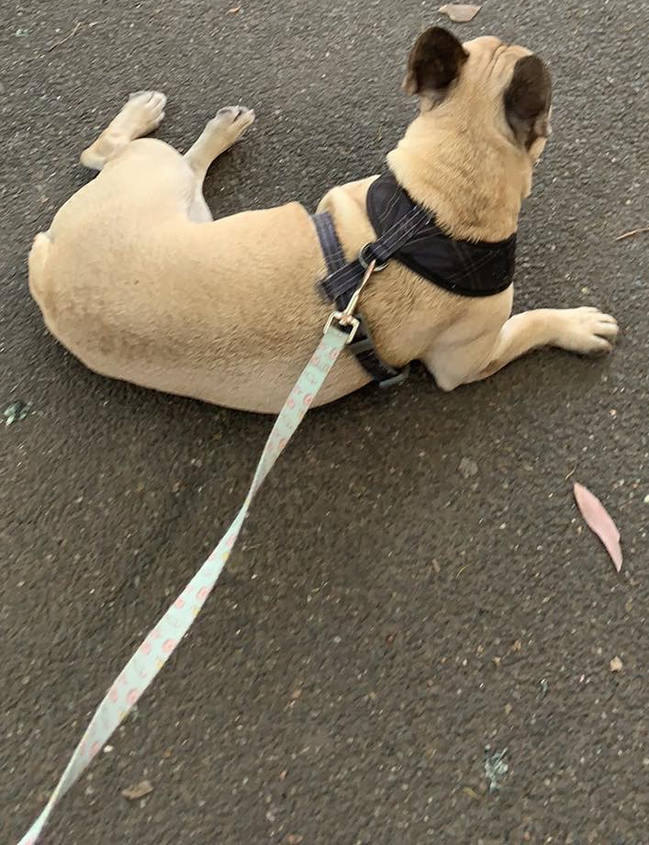
WALKIES
Elizabeth’s Dashboard
Contact Details: 0401 123 456
Address:
Unit 12
St Andrews Pl
Nth Melb, VIC, Aus
Registered Dogs:
Rocky (French Bulldog)
Book Dog Walker
Go to {dog} Profile
Current Walk
Add New Dog
Update
Home
Logout

Slide 3
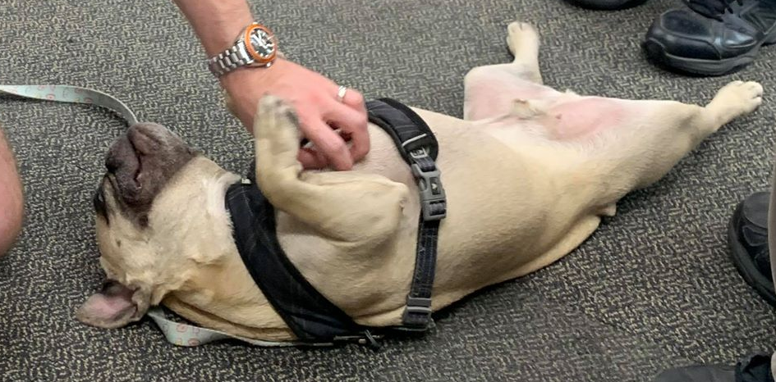
WALKIES
Rocky’s Profile
Breed: French Bulldog
Age: 5
Health Issues: None
Veterinarian Contact: Nth Melb Vet
Other: Friendly toward other dogs but prefers human interaction.
See Previous Walks
Book New Walk
Delete this Dog
Update
Home
Logout

Slide 4
WALKIES
Rocky’s Previous Walks
10 Dec 2019
5 Dec 2019
6 Nov 2019
Book New
Home
Logout

Slide 5
WALKIES
10 Dec 2019
The weather was {sunny}. {Rocky} went to the dog park in North Melbourne and played with a stick. He did one poo at the park but did not stop for any wees.
Book New
Home
Logout

Slide 6

WALKIES
Current Walk
Book New
Home
Logout

Slide 7

WALKIES
Dog Walker Dashboard
Today’s Dogs
Find Human
Find Dog
Logout

Slide 8
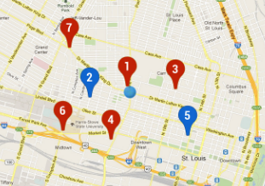
WALKIES
Today’s Dogs
Click on a pin to view dog
Logout
Home
Add Dog

Slide 9
WALKIES
Requested Appointment Details
Rocky wants to walk at 10am for 30 mins
Reject
Confirm
Modify
Logout
Home
Map

Slide 10
WALKIES
Completed Appointment
Rocky was walked at 10am for 30 mins
Confirm
Logout
Home
Map

Slide 11
WALKIES
Update Walk Details
{10am on 10 December 2019}
Weather 1: Hot/Warm/Cold
Weather 2: Sunny/Cloudy/Rain
Enter what happened on the walk.
Update
Logout
Home
Map

