Slide 1
Restaurant Revenue Prediction
Brett Pedersen

Slide 2
Problem Background
Restaurants all over the world
Investing in new sites
Predicting annual restaurant sales
Better use of resources

Slide 3
Feature Engineering
Open Date variable
Year, month, doy, dow

Slide 4
Model Comparison
Random Forest (1729028.03277)
BART (1934971.48215)
K-nearest Neighbors (1942452.98510)

Slide 5
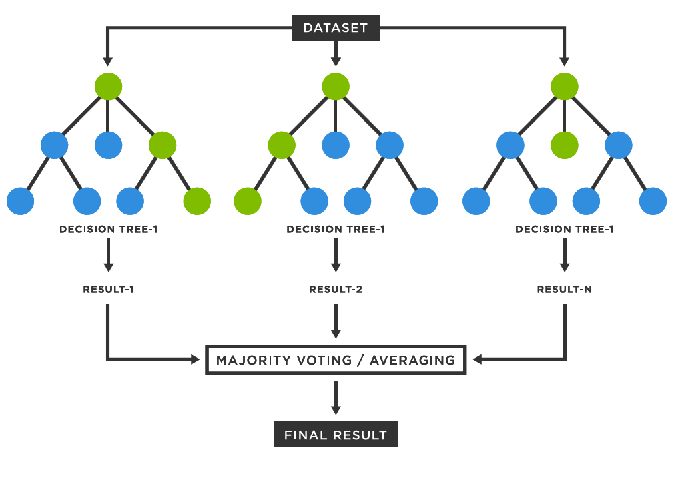
Algorithm Details
Decision trees
Ensembling
Bootstrap Sampling

Slide 6
Final Score
1729028.03277

