Slide 1
Indie .NET
Nancyfx, signalr, and RavenDb

Slide 2
Me.
Stachu Korick
Contact info on last slide
Work at AcademyOne
< 1 mi. from here
.NET stuff, education space
Awesome company (flex hours, good PTO, etc)

Slide 3
What is this talk?
Give back to the .NET scene
“Indie” .NET is just awesome
.NET tech that’s significant, but not quite mainstream

Slide 4
Organization of this Talk
{
Tech overview
Speed-lesson
Questions
} * 3
Usage in ‘Guesstimate’

Slide 5

NancyFx – What is it?
“Lightweight web framework for .NET and Mono”
Run-anywhere
View-engine agnostic
Extensible
Not in your way
Highly-testable

Slide 6
NancyFx – Code!
Hello, from Nancy
Hello from an .html view
Basic GET and POST
Testing!

Slide 7
NancyFx – Questions?
Ideas:
Why use this over ___?
Where in Nancy do I add things to the pipeline?
But I thought Nancy was on OWIN?
What about authentication?
Can I upload files?

Slide 8
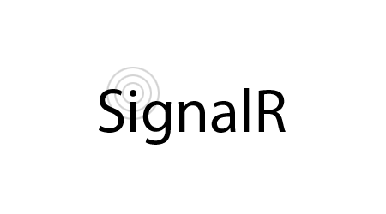
SignalR – What is realtime communication?
See demo!

Slide 9
SignalR – What is it?
“Incredibly simple real-time web for .NET”
Available on multiple client-side platforms
Client-agnostic, with official support for .NET, JS, and Java

Slide 10
SignalR – Micro-demo.
Install-Package Microsoft.AspNet.SignalR
App.MapSignalR()
Create a hub with a simple method.
Create a js client with a simple method.
Test!

Slide 11
SignalR – Misc. SignalR Stuff
Groups
ConnectionId
jQuery dependency (for now!)

Slide 12
SignalR – Available Clients
.NET
Silverlight
Windows Desktop
Windows Store
Win Phone
Java
JavaScript
Android
ObjC

Slide 13
SignalR – Questions?
Ideas:
Ok, but how does it work?
What about security?

Slide 14

RavenDb – What is NoSQL? Why should I care?
Data can often be better represented in a non-relational form
Flexible data structure
Easy to change
Easy to reindex
Scalability
Scaling out (N+!), not up (N^2)!

Slide 15
RavenDb – What is it?
“…2nd generation document DB.”
Non-relational database system
Stores data as JSON
Highly scalable
Transactional

Slide 16
RavenDb – How can I use it?
.NET client
HTTP client
Can use from other non-.NET systems
Java client
Unofficial clients
Just HTTP wrappers!

Slide 17
RavenDb – Mini-demo
Go to Visual Studio!

Slide 18
RavenDb – Questions?
Ideas:
Can you shard/replicate your data?
Do you have to pull one document at a time, or can you do more?
Is it free or commercial?

Slide 19
Guesstimate

Slide 20
Outro
Thanks!
Any last questions?
Contact:
StachuKorick@gmail.com
Stachu.NET [blog soon!]
Talk to me right after, get card.
@StachuK1992
Just google “Stachu.”

