Slide 1
Machine Learning Technologies
Lab 1 Introduction
AY 2025/2026

Slide 2
Lab rules reminder
No food or drink allowed except water in water bottles!
Please leave a max of 10 minutes before the end of time to allow the next module to take their places (just like in the lecture theaters)

Slide 3
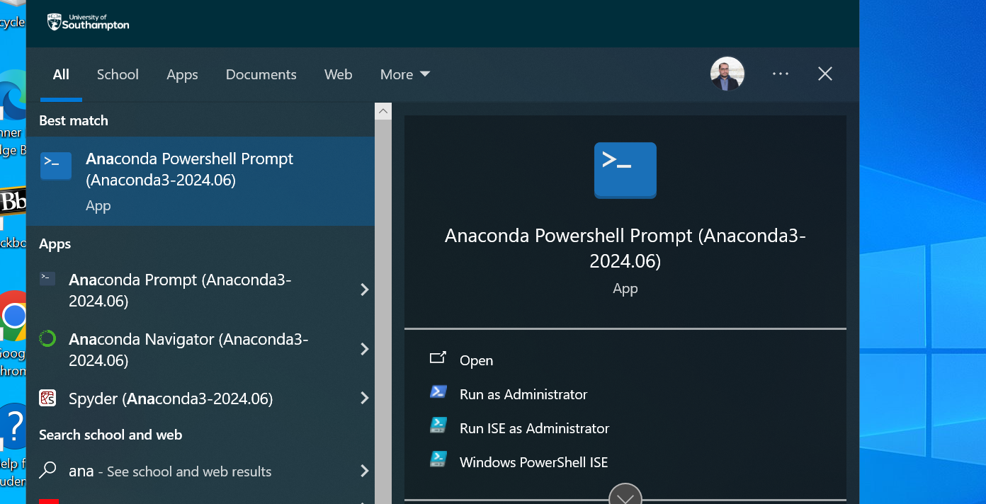
Download the .ipynb, you can do it on the home folder, or look for your OneDrive, that should be accessible
Then, start an Anaconda Power Shell Prompt from the Windows Menu (type Anaconda in the search bar)

Slide 4
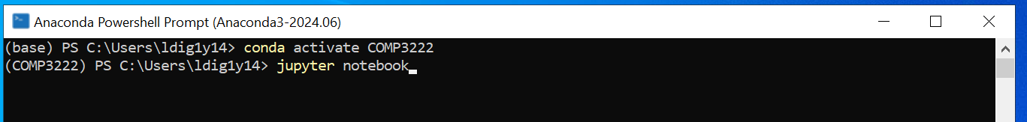
Activate COMP3222 Virtual Environment
On the Anaconda PowerShell, input the following commands to
  Activate the module's virtual environment
    For more info on what a virtual environment is, consult the guide on setting your own PC. You don’t need to know for the rest of the lab here in the ECS Lab PCs.
  Start the Jupyter Notebook server

Slide 5
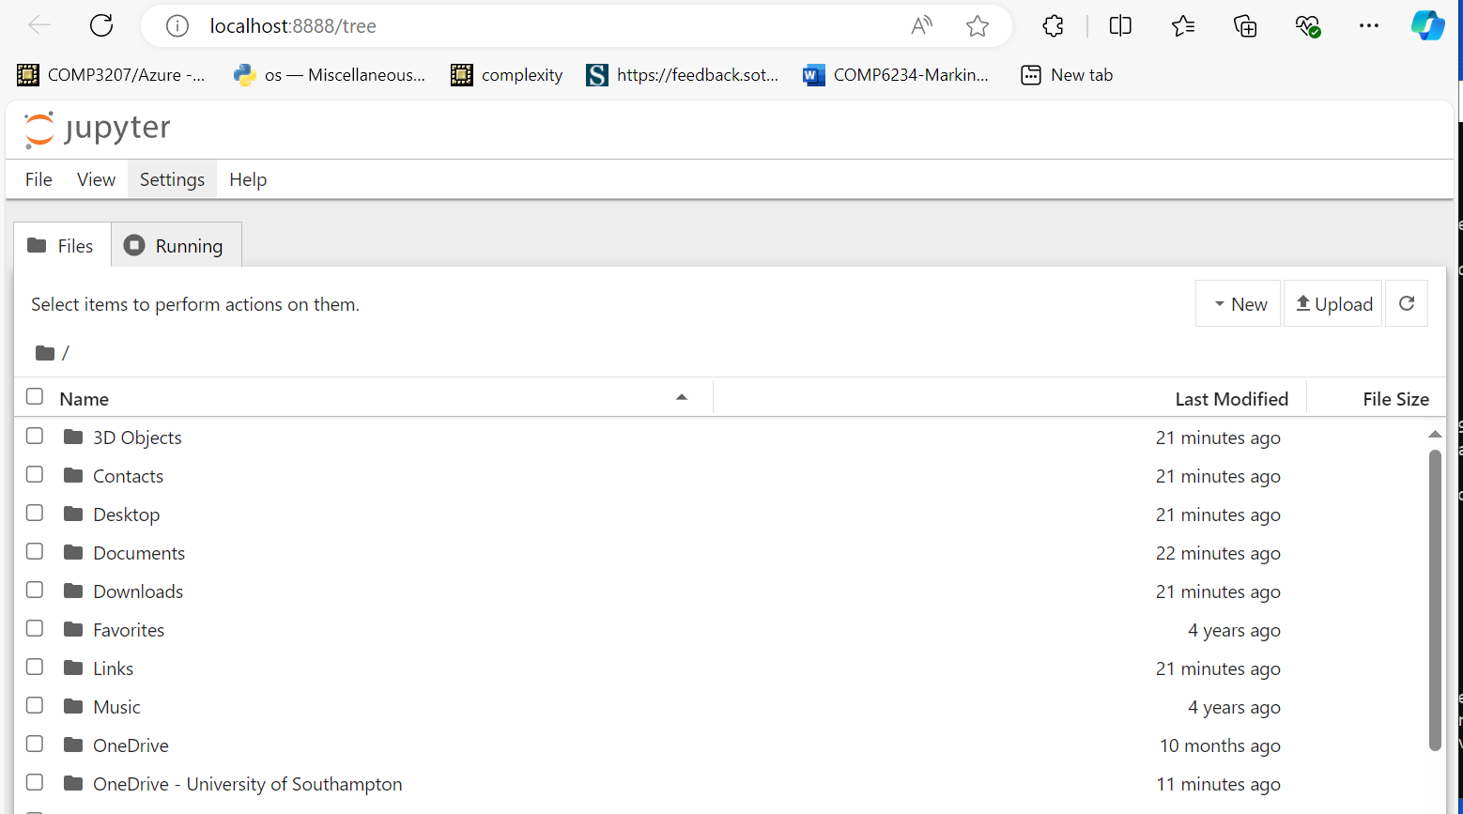
Copy paste this url into the browser (including the whole access token) to get to the Jupyter Notebook
Then look for the lab1 notebook you downloaded

Slide 6
Saving your work
If you downloaded on your OneDrive, no further action required. Otherwise, remember to copy it there, or send it to yourself by email.

