Slide 1
Text
Textbox with different fonts colours sizes
Right align
This text should be right aligned
Rotate 90
Centre align
This text should be centre aligned
Bullet points
Summary
Left align
This text should be left aligned
Go to the store
Buy milk

Slide 2
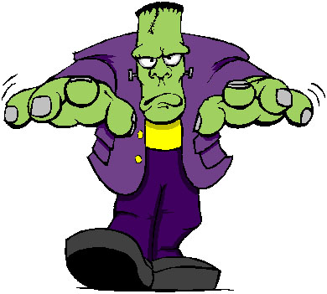

Images
Solid white background
Transparent background

Slide 3
Shapes
star
cross

Slide 4
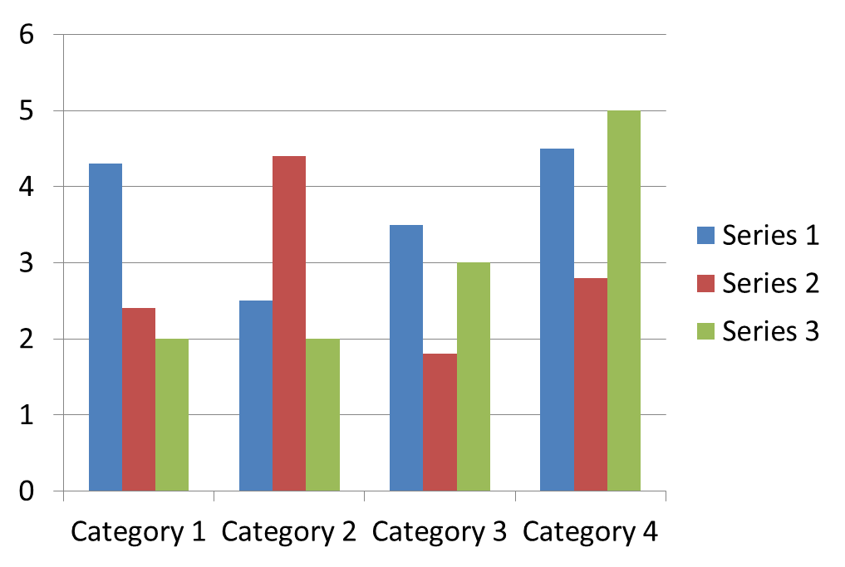
Chart

Slide 5
Table
Column1 | Column2 | Column3 | Column4
data11 | data21 | data31 | Data41
data12 | data22 | data32 | data42

Slide 6
Auto-update date and slide in footer

Slide 7
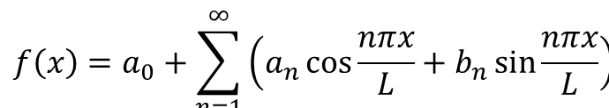
Math formula

Slide 8

Word art

Slide 9
β∑ unicode text (beta, sigma)

Slide 10
Text transition
Fly in transition for title

