Slide 1

What’s New in Aplia for
Fall 2011?
DSM Version

Slide 2

Agenda
Gateway integration
Practice Reviews (Study tools)
Test banks
Payment integration with SSO
Accessibility (VPAT)
Handling grades
Instructor “Welcome Back” emails
Other
Discipline specific features
  Bio Assets and Virtual Biology Labs
  Diagnostics for Dev Writing & Grammar

Slide 3

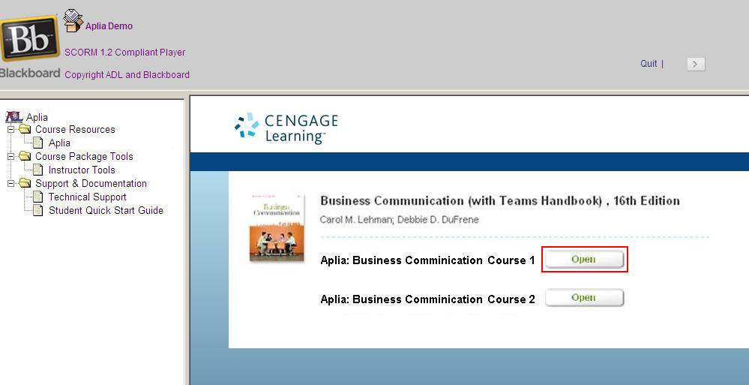
Gateway Integration
Provides single-sign on into Aplia from LMSs

Slide 4
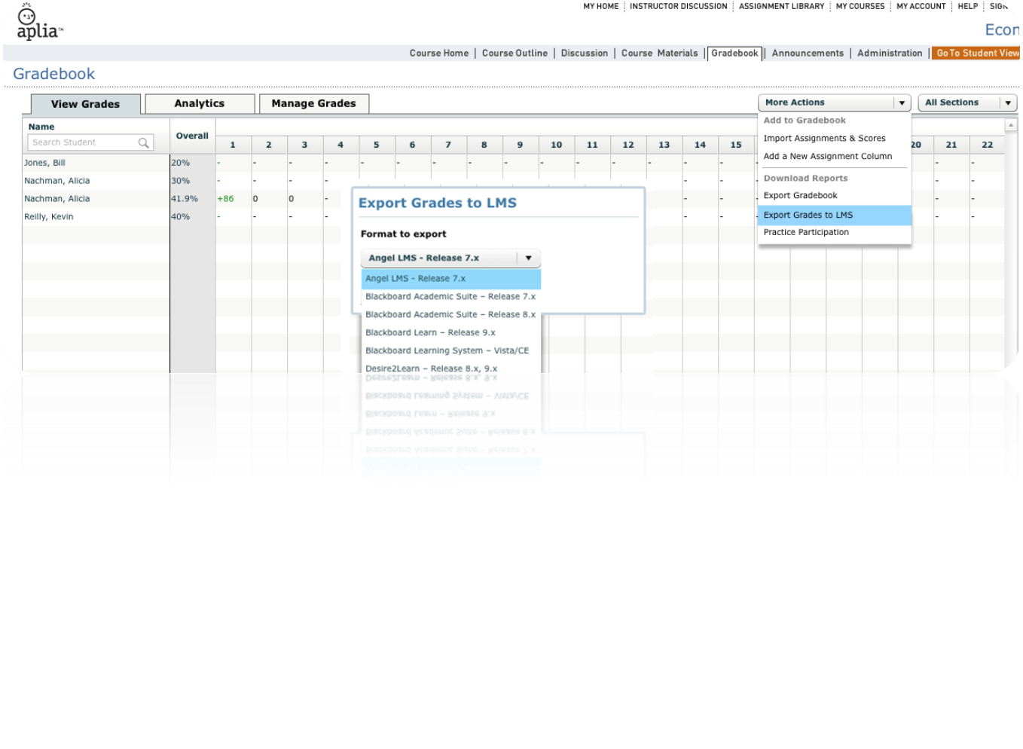
Gateway Integration
Aplia grade exports compatible for import into all major LMSs
More Gateway info to be covered at NSM

Slide 5
Practice Reviews (Study tools)
Students study smarter
    We’re not promising that students will score better on tests, but we’re helping students look over targeted materials they didn’t do well on
Practice review assignment
  Definition: A practice assignment consisting of questions in which the students scored below a certain (tba) percentage from a graded assignment
  Available after due date for visible, graded assignments
  No deadline and students have unlimited retakes
  If the graded question was randomized, the review questions will also be randomized
*Feature available September 10th

Slide 6

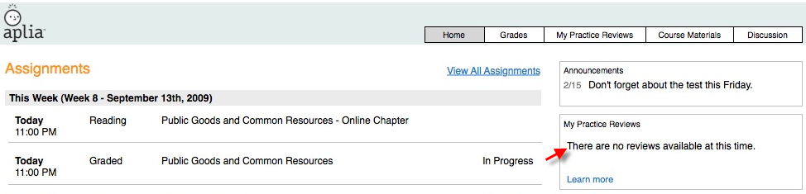
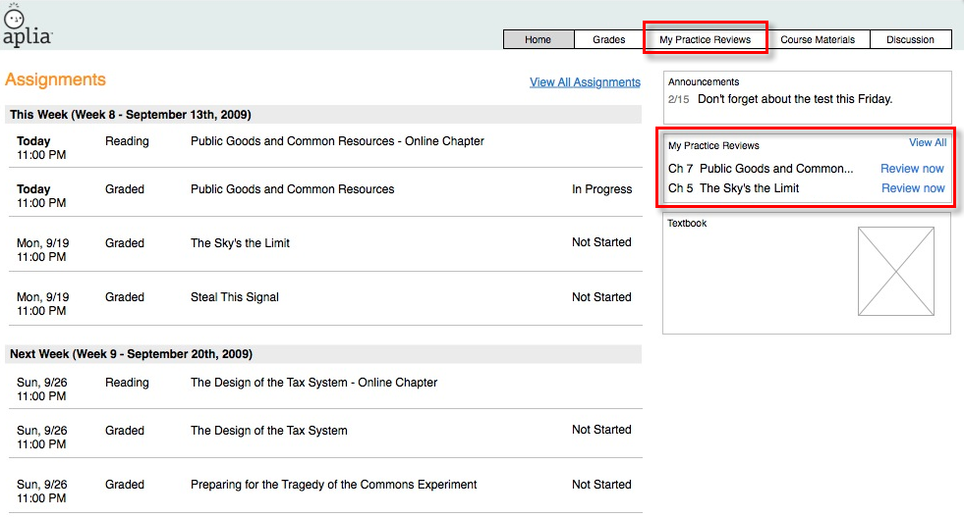
Accessing practice reviews
Notes:
When student enters course, they can see their newest reviews and their stati
If there are no reviews (why?) we’ll indicate that with a Learn more link that’ll take them to the My Reviews page that will explain how reviews work

Slide 7
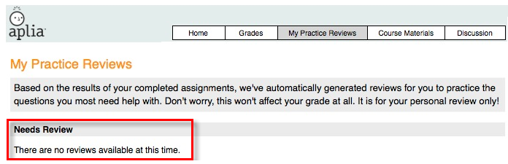
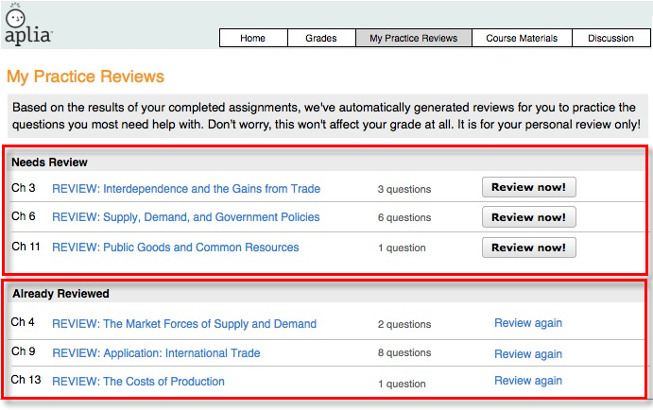
Accessing practice reviews

Slide 8
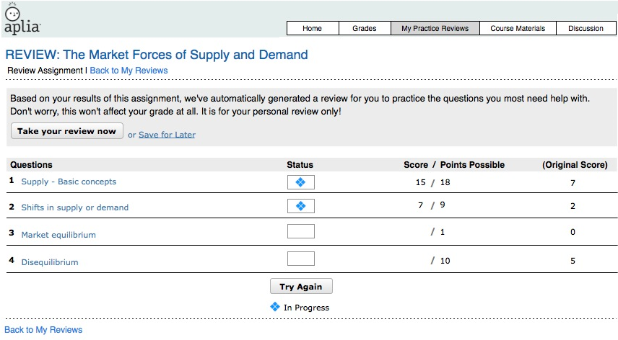
Completing a practice review

Slide 9
Test Banks
What are they?
Availability
  Almost all titles
  Specific release dates to be announced
Visit our Confluence page for complete list
  http://confluence/display/PRDCT/Test+Banks

Slide 10
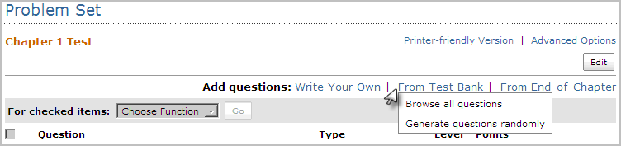
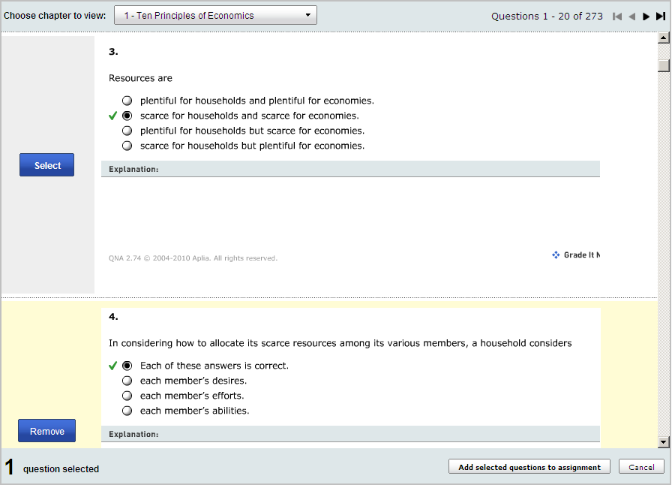
Once released, they automatically populate in courses

Slide 11
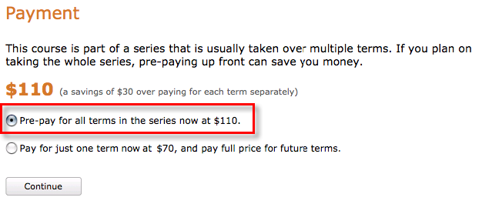
Payment Integration with CengageBrain
Multi-term payment options
  Cengage products offer a pre-payment option for multi-terms
  Non-Cengage products offer two-term partial credit as before
Notes:
Multi-term payment allows student the option to pay for their courses upfront at a discounted price
We’ll support existing payment codes

Slide 12
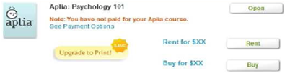
Payment Integration with CengageBrain
Book rentals
  Students can now rent books on their CB dashboard for 20% of the book list price (for 120 day rental), which is listed in Magellan
    Exceptions (titles unavailable for rentals)
      Dole/Taggart Connect
      Carter Mindscapes
      BLaw eSeries
      Legal Environment eSeries
      4ltr titles
Book fulfillment prices
  Books are fulfilled at 40% of the book list price, which is listed in Magellan
    Exceptions (titles unavailable for fulfillment)
      BLaw eSeries, but its fulfillment can still be done via Aplia.com
      Legal Environment eSeries, but its fulfillment can be done via Aplia.com
      4ltr titles
Notes:
Dole/Taggart (because it has no ebook and the base price is too low
blaw eseries; legal env’t eseries – because the looseleaf version is only available as an upsell for students who paid the digital fee, and is not available for purchase or rent on CB.com

Slide 13
Accessibility VPAT Report
Aplia will have a passing VPAT report for Fall 2011
    VPAT = Voluntary Product Accessibility Template
    A document created by the Information Techology Industry Council based on Section 508 Accessibility Standards
    Schools with government funding often can’t work with vendors that don’t have a VPAT that shows Section 508 conformance
    Non-homework student pages will have passed the VPAT
A passing VPAT opens door for discussions for adoptions
wanting to see that we’re making efforts to be accessible.
Notes:
Schools that get government funding must show they comply with Section 508 Accessibility Standards
That means all the vendors that school works with must be Section 508 conformant
A vendor shows Section 508 conformance by providing a VPAT, a Voluntary Product Accessibility Template, to the school
An independent council as made up this template so that vendors can prove to schools that they conform to the standards
If Aplia can provide a passing VPAT, it removes this possible obstacle to adopting Aplia

Slide 14
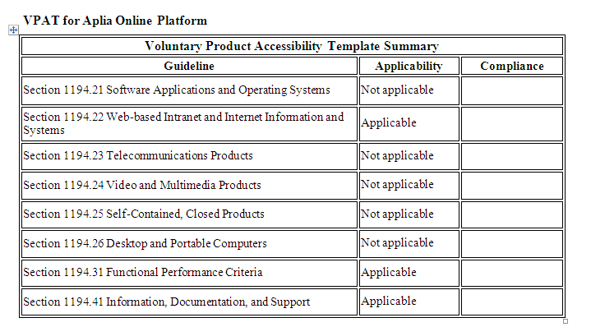
Example VPAT
Notes:
Schools that get government funding must show they comply with Section 508 Accessibility Standards
That means all the vendors that school works with must be Section 508 conformant
A vendor shows Section 508 conformance by providing a VPAT, a Voluntary Product Accessibility Template, to the school
An independent council as made up this template so that vendors can prove to schools that they conform to the standards
If Aplia can provide a passing VPAT, it removes this possible obstacle to adopting Aplia

Slide 15
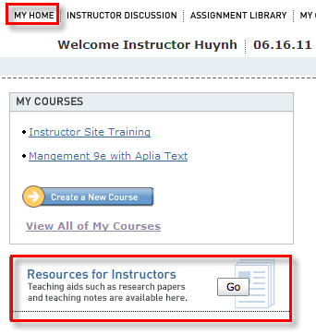
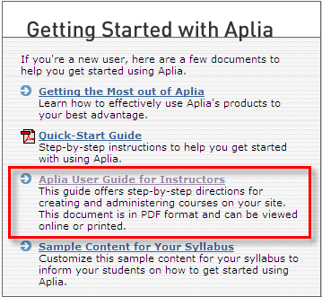
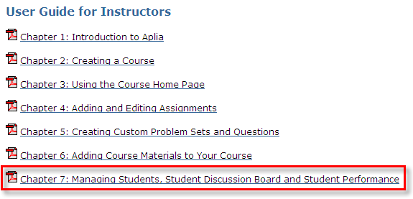
Handling Grades Calculations
Instructors may ask us to perform grade calculations or change grades
Provide instructors with instructions
  Chapter 7 of the Aplia User Guide for Instructors
  Ask for assistance for Support
FERPA – Family Educational Rights and Privacy Act: protects the confidentiality and accuracy of student education records by granting rights of access, review and amendment to parents and eligible students.
  For more info, please refer to the FERPA statement on the Aplia Inside page (Marketing and Selling Aplia section).

Slide 16
Communication to Instructors
“Welcome Back” email
Opportunity to reach instructors who have gone dark
Communication to go out week of July 25th from DSMs
DSMs to receive templates and list of their instructors to email
Notes:
B&E DSMs can leave after this

Slide 17
Other things
Be the first ten with a perfect score to complete Aplia assignments for a prize
DSM Survey
Questions?
Notes:
B&E DSMs can leave after this

Slide 18
Biology
Offer complete solution by integrating
  Biology Assets
  Virtual Biology Labs

Slide 19
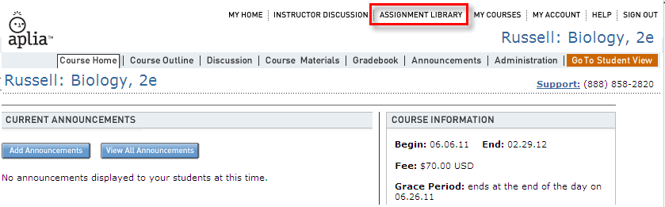
Bio Assets in Assignment Library
Cengage textbook assets (videos, animations, etc.) in the Assignment Library
Product-specific, so assets vary
Assignable, but not gradable

Slide 20
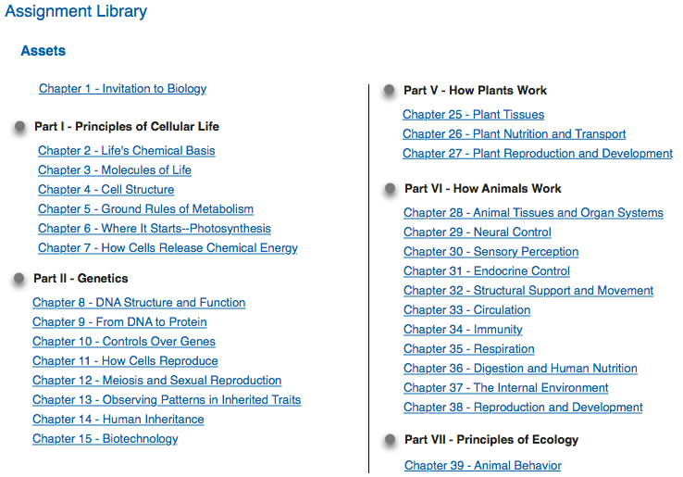
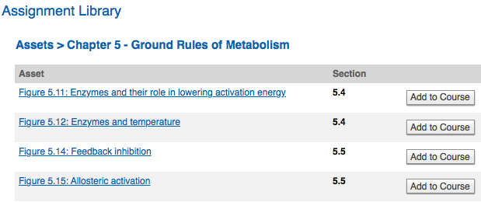
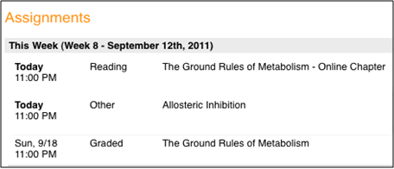
Bio Assets in Assignment Library
*Feature available for use by August 1st

Slide 21
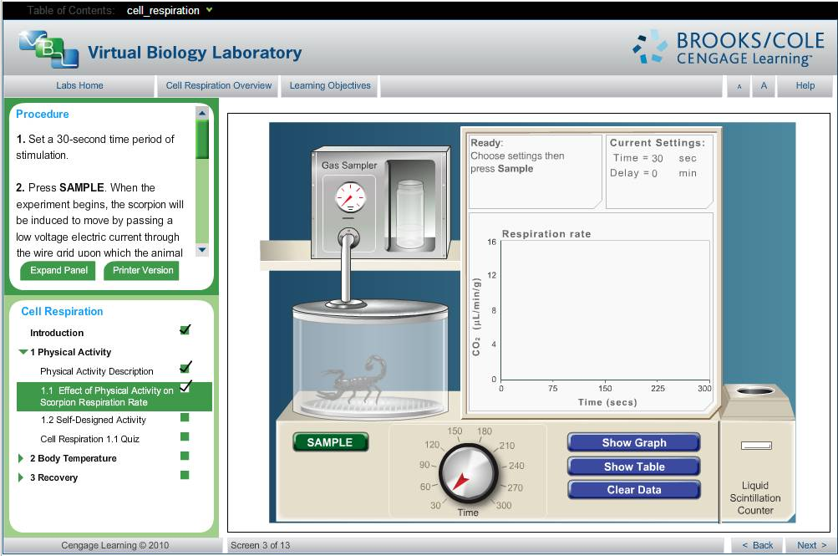
Virtual Biology Labs in Aplia
Standalone interactive practice activities integrated into Biology courses
Practice – activity recorded in the Practice Participation report
*Feature available for use by August 19th
Notes:
Cannot change into graded or change points possible

Slide 22
Questions?
Notes:
B&E DSMs can leave after this

Slide 23
Diagnostics for Dev Writing & Grammar Courses
Test, diagnose, and report on student weaknesses and strengths
Available in Dev Writing and Aplia for Grammar courses
How it works
  Pretest assignment in the first week of school
  Posttest assignment available in Unassigned
  These assignments test students on topics carefully picked based on research on various state exams & major course topics
  Assignments are scored but are excluded from grade calculations; scores can be included by making changes in Manage Grades
Notes:
B&E DSMs can leave after this

Slide 24
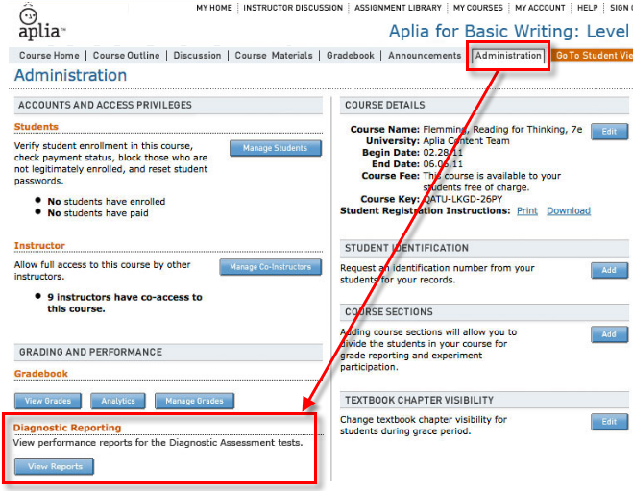
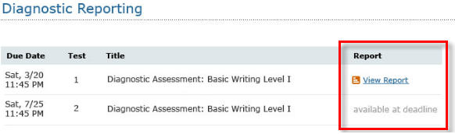
Diagnostics for Dev Writing & Grammar Courses
Notes:
Also assessible from Home page and Administration pages
Label Diagnostic Reporting may be changed to Diagnostic Assessment

Slide 25
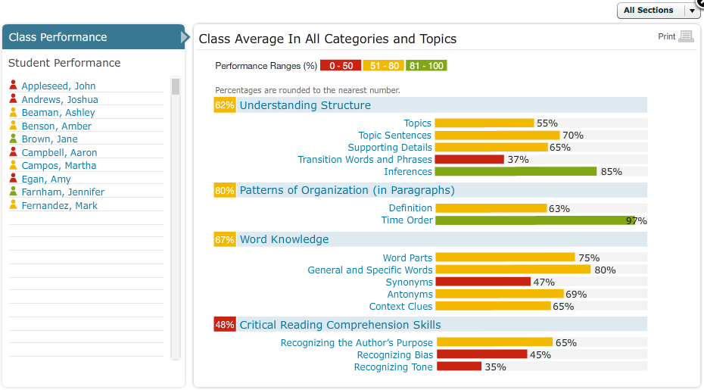
Diagnostics for Dev Writing & Grammar Courses
Notes:
B&E DSMs can leave after this

Slide 26
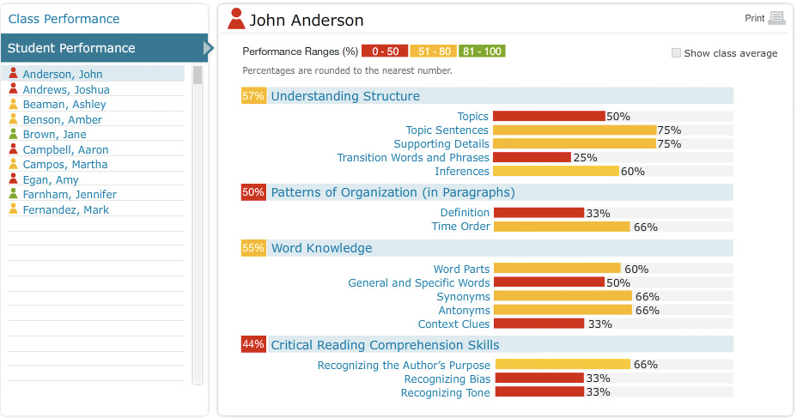
Diagnostics for Dev Writing & Grammar Courses
Notes:
B&E DSMs can leave after this

Slide 27
Questions?
Notes:
B&E DSMs can leave after this

Slide 28

Back Up Slides

Slide 29
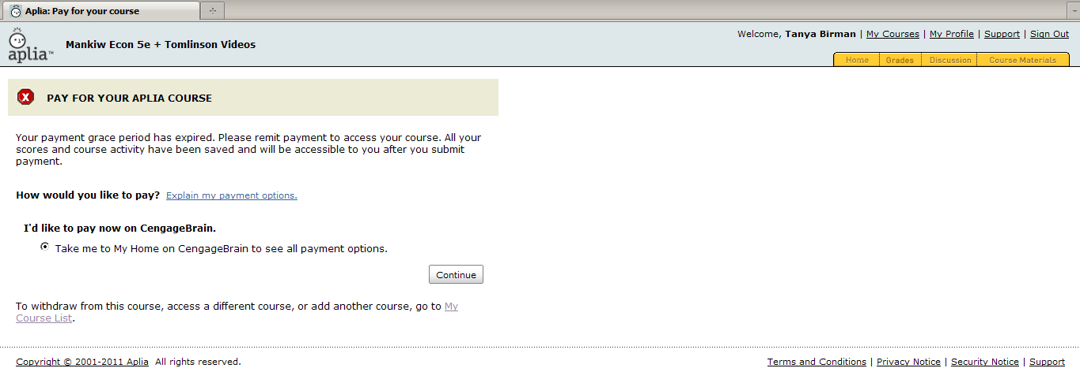
Payment Integration with CengageBrain
Students pay via CengageBrain
  Students on aplia.com will be taken to CB to pay
  Exceptions:
    Cengage old editions
    Online Working Papers
    Nelson, Cengage EMEA and Cengage Australia
Notes:
Multi-term payment allows student the option to pay for their courses upfront at a discounted price

Slide 30
BACKGROUND ON VOLUNTARY PRODUCT ACCESSIBILITY TEMPLATE
To facilitate effective communication between producers of products and services and those who acquire them concerning the accessibility of specific products, an accessibility information template was created by a joint government and industry effort. The VPAT document was created by the Information Technology Industry Council (www.itic.org) based on Section 508 Standards established by the United States Access Board (www.access-board.gov) in 2001.
The use of the VPAT as an evaluation tool has enabled companies to self-document and formally attest to conformance and nonconformance with specific Section 508 requirements point by point. Its purpose is to assist federal and state contracting officials and other purchasers in making preliminary assessments regarding the availability of commercial Information and Communication Technologies (ICT) products and services with features that support accessibility. Vendors are frequently required to submit VPATs with their responses to RFPs and other government purchasing proposals.
For each ICT product category to which Section 508 applies, three different requirements need to be addressed. (Complete information regarding these requirements can be found at the www.section508.gov and www.itic.org websites):
SPECIFIC REQUIREMENTS, CORRESPONDING TO SPECIFIC PRODUCT GROUPS:
  a. Software Applications and Operating Systems
  b. Web-based Internet Information and Applications
  c. Telecommunications Products
  d. Video and Multi-media Products
  e. Self-Contained, Closed Products
  f. Desktop and Portable Computers
GENERAL REQUIREMENT, “FUNCTIONAL PERFORMANCE CRITERIA,” APPLYING TO ALL PRODUCT GROUPS
GENERAL REQUIREMENT, “INFORMATION, DOCUMENTATION, AND SUPPORT,” APPLYING TO THE INFORMATION PROVIDED ACCOMPANYING ALL ICT PRODUCTS. THUS FAQ’S, MANUALS AND THE LIKE MUST ALL BE ACCESSIBLE.
Considering that the VPAT carries important information for the procurement official, it is essential that a supplier/producer provide an accurately prepared VPAT that fairly and responsibly represents its product and/or service.

Slide 31
FERPA
Cengage Learning adheres to the Family Educational Rights and Privacy Act (FERPA) with regard to potential data collection practices of third parties under FERPA. FERPA protects the confidentiality and accuracy of student education records by granting rights of access, review and amendment to parents and eligible students. FERPA also requires informed consent prior to most disclosures of personally identifiable information by the educational institution with which a student is affiliated.
As Cengage Learning is not an educational institution, Cengage falls under the third party classification under FERPA. This means that data we collect within the confines of course management is the property of the educational institution. We are allowed to use this data within the normal confines of course management and system announcements. A third party is NOT required to seek consent prior to receiving this information; this is the responsibility of the given educational institution. We may not and do not use this personally identifiable information for marketing, sales or anything else other than course management. Our security processes and development go through a series of regular audits to assure that all efforts and employees are committed to our customers’ overall security and protection. The privacy of our customers’ and clients’ information is of utmost importance to us as a corporation.
What Aplia does to protect student information: login, registration, and payment are all encrypted using the Secure Sockets Layer (SSL) protocol. You can see this encryption in action in the URL bar when you register, login, or pay: you will see “https” instead of “http.” It means the data being communicated for these transactions is being transmitted in an encrypted state that protects it in transit.

Slide 32
Supported LMSs for Gateway Integration
Angel LMS – Release 7.x
Angel LMS – Release 7.2 (Angel72)
Angel LMS – Release 7.3 (Angel73)
Angel LMS – Release 7.4 (Angel74)
Blackboard Academic Suite – Release 7.x
Blackboard Academic Suite – Release 7.x (bb73)
Blackboard Academic Suite – Release 8.x
Blackboard Academic Suite – Release 8.x (bb08)
Blackboard Learn – Release 9.x
Blackboard Learn – Release 9.x (bb09)
Blackboard Learning System – Vista/CE
Blackboard Learning System (formerly WebCT) – CE 6.x (WEBCT)
Blackboard Learning System (formerly WebCT) – CE 8.x (WEBCT)
Blackboard Learning System (formerly WebCT) – Vista 4.x (WEBCT)
Blackboard Learning System (formerly WebCT) – Vista 8.x (WEBCT)
Desire2Learn – Release 8.x, 9.x
Desire2Learn – Release 8.3 (D2L)
Desire2Learn – Release 8.4 (D2L84)
Desire2Learn – Release 9.x (D2L90)
Moodle
Moodle – Release 1.8 (Moodle)
Moodle – Release 1.9 (Moodle19)
Moodle – Release 2.0 (Moodle20)

