Slide 1

eEducation
2015. Research and development into solutions that make education work better
Notes:
Essential
Exciting
Challenging

Slide 2
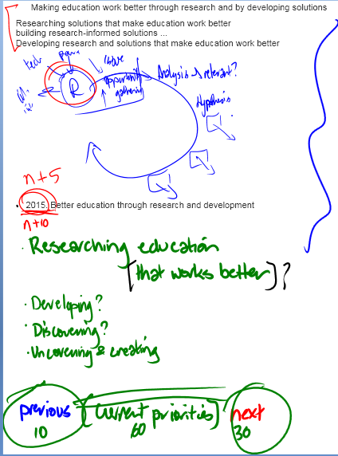

Slide 3
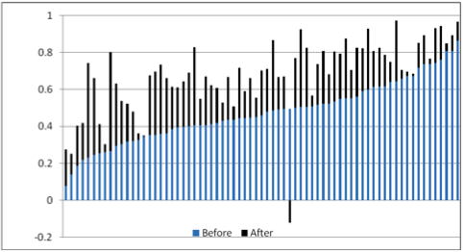
Student engagement
Notes:
Student engagement
How can we make the University experience compelling enough for students to fully engage when they do have time/attention for it?
We want our students to look like this, …

Slide 4
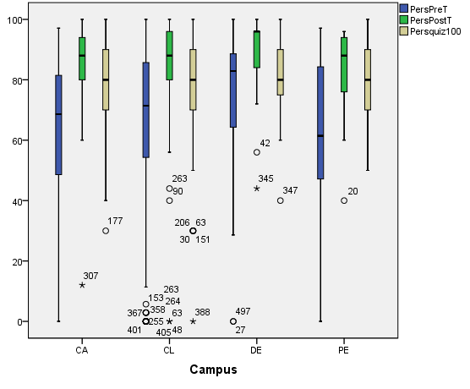
1
2
3
4
Notes:
All four compared. Essentially what we hoped for happened!!! Whoopeee! Students appeared to learn how to learn.

Slide 5
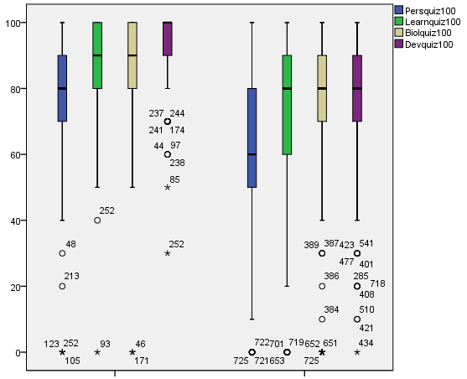
Performance on assessable quizzes
Students who completed study plans
Students who did not complete study plans
Notes:
Performance on assessable quizzes if students used the study plans over the 4 modules. Note hand drawn red line of trends, students who did not use myPsychLab asymptoted their average performance below maximum, students who used myPsyLab continued to improve. Need to review assessable quizzes.
In essence, I don’t want to dwell on this but it shows, on average, students who used myPsychLab were two grades (C to HD) higher than students who didn’t.

Slide 6
Not there
There but no myLab
There w/ myLab
There w/ MeTL

Slide 7
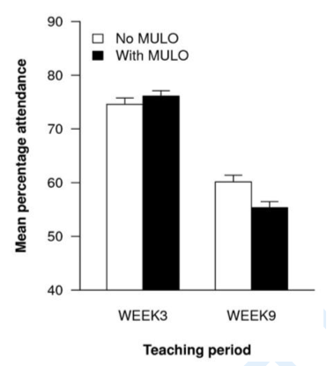

Slide 9
Step 1:
☑
Be effective

