Slide 1

OFF BY ONE
SKYGUARD
Understanding unusual
weather readings
AI/ML-Based Intelligent Anomaly Detection
for Automatic Weather Stations (AWS)
A working prototype
500 simulated stations
Temperature
Pressure
Humidity
SIH26073
Disaster Management / Software
OFF BY ONE / Team ID 132195
SKYGUARD / SIH26073
01
Notes:
Official PS and user team details from linked source Canva deck. Synthetic prototype, no live IMD feed.

Slide 2
OFF BY ONE
PROPOSED SOLUTION
An unusual reading needs an explanation before an operator can act.
Station history
Weather
AWS reading
Keep genuine extremes visible
Evidence fusion
Spikes, drift and stuck values
Fault
Noisy, missing or
unusually high / low
Combine history, ML and
physical consistency
Investigate sensor or data issue
Virtual Buddy
Uncertain
Trusted nearby stations
add weather context
Request human review
Original observations stay intact. Operators review proposed corrections separately.
SKYGUARD / SIH26073
02
Notes:
Source: local T/P/RH contract and pipeline. Virtual Buddy uses eligible nearby peers. Six technical classes group into these outcomes for explanation.

Slide 3
OFF BY ONE
TECHNICAL APPROACH
Temporal + ML
INPUT
Validation
Causal history features
Isolation Forest score
Decision
OUTPUT
Temperature
Pressure
Relative humidity
Station ID + timestamp
Readings
Evidence
Time + schema
Handle data gaps
Save raw values
Combine checks
Explain cause
Flag uncertainty
Map + reports
Incidents
Human review
Physics + peers
T/P/RH relationships
Trusted station comparison
Healthy / Weather / Sensor fault
Data issue / Complex / Needs review
TECH STACK
React
Three.js
FastAPI
Python
SQLite
scikit-learn
SKYGUARD / SIH26073
03
Notes:
Current architecture: React/Three.js UI, FastAPI/Python, scikit-learn Isolation Forest, SQLite. Causal features only. No NWP. Raw values and correction proposals stored separately. Six output classes retained. Evidence strength is uncalibrated. Icons Lucide ISC, logo sources in pitch/logos/SOURCES.md.

Slide 4
OFF BY ONE
FEASIBILITY & VIABILITY
Built and working
Technical
Real observations
Expert labels
Map, history, detection and review work
together in a local prototype.
Connect an authorised
AWS feed.
Label faults and
weather events.
Financial
Open-source tools reduce licensing needs.
Hosting and support costs need a pilot.
FIELD
VALIDATION
Operational
Uses standard temperature, pressure and
humidity inputs from weather stations.
New conditions
Measure value
Fault recall in the synthetic test (%)
Test different stations
and seasons.
Measure false alerts
and review time.
4,032 simulated observations / 24 unseen stations / 7 scenarios
Known limit: weather recall 9.72%. Field accuracy is unproven.
SKYGUARD / SIH26073
04
Notes:
Paired benchmark ml/artifacts/evaluation_v2_comparison.json. 4,032 samples,24 station identities,7 scenarios. Fault recall77.47%/85.76%, weather recall9.72%. Same simulator family, not field validation. Financial and operational benefits require measurement.

Slide 5
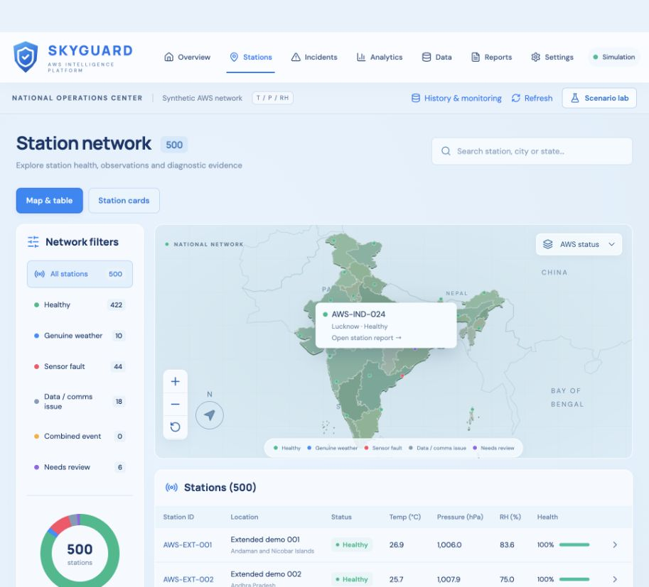
OFF BY ONE
IMPACT & BENEFITS
A station report turns scattered readings into evidence an operator can review.
Locate the station
Map status dots identify stations
that need attention.
Understand the alert
History and nearby observations
help explain the likely cause.
Record the decision
Reviews and proposed fixes retain
a traceable record.
ACTUAL PROTOTYPE / SIMULATED STATIONS
Expected benefit
Less searching and more focused investigations.
SKYGUARD / SIH26073
05
Notes:
Screenshot captured from the actual local SkyGuard station UI this turn. Data is simulated. Operator workflow is implemented; time and cost savings not field measured. Regional teams can track recurring incidents. Original observations retained.

Slide 6
OFF BY ONE
RESEARCH & REFERENCES
Each source informed a specific part of the project.
SOURCE
HOW IT INFORMED SKYGUARD
SIH26073 problem statement
Defines the target users and T/P/RH task.
AWS anomaly-detection need and scope
IMD surface instrumentation
Informs observation metadata and station context.
AWS measurements and monitoring
WMO Guide No. 8
Guides physical plausibility and quality checks.
Measurement methods and data quality
scikit-learn: Isolation Forest
Supports the ML score alongside other evidence.
Unsupervised anomaly detection
PMFBY WINDS / OpenStreetMap
Inspires zoom behaviour and location exploration.
Station maps and geographic detail
Project evidence: reproducible evaluation artifact and recorded limitations accompany the prototype.
SKYGUARD / SIH26073
06
Notes:
References:
SIH problem statement supplied by user: references/tprh-revision.txt and original brief.
IMD: https://mausam.imd.gov.in/imd_latest/contents/surface-met.php
WMO: https://wmo.int/publication-series/guide-instruments-and-methods-of-observation-wmo-no-8
scikit-learn: https://scikit-learn.org/stable/modules/generated/sklearn.ensemble.IsolationForest.html
PMFBY: https://pmfby.gov.in/winds/weather
OpenStreetMap: https://www.openstreetmap.org
Local evidence: ml/artifacts/evaluation_v2_comparison.json and docs/LIMITATIONS.md.
Visual direction: user-supplied SIH reference screenshots (technical flow and feasibility slide).

