Slide 1

A Monte Carlo Simulation Of Clinic Waiting Time
Tianyu Zhang
STAT 7500
Villanova University

Slide 2
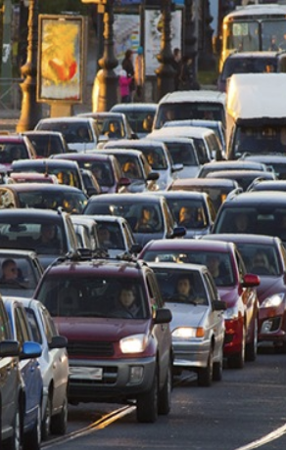
How much time do we spend on Waiting?
According to a Timex survey, Americans wait:
on average of 20 minutes a day for the bus or train
18 minutes whenever they visit a doctor
28 minutes in security lines whenever they travel
21 minutes for a significant other to get ready to go out
13 hours annually waiting on hold for a customer service
38 hours each year waiting in traffic
those living in Big cities wait in traffic more than 50 hours annually

Slide 3
Hypothetical clinic
Baseline Average Waiting Time: 18.31 minutes ( = 18 minutes and 20 seconds)
Hypothetical Clinic:
10 Patients per Day
10 Years: 3650 Days
36,500 Observations

Slide 4
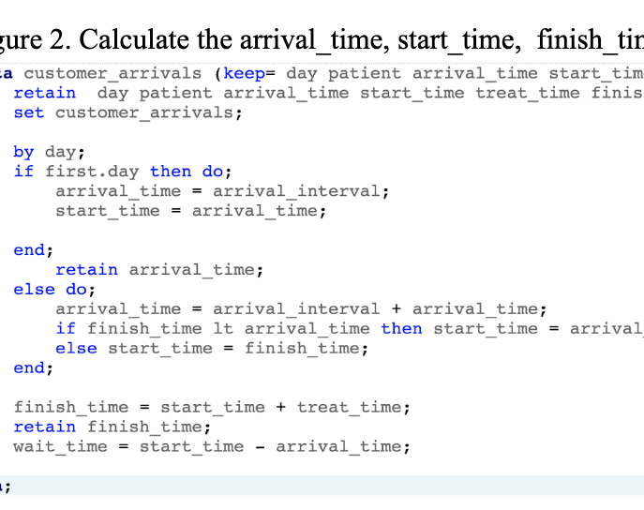
Variables in wait time table
random values: arrival_interval, finish_time
arrival_time ->current patient’s arrival interval + last patient’s arrival_time
start_time -> arrival_time if no waiting or last patient’s finish time
finish_time -> start_time + treat time
wait time -> start_time – arrival_time

Slide 5
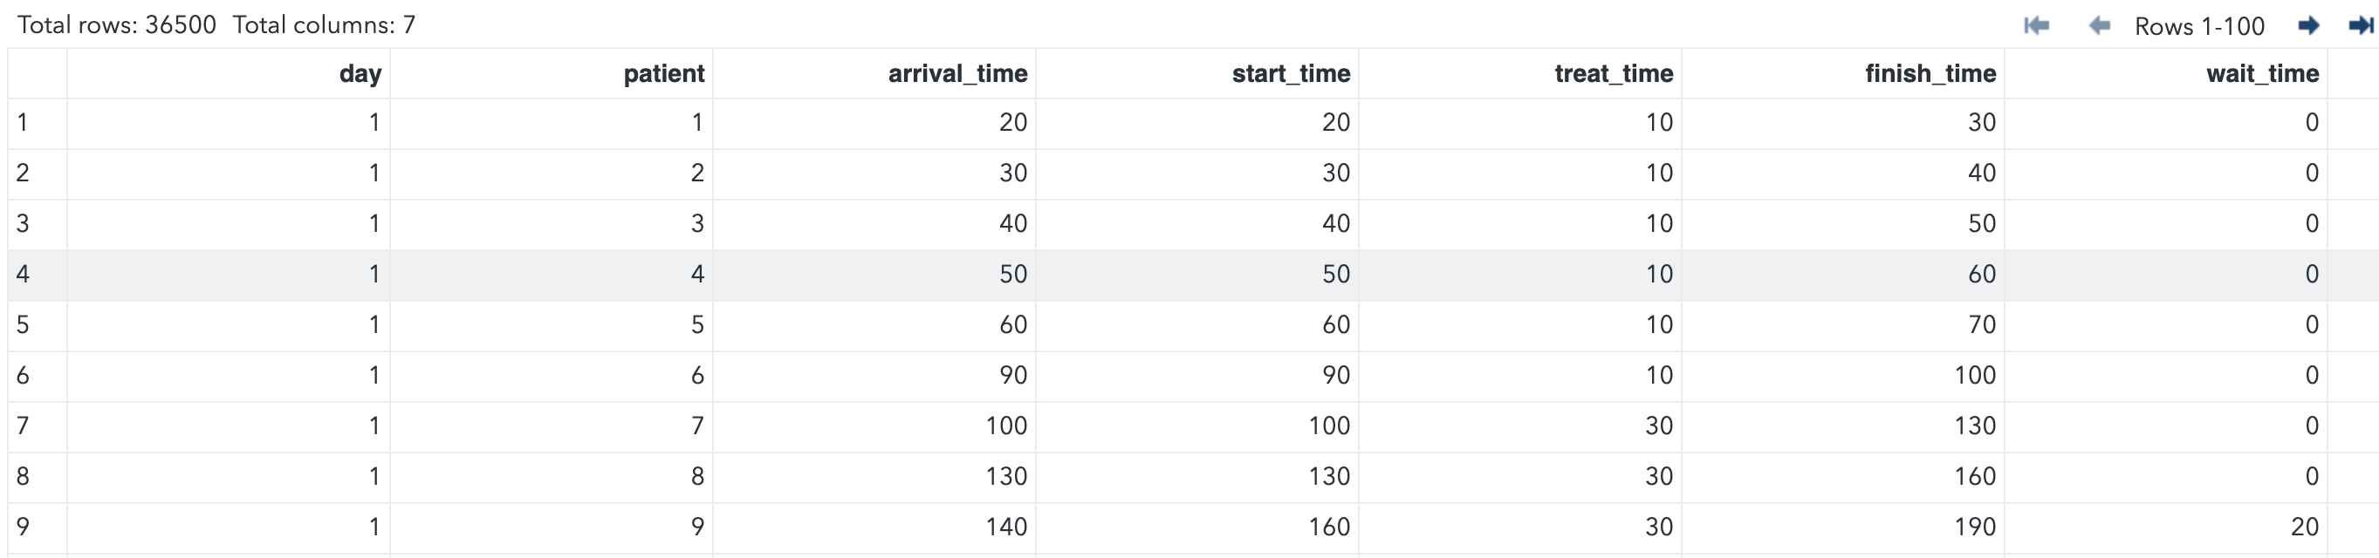
Variables in wait time table
random values: arrival_interval, finish_time
arrival_time ->current patient’s arrival interval + last patient’s arrival_time
start_time -> arrival_time if no waiting or last patient’s finish time
finish_time -> start_time + treat time
wait time -> start_time – arrival_time

Slide 6
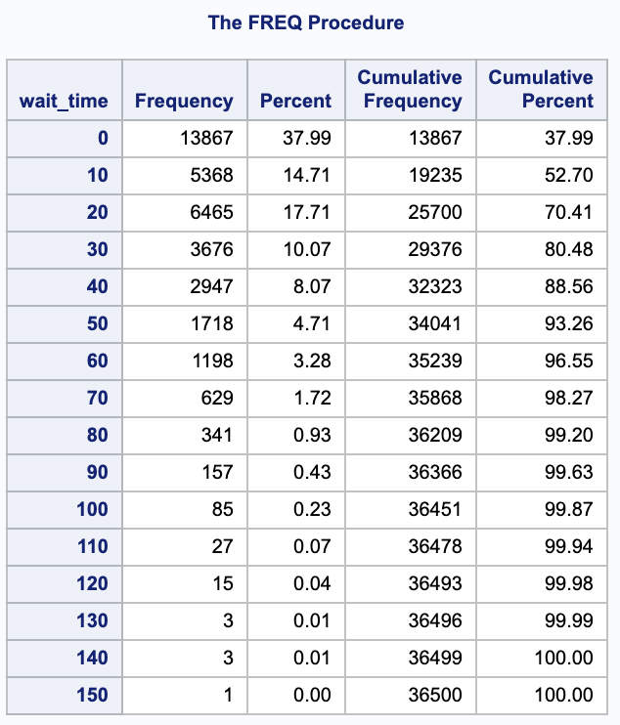
frequency distribution of wait time
37.99% patients have 0 wait time
1 out of 36500 patients has a 150 minutes (2 hours, 30 minutes) wait time

Slide 7
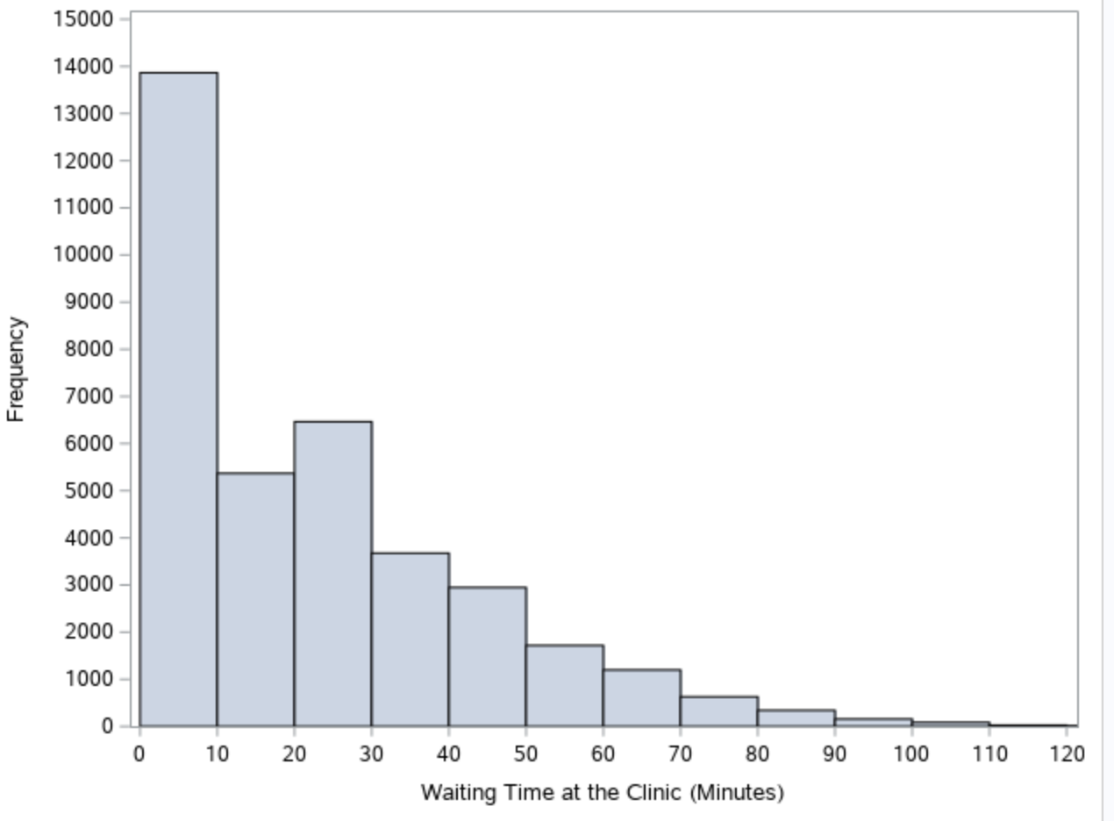
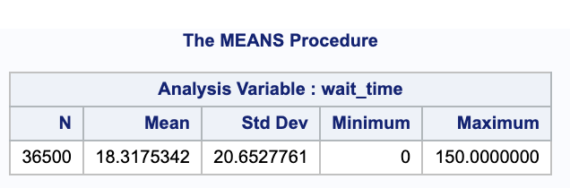
Frequency distribution of wait time
52% patients have less than 10 minutes wait time
Mean wait time = 18. 31 minutes

Slide 8
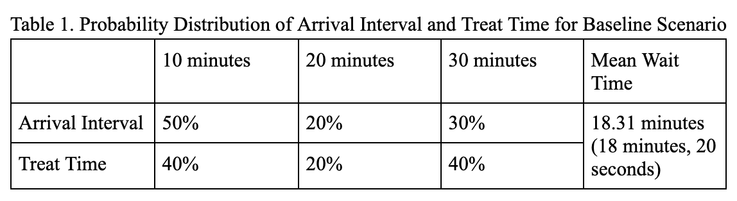
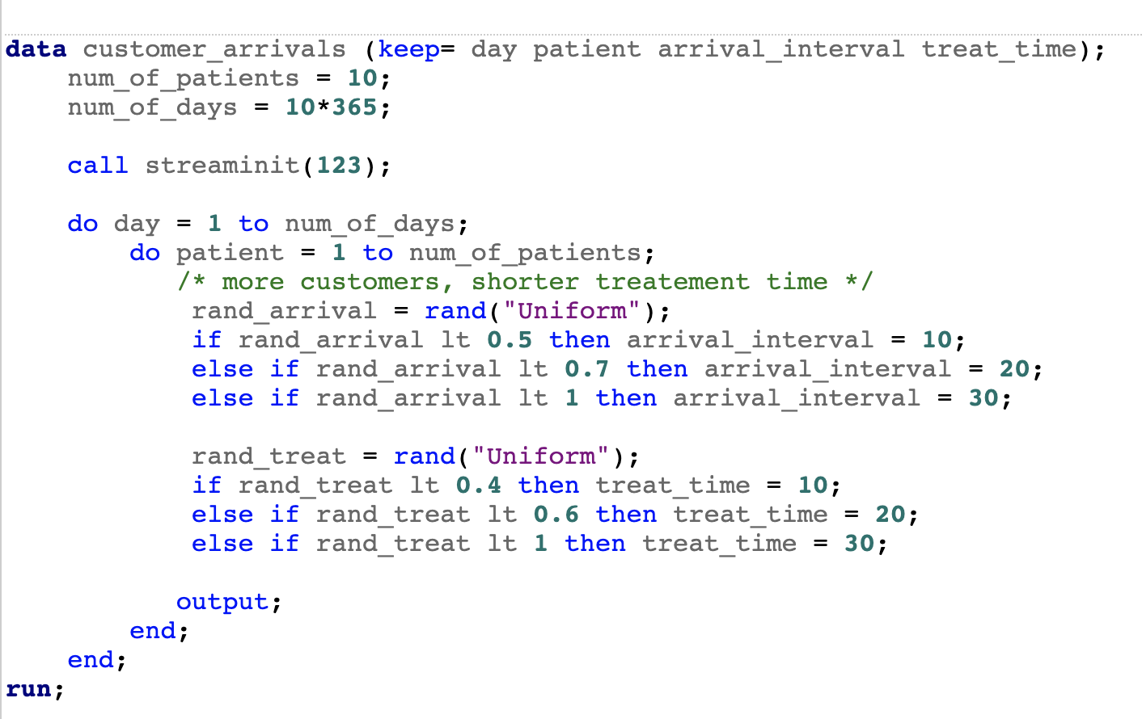
mapping probabilities
arrival_interval
random values < 0.5 maps to arrival_interval of 10 minutes
0.5 < random values < 0.7 maps to arrival_interval of 20 minutes
0.7 < random values < 1 maps to arrival_interval of 30 minutes
treat_time
random values < 0.4 maps to treat_time
of 10 minutes
0.4 < random values < 0.6 maps to treat_time
of 20 mintes
0.6 < random values < 1 maps to treat_time
of 30 minutes

Slide 9
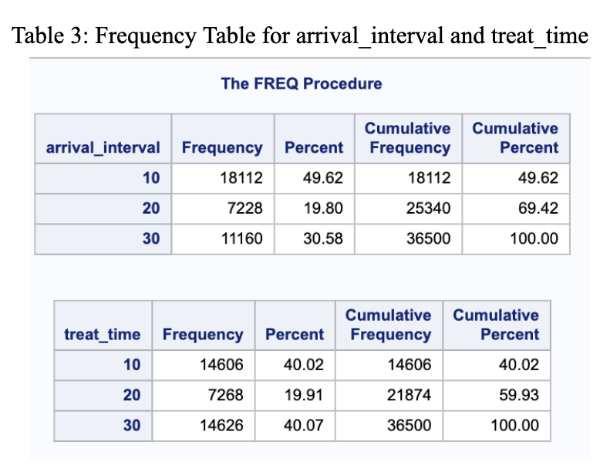
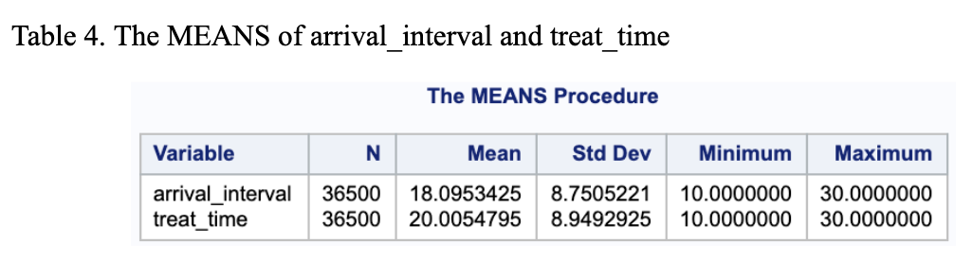
Check frequency distribution of two random values
Has the proportion we expected !

Slide 10
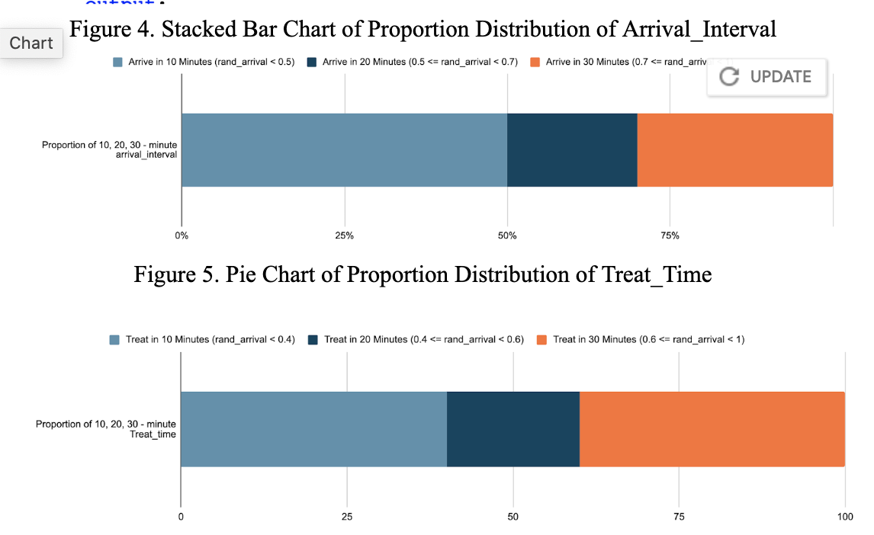
create all possible scenarios by varying probabilities
Four boundaries that controls the probability proportion of arrival_interval and treat_time
Vary these four values to create all combinations of probabilities
Probabilities ranging from 0% to 100% incrementing by 10%
For the two boundaries for arrival_interval, there are 66 possibilities.
For the two boundaries for treat_time, there also are 66 possibilities.
The combination of all possible arrival_interval and treat_time creates 66*66 = 4356 different possibilities.

Slide 11
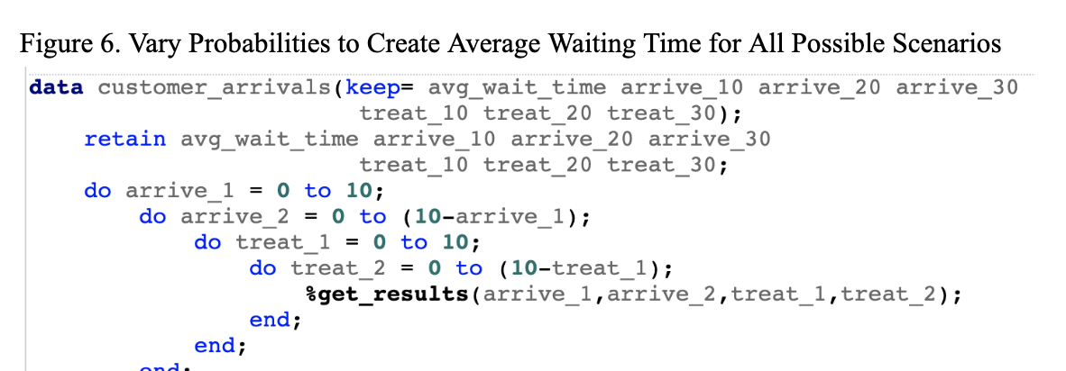
create all possible scenarios by varying probabilities
Four do –loops to vary probabilities

Slide 12
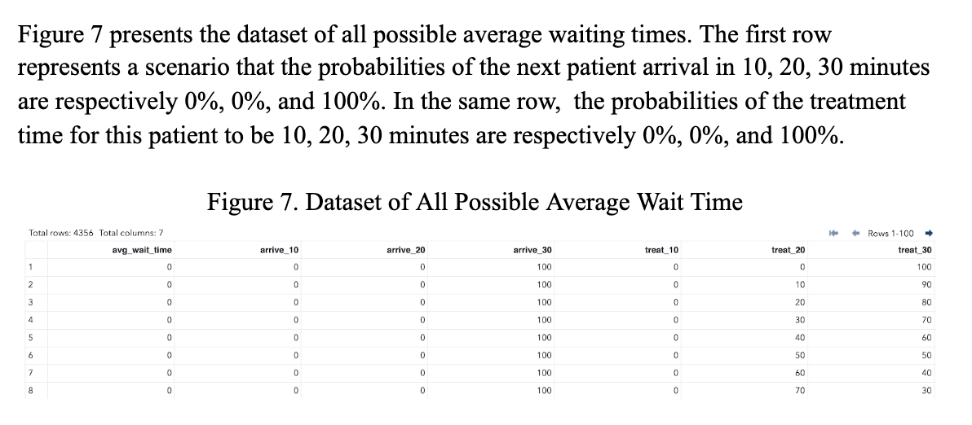
Results: average wait time dataset

Slide 13
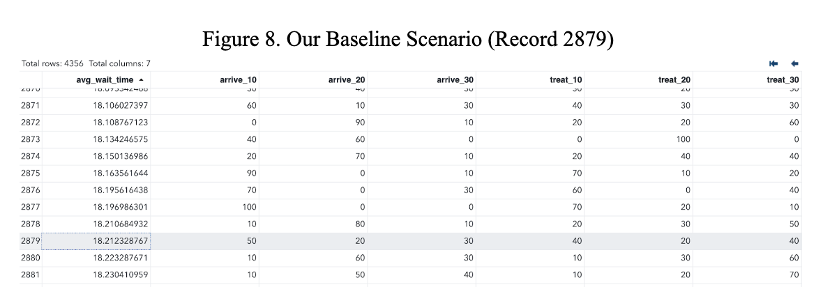
find baseline scenario among all scenarios
Slightly different average wait time value due to the much larger dataset (36500 * 4356 records) that the random values are generated from
It ranks 2879 among 4356 records.
The adjacent rows has very different probability proportions, but its average waiting times only differ from our baseline by 0.002 minutes.

Slide 14
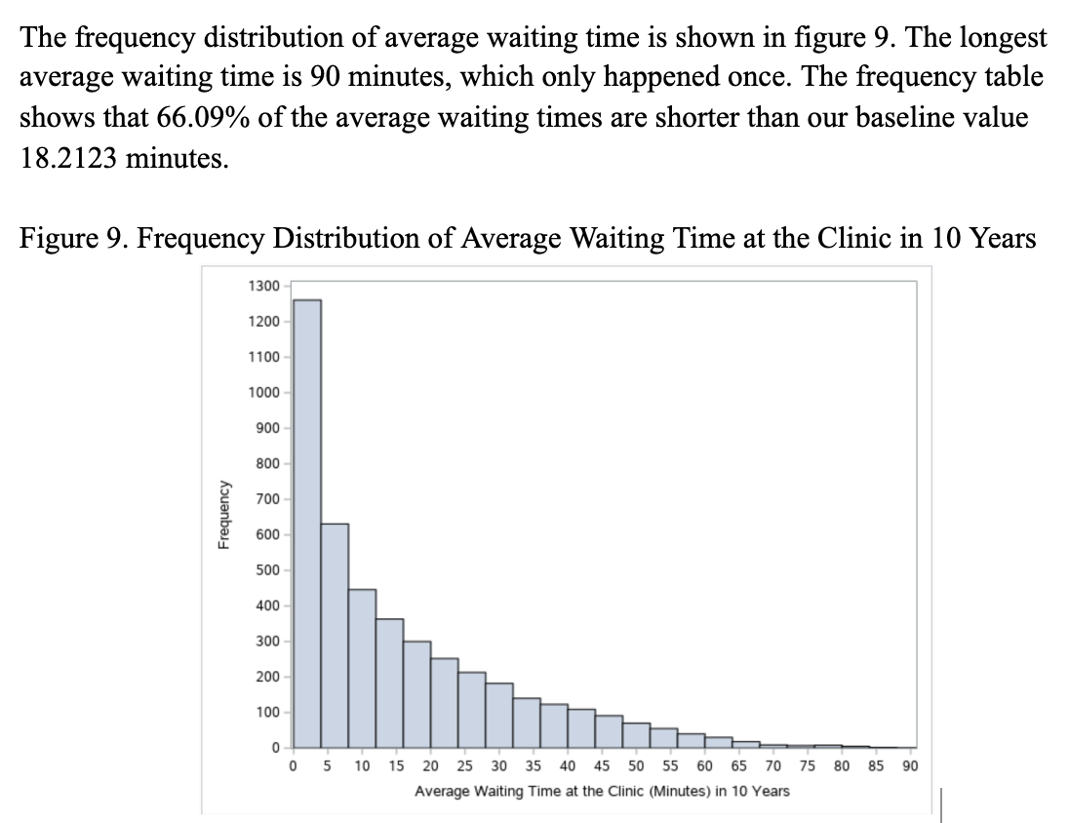
frequency distribution of all average waiting time
5.3% scenarios have 0 - minute average wait time
Mean average wait time is up to 16 minutes

Slide 15
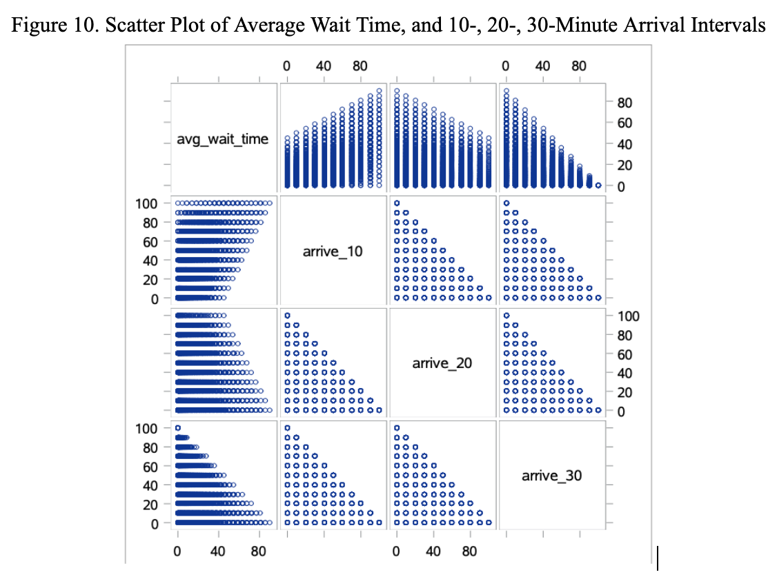
Scatter plot of average wait time and arrival intervals

Slide 16
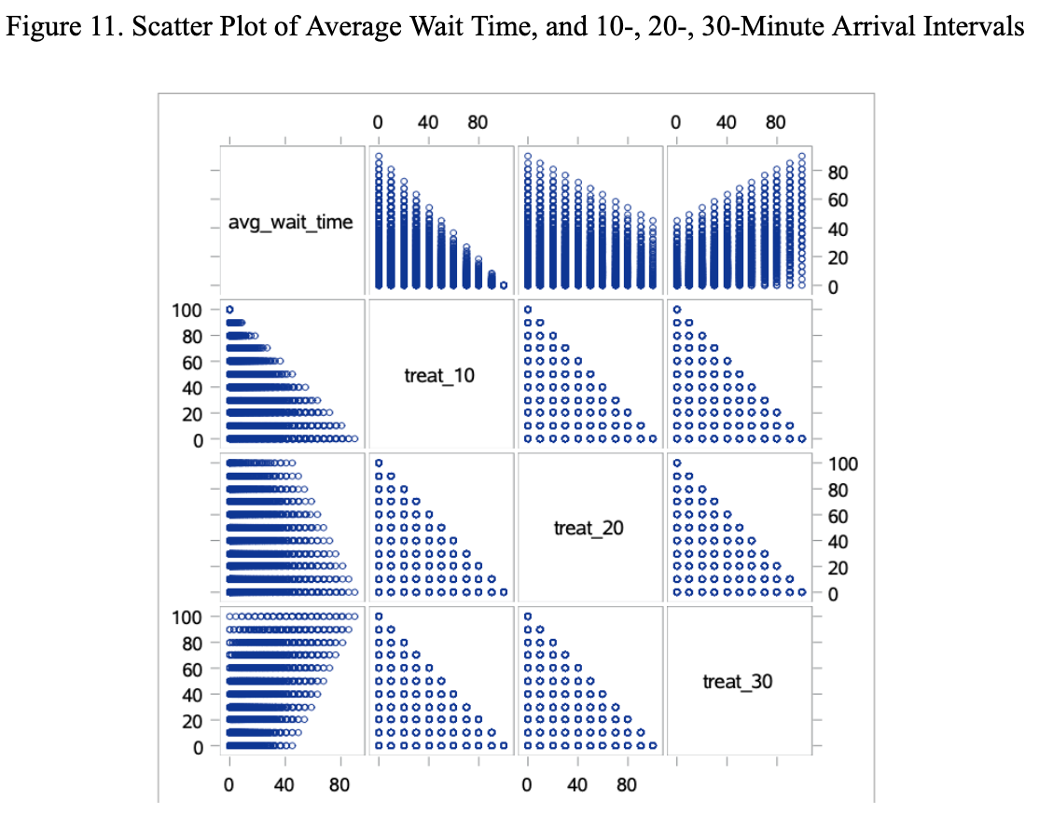
Scatter plot of average wait time and treat time

Slide 17
What can we learn?
patients can try to make an appointment at a less busy time
doctors can arrange some long appointments at a less busy time

Slide 18
references
https://www.fiercehealthcare.com/practices/ppatients-switched-doctors-long-wait-times-vitals#:~:text=Across%20specialties%2C%20the%20average%20wait,consecutive%20decrease%20in%20wait%20times.

