Slide 1
Team: Luna R
Presented by: Two Seniors
Week 3
Xinghai Nian, Bingzhen Chen(Leader), Xiaoqian Yang

Slide 2
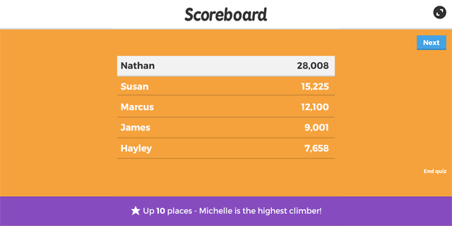
Flashcards to learn a foreign language
Description: A website where users can learn a foreign language using flashcards.
Users would need to register or sign in first.
Then there are two modes: 1. Study Mode: using flashcards to study.
2. Quiz Mode: Multiple choices, true and false questions.
User score, score rank, time to take the quiz will be saved.

Slide 3
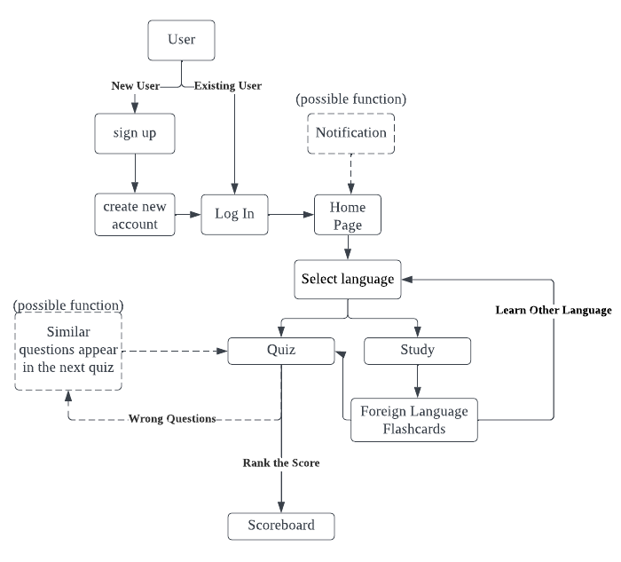
Flowchart

Slide 4
Use Case
Log in, if users don’t have account need to create new account
On the home page users can select the language they want to learn
After selecting a language, users can choose whether to study or take quiz
After take quiz the score will recorded and ranked

Slide 5

Tasks per person
Xinghai Nian: home page, nav bar, sign in/up, logout, user accounts.
Bingzhen Chen: study mode design, quiz mode quiz question design, flashcards design.
Xiaoqian Yang: create database, connect database to website, score board design
Everyone will do a little bit of everything, may change with progress.

Slide 6
Milestones:
 | Description | Date
Milestone 1 | Setup Github repo & work enviorment Research on tech skills to learn Website structure design | week 2: 02/09/2023
Milestone 2 | Frontend/backend development (home page, register, login) | week 4: 02/23/2023
Milestone 3 | Frontend/backend development (study mode design) | week 6: 03/09/2023
Milestone 4 | Frontend/backend development (quiz mode design) | week 8: 03/23/2023
Milestone 5 | Frontend/backend development (score board design) | week 10: 4/06/2023
Milestone 6 | Test website, possibly deploy the website. | week 12: 04/20/2023

Slide 7
Inspiring aspects of Luna R
We’ve never worked with SQLite and Flask so it will be interesting to learn more about how it’s used and structured together to develop a web app
Adding additional language support for FoodReal would improve usability for a bigger user base

Slide 8
Areas for collaboration
Suggestions for Improvement
We can help create a small quiz question database for Korean and Khmer
Test the quizzing feature
Make the web app mobile friendly if possible
Add more languages to the quiz
Gamify scoring system to improve user retention

