Slide 1
Team: Luna R
Week 5
Xinghai Nian, Bingzhen Chen, Xiaoqian Yang

Slide 2
Flashcards to learn a foreign language
Description: A website where users can learn a foreign language using flashcards.
Users would need to register or sign in first before they can choose a language.
Then there are two modes:
1. Study Mode: using flashcards to study.
2. Quiz Mode: Multiple choices, true and false questions.
User score, score rank, time to take the quiz will be saved.

Slide 3

What we’ve accomplished:
Milestone 2.
Populate quiz questions into database for Quiz mode.
A transaction page after user login to allow users choose language and mode.
Quiz mode (take quiz) frontend & backend design.
Milestone 2 | Frontend/backend development (home page, register, login) | week 4: 02/23/2023
Milestone 3 | Frontend/backend development (study mode design) | week 6: 03/09/2023
Milestone 4 | Frontend/backend development (quiz mode design) | week 8: 03/23/2023
Milestone 5 | Frontend/backend development (score board design) Test website, possibly deploy the website. | week 10: 4/15/2023

Slide 4

What we are doing right now:
Frontend design for Study mode
Populate study materials for Study mode
Frontend & backend design for Quiz result

Slide 5
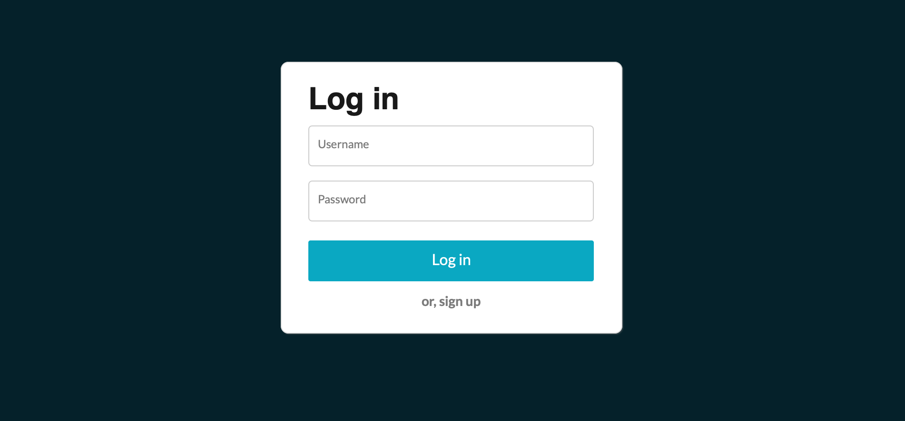
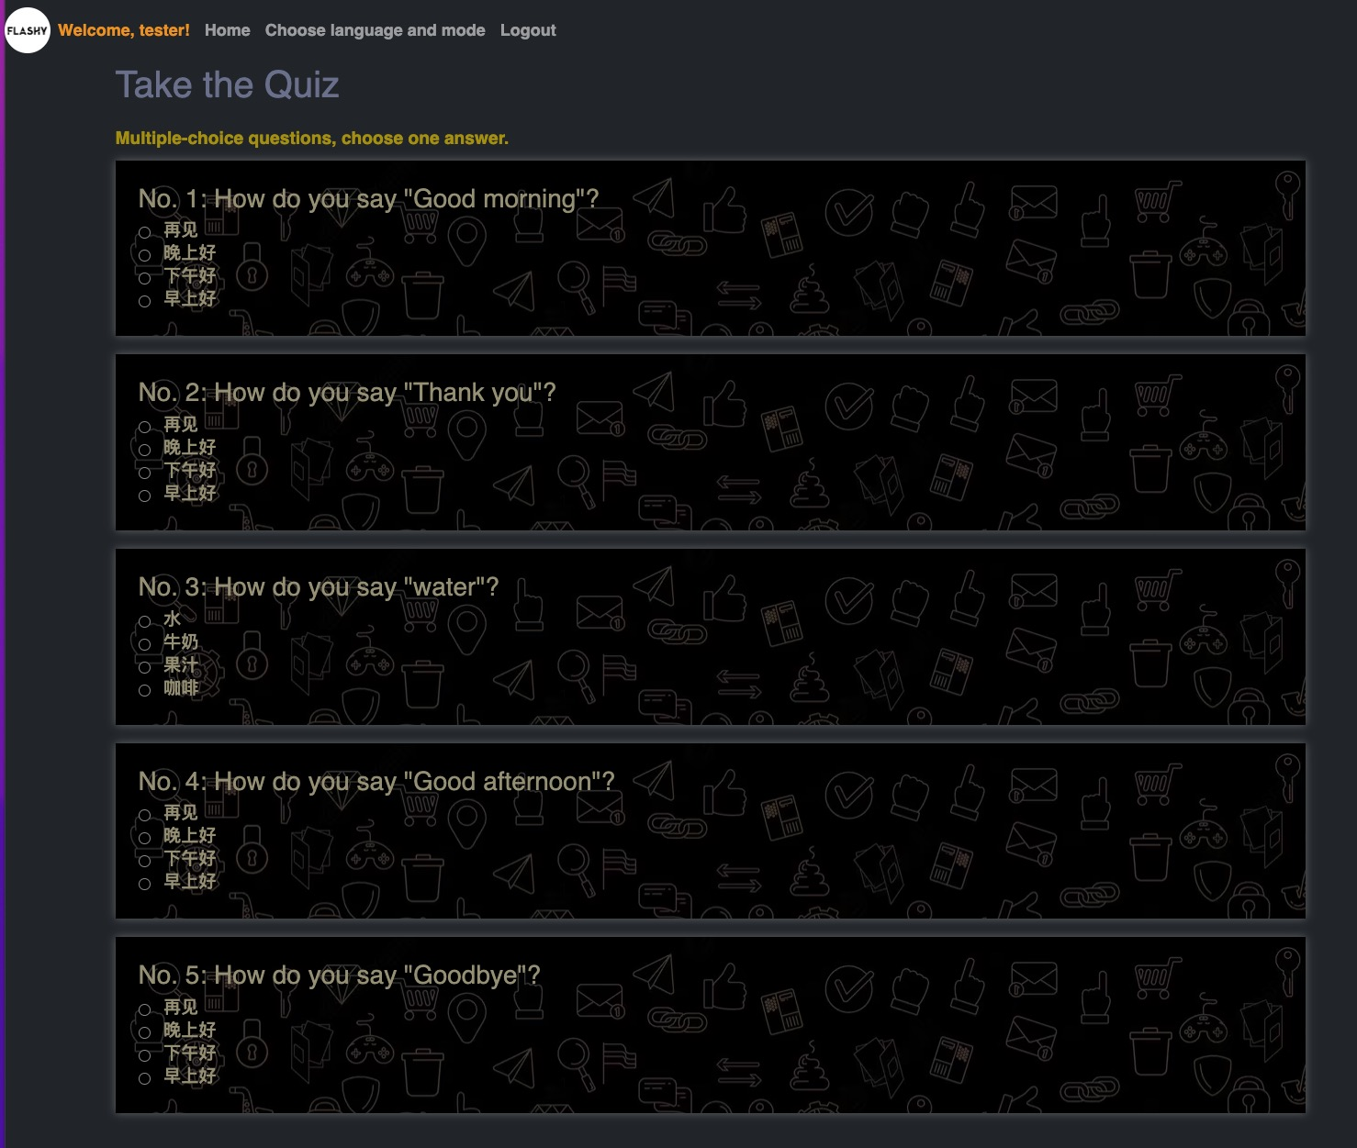

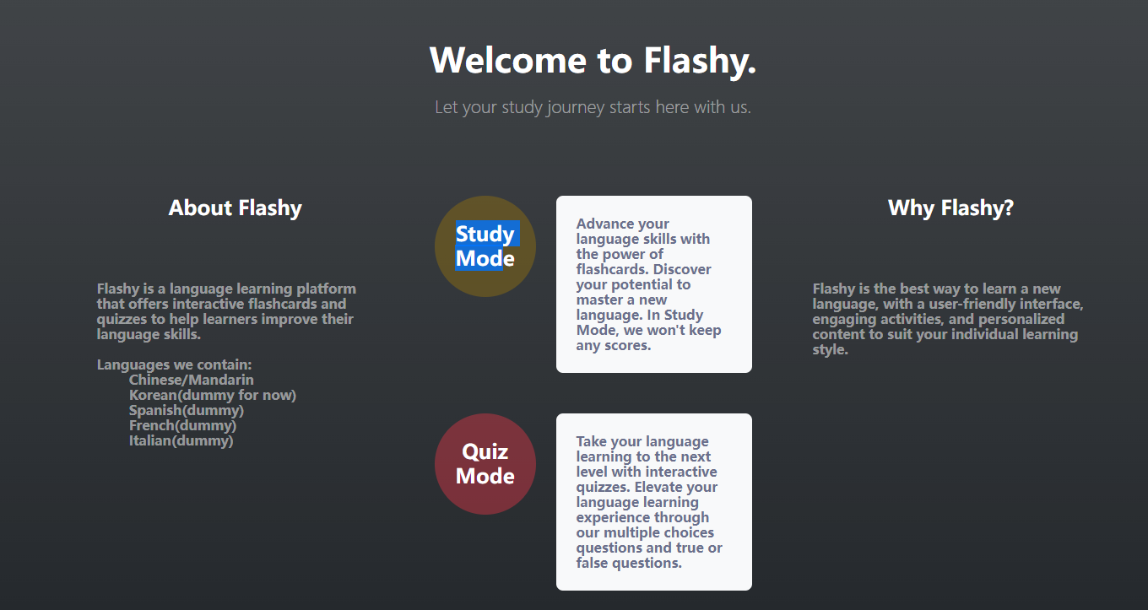
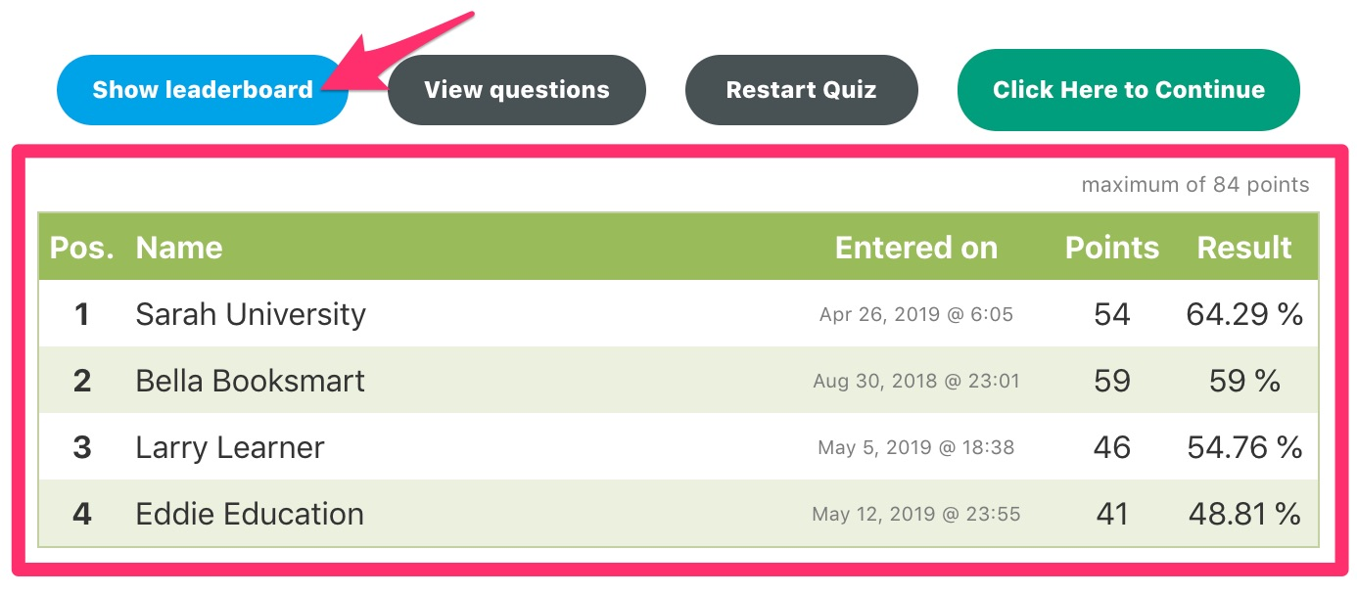
Documentation for application users
register
login
study or quiz
study by using flashcards
T/F and multiple choice questions
scoreboard after quiz

Slide 6
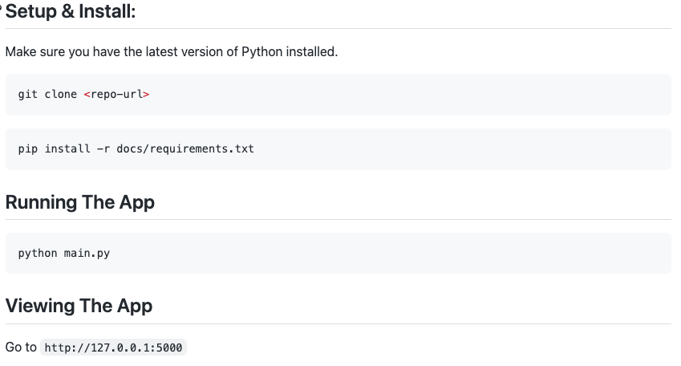
Documentation for expert users

Slide 7
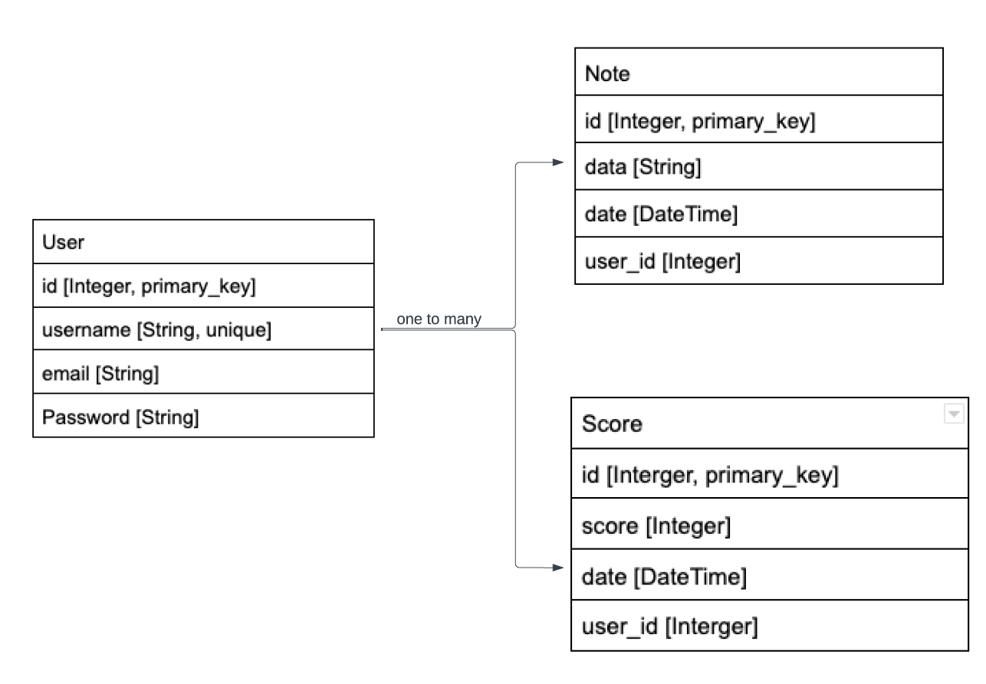
Note: in study mode, allowing users to keep notes.
Score: in quiz mode, recording score and taking time for each quiz.

Slide 8
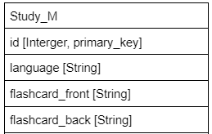
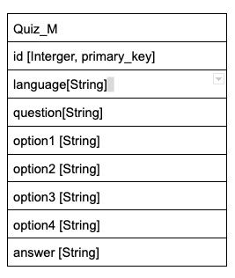
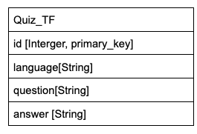
Table for flashcard:
Table for multiple choice questions:
Table for True or False questions:

Slide 9
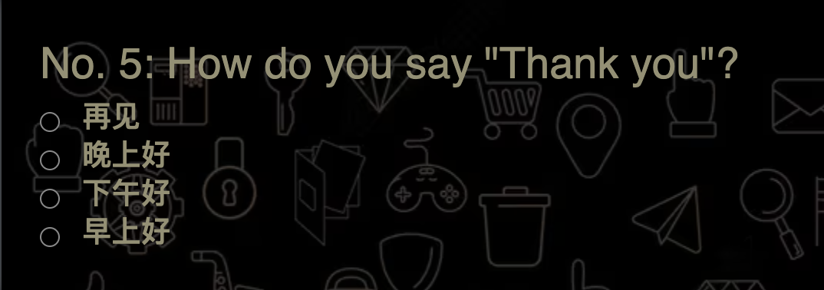
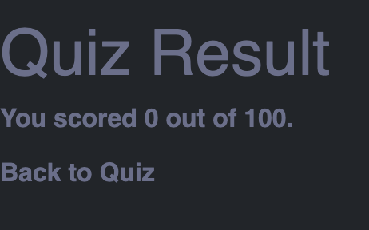
Feedback from Team Deepcourse
Product:
Lists all password and/or username requirements for registration
The Sign up will pop back to Login if there is an error
Make sure correct answer is provided in the quiz
Make sure the scoring after quiz is available

Slide 10
Response to Feedback
We updated the database to fix the options of that one question. Thank you for checking so thoroughly.
We are still working on the quiz result part
Thanks for your feedback!

