Slide 1
Team: Luna R
Week 14
Xinghai Nian, Bingzhen Chen, Xiaoqian Yang

Slide 2
Flashcards to learn a foreign language
Description: A website where users can learn a foreign language using flashcards.
Users would need to register or sign in first before they can choose a language.
Then there are two modes:
1. Study Mode: using flashcards to study.
2. Quiz Mode: Multiple choices, true and false questions.
User score, score rank, time to take the quiz will be saved.
3. Administer: List all user accounts, all questions and all flashcards. And allow administer to delete them.
Github: https://github.com/StacyYang/Flashcards-to-learn-a-foreign-language

Slide 3
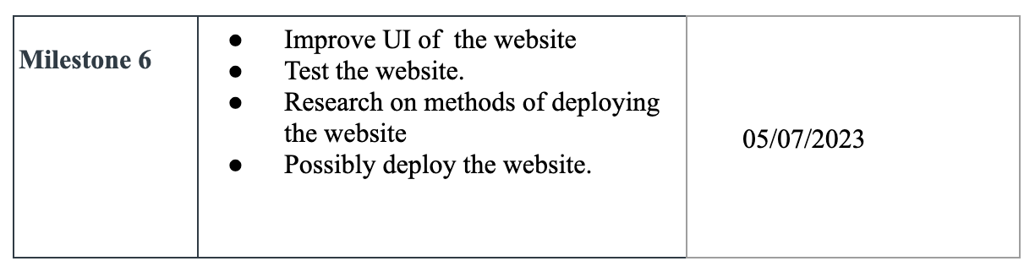

What we’ve accomplished:
Last Mission:

Slide 4

What we are doing right now:
Prepare for final presentation

Slide 5
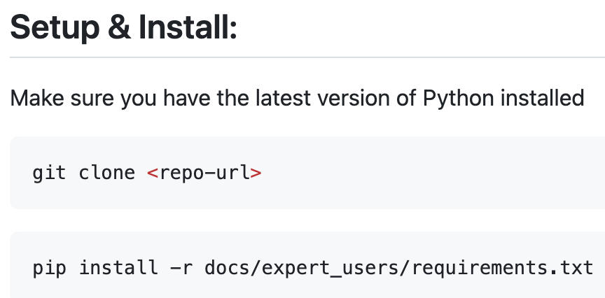



Documentation for expert users

Slide 6
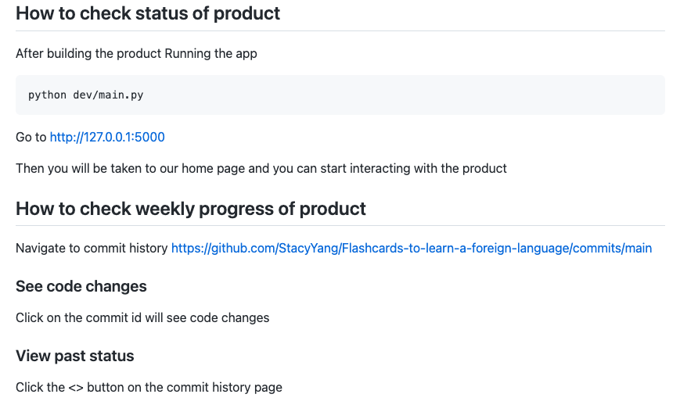
How to check the status for our product

Slide 7
Hosting methods:
Two common methods we can consider for our website:
Heroku
AWS EC2
We might not move on with deploying the website if it’s not a hard request.

Slide 8
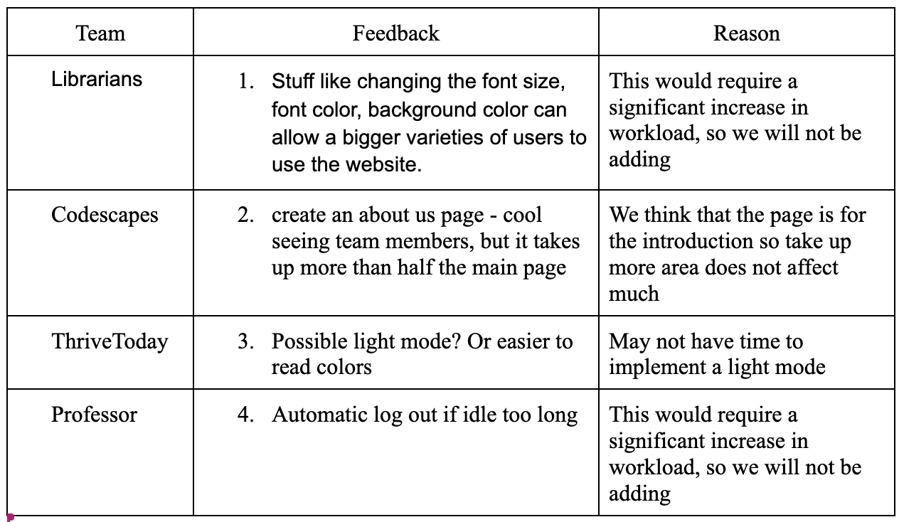
Feedback summary : not to be fixed

Slide 9
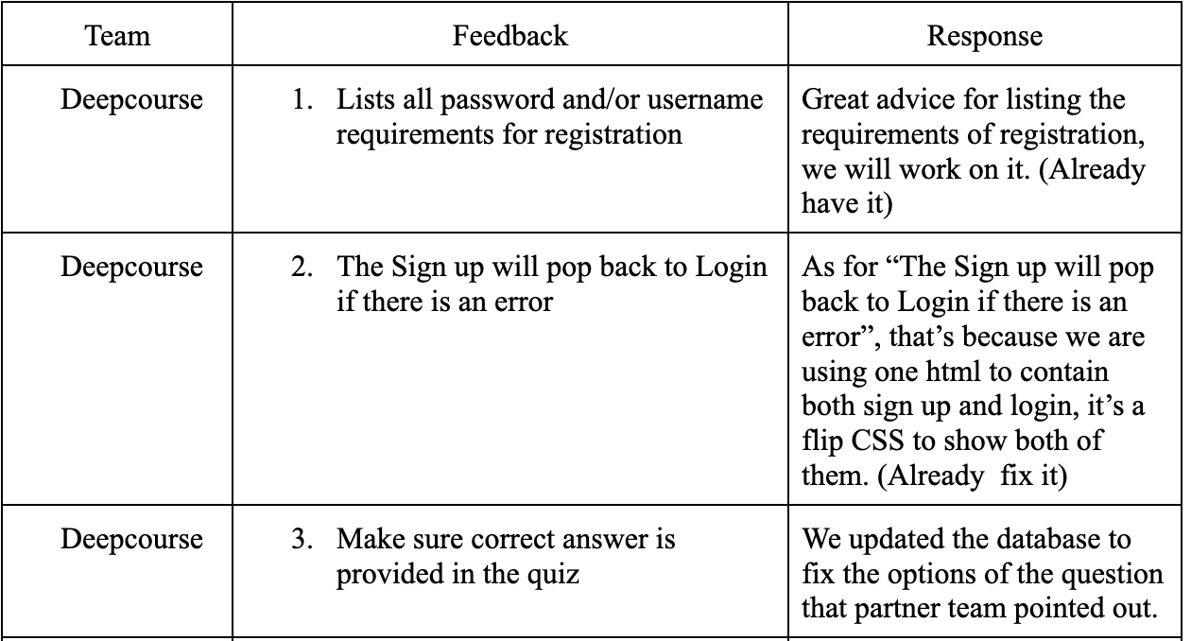
Feedback summary : to be fixed

Slide 10
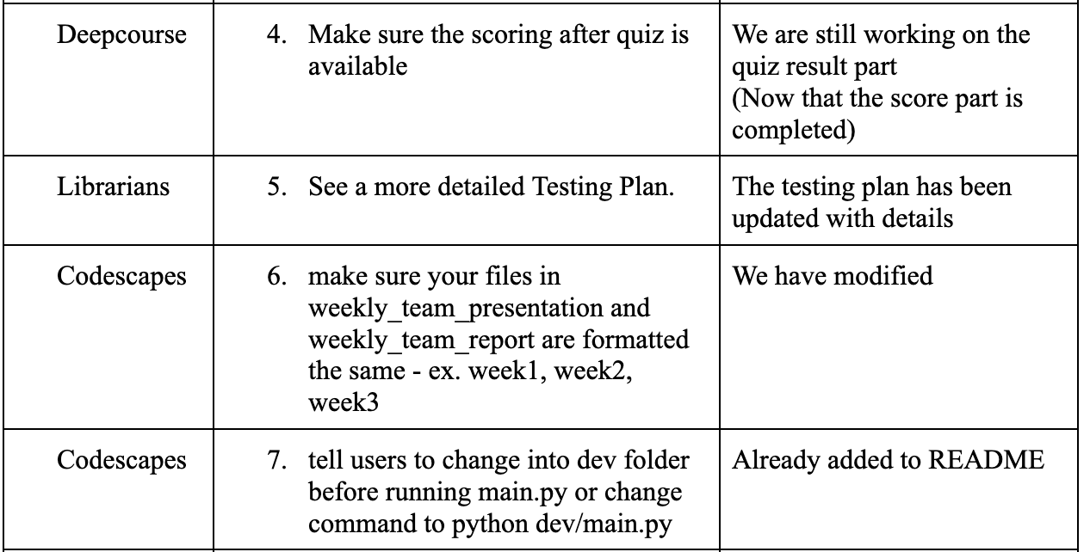
Feedback summary : to be fixed continued

Slide 11
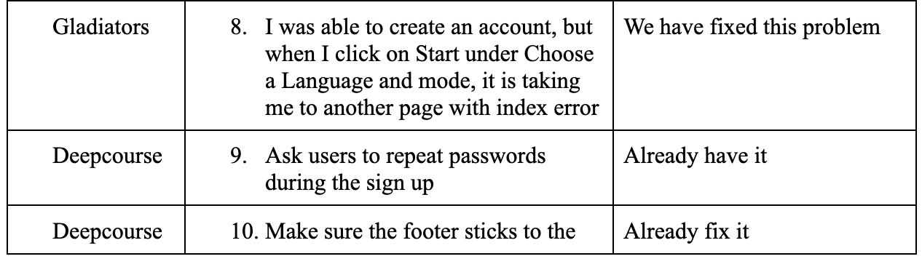
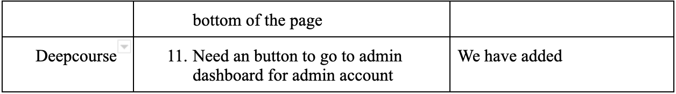
Feedback summary : to be fixed continued

Slide 12
Feedback from partner FoodReal:
Expert user experience on building/testing the product:
Our team noticed a bug when we tried to create a new note and edit it. We think this issue is related to the database. (We also noticed this too, but can't fix it at this time)
It would be nice if the website is hosted (it’s not a hard request)
Overall, the UI of the website looks clean and easy to navigate (Thank you!)
Was able to build the product with the instructions and use the study mode and quiz mode of the app

Slide 13
Demo Time

